Slide 1
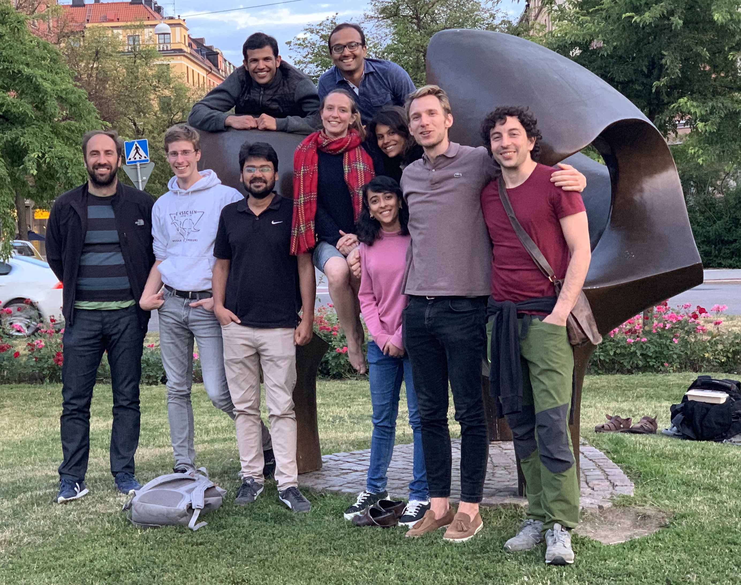
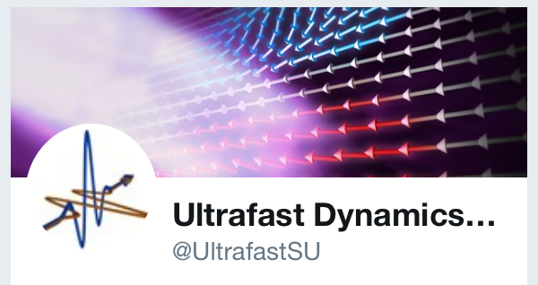
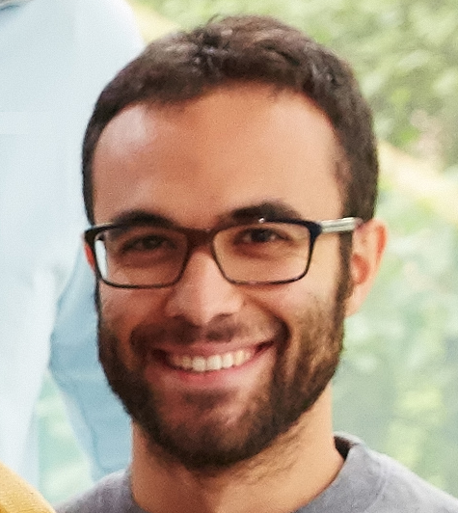
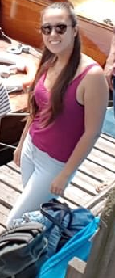






Ultrafast dynamics through X-ray pump-probe experiments
Funding agencies:
Stefano Bonetti
Department of Physics
Stockholm University
Department of Molecular Sciences and Nanosystems
Ca’ Foscari University of Venice
Notes:
Rodolfo, Julio, José Luis

Slide 2
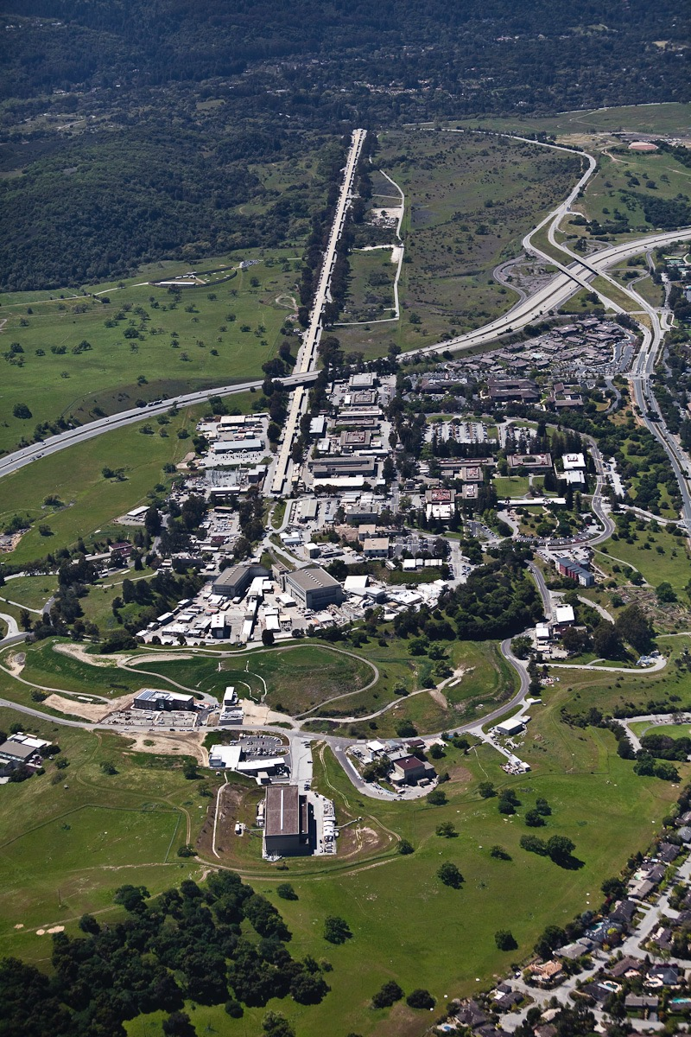
Free electron laser: the LINAC
LINear ACcelerator (LINAC)
Starts from amplified femtosecond laser (2018 Physics Nobel prize)
Generate femtosecond electrons bunches
Electron bunches accelerated and compressed
electrons
First key step: only relativistic electrons (99.99% of speed of light) can be compressed to femtosecond bunches
Why? Space charge problem: electrons repel each other, but are seen further apart in a relativistic frame
photons

Slide 3
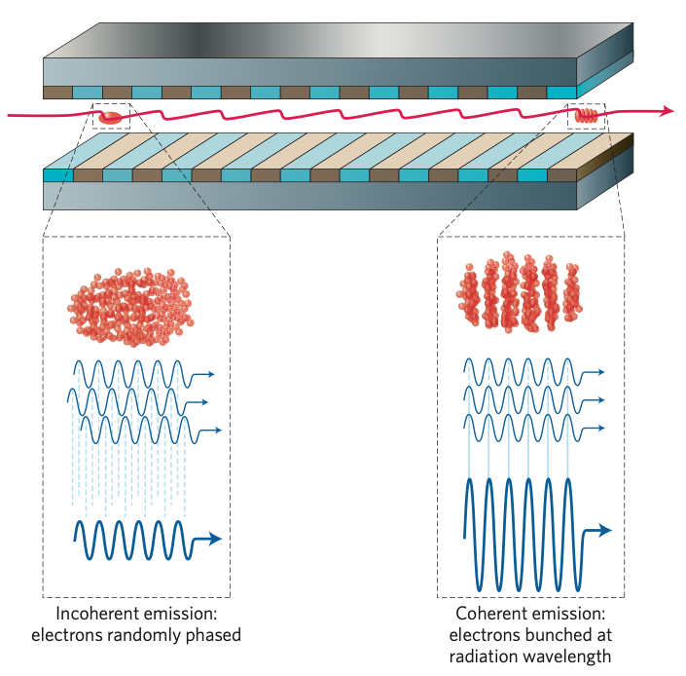
Free electron laser: the undulator
~100 m long undulator aligned with micrometer precision: engineering marvel of this machine
2nd key step: microbunching, i.e. electrons align in parallel sheets
How? Self-Amplified Spontaneous Emission (SASE): order out of chaos.
Idea: John Madey, Evgeny Saldin, Claudio Pellegrini

Slide 4
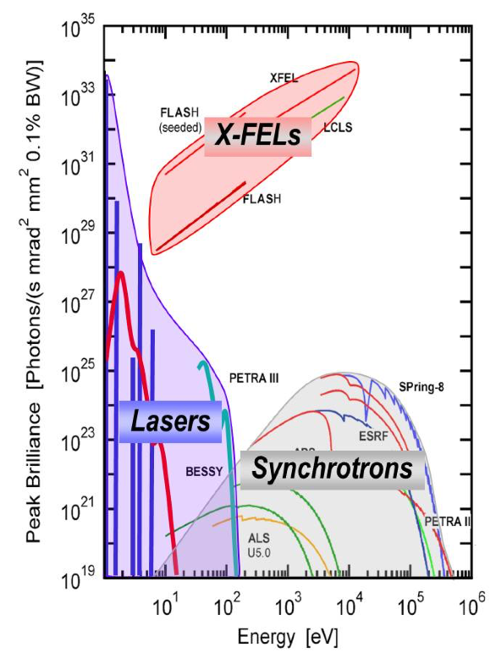
X-ray sources: brilliance
1 keV photon energy, ca 1 nm wavelength
FEL:
5 * 10³² ph/(s mrad² mm² 0.1% BW)
9 orders of magnitude jump!!!
Best synchrotron:
5 * 10²³ ph/(s mrad² mm² 0.1% BW)

Slide 5
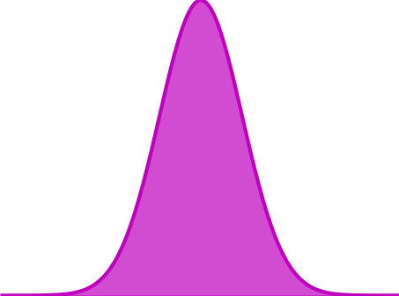
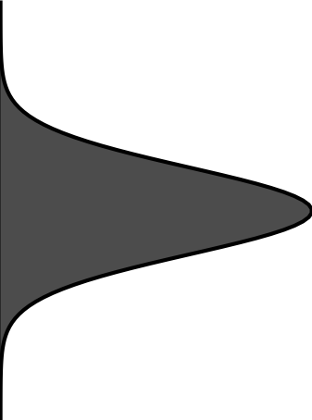
How to capture fast dynamics: the hummingbird photo trick
“Pump-probe experiments”
Pump
Probe
Δt

Slide 6
How do you set up a pump-probe experiment at a FEL?

Slide 7
SPATIAL OVERLAP (reference sample 1)
TEMPORAL OVERLAP (reference sample 2 )
ACTUAL SAMPLE

Slide 8
Alignment procedure at a XFEL
SPATIAL OVERLAP (reference sample 1)
YAG screen: see x-rays and NIR radiation
Often provided by the facility, but if your sample geometry is strange or cannot be changed, you need to prepare this yourself

Slide 9
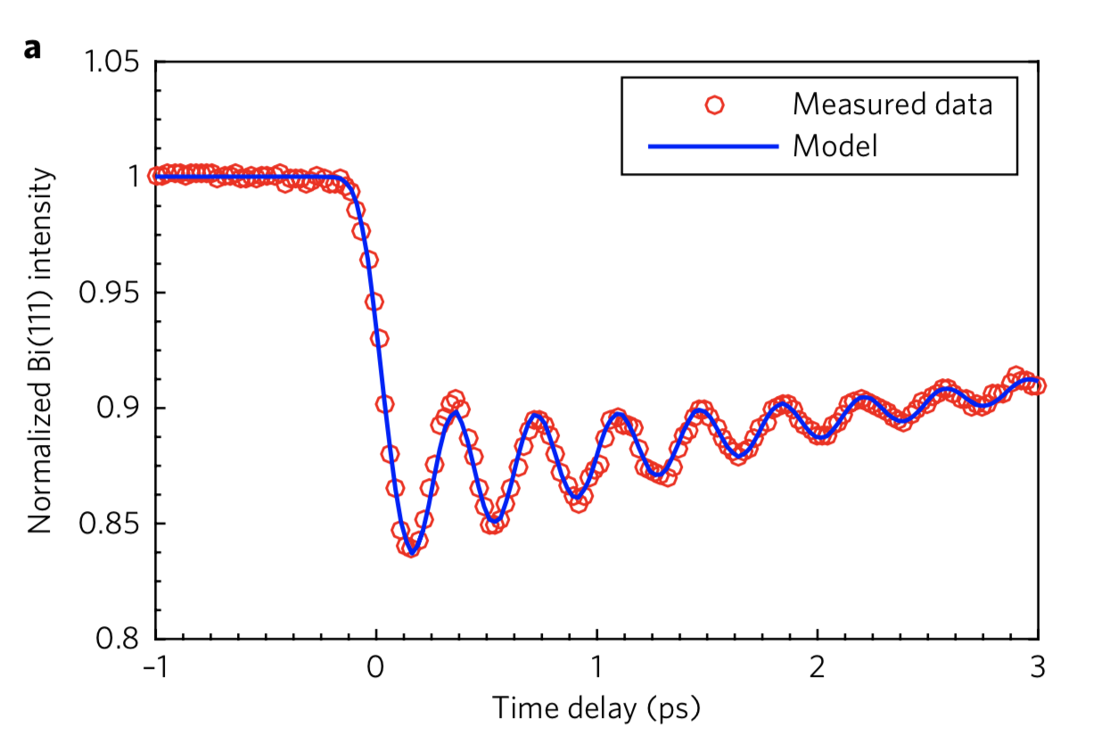

Bi(111) Bragg peak
TEMPORAL OVERLAP (reference sample 2 )
XAS or XMCD on thin film on SiN membrane
Often provided by the facility, but if your sample geometry is strange or cannot be changed, you need to prepare this yourself

Slide 10
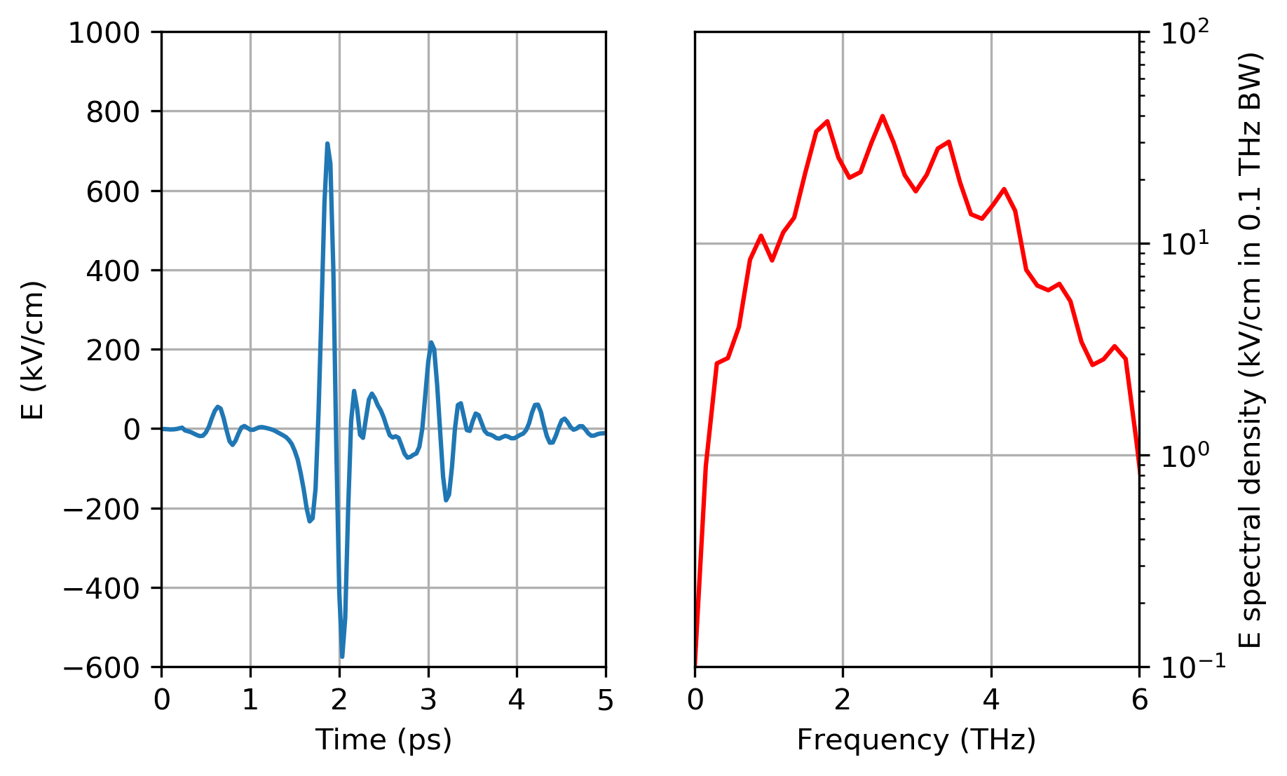
GaP crystal: electro-optical sampling
THz alignment
If you go away from “standard” NIR lasers, check carefully with local scientists on feasibility of experiment, well ahead of time. What can routinely be done at home may be very tricky at an FEL.
Be prepared to spend time to help set up

Slide 11
Now your sample is mounted, aligned, and you start to record data
Now the difficult part starts…

Slide 12
Data normalisation
Key part of getting good data at XFEL
Each x-ray shot is different: shot-to-shot analysis needed
Always make back of the envelope estimates: does what I see make sense? Very complex experiments, you cannot trust blindly the data that come out.
Data are 10s or 100s or TBs, can’t try new ideas every 5 minutes

Slide 13
Key example: your detector(s)
Your detectors are part of the experiment, with random and systematic errors
Systematic nonlinearities always exist
Response of your detector(s) as a function of x-ray photon intensity must be constantly measured and monitored!
Work only in linear regime, throw away other shots when normalising data, unless you can model reliably.
SIGNAL
REFERENCE (I0)

Slide 14
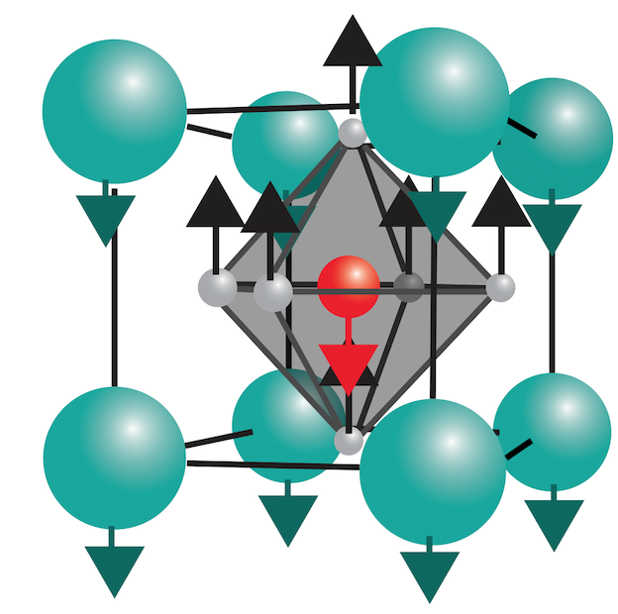
Two experiments
Phonon up-conversion in
strontium titanate
Magnon localisation and coalescence in ferromagnetic alloys

Slide 15
Two experiments
Phonon up-conversion in
strontium titanate
Magnon localisation and coalescence in ferromagnetic alloys

Slide 16
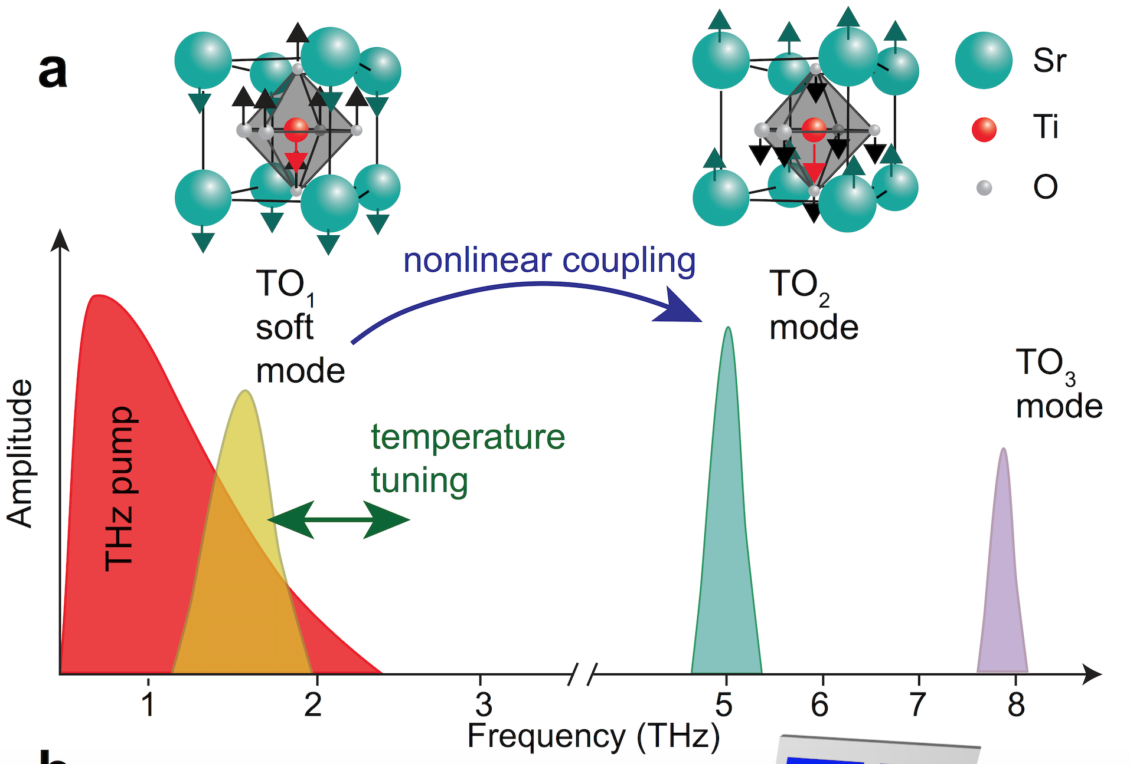
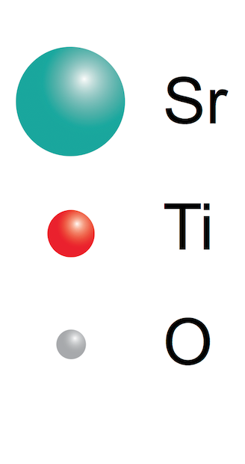
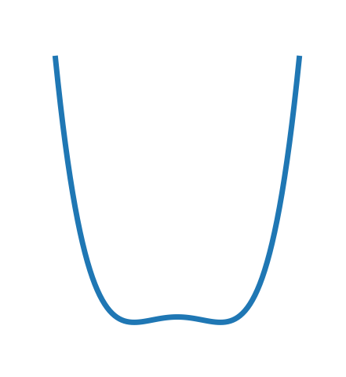
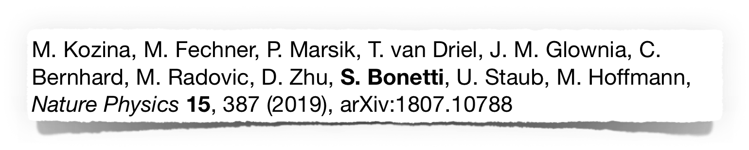
SrTiO3 (STO): perovskite with soft phonon mode
V
add potential with explanation of softening mode
at THz frequencies
potential not well known from DFT
x
Notes:
explanation of soft phonon mode

Slide 17
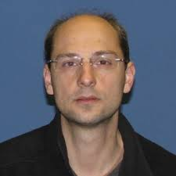
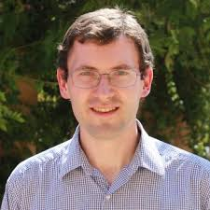
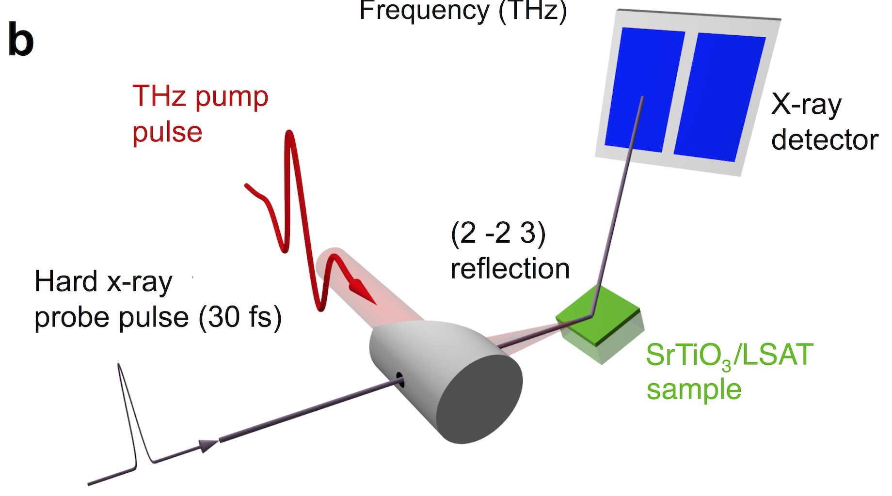
Idea: drive the soft phonon and probe the atomic motion directly
Collaboration with Matthias Hoffmann and Mike Kozina, Stanford / SLAC
V
x
Notes:
probe the potential

Slide 18
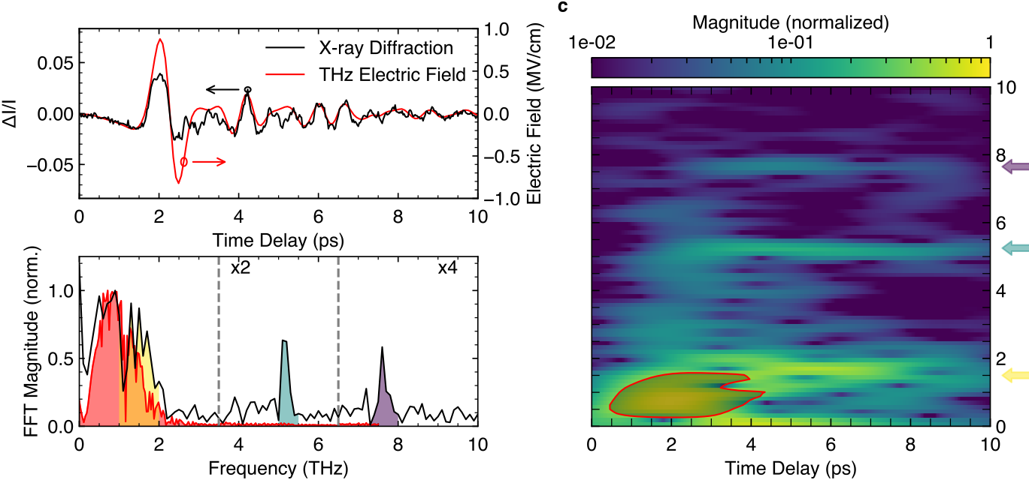
Phonon up-conversion

Slide 19
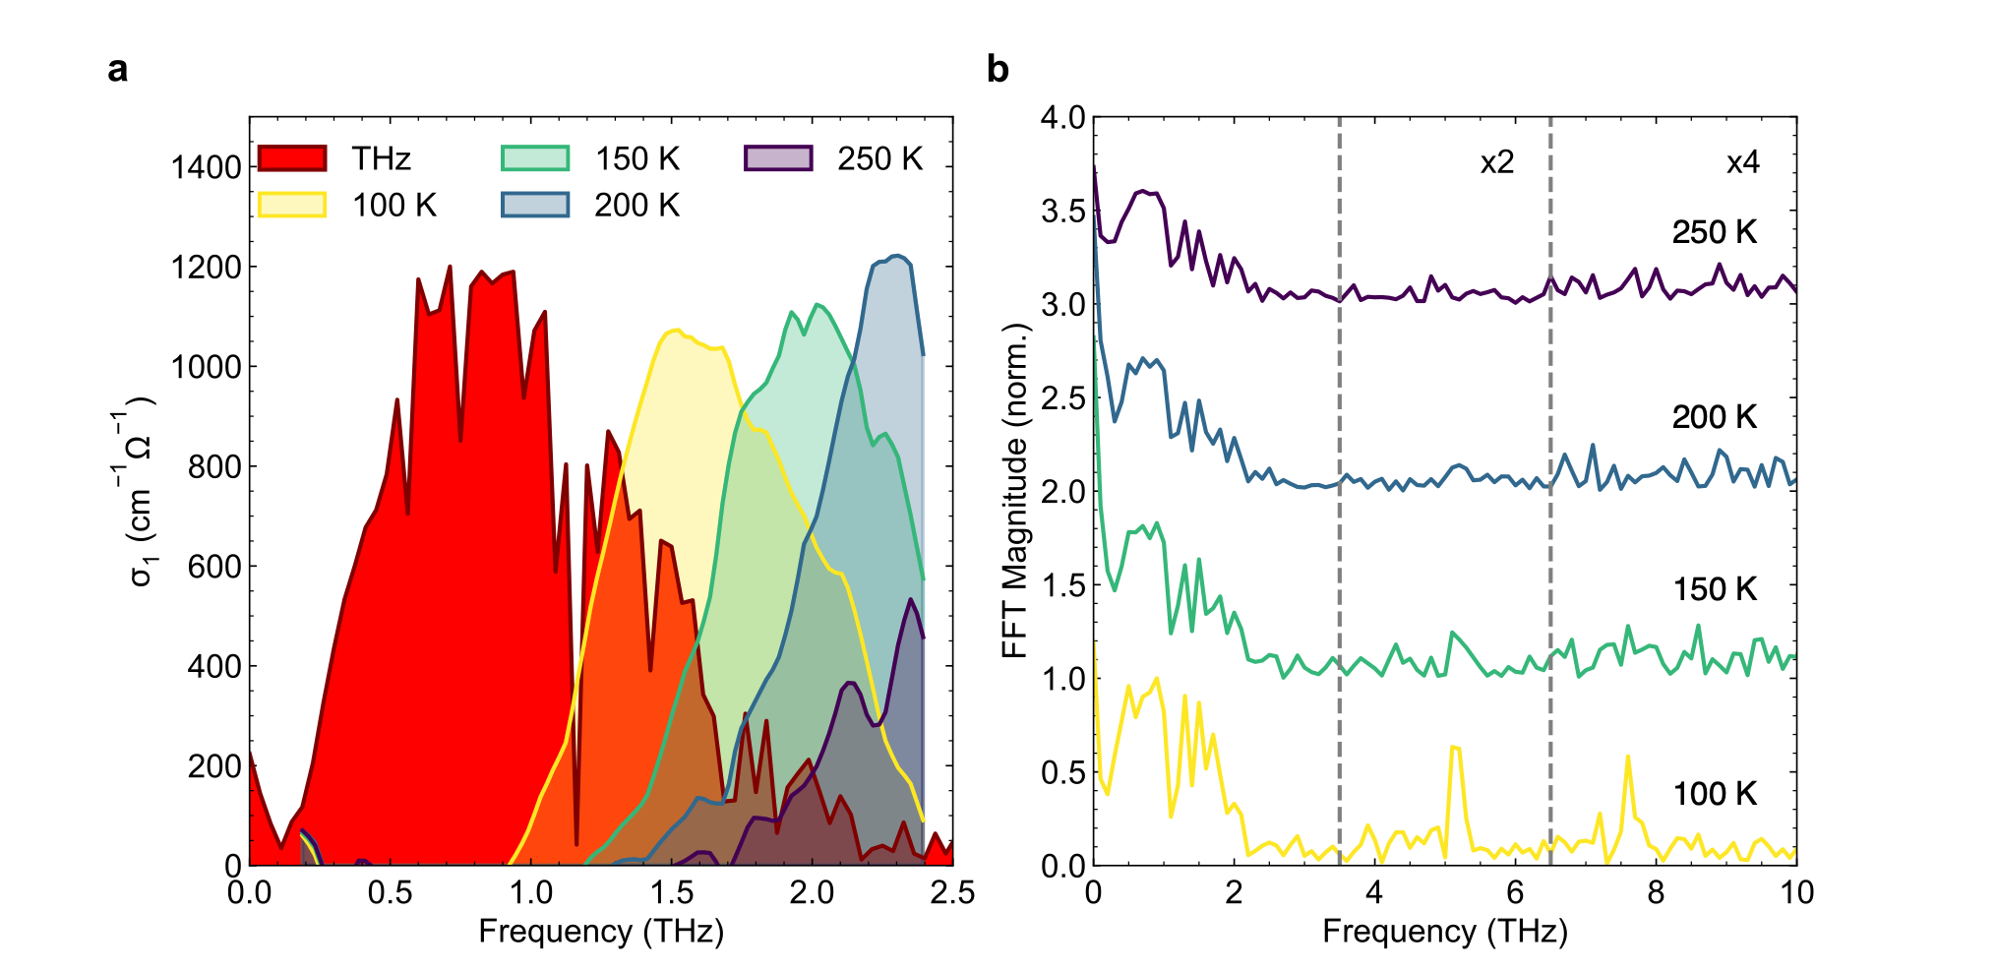
Phonon softening with temperature and overlap with THz

Slide 20
1.3 pm motion (15% displacement ferroelectric BaTiO3 at RT)
Drive 1 THz mode (TO1), excite 5 THz mode (TO2)
Excite also “silent” mode at 8 THz (TO3): access of symmetry-forbidden modes via nonlinear coupling
Possibly key to understand electron-phonon coupling in some superconductors

Slide 21
Two experiments
Phonon up-conversion in
strontium titanate
Magnon localisation and coalescence in ferromagnetic alloys

Slide 22
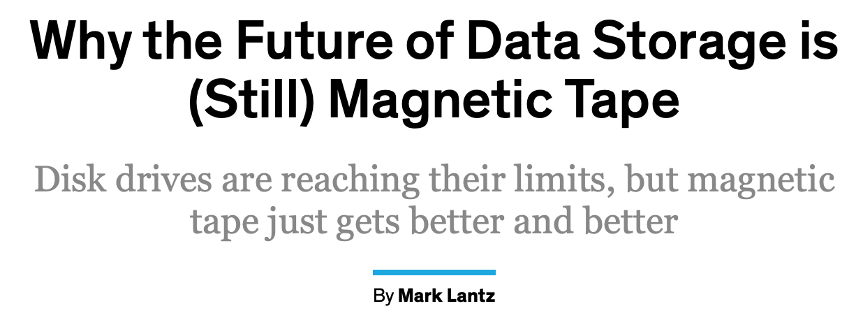
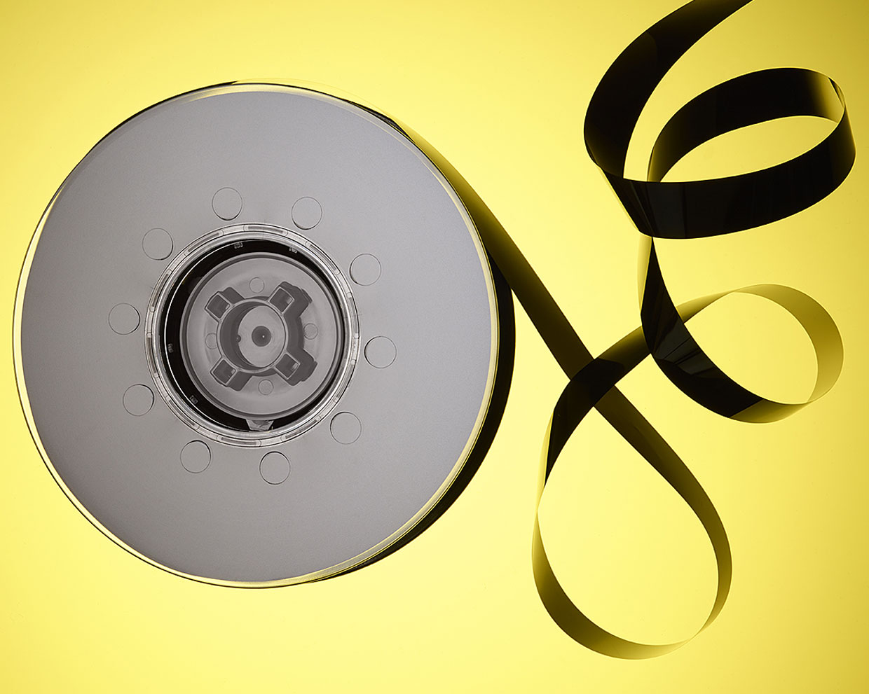
Why magnetism?
90%+ storage in data-centers worldwide is magnetic (cheap and reliable)
Bottle-neck for computing speed is storage
Data-centers are very energy-hungry (most energy goes into heat and cooling):
4% world electricity, 2% emission (now)
20% world electricity (2025)

Slide 23
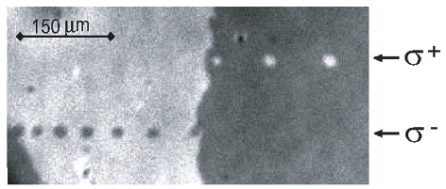
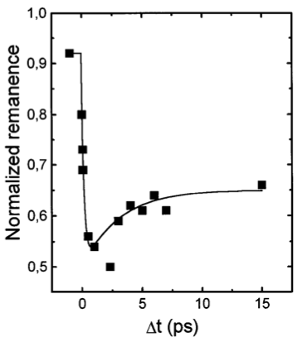
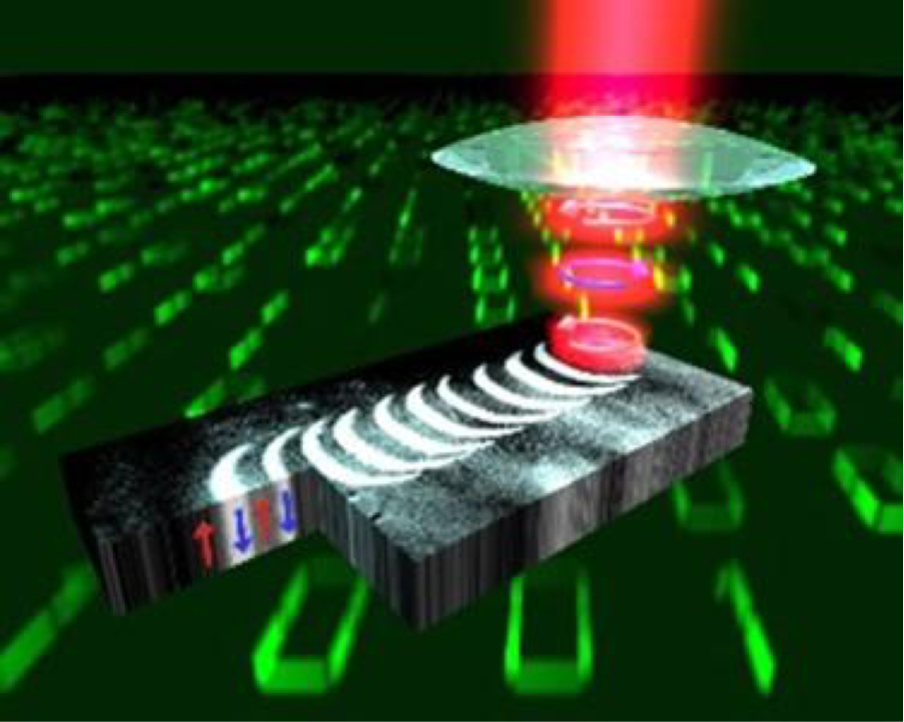
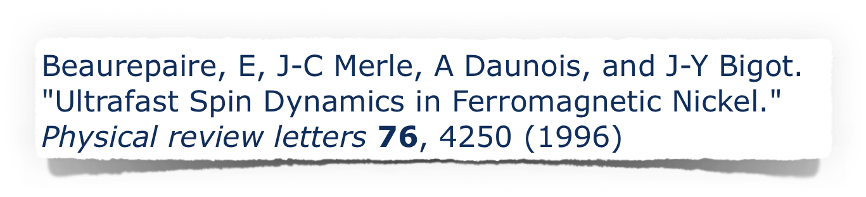

Ultrafast magnetism

Slide 24
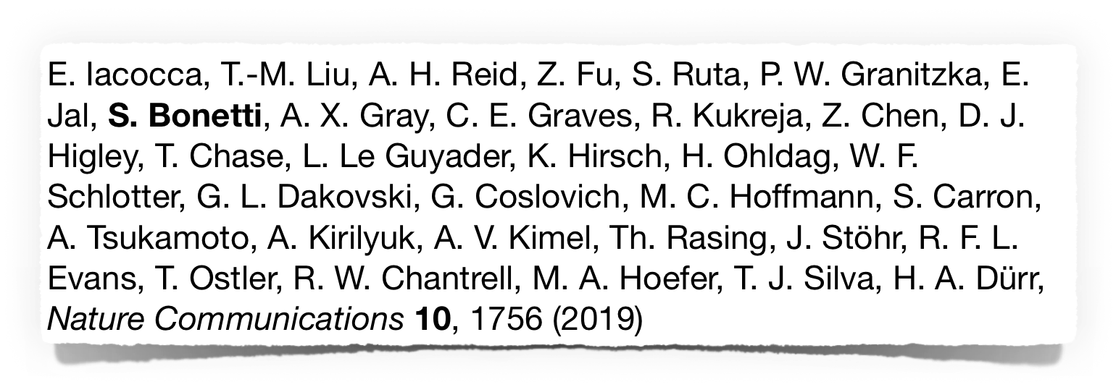
X-ray magnetic scattering
Pump: NIR laser
Probe: circularly polarised x-rays (sensitive to magnetic contrast)
Diffraction experiment: probe temporal dynamics of not only average intensity, but also q-vector distribution
Thin film sample
on x-ray transparent membrane

Slide 25
X-ray scattering: typical data
Features of various size spread randomly in your sample: diffuse blob with center of mass at q = 0
Features with long-range correlations: ring pattern, radius in q is 1/(correlation length)

Slide 26
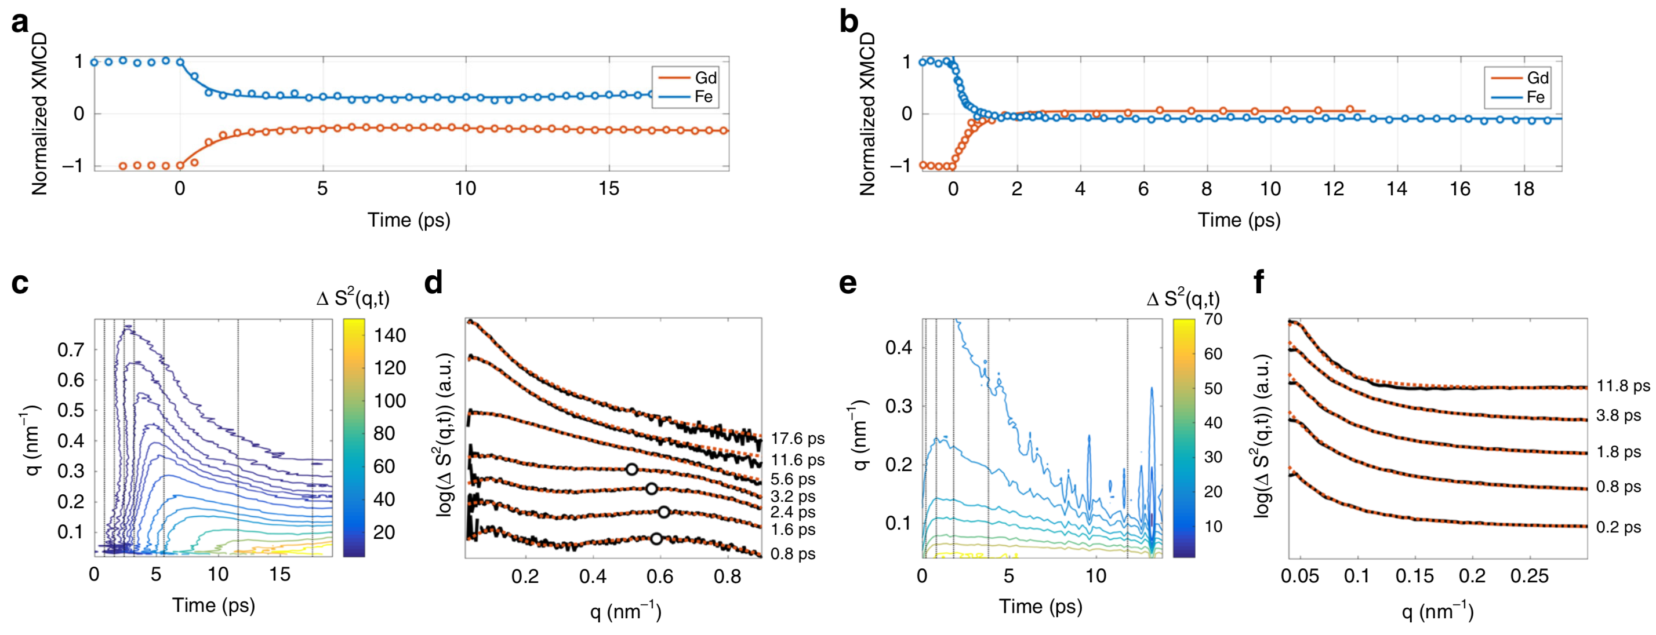
Non-switching vs switching behaviour: different laser fluence
NO-SWITCHING
SWITCHING
Step 1: creation of small reversed magnetisation spots (magnons localise)
Step 2: expansion with time (magnons coalesce)

Slide 27
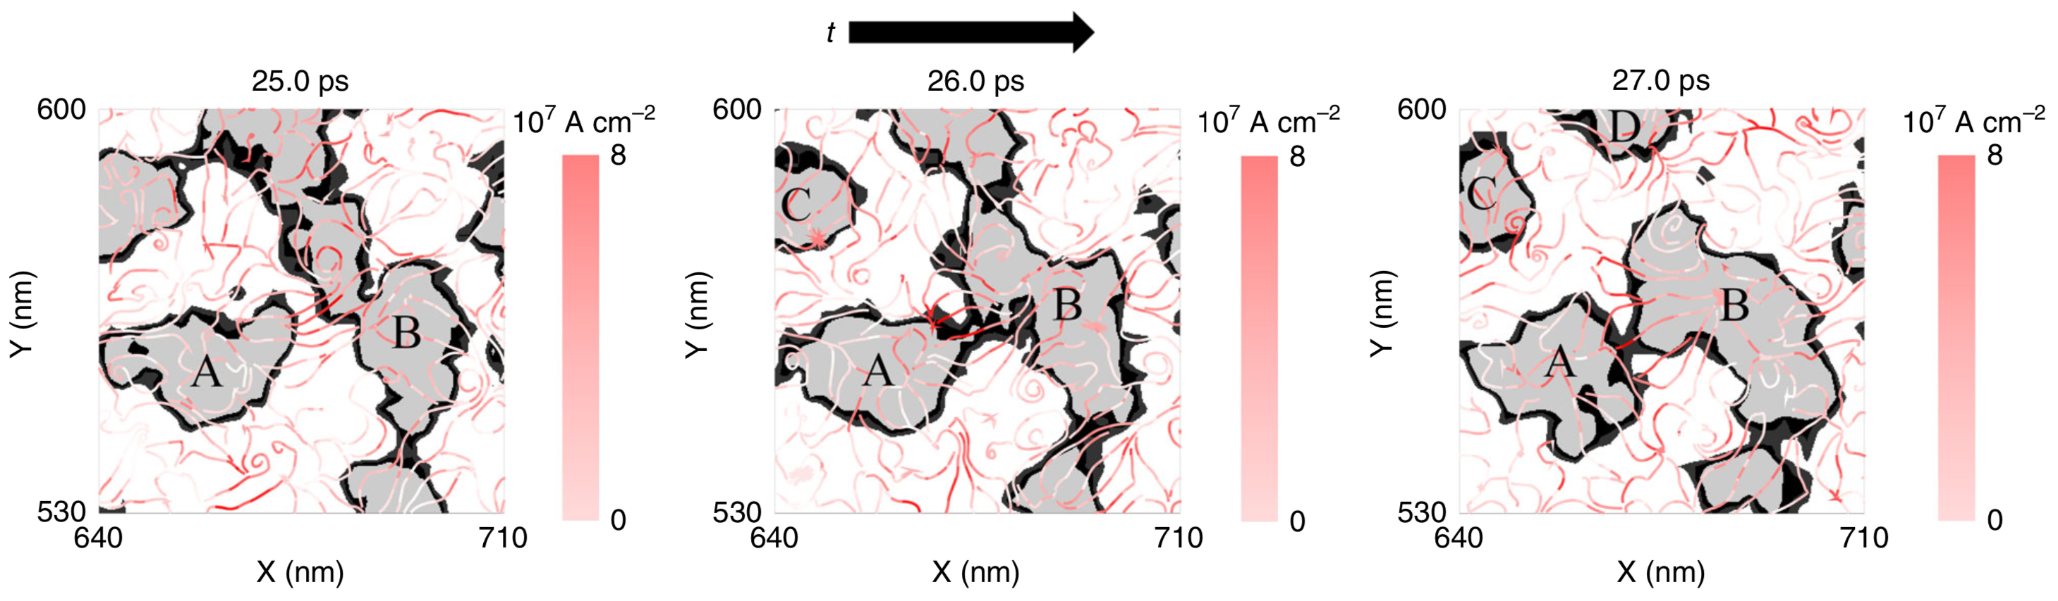
Magnons localisation and coalescence can be described with hydrodynamic theory
What “flows” is angular momentum, driven by spin currents

Slide 28
This is very complicated…
Can’t we just take an image of the thing?

Slide 29
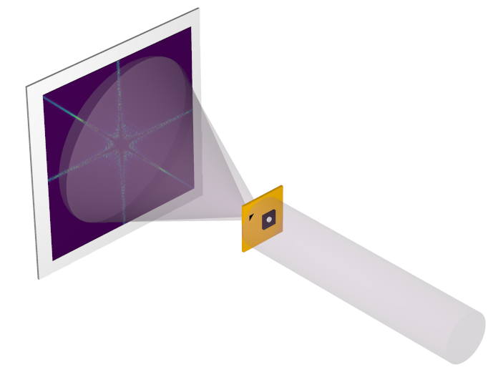
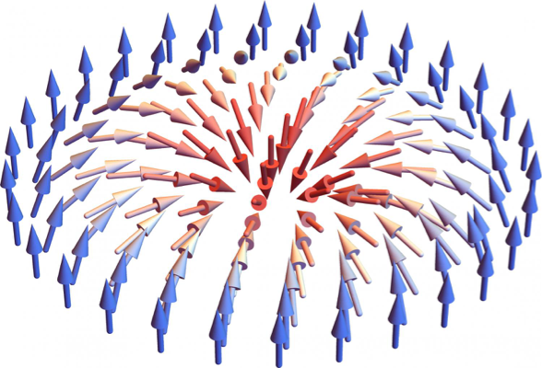
Holographic magnetic imaging at European XFEL
Interference pattern
Sample with
reference structure
Skyrmion
S. Bonetti et al., X-ray holography of ultrafast magnetism: femtosecond movies at the nanoscale
Beam time at EU XFEL, May 2019
Coherent x-rays pulses

Slide 30
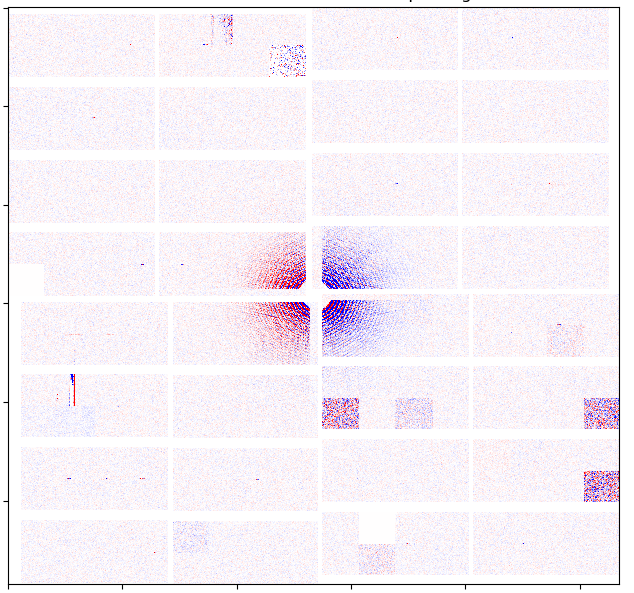
Time-resolved imaging at superconducting XFEL
Fe L3 edge, 8 nm Fe in CoFeB multilayers. Possible signature of chiral state?
Image recorded in approx 60 minutes at nominal 1.1 MHz rep. rate (effective 1.5 kHz).
At regime: nominal 4.5 MHz (effective 6 kHz)
400 TB of data stored during entire experiment

Slide 31
Take-home messages
X-ray experiments are complex -> careful alignment procedures
Data normalisation key to successful experiments
State-of-the-art (some of it) at FELs in condensed matter:
We can drive phonons with terahertz fields and probe atomic motion in real time and space
We can excite ultrafast spin currents with laser fields and probe ultrafast magnon dynamics
We are close to time-resolved holographic imaging at superconducting FELs

Slide 32
Thank you for your attention!

