Slide 1

ELI-ALPS Overview
Dimitris Charalambidis
Chief Scientific Advisor
ELI Summer School 2019
Dolní Břežany, 25-30 August, 2019

Slide 2
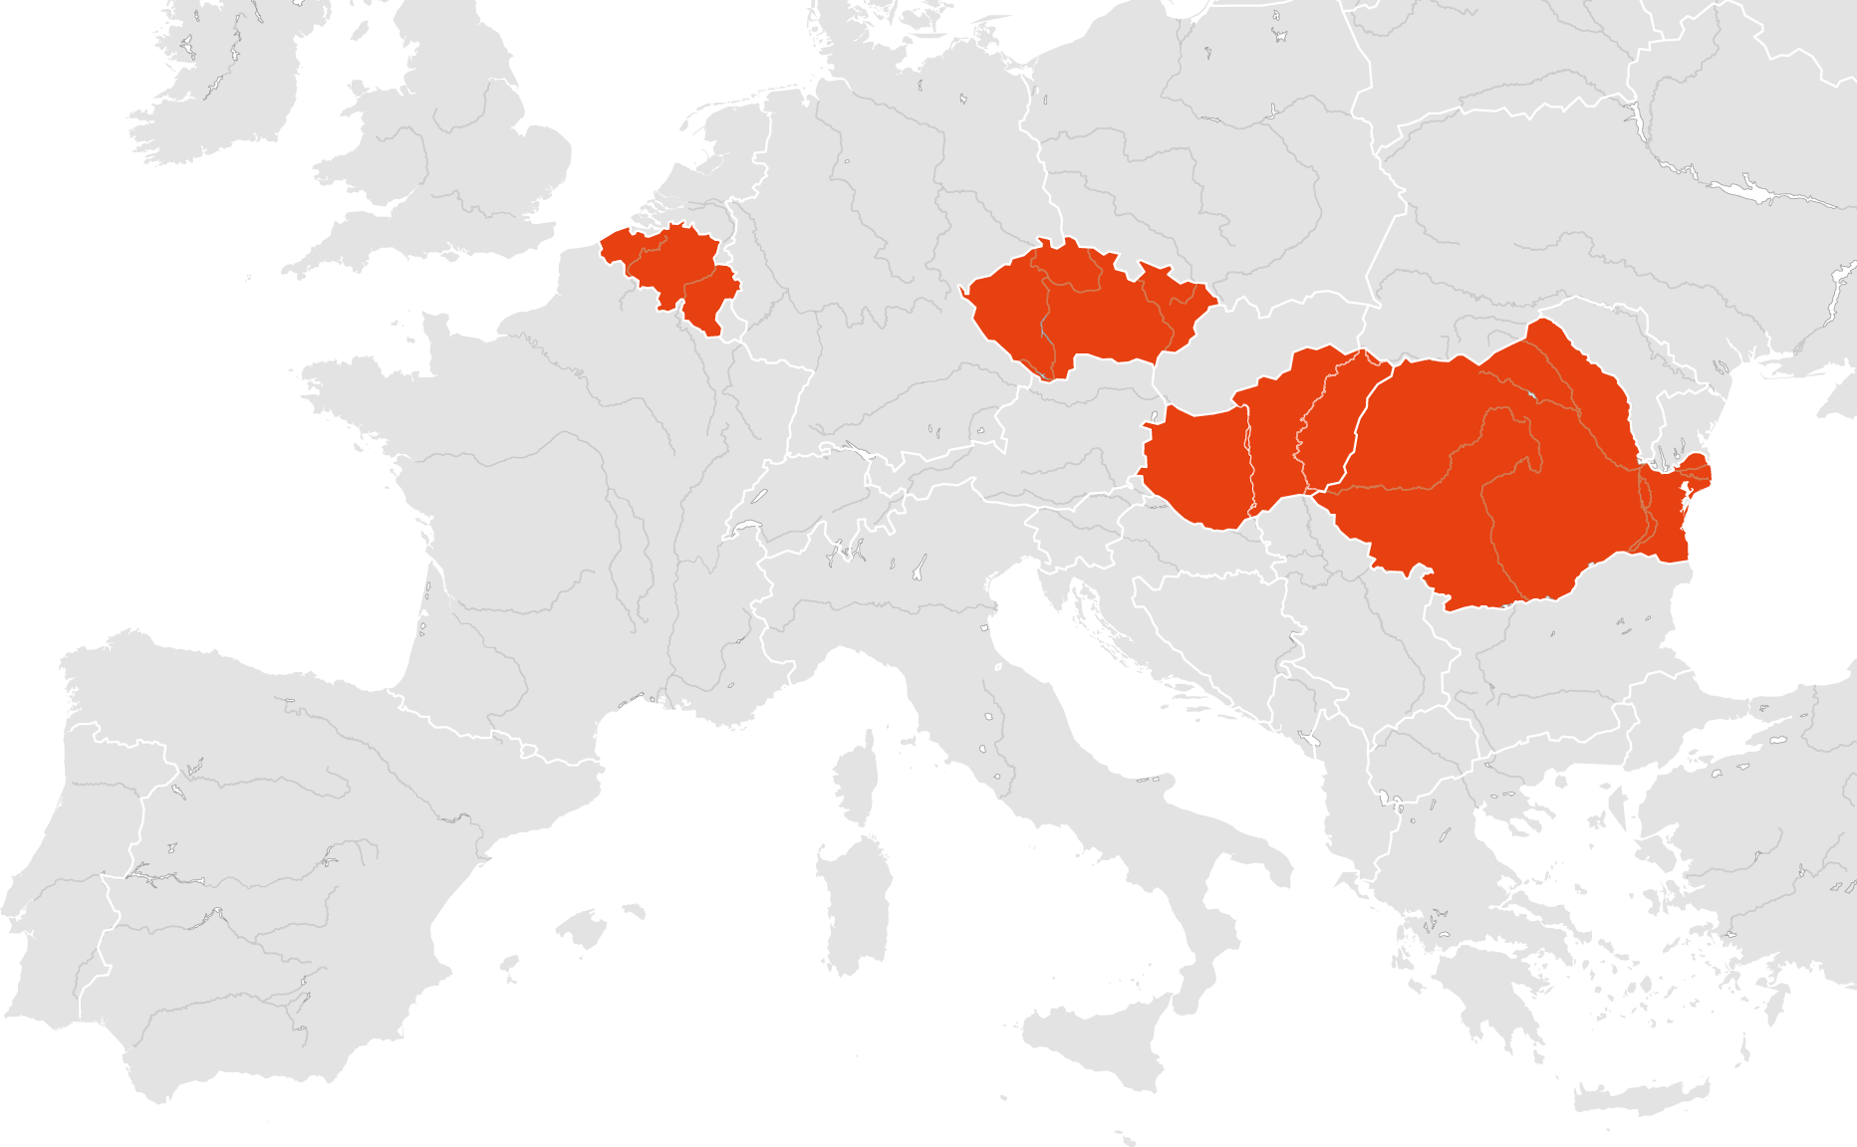
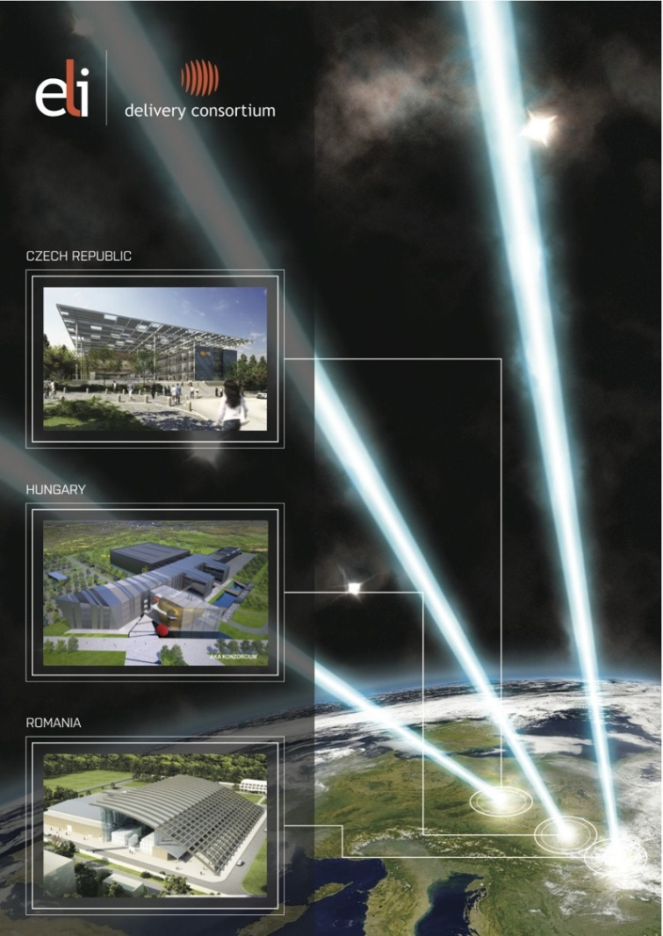
The ELI Project
The three pillars, ELI-DC & the initial vision
ELI-DC
The consortium coordinating the implementation of the three pillars & the establishment of the ELI-ERIC
ELI-ALPS Szeged
Hungary
Investigations of ultra-fast dynamics @ attosecond & nm spatiotemporal scales
ELI-BL Dolni Brezany
Czech Republic
Applications of ultra-short pulses of high-energy particle & radiation beams
ELI-NP Magurele
Romania
Ultra-intense laser & brilliant gamma/neutron beams enabling photonuclear studies
UHFS
Ultra-High-Field Science
@ unprecedented laser field strength
(location: to be decided later)

Slide 3
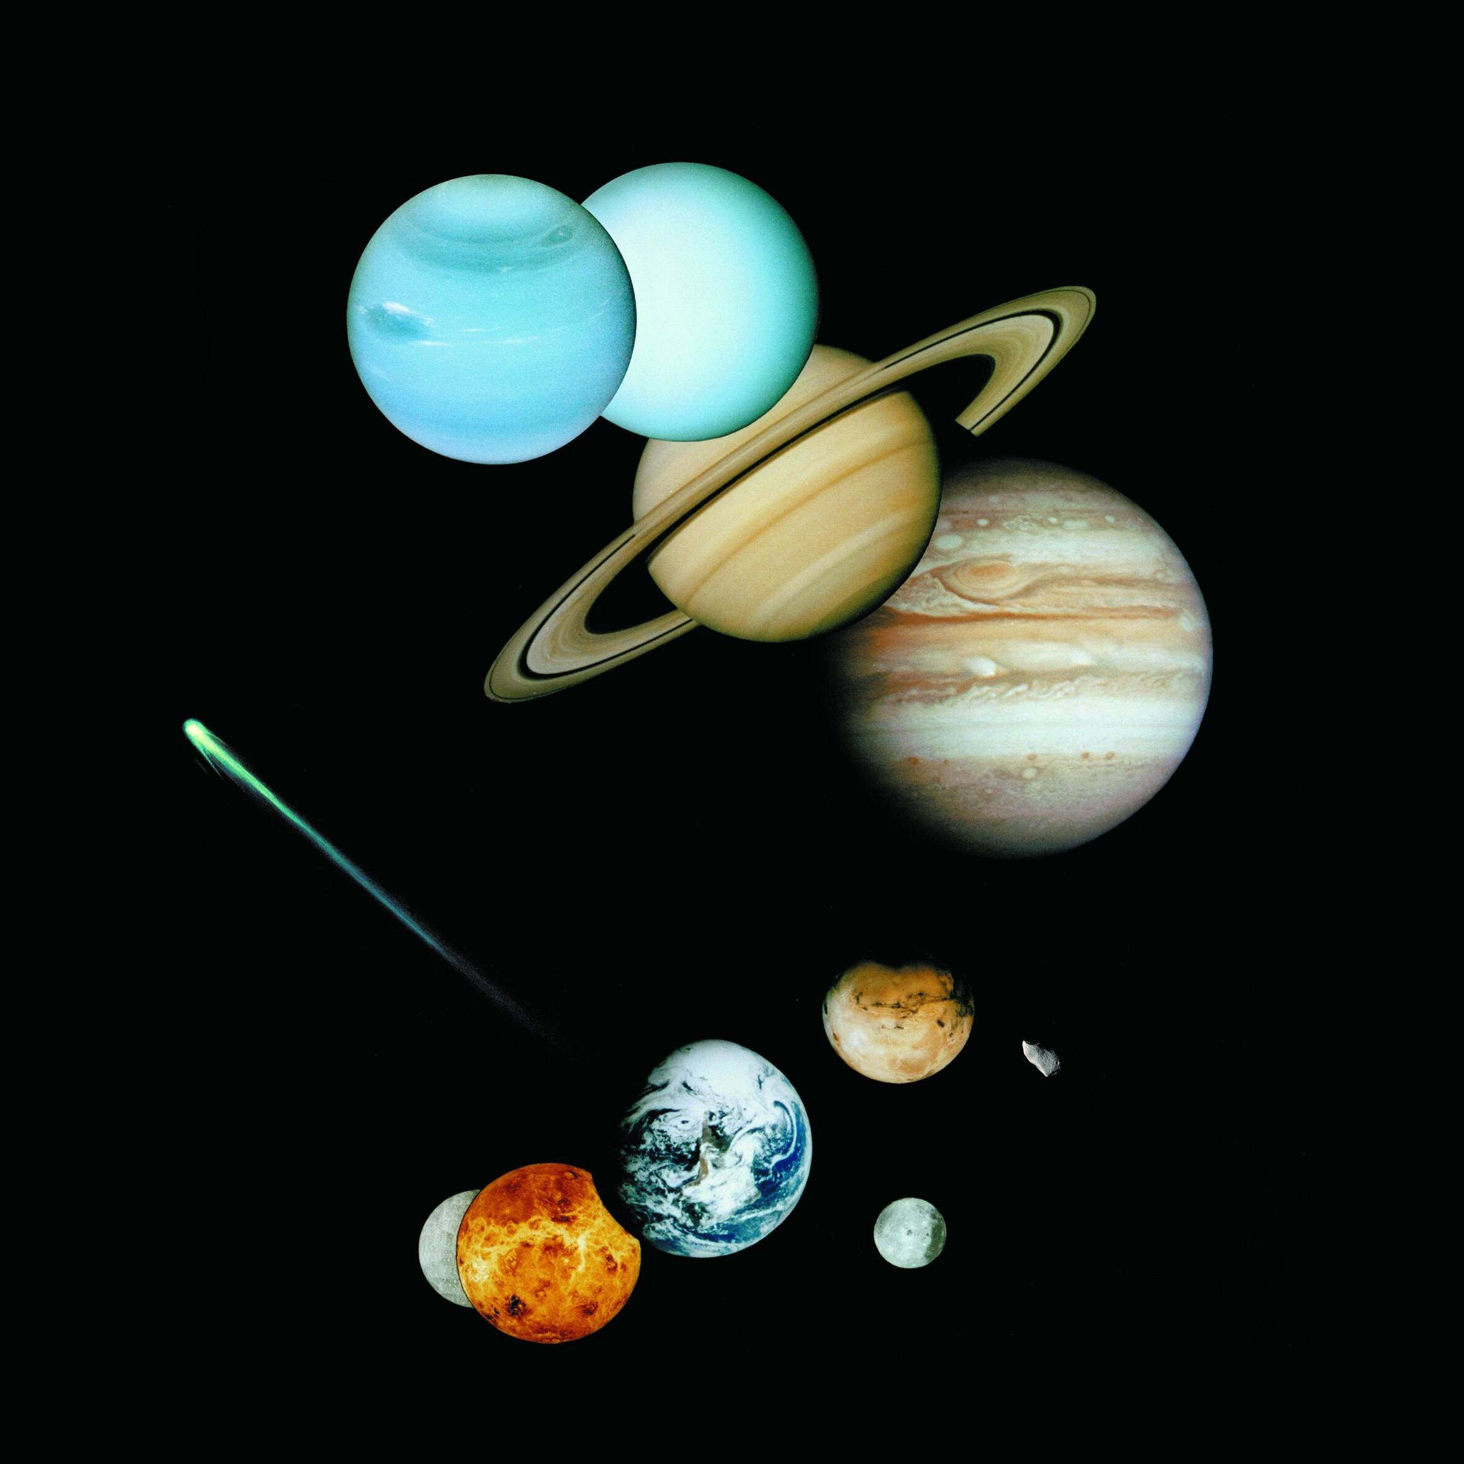

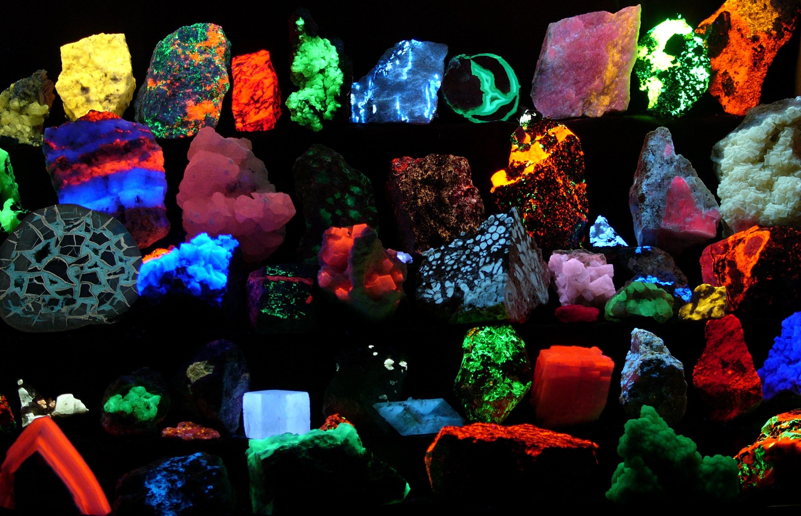
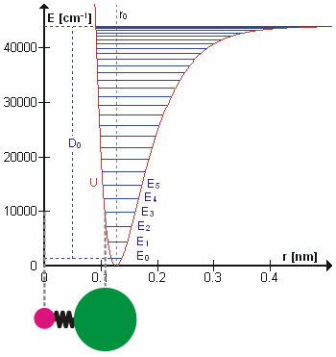

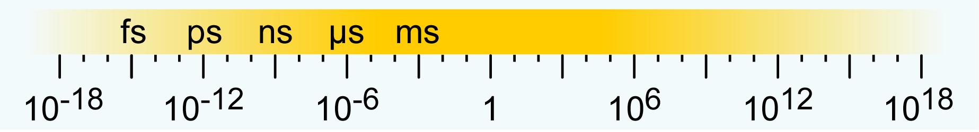
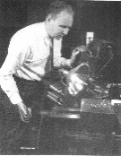
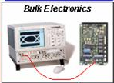
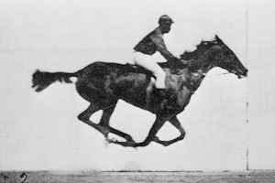
What for attosecond
Time scales of phenomena & how to capture motion
planet orbiting & rotation
visible object motion
coupling to the vacuum & molecular rotation
molecular vibration & chemical reaction
age of the
mankind
age of the
universe
electronic motion & e-e correlations
as
time / seconds
VUV/x-ray techniques
stop watch
optical technologies
camera diaphragm
fast electronics

Slide 4
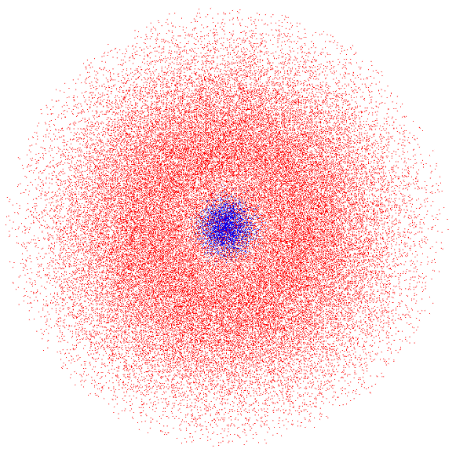

The uncertainty principle
Å scale confinement ↔ asec motion times
Δx·Δp ~ ħ/2
(Δx²·m/Δt~ ħ)
Δx_{atom}~1Å, m_{el} ~ 10⁻³⁰kg, ħ~10⁻³⁴ J·s
Δt_{el} ~ 100 attoseconds!
(1atto=10⁻¹⁸)

Slide 5
The superposition principle
Attosecond pulses ↔ ultra-broad spectrum
Δt_{pulse} ∝ Δω⁻¹
Δν_{1/2} ≈10¹⁶ Hz
Δτ_{1/2} = 80as
(10 as)
(10¹⁷ Hz)
Attosecond pulses have to be VUV,XUV or x-ray pulses!

Slide 6
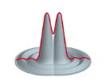
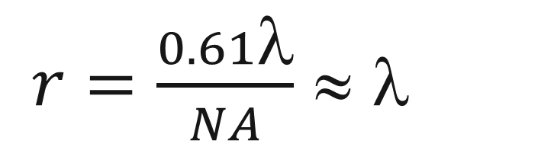
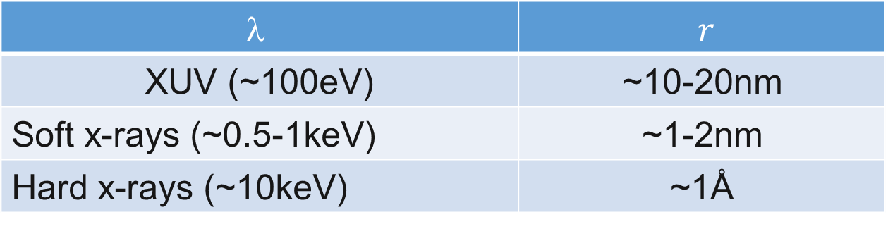
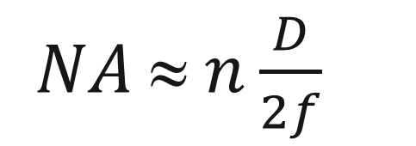
The diffraction principle
The XUV/x-ray bonus: high spatial resolution
r
$r=\frac{0.61λ}{NA}$ ≈ $$
$NA ≈ n\frac{D}{2f}$
$$$$ | $r$
XUV (~100eV) | ~10-20nm
Soft x-rays (~0.5-1keV) | ~1-2nm
Hard x-rays (~10keV) | ~1Å

Slide 7
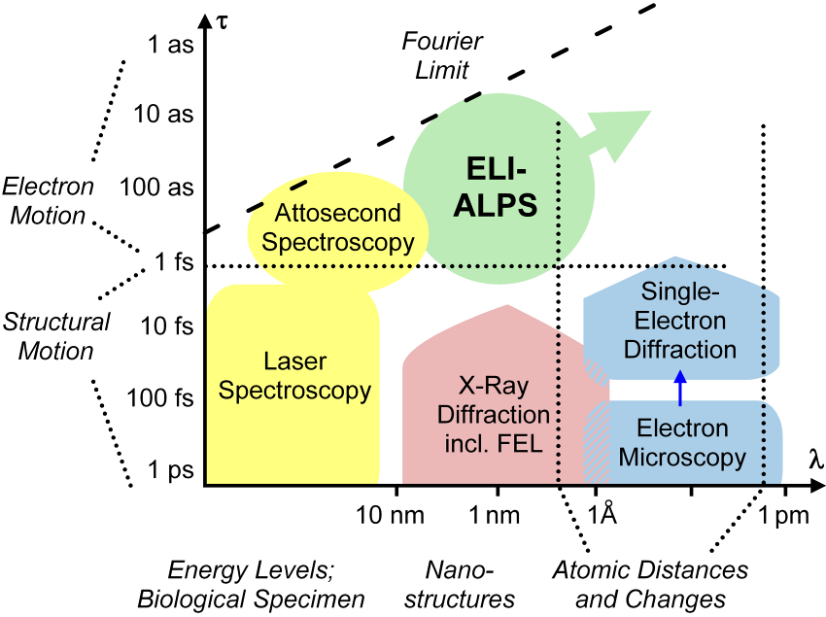
The scientific mission of ELI-ALPS
Visualizing structural ultrafast dynamics

Slide 8
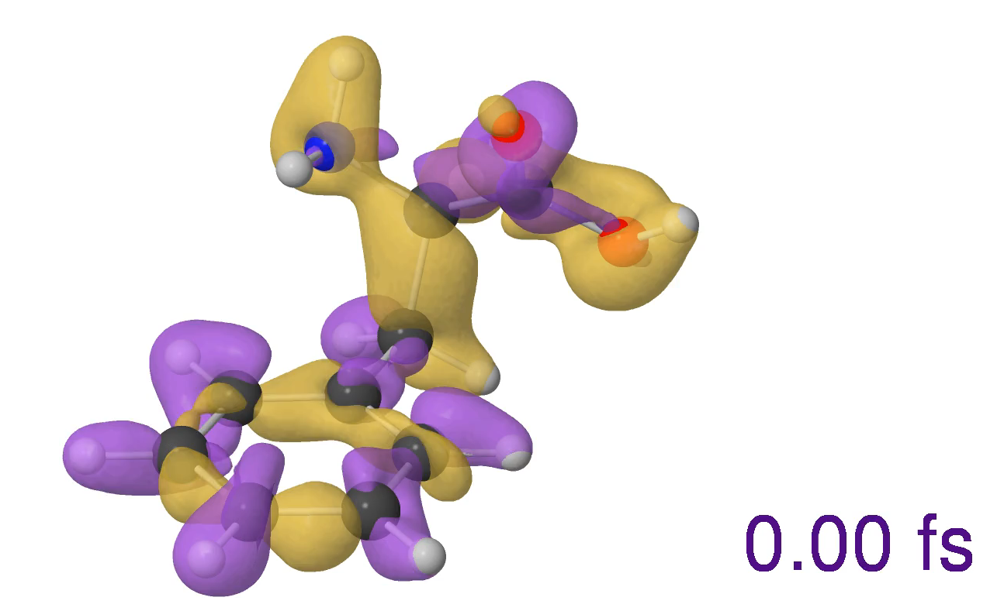
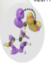
The scientific mission of ELI-ALPS
Visualizing structural ultrafast dynamics
Visualizing ultrafast structural dynamics
Calculation by
Fernando Martin
& Alicia Palacios
Phenylalanine
X-ray
XUV
Video from: F. Calegari et al. Science 346, 336 (2014)

Slide 9
Schematics of ELI-ALPS
Lasers, Secondary Sources, End-stations
Primary sources
(laser beams)
Secondary sources
(attosecond pulses, particles, THz, MIR)
Experiments
High repetition rate (HR) laser:
By 2019-20: 100 kHz, > 5 mJ, < 6 fs, VIS-NIR, CEP
In 2017: 100 kHz, > 1 mJ, < 6,2 fs, VIS-NIR, CEP
Atto1: GHHG HR
Attosecond studies in atomic and molecular physics
Atto2: GHHG HR
Atto3: GHHG SYLOS
Condensed matter physics
Low
shielding
Mid-infrared (MIR) laser:
By 2024-25: 10 kHz, > 10 mJ, < 2 cycles, 4 µm-8 µm
In 2017: 100 kHz, > 150 µJ, < 4 cycles, 2.3 µm-3.8 µm
Atto4: GHHG SYLOS
MIR
Nanophysics, materials science
THz1: spectroscopy
Terahertz pump laser:
By 2020-21: 100 Hz, > 1 J, < 0.5 ps, 1.5 µm-2 µm
By 2018: 50 Hz, > 500 mJ, < 0.5 ps, 1.03 µm
THz2: high energy
THz spectroscopy
BEAM DELIVERY
Atto5: SHHG SYLOS
High resolution imaging
Medium
shielding
Particle1: e⁻ SYLOS
Single cycle (SYLOS) laser:
By 2019-20: 1 kHz, >100 mJ, < 5 fs, VIS-NIR, CEP
In 2017: 1 kHz, >45 mJ, < 10 fs, VIS-NIR, CEP
Source develpoment
Atto6: SHHG HF
Plasma physics
High field (HF) laser:
By 2024-25: 10 Hz, >2 PW, <10 fs
By 2018: 10 Hz, >2 PW, <17 fs
High
shielding
Particle2: ion HF
Particle3: e⁻ HF
Radiobiology

Slide 10
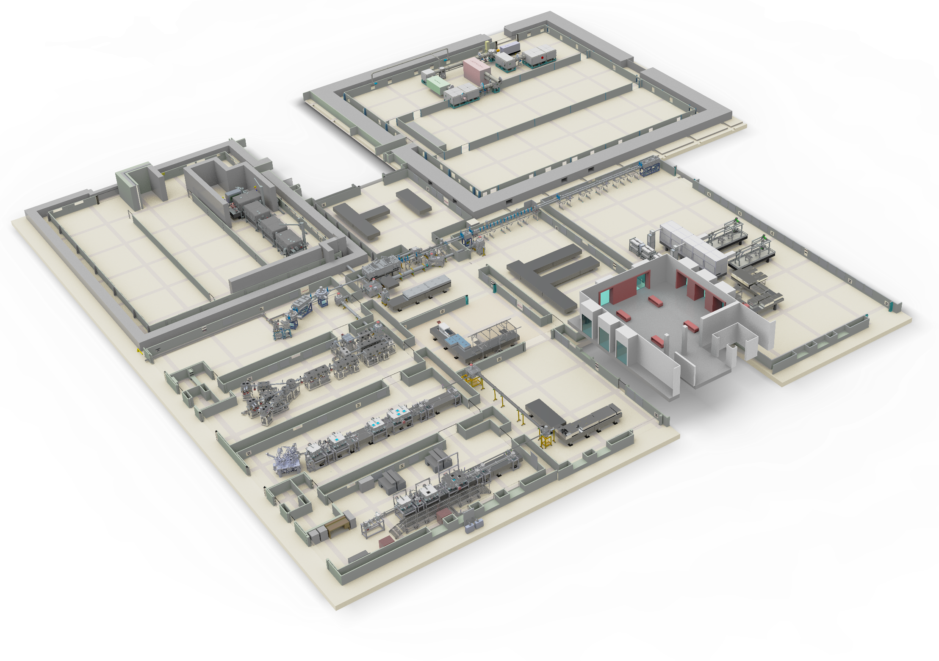
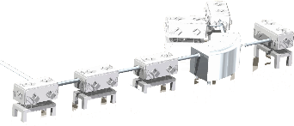
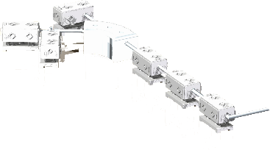
Experimental areas
Laser halls, LTA, MTA, HTA
PW SHHG
High-shielded
Target Area (HTA)
Medium-shielded
Target Area (MTA)
Ions
PW e-
1kHz SHHG
THz
PW
Laser halls
e⁻
SYLOS
SYLOS al
1kHz GHHG long
MIR
1kHz GHHG compact
HR1
Vibration isolation
VC-E (ASHRAE)
HR GHHG CM
Low-shielded
Target Area (LTA)
Clean room environment.
ISO 7 & ISO 8
HR GHHG GP
Temperature and relative humidity
21°C (±0.5°C), 35±5% (tunable).

Slide 11
Lasers
Parameters & Status
 | Parameters | Status | Operation / due date
HR1 | 1.030.9 μm, 100 kHz, 40 fs, 1.5 mJ 1,03 μm, 100 kHz, <7 fs, 1 mJ, CEP<100 mrad | Operational Installation | since October 2018 by September 2019
HR2 | 1.03 μm, 100 kHz, <6 fs, 5 mJ, CEP<100 mrad | In development | by November 2019
MIR | 2.8-4 μm, 100 kHz, <40 fs, 0.15 mJ, CEP<100 mrad | Operational | since October 2017
SYLOS | 0.9μm, 1 kHz, <6.5 fs, >30 mJ, CEP<250mrad 0.9μm 1 kHz, <6.5 fs, >105 mJ, CEP<250mrad | Operational In development | since 13th May 2019 by Fall 2020
SYLOS alignment | 0.85μm10 Hz, <12 fs, >40 mJ, ~850 nm | Operational | since January 2019
HF PW | 0.8 μm, 10 Hz, <17 fs, 34 J | Installation | end 2020
THz Pump | 1 kHz, 100 fs, 1 mJ 1 μm, 50 Hz, <0.5 ps, 0.5 J | In development | July 2019 by July 2020

Slide 12
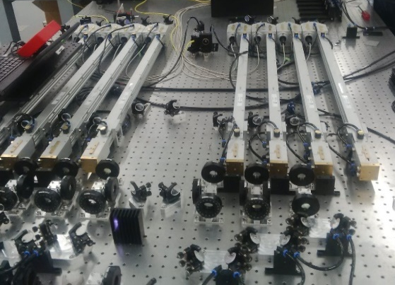
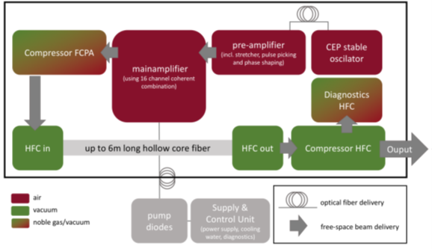
Primary sources
The HR I, II Laser Systems
IAP FSU Jena + Fraunhofer IAF +
Active Fiber Systems GmbH
Wavelength 1030 nm
Energy 1mJ, >5 mJ
Pulse duration 40fs, <6 fs
Rep.rate 100 kHz
CEP stability <100 mrad
Energy stability 0.8%
Strehl ratio 0.9
TDR: completed December 2017
Commissioning @ ELI-ALPS:
HR1: commissioned Oct 2018
Short pulse operation: Sept 2019
HR2: Nov 2019

Slide 13
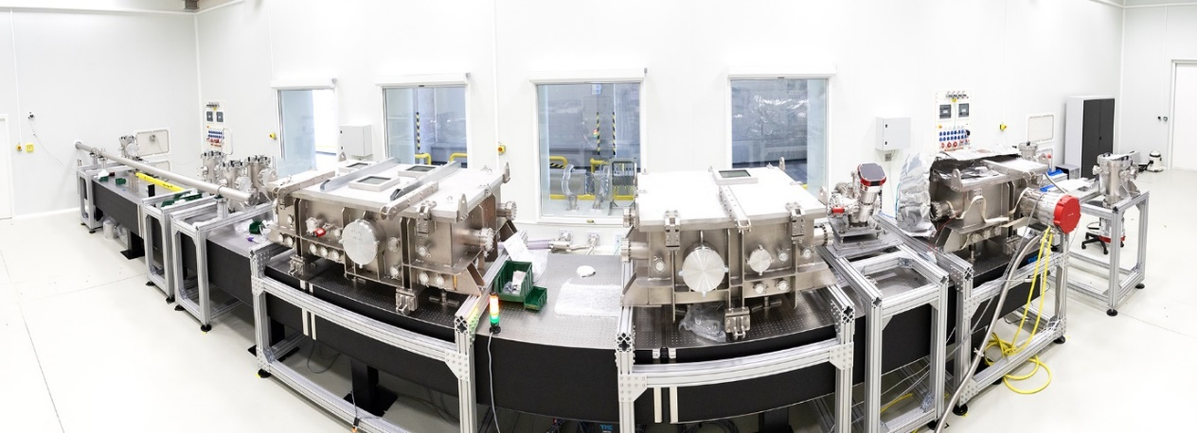
HR GHHG beamline I
Gas/liquid phase experiments
F. Calegari et al.
Science 346, 336 (2014)
⁺⁺NH₂-CHR
from aminoacid phenylalanine
H.-J. Wőrner et al.
Science 350, 790 (2015)
Methylamidated diglycine
100 kHz Rep rate
Versatile design
&
Fast structural changes during
proton transfer
isomerization
motion through conical intersections
selective bond breaking by charge localization
……………..
Porphyrin
Nitrosobenzene
@ ALPS with improved statistics
By A. Kuleff

Slide 14
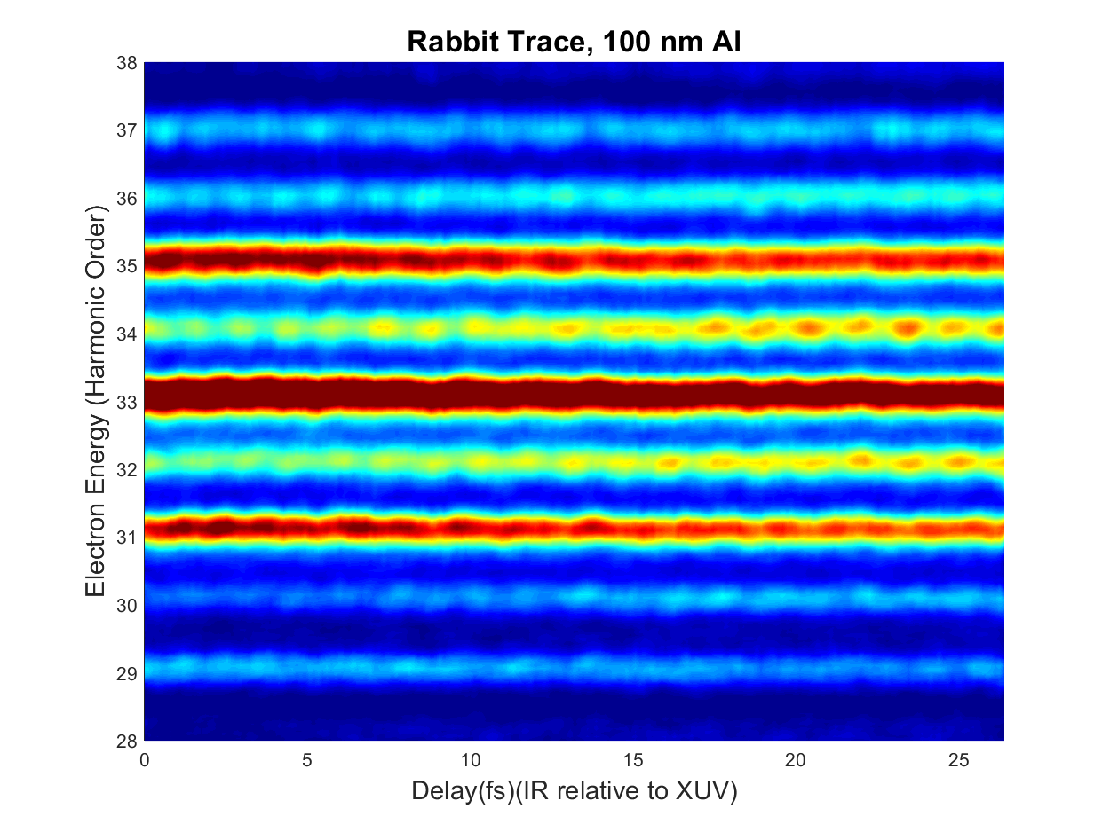
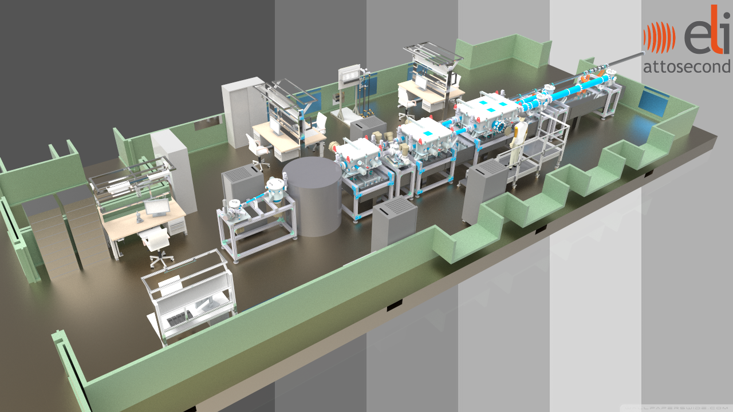
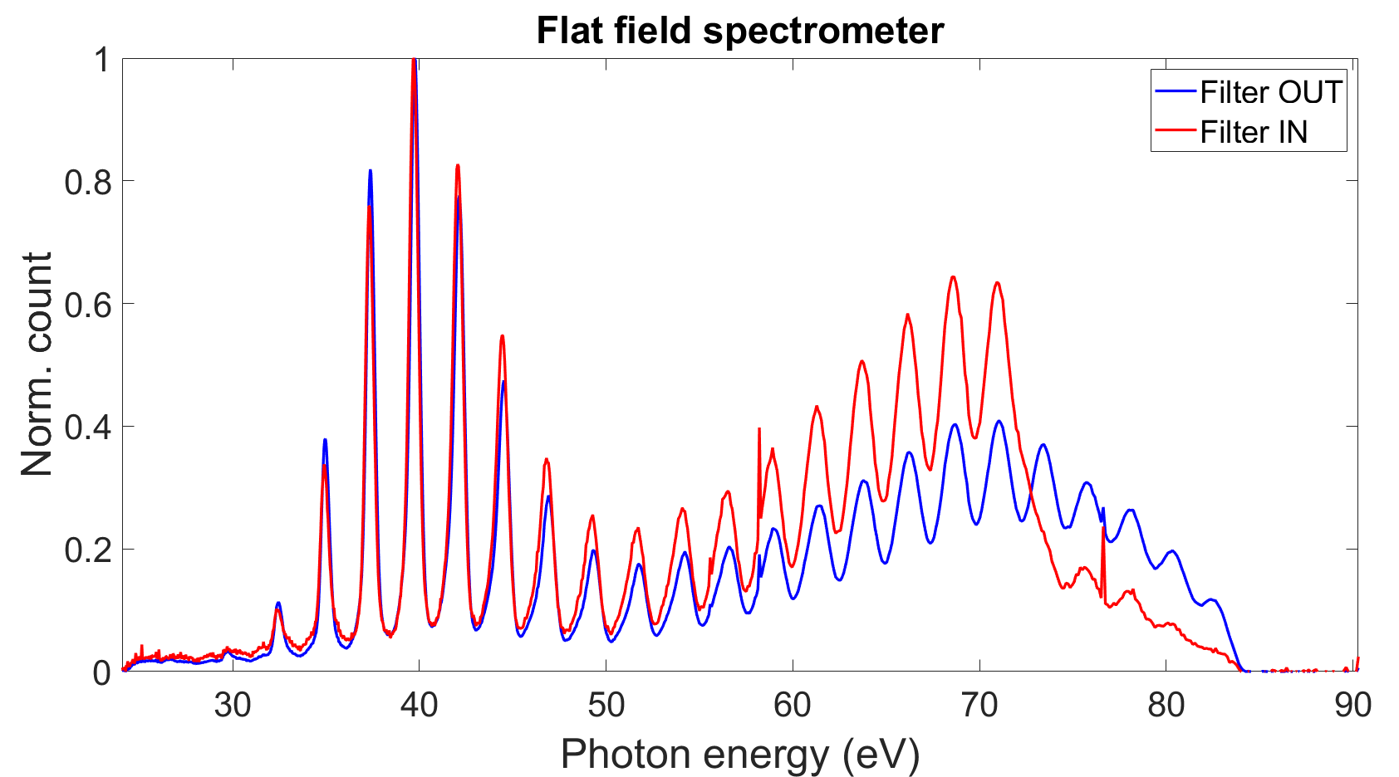
HR GHHG beamline I
Spectrum and Rabbit measurements
Developers: CNR-IFN Milano / Padua, Italy
first attosecond pulse: June 2019
user ready: Dec 2019

Slide 15
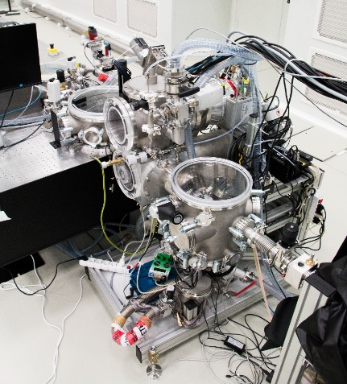
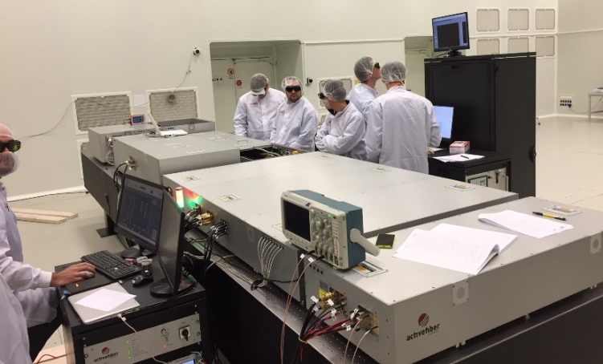

HR I laser commissioning experiments
Liquid phase dynamics
“User”:
Prof. Hans-Jakob Wőrner, ETH, Zürich
in collaboration with ELI-ALPS’s team
Project:
Study of dynamics in liquid phase (liquid microjets)
Started:
January 2018
Means:
ELI-ALPS:HR laser,
ETH: GHHG, liquid target jet,
detection system
Specification exploited: 100 kHz Rep rate
This & other future experiments are part of the recently approved ERC consolidator grant of Prof. H.-J. Wőrner

Slide 16
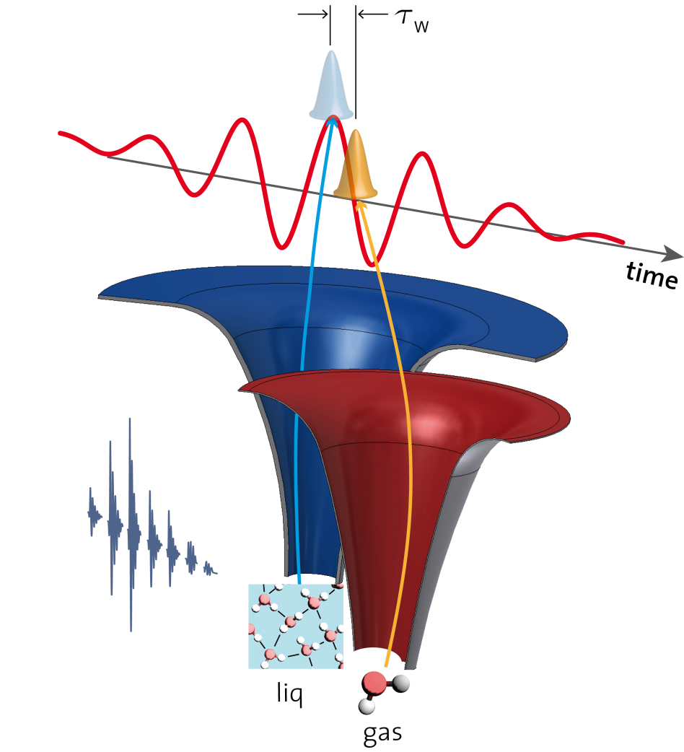
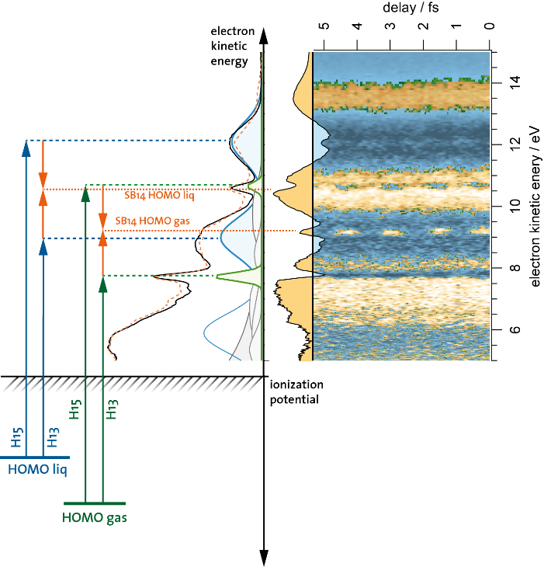


HR I laser
Attosecond dynamics in liquid phase
photoionization delay
Previous results
Ionization delay Δτ
≈ =(69 ± 20) as
Goals of ELI-ALPS experiment
Measure attosecond photoemission delays:
At higher photon energies
Angle-resolved measurements
First attempts to
observe and
time-resolve intermolecular Coulombic decay in liquid water

Slide 17
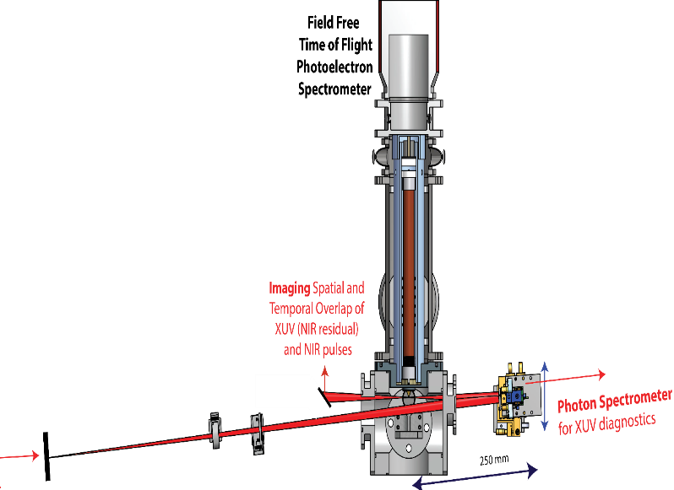
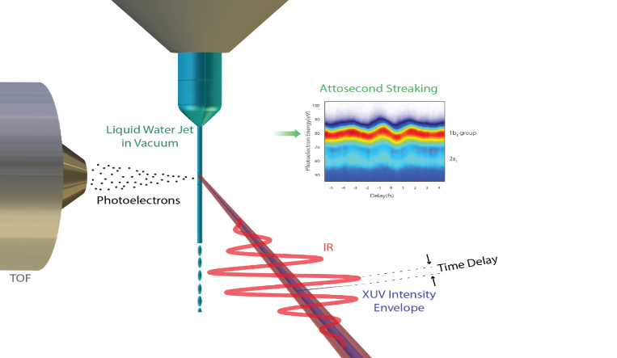
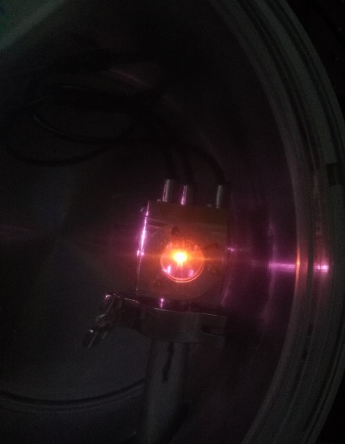
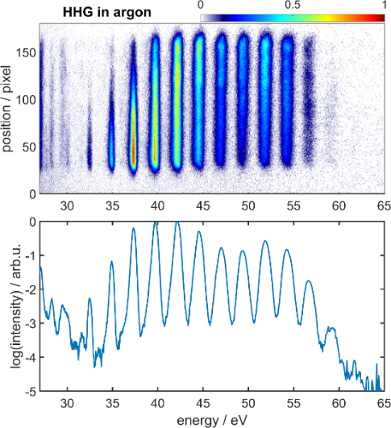
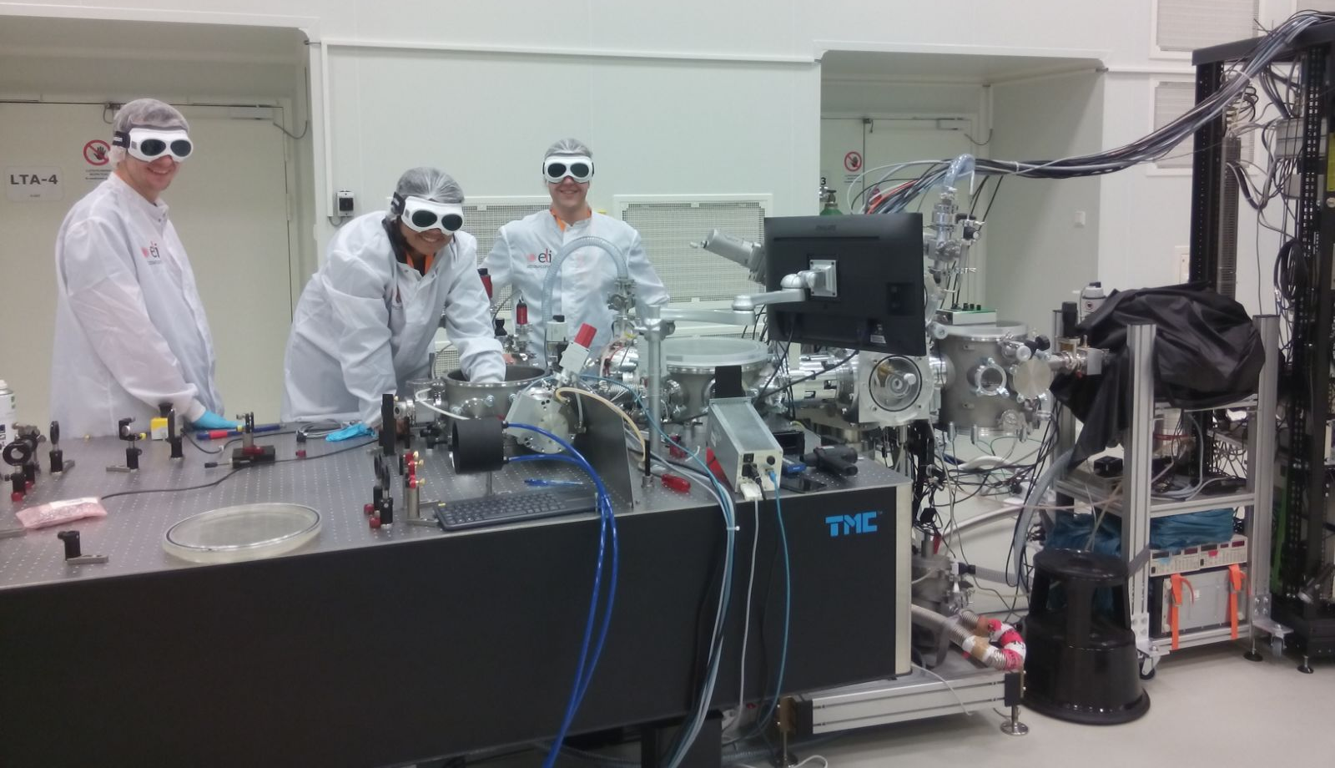
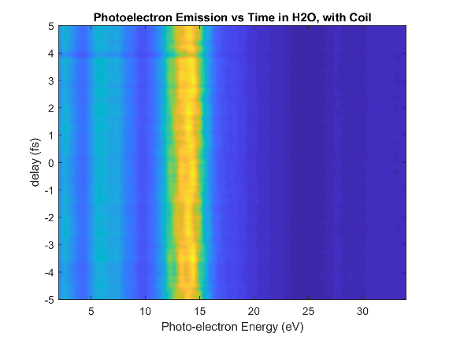
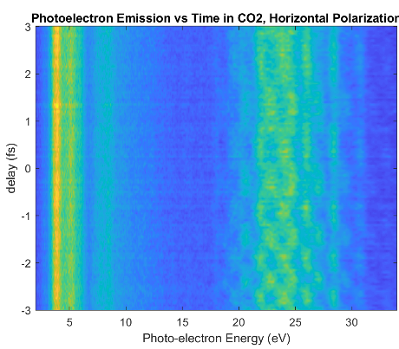
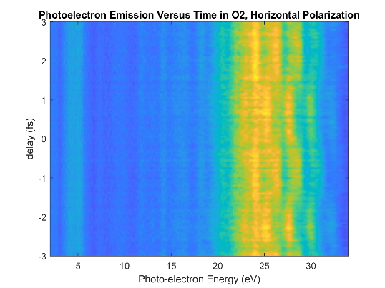
HR I laser
Attosecond beamline & ALPS HR I laser
The ETH Zurich team
Hans Jakob Wörner, Arohi Jain, Thomas Gaumintz, Andreas Schneider
HHG target @ ELI
HHG
Laser

Slide 18
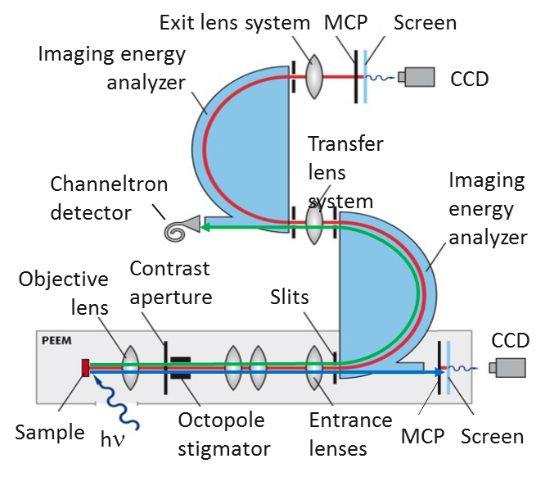
HR GHHG source II
Surface science & CM experiments BL
Equipped with a delay-compensated
XUV monochromator and a NanoEsca ens-station
first attosecond pulse: Dec 2019
user ready: Apr 2020
Developers: CNR-IFN Milano / Padua, Italy

Slide 19
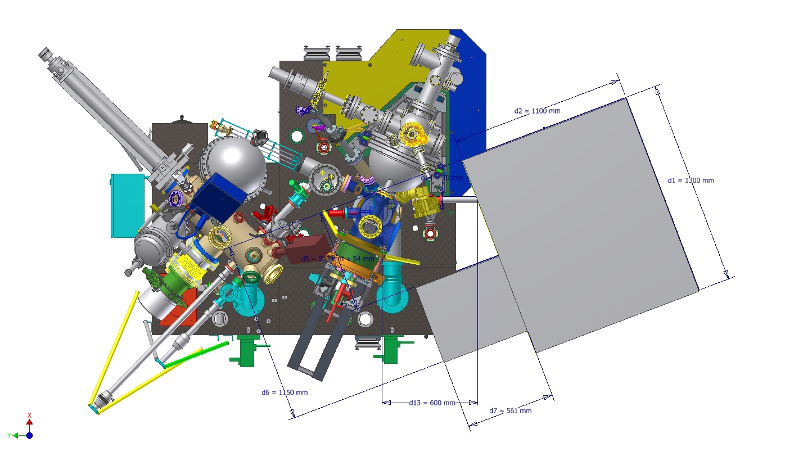
HR GHHG source II
Surface science & CM experiments BL
Real and k-space mapping
Band structure
Spin diagnostics
Magnetic imaging
Plasmonics
ARPES
with
Energy (few tens of meV), spatial (nm) & temporal (fs/asec) resolution
CM and surface science end-station providing
PEEM
Electrostatic analyzer
Spin filter
Time of flight
Sample preparation chamber (with LEED, XPS, sample manipulators)
Nano-ESCA end-station
user ready: Dec 2019
Developers:
Scienta-Omicron,
Focus Gmbh
Collaboration with: Univ. of Kaiserslautern, Univ. of Göttingen

Slide 20
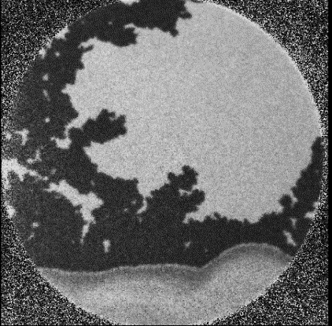
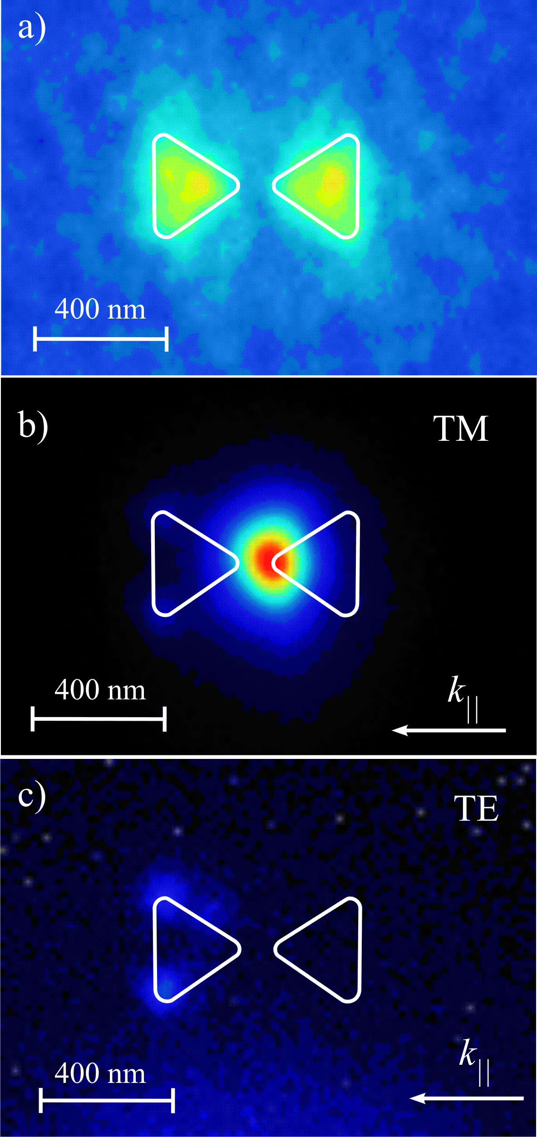

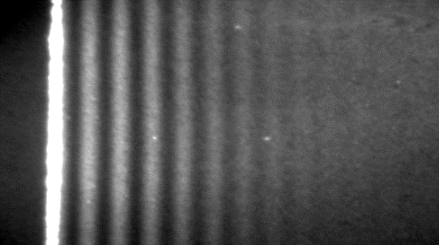
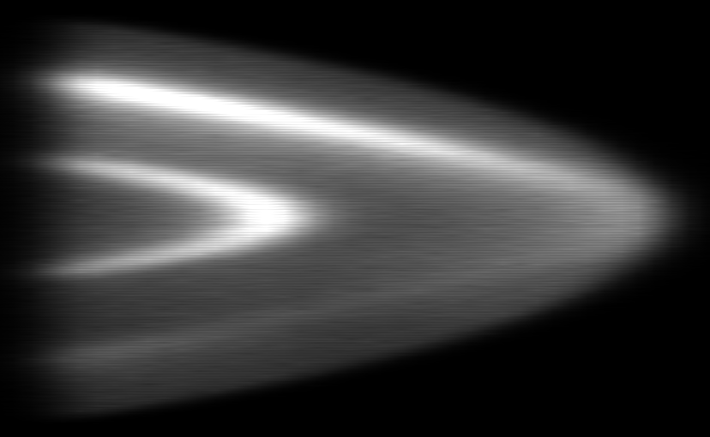
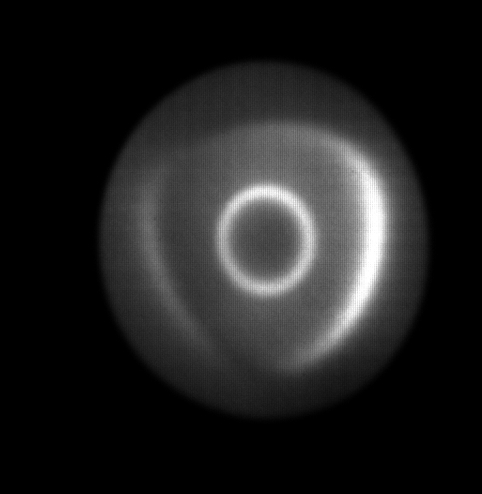


HR (100kHz) GHHG beamline II
Condensed Phase/Surface Science Experiments
Magnetic Imaging
Plasmonics
$$\text{h}\text{ν} \text{=} \text{1}\text{.}\text{55 }\text{eV}$$
$$\text{h}\text{ν} \text{=}\text{ 4.9} \text{eV}$$
10µm
400 nm
P. Melchior et al.,
Phys. Rev. B 88, 104415 (2013)
Melchior et al., AIP Conference Proceedings,
1398, 9-13 (2011)
k Space – Au(111) surface state
Resolution: Δk ≈ 20 mÅ⁻¹
By Philip Thielen http://www.physik.uni-kl.de/
aeschlimann/
k_{y}
200mÅ⁻¹
200 meV
k_{x}
E_{kin}

Slide 21
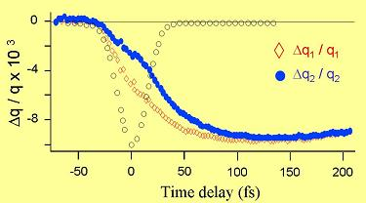
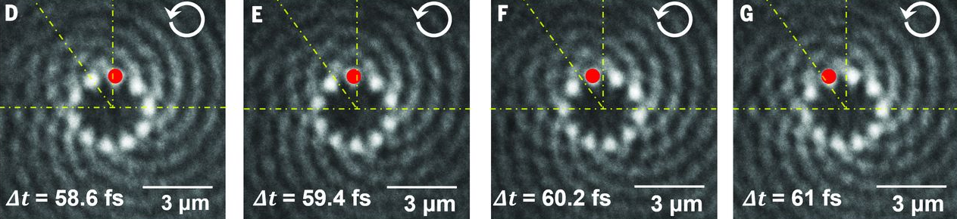
HR GHHG source II
Surface science & CM experiments BL
Condensed Mater & Surface Ultrafast Dynamics
Femtomagnetism
NanoEsca + Spin Filter
100kHz
VUV
J.Y. Bigot et al. (1998)
Sub-fs dynamics
in nanoplasmonic vortices
Science 355, 1187 (2017)

Slide 22
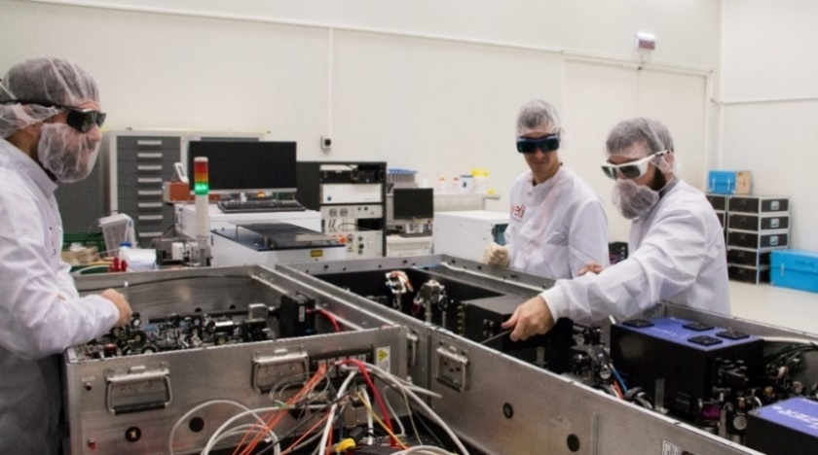
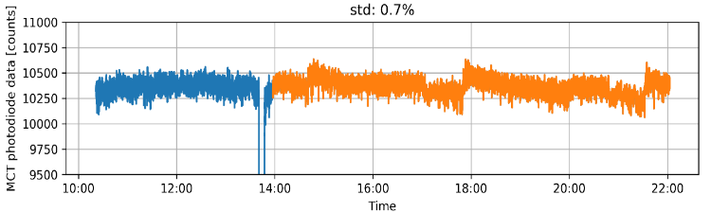
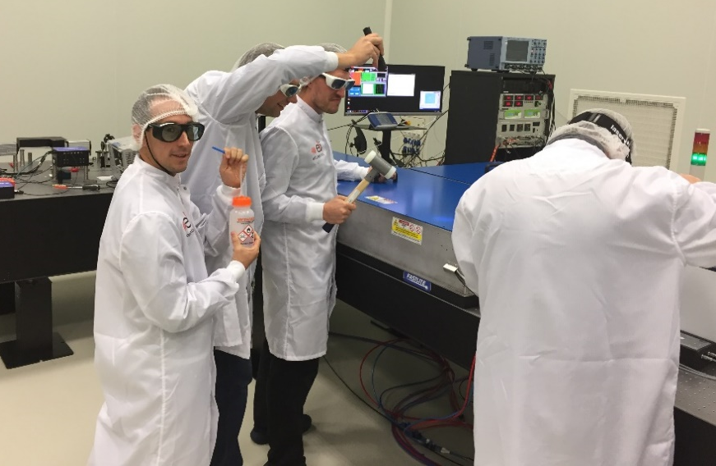


Primary sources
The MIR Laser Systems
Fastlite + ELI-ALPS
energy
CEP
Wavelength 2.3 µm-3.8 µm
Pulse duration <4 cycles
Pulse energy 150 µJ
Rep.rate 100kHz
Energy stability 0.7% rms
CEP drift 65 mrad rms
ASE contrast >10⁶
Strahl ratio >0.7
Delivered: October 2017
Fully commissioned: January 2018

Slide 23




Mid IR laser-matter interactions
The benefits
E_{k}~0
E_{k,max}
E_{k,out}~0
I_{p}
Keldysh ∝λ⁻¹.I^{-1/2} tunneling regime
U_{p} ∝λ².I
HHG cutoff ∝l².I keV photons
E_{e} ∝l².I LIED
t_{attosecond} ∝l^{-1/2} shorter XUV pulses
Atto chirp ∝λ⁻¹

Slide 24
Mid IR laser applications
Some examples from other labs
Jens Biegert
(Nature Commun. 6, 661 (2015); Nature Commun. 7, 11493 (2015))
Advanced gas and CM HHG source
(water window/keV harmonics)
Laser Induced
Electron Difraction
(taking molecular selfies)
Jens Biegert (Nature Commun. 6, 661 (2015); Nature Commun. 7, 11493 (2015))

Slide 25

Mid IR laser commissioning experiments
The quantum-spectrometer (QS)
The classical (wave) spectrometer Principle: Diffraction or refraction
The quantum (photon) HHG spectrometer Principle: Photon statistics
“Creation” of one n-th order harmonic photon results from “annihilation” of n laser photons
Statistics of the missing laser photons reveal the harmonic spectrum

Slide 26


Mid IR laser commissioning experiments
Band gap material HHG QS
ZnO 500μm thick
I_{L}≈ 5 x 10¹¹ W/cm²
mid-IR
λ=3.2 μm

Slide 27


Mid IR laser commissioning experiments
The quantum-spectrometer results
1st User paper from ELI-ALPS

Slide 28
Mid IR laser commissioning experiments
He droplet ionization (on going)
Mid-IR laser photoionization of He droplets
“User”:
Prof. Marcel Mudrich (Univ. of Aarhus) & Prof. Frank Stienkemeier (Univ. of Freiburg)
Project:
„Study of photoionization of Helium dropplets of different size and, eventually with different dopant atoms (usually alkali atoms)”
Observation of the initial ionization process, charging process and the Coulomb explosion of the clusters that proceeds when using the long wavelenght pulses.
Image (using a VMI) the photoelectron and photoion angular distributions
Panned:
July-August 2018
Means:
ELI-ALPS:Mid-IR laser,
User: Experimental workstation

Slide 29






Mid IR laser
Laser Induced Inner Shell x-ray Fluorescence
«User »: Prof Gilad Marcus, The Hebrew University at Jerusalem
Implemented: Sept 2018
$$I≈2×{10}^{15}\frac{W}{cm^{2}}$$
PRL 116, 073901 (2016)
Obtained spectra
Means:
ELI-ALPS: Mid-IR laser, vacuum pumps
Gilad Marcus: Neon jet, vacuum chamber
X-ray spectrometer
Ne K-shell and Kr L-shell + continuum

Slide 30

Mid IR laser commissioning experiments
Feasibility study of GHHG
Harmonic generation in gas
HHG cutoff, U_{p}∝λ²⋅I → high photon energies
October 2017
MIR-ALPS
Dispersion management / polarization gating
XUV Spectrometer
100 kHz, > 150 µJ,
< 4 cycles, 2.3 µm-3.8 µm
Gas jet
Collaboration with CEA Saclay (T. Ruchon)
Planned: June 2018

Slide 31
Primary sources
The SYLOS “alignment” Laser Systems
For pre-aligment & optimization
of the 4 SYLOS driven beamlines
Central λ 900 ±10 nm
Pulse duration <50fs
Pulse energy >40mJ
Rep.rate 10Hz
Energy stability <2.0%
ASE contrast >106
Strahl ratio >0.7
EKSPLA
TDR: completed December 2017
Delivered: November 2018
Fully commissioned: December 2018

Slide 32




SYLOS alignment and SYLOS Systems
The transmutation project proposed by
T. Tajima & G. Mourou
Project: Transmutation of TransUranic Minor Actinide (Np, Am, Cm) spent nuclear waste via “cheaply” produced 14 MeV neutrons generated via DT or DD fusion reactions
Driven 100 keV deuteron acceleration by ultra-short, ultra high rep. rate lasers (SYLOS)
Phase 1:
Acceleration of deuterium nuclei to
~100 keV by the SYLOS laser.
@ 100 keV the DT fusion reactions
cross-section is maximised.
Phase 2:
Creation of copious amounts of DT (or DD)
fusion neutrons by the deuterium beams
@ a Tritiated (or Deuterated) target
(>10¹²-10¹³ neutrons/laser shot)
Phase 3:
Transmutation to safe radiotoxicity levels and volumes
of TRU spent nuclear waste interacting with the isotopically
emitted neutrons
«User »: Prof Karoly Osvay, University of Szeged
Means: ELI-ALPS: SYLOS laser systems, Univ. of Szeged experimental set-up

Slide 33


Primary sources
The SYLOS 2a, 2b Laser Systems
ELI-ALPS + Light Conversion +EKSPLA
Pulse energy 30 & 105 mJ
Pulse duration <10 & 6.5 fs
Rep.rate 1kHz
CEP stability 250 mrad
Energy stability <1.0%
ASE contrast 10¹⁰
Strehl ratio >0.7
Central λ 910 nm
Beam ∅ 60 mm
TDR: completed December 2017
SYLOS 2a: commissioned: May 2019
SYLOS 2b: Fall 2020

Slide 34





The SYLOS GHHG “compact” beamline
Gas Phase Experiments
NL XUV
IR-XUV
ReMi
Separation
Generation
PG
QPM-GHHG
MBES
f = 3, 6, 9 m
mechanical assembly: completed
optical assembly: ongoing
first attosecond pulse: Dec 2019
user ready: Apr 2020
Developers: FORTH Heraklion, Greece

Slide 35





SYLOS GHHG “compact” BL proposals
Non-linear processes in the XUV/XUV-pump-XUV-probe
He double ionization
20m
Molecular coupled dynamics
K. Ishikawa et al. Phys. Rev. A 72, 013407 (2005)
Requires
Reaction Microscope for two-electron (p₁ and p₂) coincidences
High XUV intensities (10¹⁵- 10¹⁶ W/cm²)
High rep rate (>1kHz)
High temporal resolution (~100 asec)
Uniquely available @ ELI-ALPS
Collaboration with:
Univ. Heidelberg, FORTH, Univ. Freiburg

Slide 36





SYLOS GHHG “long” Beamline
Non-linear processes in the XUV/UV-pump-XUV-probe
mechanical assembly: Nov 2019
optical assembly: Feb 2020
first attosecond pulse: May 2020
user ready: Oct 2020
ReMi
VMI
Developer: Lund University, Sweden

Slide 37

SYLOS GHHG “long” BL proposals
Non-linear processes in the XUV/UV-pump-XUV-probe
UV-XUV pump-probe on aminoacids’ chains
3H UV pump
(4.5 eV)
50 m
H
N
Pump-probe options
XUV + XUV
XUV + IR
XUV + XUV + IR
XUV + XUV + IR + IR / SHG / THG / VUV / XUV
HHG XUV probe (20 eV)
H
O
N
H
Unique elements of SYLOS GHHG BLs
1kHz
10-100eV
5μJ - 0.5nJ
APTs & isolated
O
e⁻
Δt
O
CH₃
H₃C
N
H
O
N
Few femtosecond resolution using HHG and synchronized 3rd harmonic
2) e⁻ emission variation depending on the
delay delay after the excitation
O
CH₃
N
H
H
Collaboration with: Univ. of Lund, Univ. Freiburg

Slide 38

SYLOS GHHG beamlines
Expected pulse energies
O. Jhan et al., Optica (2019) (in press)

Slide 39




Recent developments
The 20-GW HHG source of the asec S&T lab @ FORTH-IESL
20m
HHG chamber
Experimental chamber
(Split spherical mirror XUV-pump-XUV-probe facility)
XUV beam manipulation
Chamber (irises, filters, toroidal mirror systems)
XUV-IR separation & beam wavefront/ XUV delay line
splitter chamber
Focusing optics chamber
2nd Experimental chamber
FO.R.T.H. - I.E.S.L.
XUV pulse energy 230µJ (Xe), 130µJ (Ar) (one jet 135 & 75µJ)
0.7 ·10¹⁴ photons/pulse!! (FEL number of XUV photons!!!)
Focused intensity if low loss XUV optics would be used: ~10¹⁷ W/cm²
Maximum focused intensity in this experiment: ~7·10¹⁵ W/cm²
Conversion efficiency per harmonic, one jet: 1·10⁻³ (Xe), 2·10⁻⁴ (Ar)
Preliminary ATP pulse duration: ~0.5fs
A. Nayak et all. Phys. Rev. A 98, 023426

Slide 40


Research through secondments
Multi-GHHG-photon multiple ionization
Numerical calculations by
H. I. B. Banks & A. Emmanouilidou
A. Nayak et all. Phys. Rev A 98, 023426 (2018) https://link.aps.org/doi/10.1103/PhysRevA.98.023426

Slide 41


Other ELI-ALPS Secondary Sources
The SYLOS driven SHHG beamline
SYLOS driven
The first 1 KHz SHHG source !
to be contracted: Nov 2019
operational: Nov 2021

Slide 42
Other ELI-ALPS Secondary Sources
The PW driven SHHG Beamline
Spectrum cut-off 500eV – 1 keV
Output energy 70mJ (all orders 10<n< 20)
700 μJ (orders >20)
SHHG pulse duration <100 asec for ROM
< 200 asec for CWE
to be contracted: Apr 2020
operational: Apr 2022

Slide 43



PW driven SHHG source proposals
Multiphoton Inner Shell Processes
Requires
High XUV intensities (10¹⁷- 10¹⁸ W/cm²)
High temporal resolution (~ sub-100 asec)
Potentially available @ ALPS’s XUV sources
Two-photon K-shell ionization cross-sections & ionization energies of H-like ions
Two-photon K-shell, single-photon L-shell single photon K-shell ionization probability of H-like Be and B

Slide 44


Laser driven electron acceleration
Examples of applications of other labs
  Betatron radiation tomography
Cole et al. Scientific Reports 5, 13244 (2015)

Slide 45





In house services for operation & users
Workshops & Laboratories
Mechanical and electrical workshops
Optical preparation laboratory
Optical workshop for custom optics and coatings

Slide 46

National users’ collaborative projects Experiments of Wigner RC @ ELI-ALPS
Developing ultrafast nanooptical
circuitry (Dombi-group)
B. fs stimulated Raman spectroscopy
endstation (Veres-group)
C. Time-resolved investigation of
functional molecules (Vankó-group)
D. Acceleration of negative ion and
neutral atom beams (Dzsotjan-group)

Slide 47




National users’ collaborative projects Experiments of BRC @ ELI-ALPS
E
0.3 ps
4 ps
0.3 ps
2 ps
6 ps
12 ps
E
ω_{a}
ω_{a}
k₁
ω_{b}
ω_{b}
excitation
k₂
ω_{c}
ω_{c}
ω_{c}
ω_{b}
ω_{a}
detection
Nonadiabatic processes
Long leaving Quantum coherences
Akhtar et al.,
J. Biol. Chem. B 123:6765 (2019)

Slide 48


ELI ALPS
Achievements
3 Laser systems already commissioned
+ 3 systems foreseen till end 2019
1st RABBITT Signal
20/06/2019
1st User paper from ELI-ALPS
August, 2019 | headcount | FTE
researchers | 94 | 79.3
research engineers | 34 | 31.9
technicians | 13 | 12.1

Slide 49



Collaborative commissioning
users’experiments
User access until Sep 2019: 180 days
Up-coming projects

Slide 50

Open commissioning user call
https://www.eli-alps.hu/en/Users-and-Calls-1/Calls-1
www.eli-alps.hu

Slide 51












Organizational chart
Scientific & Research Technology Directorates
Dimitris Charalambidis
Chief Scientific Advisor
Katalin Varju
Research Technology Director
Giuseppe Sansone
Scientific Advisor
Rodrigo Lopez-Martens
Scientific Advisor
Karoly Osvay
Scientific Advisor
Attosecond and Strong Field Science
Division
Sandor Varro
division head
AMO and Quantum Optics Theory Group
Sandor Varro
Charge Dynamics in
(Bio)materials Group
Sophie Canton
Computational Materials Science Group
Mousumi
Upadhyay Kahaly
Laser Plasma Group
Sargis Ter-Avetisyan
Scientific
Applications
Division
Peter Dombi
division head
Csaba Janaky
deputy division head
Biomedical Applications
Group
Katalin Hideghety
Surface Dynamics Group
Laszlo Ovari
Ultrafast Dynamics and Reaction Control Group
Viktor Chikan
Ultrafast Nanoscience
Group
Peter Dombi
Particle and
Terahertz Sources
Division
Christos Kamperidis
division head
Daniel Papp
deputy division head
Electron Acceleration Group
Nasr Hafz
Ion Acceleration
Group
Terahertz Source and Applications Group
Jozsef Fulop
Attosecond
Sources
Division
Subhendu Kahaly
acting division head
HR Attosource
Group
Miklos Fule
Surface Plasma Attosources Group
Subhendu Kahaly
SYLOS Gas Attosources Group
Sergei Kuehn
Diagnostics and Applications
of Attosources Group
Balazs Major
Laser
Infrastructure
Division
Adam Borzsonyi
division head
High Field Laser
Group
Mikhail Kalashnikov
High Repetition Rate Laser Group
Peter Jojart
Mid-Infrared Laser
Group
Balint Kiss
Single-Cycle Laser Group
Adam Borzsonyi
Engineering
and Integration Division
Lajos Fulop
division head
Electrical Engineering Group
Ferenc Horvath
Infrastructure Liaison Group
Andras Makai
Mechanical Engineering Group
Andras Makai
Software Engineering Group
Lajos Schrettner
Research Technology
Service Division
Gergo Meszaros
division head
Electrical
Workshop
Viktor Varkonyi
Mechanical Workshop
Zoltan Vajna
Optical Preparatory Workshops
Gergo Meszaros
Vacuum Technology and Equipment Assembly Group
Arpad Mohacsi

Slide 52
THANK YOU !

