Slide 1


Atomic Diagnostic for
Ultrahigh Intense Laser Pulses
Marcelo Ciappina
ELI-Beamlines, Institute of Physics
Czech Academy of Sciences
Prague, Czech Republic
ELISS’ 19, 30/09/2019

Slide 2
Introduction
Intensity regimes for optical and infrared wvln
  Moderate intensities<10¹⁵ W/cm²
“easy”: single ionization yield, photoelectron spectra, high-order harmonic generation (HHG)
  Intermediate intensities~10¹⁵~10¹⁷ W/cm²
“problematic”: competition between sequential and non-sequential ionization (recollision driven), “knee” in the ionization yield
  High and ultrahigh intensities >10¹⁸ W/cm²
“easy?”: multiple sequential ionization, magnetic field prevents recollision, relativistic effects?
New: relativistic Thomson scattering?

Slide 3

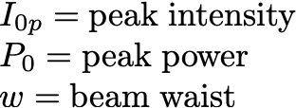
Motivation:
Ultrahigh intensities to be reached soon
 | 1PW | 3PW | 10PW
100 μm | 10¹⁹W/cm² | 3•10¹⁹W/cm² | 10²⁰W/cm²
10 μm | 10²¹W/cm² | 3•10²¹W/cm² | 10²²W/cm²
1.3 μm | 7•10²²W/cm² | 2•10²³W/cm² | 7•10²³W/cm²

Slide 4
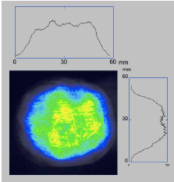

Motivation
Will we be able proving this?
V. Yanovsky et al., Opt. Exp.16, 2109 (2008)

Slide 5
Motivation
Will we be able confirm these intensity values?
Which strong-field processes can be used for a
  straightforward
  quantitatively precise and
  unambiguous
measurement of ultrahigh intensities in a laser focus?

Slide 6
How can we affirm that a certain value of intensity has been achieved?
Which strong-field processes can be used as simple, straightforward and unambiguous measures of ultrahigh intensities in a laser focus?
  Acceleration of ions and electrons in laser-plasma interactions
  Manifestations of radiation reaction effects
  Radiation of probing particles in a laser focus

Slide 7
How can we affirm that a certain value of intensity has been achieved?
Which strong-field processes can be used as simple, straightforward and unambiguous measures of ultrahigh intensities in a laser focus?
  Acceleration of ions and electrons in laser-plasma interactions
  Manifestations of radiation reaction effects
  Radiation of probing particles in a laser focus
  Multiple ionization of atoms

Slide 8
Strong-field ionization as a probe of intensity
Why ionization?
  local in time and space
  sensitive mostly to the electromagnetic field amplitude and much less to the pulse duration and not at all to its total energy
  highly nonlinear: a small change in intensity results in a considerable variation of the ion or photoelectron signal

Slide 9
Strong-field ionization as a probe of intensity
Why ionization?
  local in time and space
  sensitive mostly to the electromagnetic field amplitude and much less to the pulse duration and not at all to its total energy
  highly nonlinear: a small change in intensity results in a considerable variation of the ion or photoelectron signal
Further advantages:
  the theory requires almost no model assumptions or approximations
  “easy to implement” in experiment

Slide 10






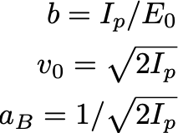



Single-electron or correlated?
  adiabaticity: no e-e correlation effects on ionization

Slide 11





Relativistic or nonrelativistic?
  adiabaticity: no e-e correlation effects on ionization
  tunneling remains nonrelativistic up to 10²⁶W/cm²!

Slide 12






Sequential nonrelativistic static-field ionization
A.M. Perelomov, V.S. Popov, M.V. Terentyev, Sov. Phys. JETP 23, 924 (1966)
B.M. Karnakov, V.D. Mur, V.S. Popov, JETP Lett. 66, 229 (1997)– relativistic version

Slide 13
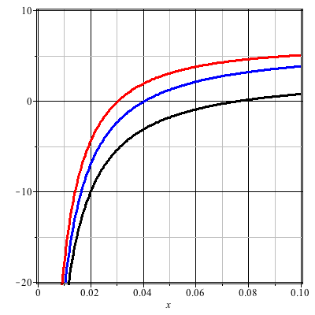








Sequential nonrelativistic static-field ionization
+10
0
-10
-20
0
0.02
0.04
0.06
0.08
0.10

Slide 14


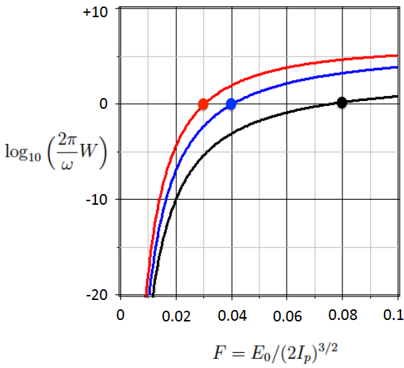



Intensity-dependent ionization offset

Slide 15
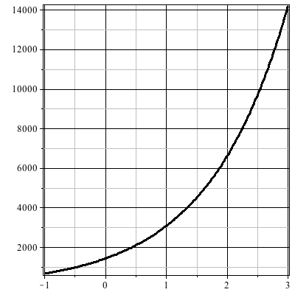







Intensity-dependent ionization offset
14
12
10
8
6
Nonrelativistic
4
2
With relativistic corrections
10²²
10²³
10¹⁹
10²⁰
10²¹

Slide 16
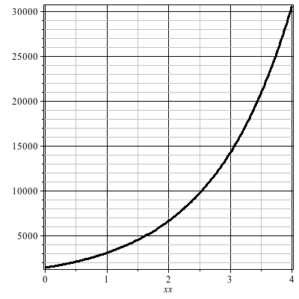

Intensity-dependent ionization offset
Kr³⁵⁺
Ionization potential, eV
Kr³⁴⁺
Xe⁵¹⁺
Xe⁴⁸⁺
Xe⁴⁶⁺
Ar¹⁷⁺
Kr³³⁺
Kr²⁸⁺
10²⁰
Ne⁹⁺
10²¹
10²²
10²³
10²⁴
Intensity, W/cm²

Slide 17
Intensity-dependent ionization offset
Ag⁴⁶⁺
Rh⁴⁴⁺
Mo⁴¹⁺
Y³⁸⁺
Kr³⁵⁺
Ionization potential, eV
As³²⁺
Kr³⁴⁺
Cu²⁸⁺
Xe⁵¹⁺
Xe⁴⁸⁺
Xe⁴⁶⁺
Ar¹⁷⁺
Kr³³⁺
Kr²⁸⁺
10²⁰
Ne⁹⁺
10²¹
10²²
10²³
10²⁴
Intensity, W/cm²

Slide 18
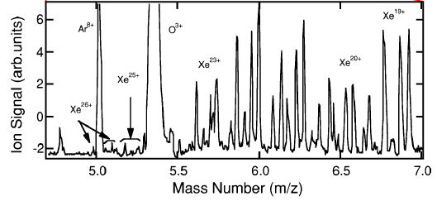
Experimental realization
Ionization of low-pressure neutral gases with subsequent TOF detection of different charge states
Ionization of many-electron atoms at intensities above 10¹⁹W/cm²
E.A. Chowdhury et al., Phys. Rev. A 63, 042712 (2001)
K. Yamakawa et al., Phys. Rev. A 68, 065403 (2003)

Slide 19
Experimental realization
Ionization of low-pressure neutral gases with subsequent TOF detection of different charge states
    background pressure 10⁻⁴ – 10⁻⁷ Torr: no plasma or other collective effects: might be not enough atoms in the case of a very tight focusing;
    a target consisting of neutral atoms: chains of rate equations have to be solved – can be demanding!
    focal averaging: a broad distribution in charge states

Slide 20
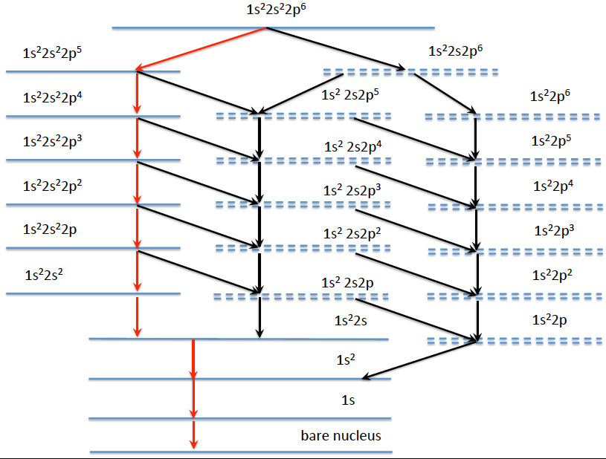
Ionization cascades
Ne
Ar⁸⁺
Kr²⁶⁺
Xe⁴⁴⁺

Slide 21
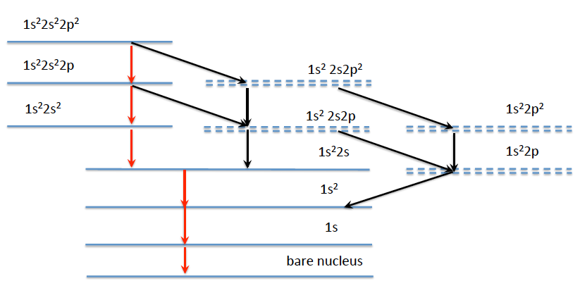
Reduced ionization cascades
Ne⁴⁺
Ar¹²⁺
Kr³⁰⁺
Xe⁴⁸⁺

Slide 22


Ionization cascades
Kr³⁰⁺
…
M. F. Ciappina et al, Phys. Rev. 94, 043405 (2019)

Slide 23
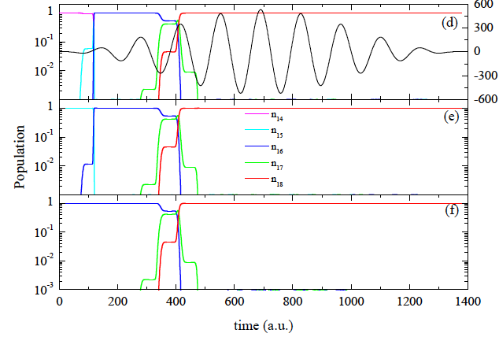
Initial-condition-independent cascades
Argon
I=10²² W/cm²
M. F. Ciappina et al, Phys. Rev. 94, 043405 (2019)

Slide 24

Initial-condition-independent cascades
Argon
Ar¹⁶⁺ ––– 0.27*10²⁰
Ar¹⁸⁺ ––– 3.0*10²¹
M. F. Ciappina et al, Phys. Rev. 94, 043405 (2019)

Slide 25
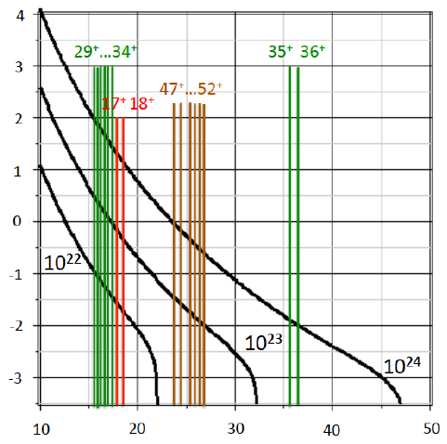






Focal averaging

Slide 26
Conclusions
Advantages:
    Numerically cheapest and experimentally most straightforward method
    Relatively high accuracy for that intervals of intensity which are densely covered by ionic states
    No intensity limitations are imposed

Slide 27
Conclusions
Advantages:
    Numerically cheapest and experimentally most straightforward method
    Relatively high accuracy for that intervals of intensity which are densely covered by ionic states
    No intensity limitations are imposed
Difficulties:
    Gaps in intensities which cannot be covered by noble gases
    For a large focal volume the signal will be oversaturated by low charge states

Slide 28
Conclusions
Advantages:
    Looks as the numerically cheapest and experimentally most straightforward method
    Relatively high accuracy for that intervals of intensity which are densely covered by ionic states
    No intensity limitations are imposed
Difficulties:
    Gaps in intensities which cannot be covered by noble gases
    For a large focal volume the signal will be oversaturated by low charge states
Do we have ultra-high intensities to measure?

Slide 29
Acknowledgments
    ELI-Beamlines (ADONIS Grant)
    Dr. Sergey Popruzhenko
    Dr. Stefan Weber, Dr. Georg Korn
    Prof. Sergei Bulanov

Slide 30
Thank you very much

