Slide 1

Ultrafast nanoscience @ELI-ALPS
Péter DOMBI
head of Scientific Applications Division

Slide 2
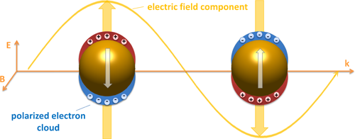
electric field nanolocalization with plasmons
100 nm
Important properties:
Nanoscale localization of electric field of light
Field enhancement … … but how much exactly?

Slide 3
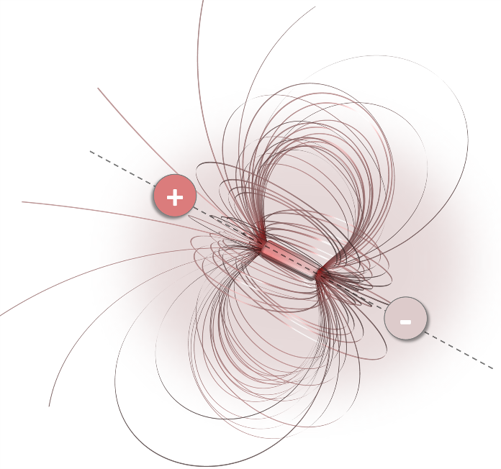
plasmon field control with nanoparticle geometry
EM field nanolocalization
Field enhancement: as much as x1000 (!)

Slide 4
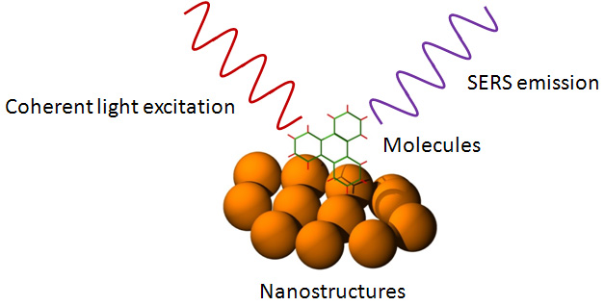
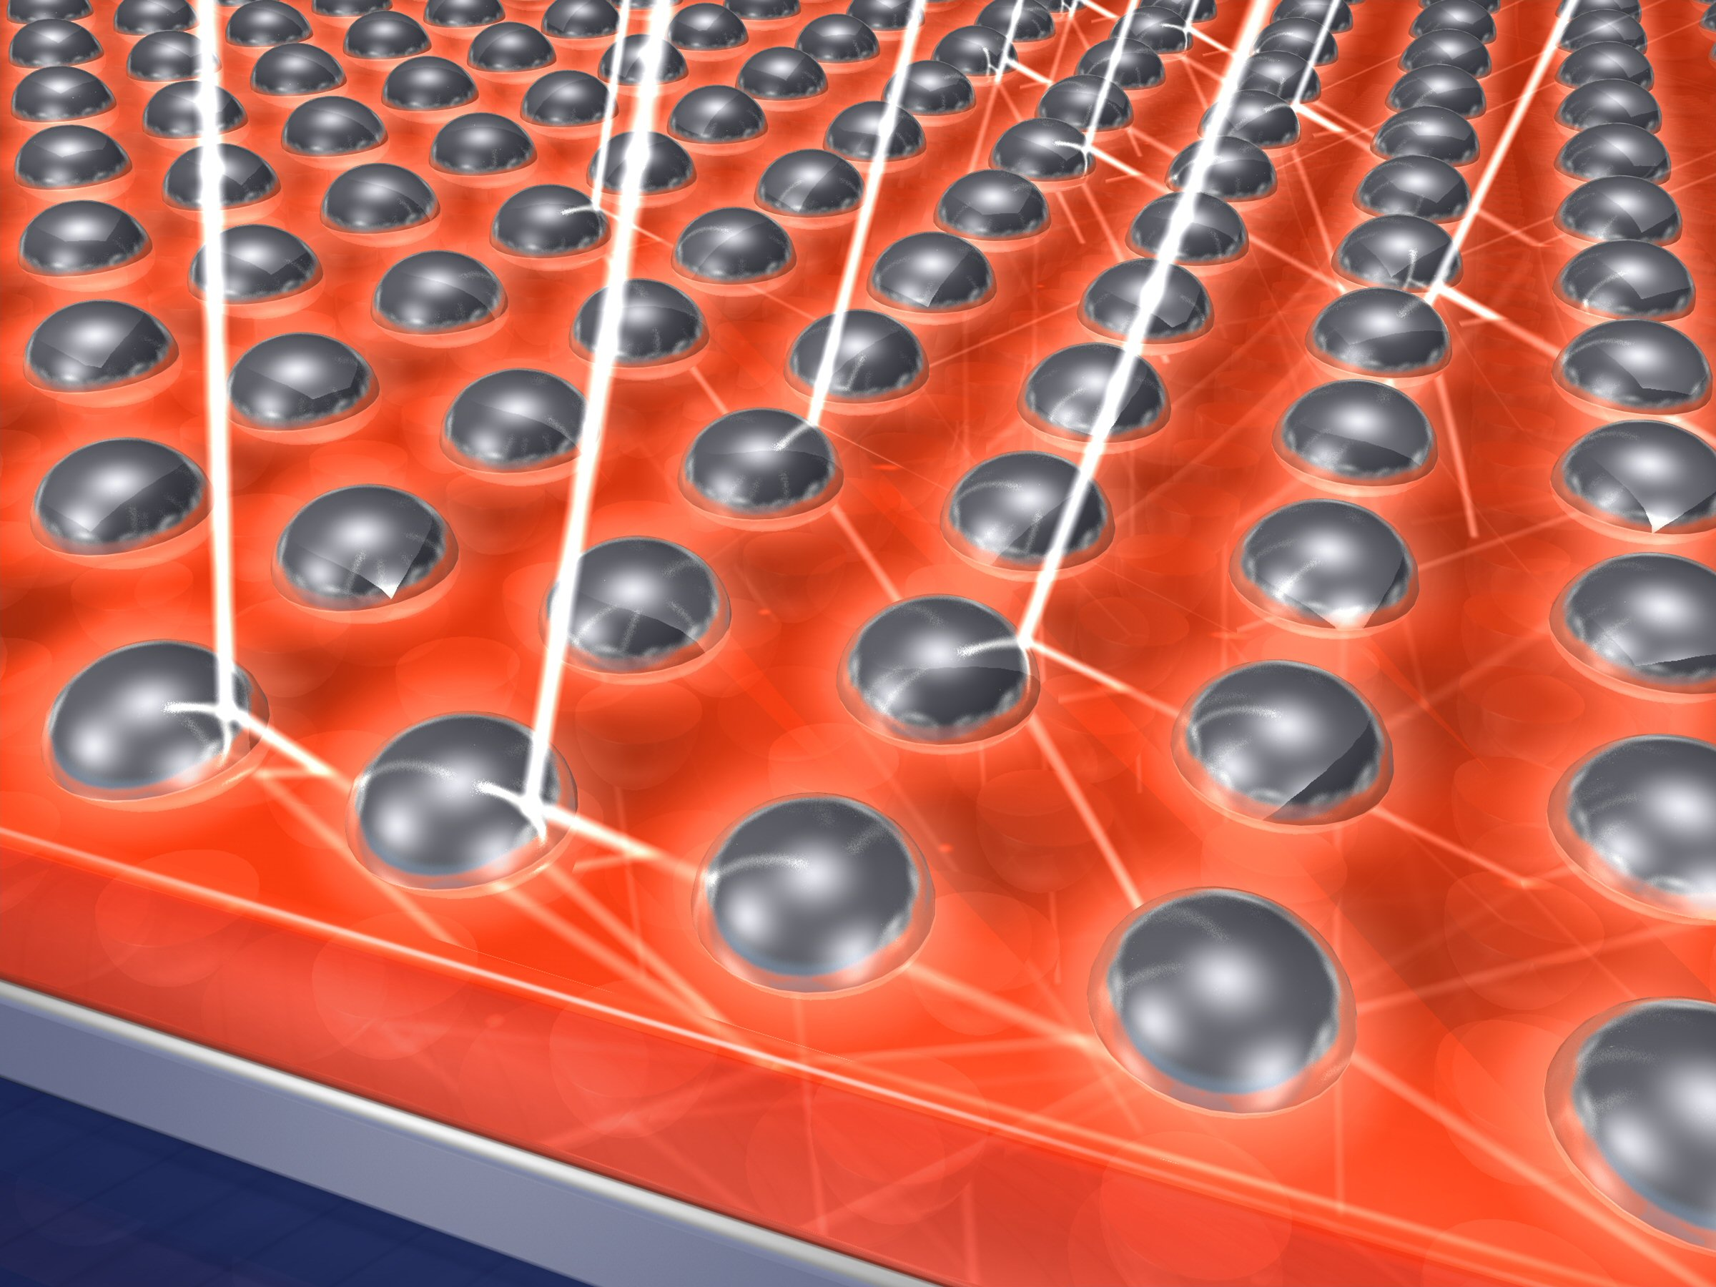
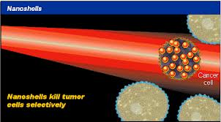
importance of nanooptical/plasmonic near-fields
applications in:
surface enhanced Raman scattering
photovoltaics
plasmonic sensors
cancer therapy, nanosurgery
nanostructured photocathodes
etc.

Slide 5
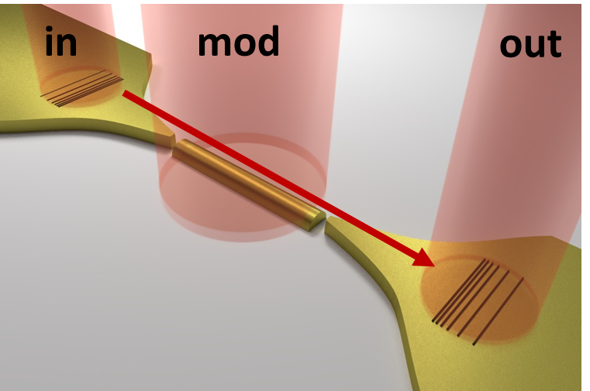
motivation: ultrafast plasmonic devices
builiding ultrafast nanooptical devices for signal processing, switching etc.
few-cycle laser pulses are highly important e.g. in attophysics // Can we make few-cycle plasmon wavepackets?

Slide 6
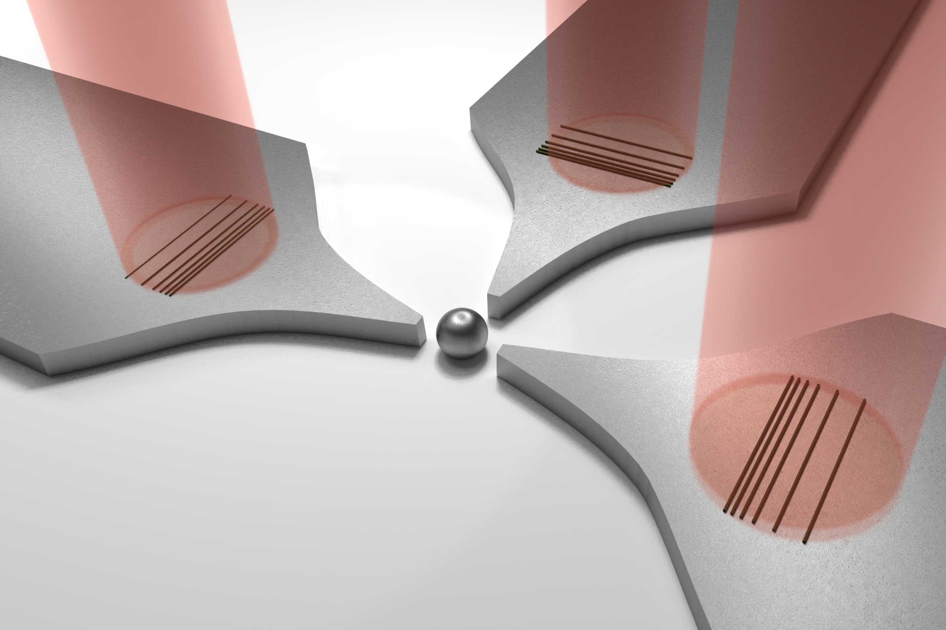
Field enhancement and dynamics probing of nanooptical switching architecture
mod
in
0
out
1
1
1
0
1
0
1
0
~20 nm
(not to scale)

Slide 7
electric field nanolocalization with plasmons
important properties:
nanoscale localization of electric field
field enhancement …
… but how much exactly?
Notes:
needless to say that in addition to…

Slide 8
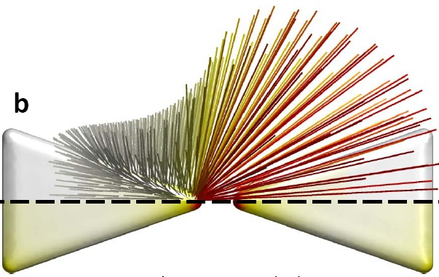
a challenge
can we measure the absolute plasmonic field enhancement value for any metallic surface sample
with an ultrafast tool
in a direct, robust, non-destructive manner?
(different than mapping)

Slide 9
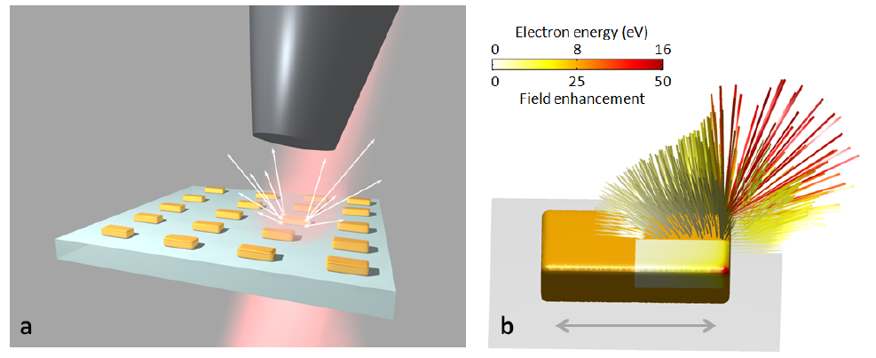
an earlier experiment
Time-of-flight electron spectrometer
Dombi et al., Nano Lett. 13, 674 (2013)
Ultrafast photoemission into plasmonic field
80-fs laser pulses
5 kHz repetition rate

Slide 10
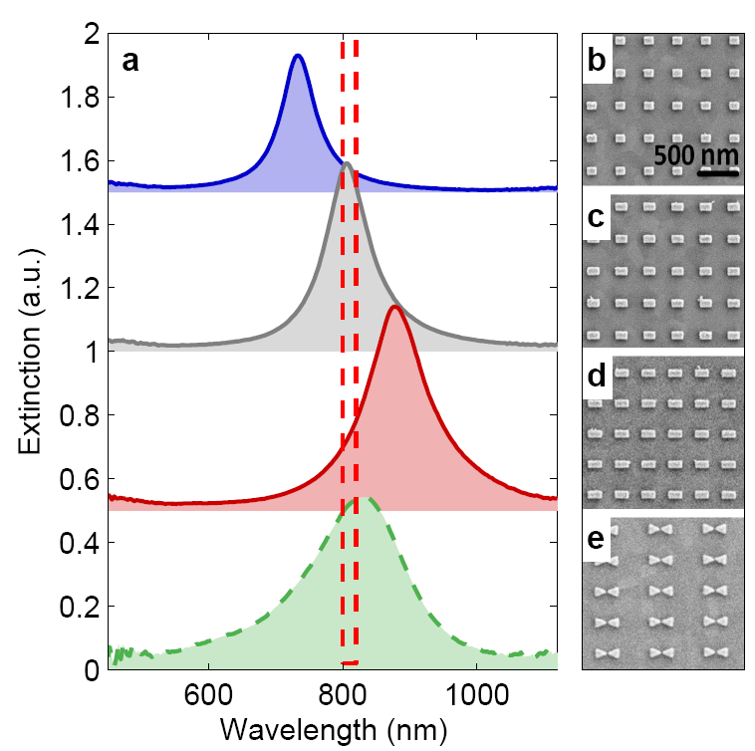
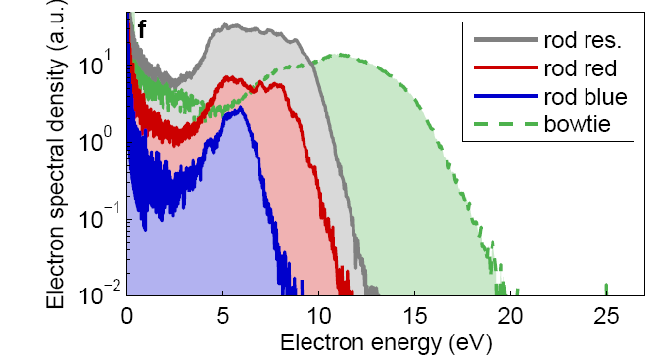
plasmon resonance strongly influences electron spectra
Dombi et al.,
Nano Lett. 13, 674 (2013)
laser spectrum

Slide 11
the question
can we use these electron spectra to extract absolute field enhancement values?

Slide 12
1. Near-field probing with ultrafast electrons 2. Time-resolved probing

Slide 13
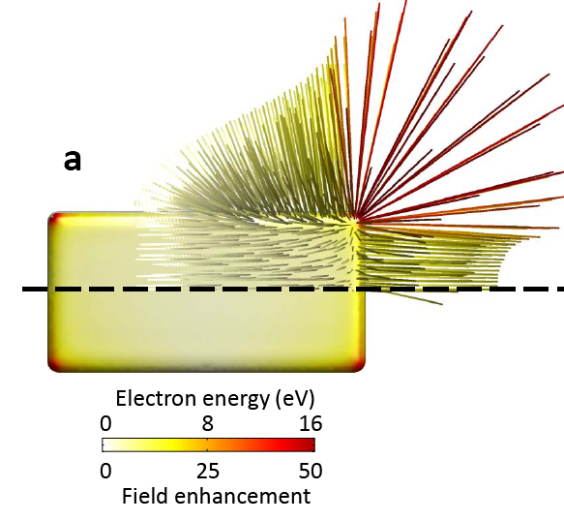
approach for measuring field enhancement
fs near-field stimulates photoemission
spectra of photoelectrons can be measured
photoelectrons rescattered at the surface have the highest kinetic energy
4. Q_{max} = 10,007 e²λ²E_{loc}² / (16 π²mc²)
5. rescattering takes place in nanometric volumes
Near field maximum can be measured with photoelectrons
Notes:
…Well-known it atomic physics as ATI, however, its counterpart with the photoemission from solids has not been exploited so far for any practical application

Slide 14
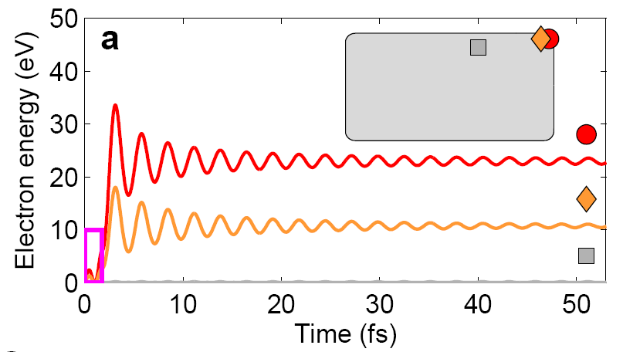
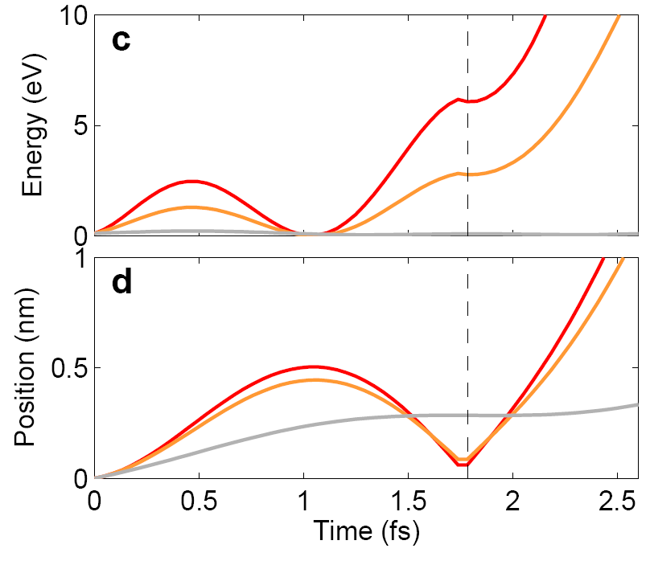
electron oscillation amplitude <0.7 nm before rescattering
Q_{max} = 10,007 e²λ²E_{loc}² / (16 π²mc²)
also for nanotips:
Thomas et al., Nano Lett. 2013

Slide 15
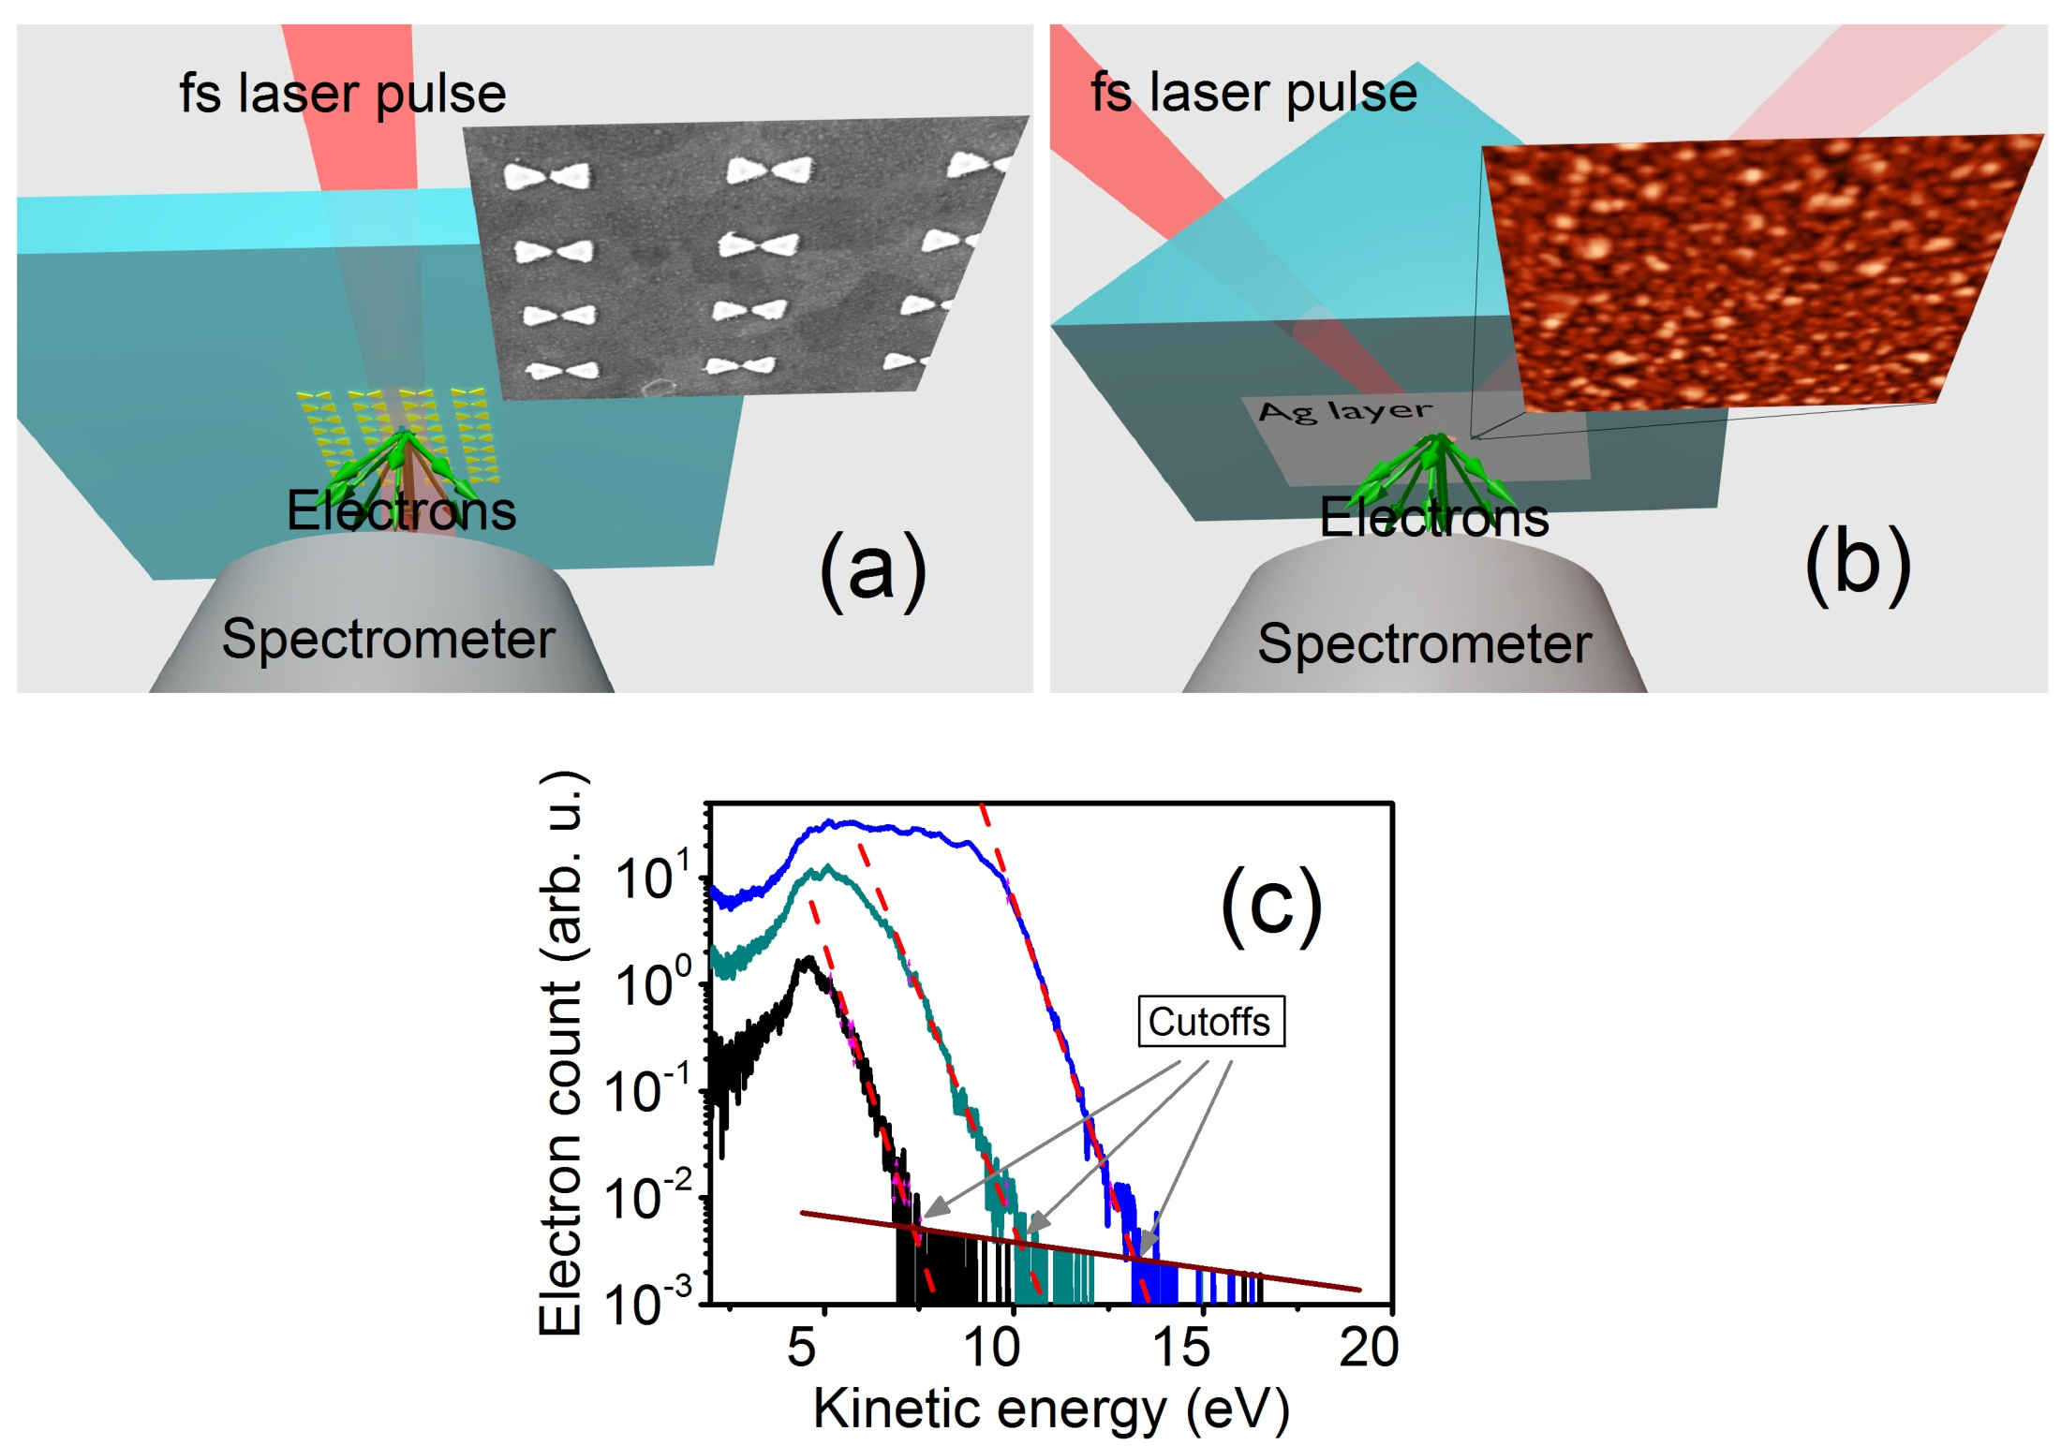
measuring field enhancement on test nanosurfaces
Q_{max} = 10,007 e²λ²E_{loc}² / (16 π²mc²)
Rácz et al., Nano Lett. 17, 1181 (2017)

Slide 16
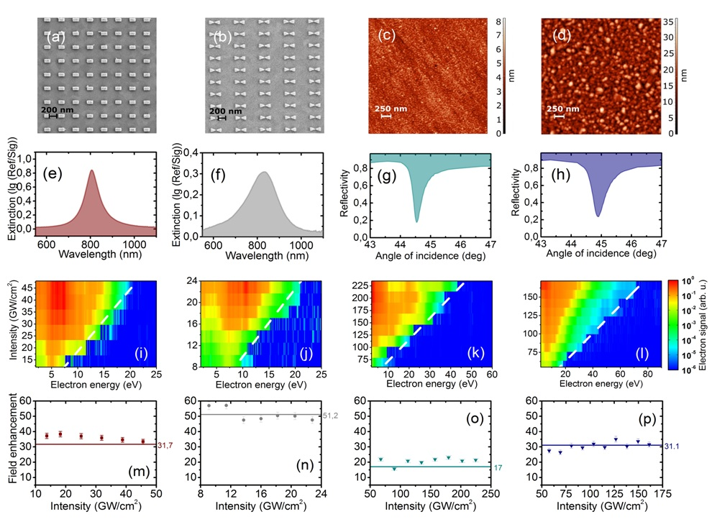
Validation
Rácz et al., Nano Lett. 17, 1181 (2017)

Slide 17
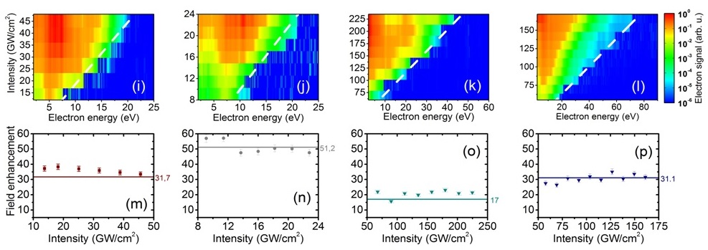
Validation
← experiment vs.
simulation
36.1 vs. 31.7
51.2 vs.50.5
Rácz et al., Nano Lett. 17, 1181 (2017)

Slide 18
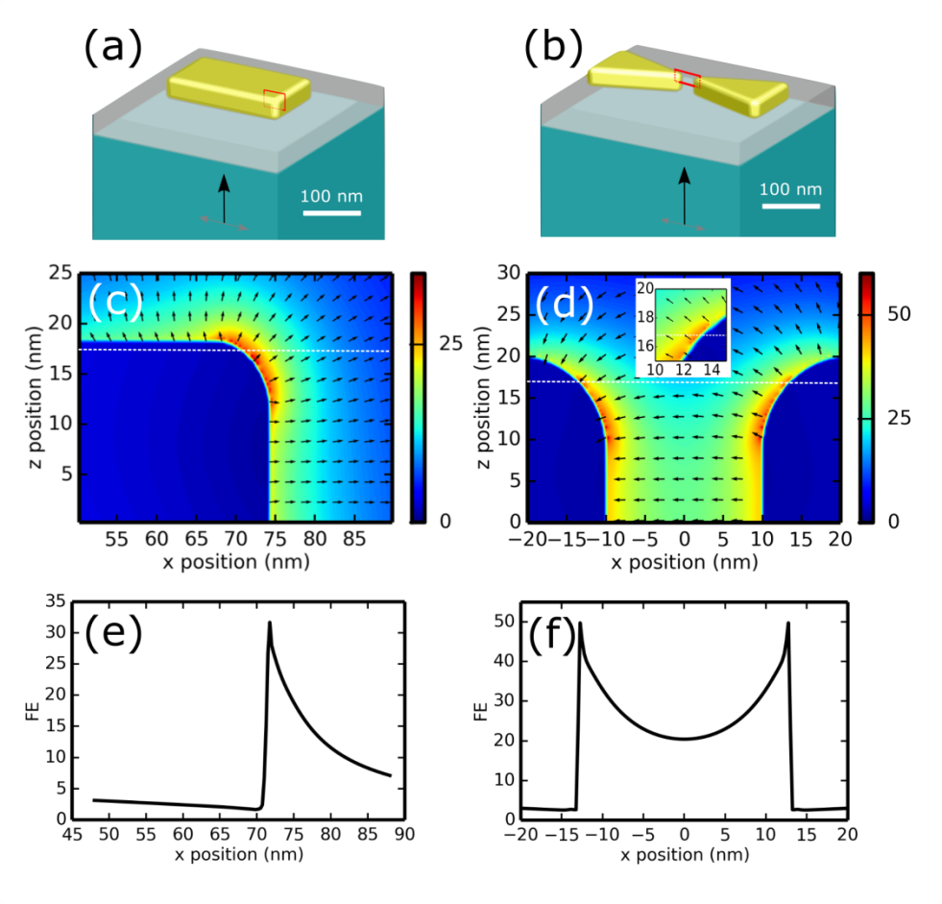
FDTD validation
Edge/corner radii
according to SEM images
No fitting parameters!
Rácz et al.,
Nano Lett. 17, 1181 (2017)

Slide 19
what can we use this tool for? – plasmon-plasmon coupling
electrons probing field enhancement…
…and thus
plasmon-plasmon
coupling
localized
plasmon
propagating plasmon
light

Slide 20
Coupling between propagating and localized modes
J. Budai et al., Nanoscale 10, 16261 (2018)

Slide 21
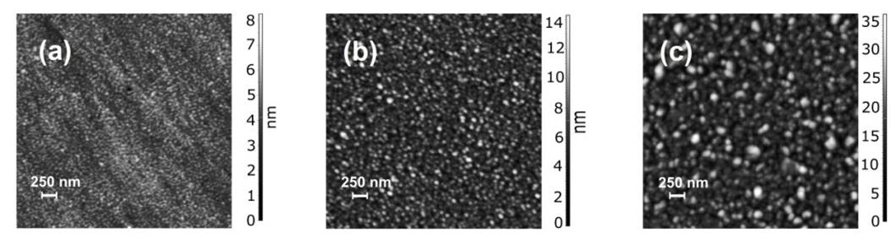
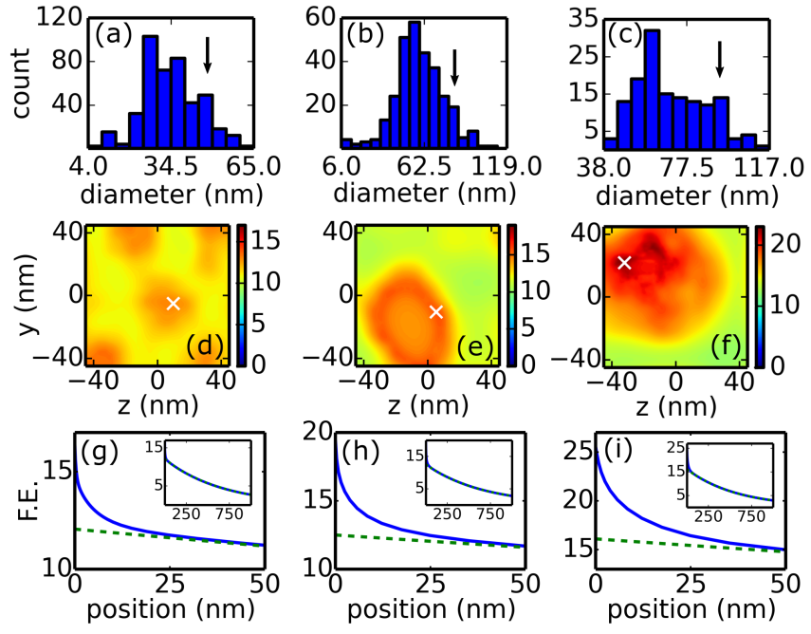
Field enhancement (FE) contributions
from localized and propagating plasmons
Smooth, experimental
FE = 20
Rougher, experimental
FE = 22
Roughest,
experimental
FE = 31
Localized plasmon
Propagating plasmon
J. Budai et al., Nanoscale 10, 16261 (2018)

Slide 22
Resonance of localized plasmon contribution

Slide 23
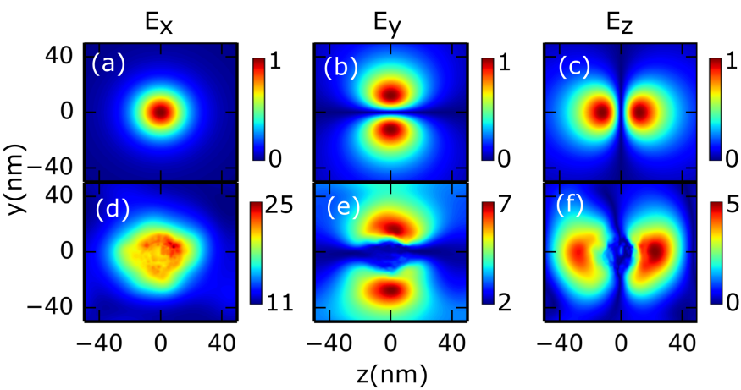
Dipole contribution to near-field
Field of a dipole
Field 20 nm above surface grain
J. Budai et al., Nanoscale 10, 16261 (2018)

Slide 24
1. Near-field probing with ultrafast electrons 2. Time-resolved probing

Slide 25
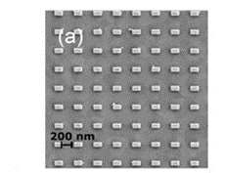
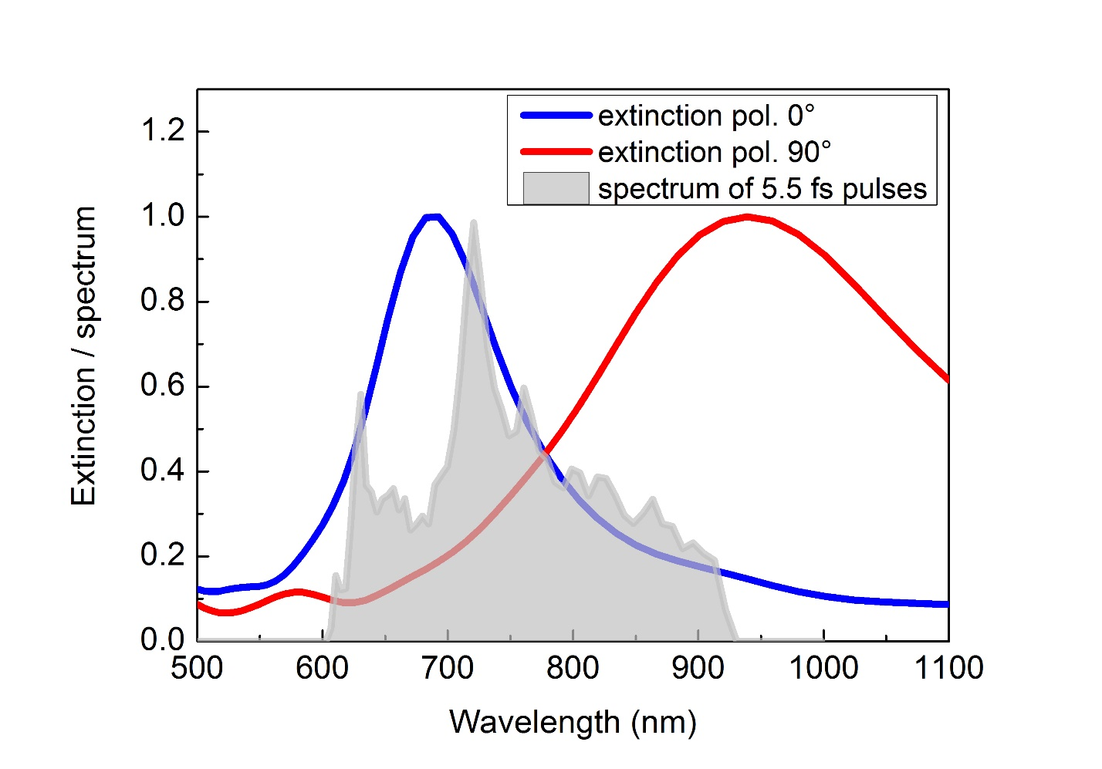
Time-resolved probing of few-cyle plasmon transients
narrow extinction
broad extinction
pol.

Slide 26
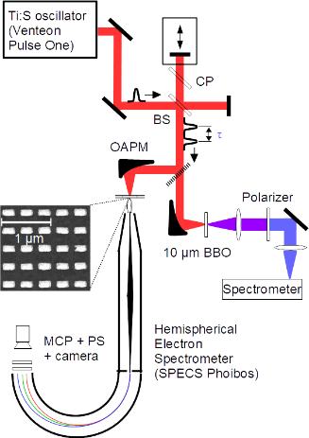
Experimental scheme
5.5 fs
80 MHz
Photoemission nonlinearity:
Work function: ~5 eV
Photon energy: 1.3-2 eV
Effective nonlinearity: ~3.3

Slide 27
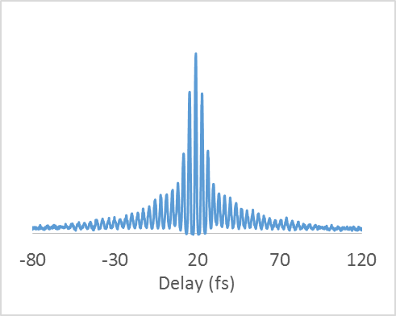
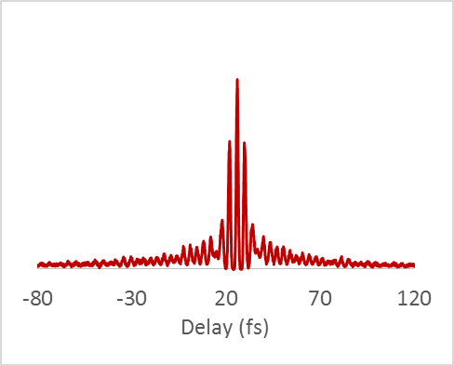
Time-resolved probing of few-cyle plasmon transients
narrow extinction
broad extinction
pol.

Slide 28
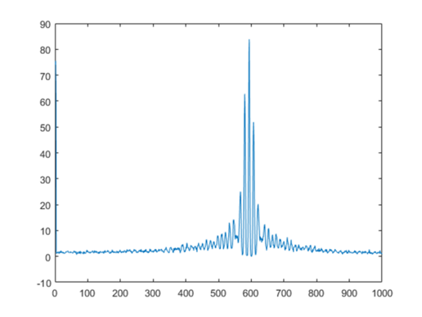
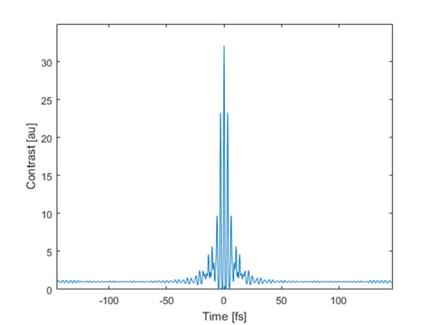
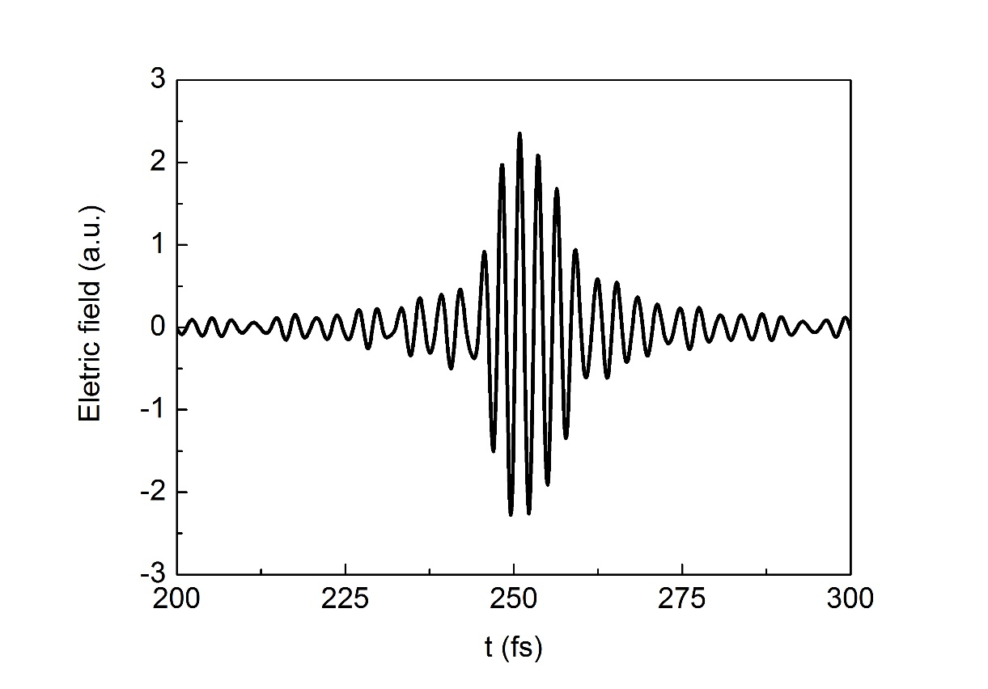
Reconstruction of plasmon transient
reconstructed
measured
8-fs plasmon
transient

Slide 29
Condensed matter user endstation

Slide 30
The condensed phase/surface science end station
Nanoesca system of Scienta Omicron
Core capability: photoemission electron microscopy (PEEM)
The sample, illuminated by ultrashort NIR and/or XUV pulses is the electron source for the electron microscope optics.
imaging with a broad range of field of views (2.5 μm-1 mm)
resolution down to 50 nm or better
real time imaging of the surface.
Lenses project a magnified image of the sample to a 2D detector.

Slide 31
Energy resolved PEEM
Nanoesca system of Scienta Omicron
Small Spot Spectroscopy mode
High sensitivity single-spot spectroscopy using the channeltron for quantitative elemental analysis. A quick spectrum from the actual field of view.
Energy resolved imaging (Imaging ESCA mode).
The main lens projects the magnified image onto the analyzer entrance. The image information is energy filtered (energy resolution: 50 meV) by highly aberration correcting IDEA & projected onto a MCP/screen stack for camera based date acquisition.

Slide 32
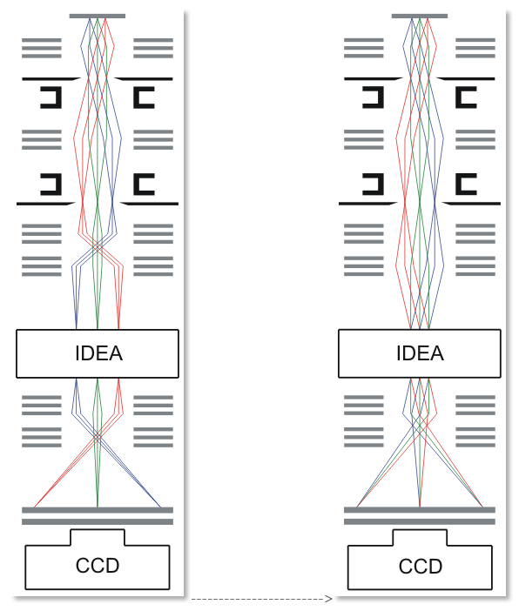
Local angle resolved photoemission (ARPES)
The electron optics can be set to image the momentum space: electrons originated from different sample points but departing at the same angle will reach the detected at the same point.
k_{x ,} k_{y ,}E resolved and imaged
Real space k-space
IDEA:
Imaging Energy Filter
Band structure of graphene
Electrons are collected from ~2π solid angle without any rotation of the sample

Slide 33
Summary
sub-nm sensitivity hot spot probing with photoelectrons
generation of few-cycle plasmon transients with off-resonant excitation
ultrafast device operation in complex plasmonic architectures
few-fs electron sources for electron microscopy
ELI-ALPS tools enhancing
ultrafast plasmonics research

Slide 35
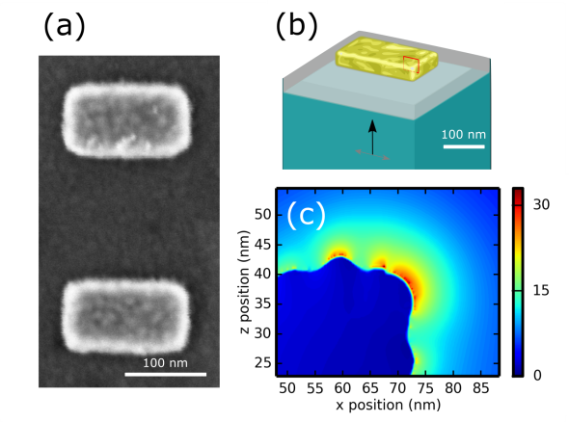
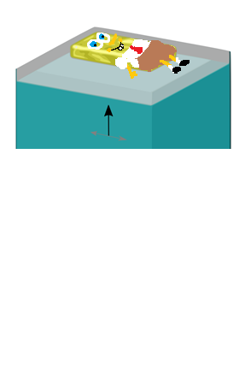

Slide 36
Time scales in solids
Energy bandwidth / eV
1
0.1
0.01
0.001
Screening
Dephasing
e-e scattering
e-phonon scattering
0.1
1
10
100
1000
Time scale / fs
Adapted from Petek, Ogawa, Progr. Surf Sci. 1997
Easily achievable laser pulse duration
Optical period at 800nm
Electron emission duration

