Slide 1
ELI Summer School 28.8.2019
Time-Resolved Ellipsometry in the Optical and VUV Region
Shirly Espinoza¹, Steffen Richter¹,
Mateusz Rebarz¹ and Jakob Andreasson^{1,2}
¹ ELI Beamlines, Czech Republic
² Chalmers University of Technology, Sweden
Supported by the European Regional Development Fund: ADONIS (CZ.02.1.01/0.0/0.0/16_019/0000789) and ELIBIO (CZ.02.1.01/0.0/0.0/15_003/0000447)
and by the National Science Foundation (DMR-1505172)
Advanced research using high intensity laser produced photons and particles (ADONIS), Reg. n.: CZ.02.1.01/0.0/0.0/16_019/0000789

Slide 2
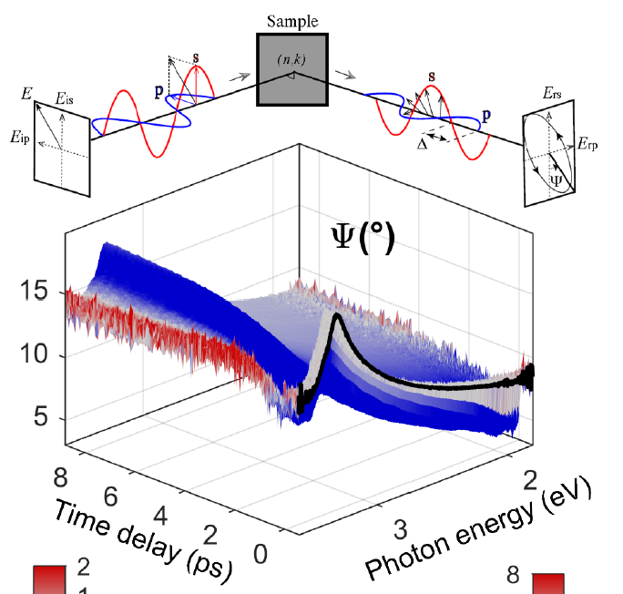

OUTLINE
Introduction to ellipsometry
Ultrafast processes in Semiconductors
Time-Resolved Ellipsometry: NIR-NUV
Dynamics of the dielectric function on Germanium and InP after a a 1.55 eV (800 nm)
Magneto-Optical VUV Ellipsometer
28.08.2019
2

Slide 3
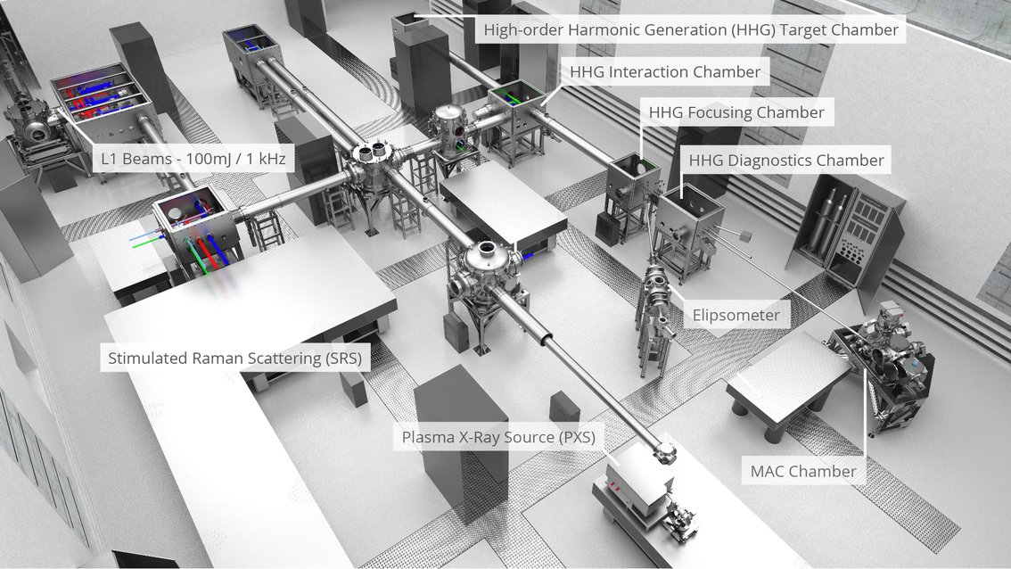
E1 End stations and beam transport for Applications in Molecular, Bio medical and Material science
1: MAC, AMO and Coherent diffractive imaging
2: ELIps, VUV magneto optical ellipsometry
3: and 4: TREX, X-ray diffraction and absorption. PR
5: Optical probes (SRS, TR-absorption, 1 and 2D IR, TR-SE)
L1
L3
HHG
and monochromator
2
1
opt. tables
5
3, 4
28.08.2019
3

Slide 4
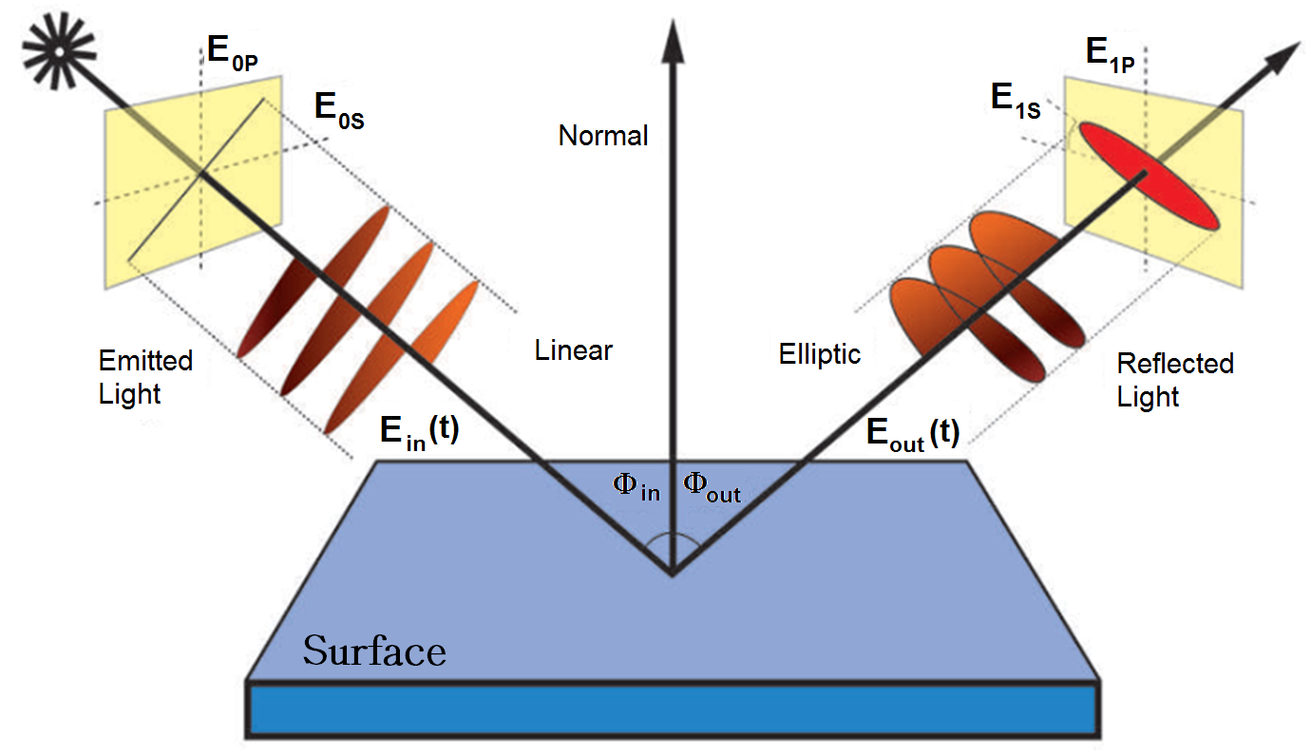
What is Ellipsometry?
ELLIPSOMETRY is a method based on measurement of the change of the polarisation state of light after reflection at non normal incidence on the surface to study
28.08.2019
4

Slide 5

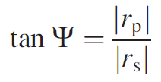
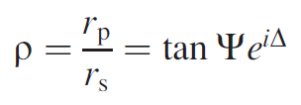

Ellipsometric parameters
Fresnel coefficients:
Amplitude ratio
Phase difference
28.08.2019
5

Slide 6
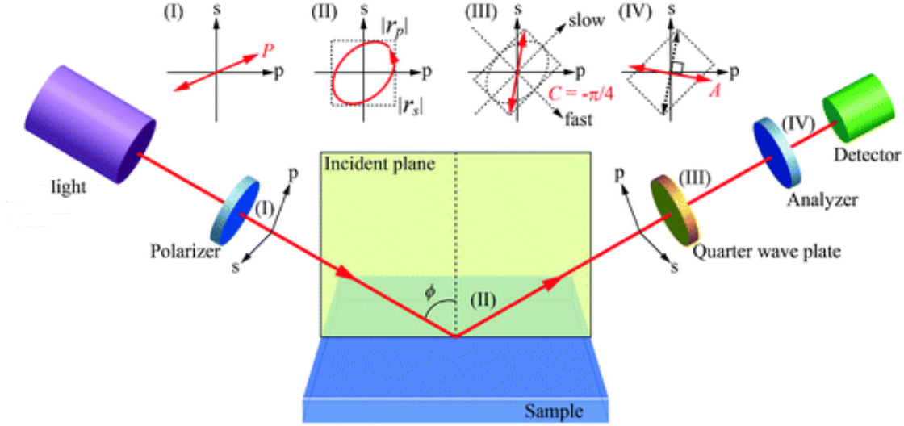
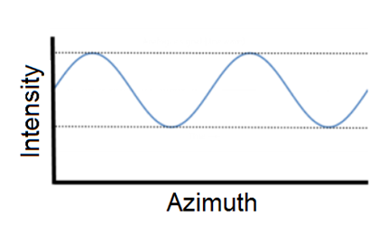
How to do ellipsometry?
PSCA – Polarizer-Sample-Compensator-Analyzer
Fourier
Analysis
28.08.2019
6

Slide 7
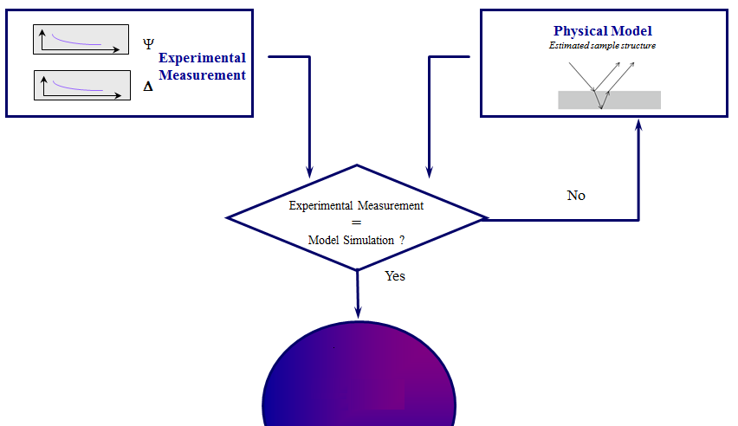
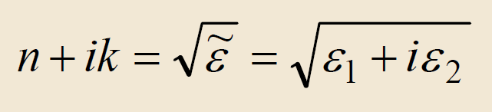
How to analyze data?
We always need models to interpret the measurements
and to get physical parameters of the layers!
n, k
28.08.2019
7

Slide 8
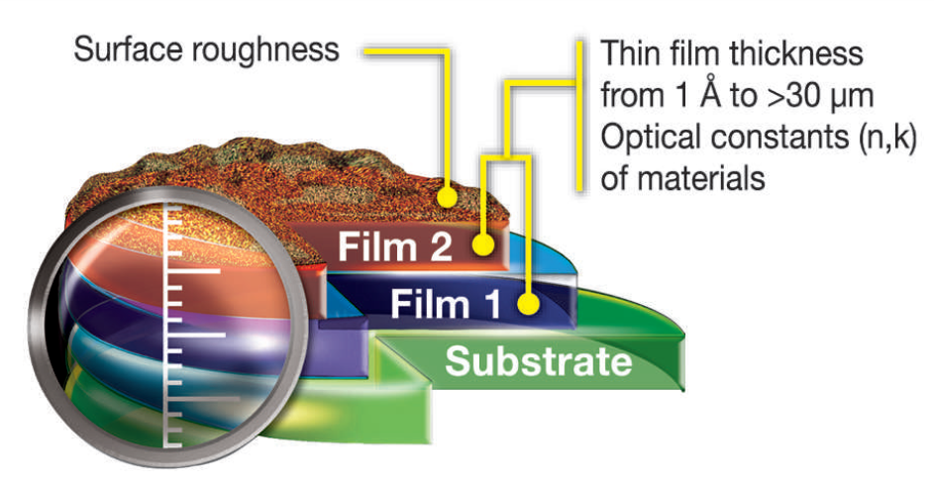
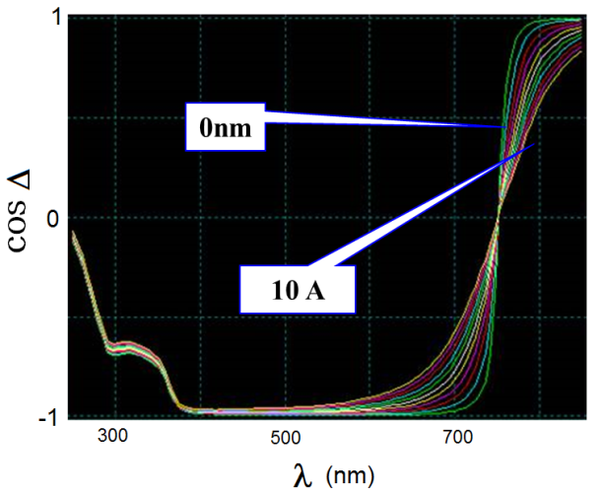
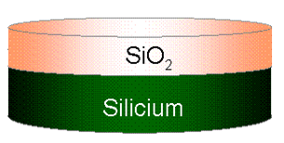
What physical parameters can we get?
Ellipsometry is:
  Well known
  Non-destructive
  Precise
Ellipsometry gives:
  Refractive index (n)
  Extinction coefficient (k)
  Film thickness
  Surface roughness
  Anisotropy
  Retardation
  Phase difference
  Birefringence
Δ is extremelly sensitive to ultra thin layers
Sensitivity
0.01 A
28.08.2019
8

Slide 9
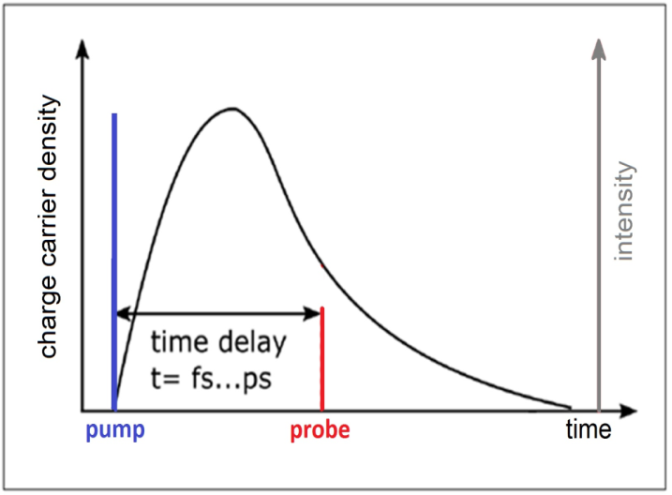
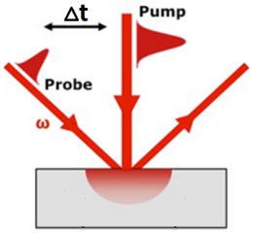
Pump-probe ellipsometry
Pump-probe reflection spectroscopy
28.08.2019
9

Slide 10
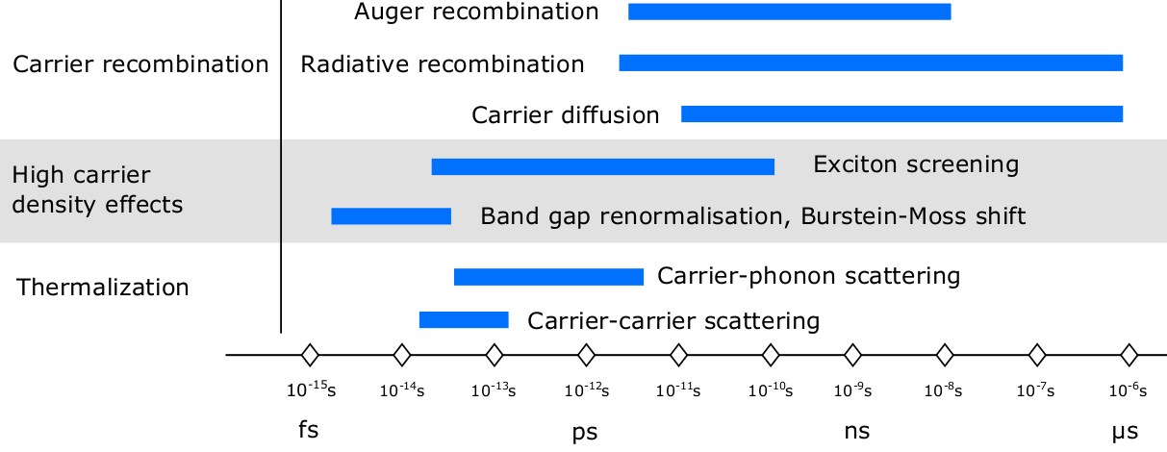
Ultrafast processes in semiconductors
Applications:
  Fast electronics
  High speed optical switching
  Light harvesting
28.08.2019
10

Slide 11
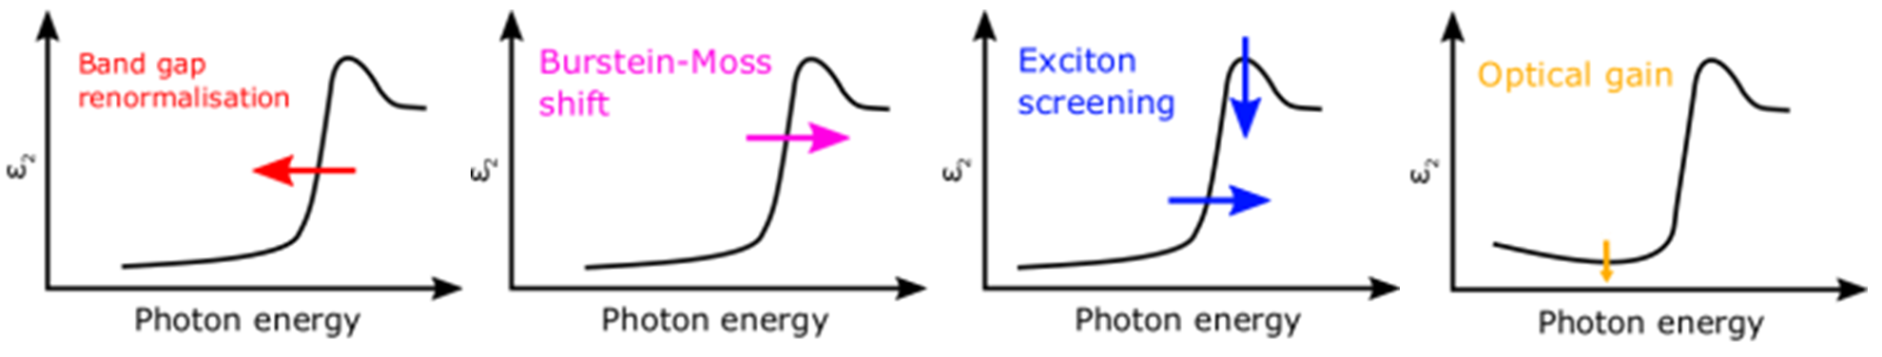
Ultrafast processes in semiconductors
Dielectric function response
28.08.2019
11
Notes:
Change grey coding

Slide 12
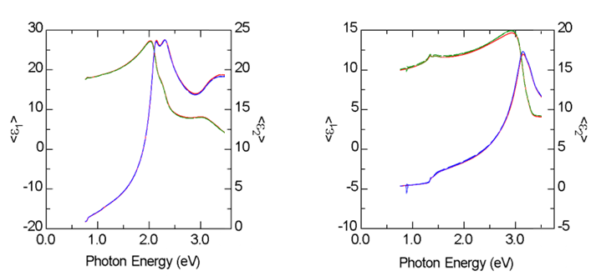
Dielectric function of Ge and InP
Germanium
Indium Phosphide
1,55 eV pump
1,55 eV pump
Bulk Ge with 29 Å oxide thickness
Bulk InP with 31 Å oxide thickness
Electronic structure of Ge and InP showing E1, and E1+D1
28.08.2019
12
Notes:
We are probing the E1 transitions which occur at the L point of the Brillouin zone and in Ge they are split by spin orbit interactions, not in InP.

Slide 13
E1 End stations and beam transport for Applications in Molecular, Bio medical and Material science
1: MAC, AMO and Coherent diffractive imaging
2: ELIps, VUV magneto optical ellipsometry
3: and 4: TREX, X-ray diffraction and absorption. PR
5: Optical probes (SRS, TR-absorption, 1 and 2D IR, TR-SE)
L1
L3
HHG
and monochromator
2
1
opt. tables
5
3, 4
28.08.2019
13

Slide 14
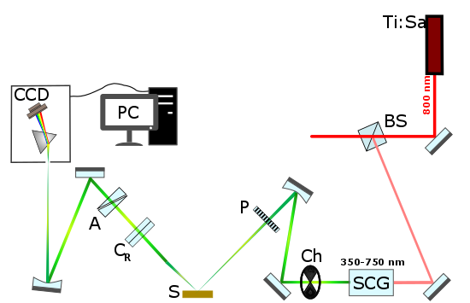
Experimental Setup
28.08.2019
14
Notes:
The lens has a rather long focal length and therefore has not a big impact in the polarization of the reflected beam.

Slide 15
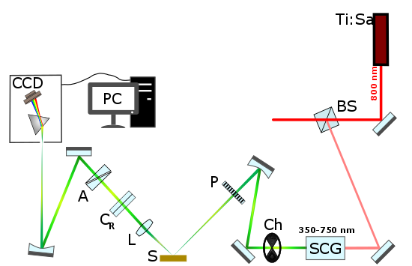
Experimental Setup
28.08.2019
15
Notes:
The lens has a rather long focal length and therefore has not a big impact in the polarization of the reflected beam.

Slide 16
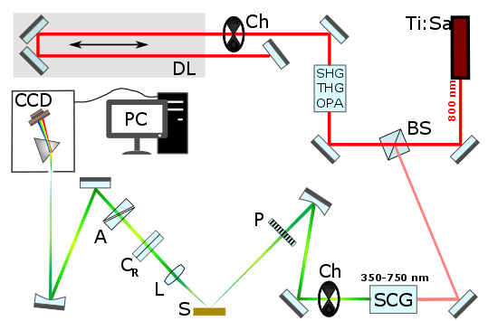
Experimental Setup
28.08.2019
16
Notes:
The lens has a rather long focal length and therefore has not a big impact in the polarization of the reflected beam.

Slide 17
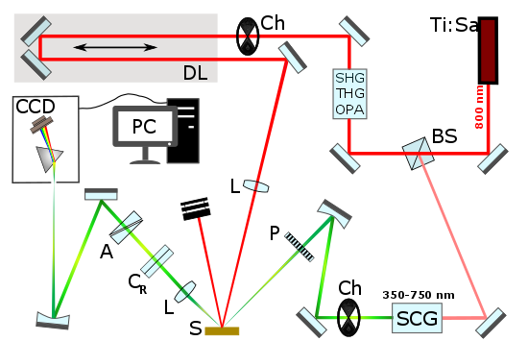
Experimental Setup
28.08.2019
17
Notes:
The lens has a rather long focal length and therefore has not a big impact in the polarization of the reflected beam.

Slide 18
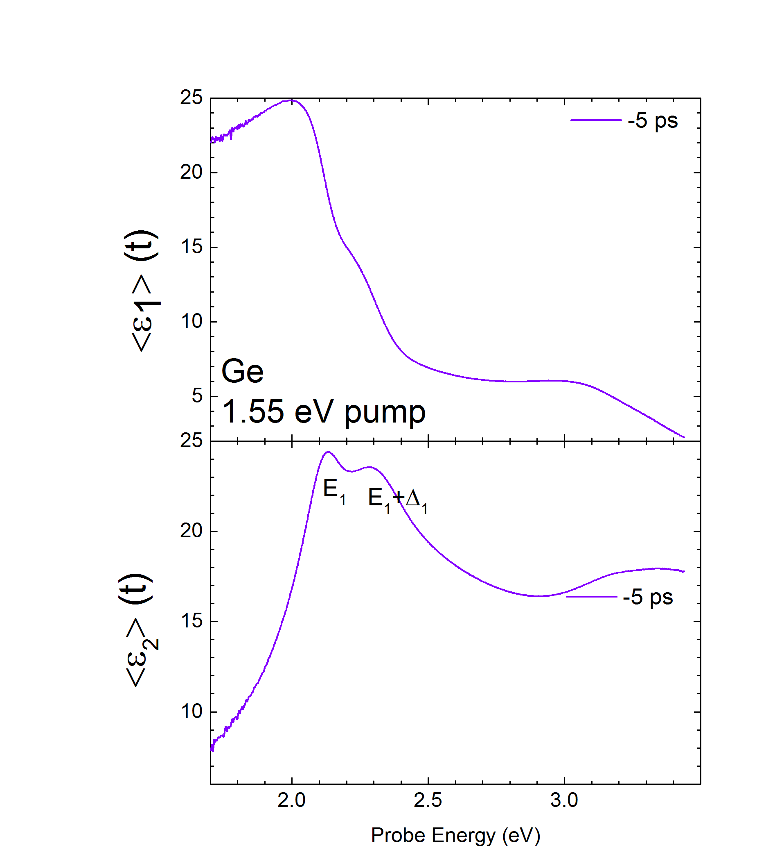
Dynamics of dielectric function of Ge
at 800 nm excitation (1.55 eV)
Carrier concentration:
10²⁰ cm⁻³
Penetration of pump: 220 nm
(350 um diam.)
Penetration of probe beams:
10 - 60 nm
(200 um diam.)
Appl. Phys. Lett. 115, 052105 (2019)
28.08.2019
18
Notes:
Real (top) and imaginary (bottom) parts of the transient pseudodielectric function of Ge (with 4.5 nm native oxide) versus photon energy during the ﬁrst 2 ps (left) and at later times (right) after photoexcitation of 1020 cm−3 electron-hole pairs with a pump photon energy of 1.55 eV.

Slide 19
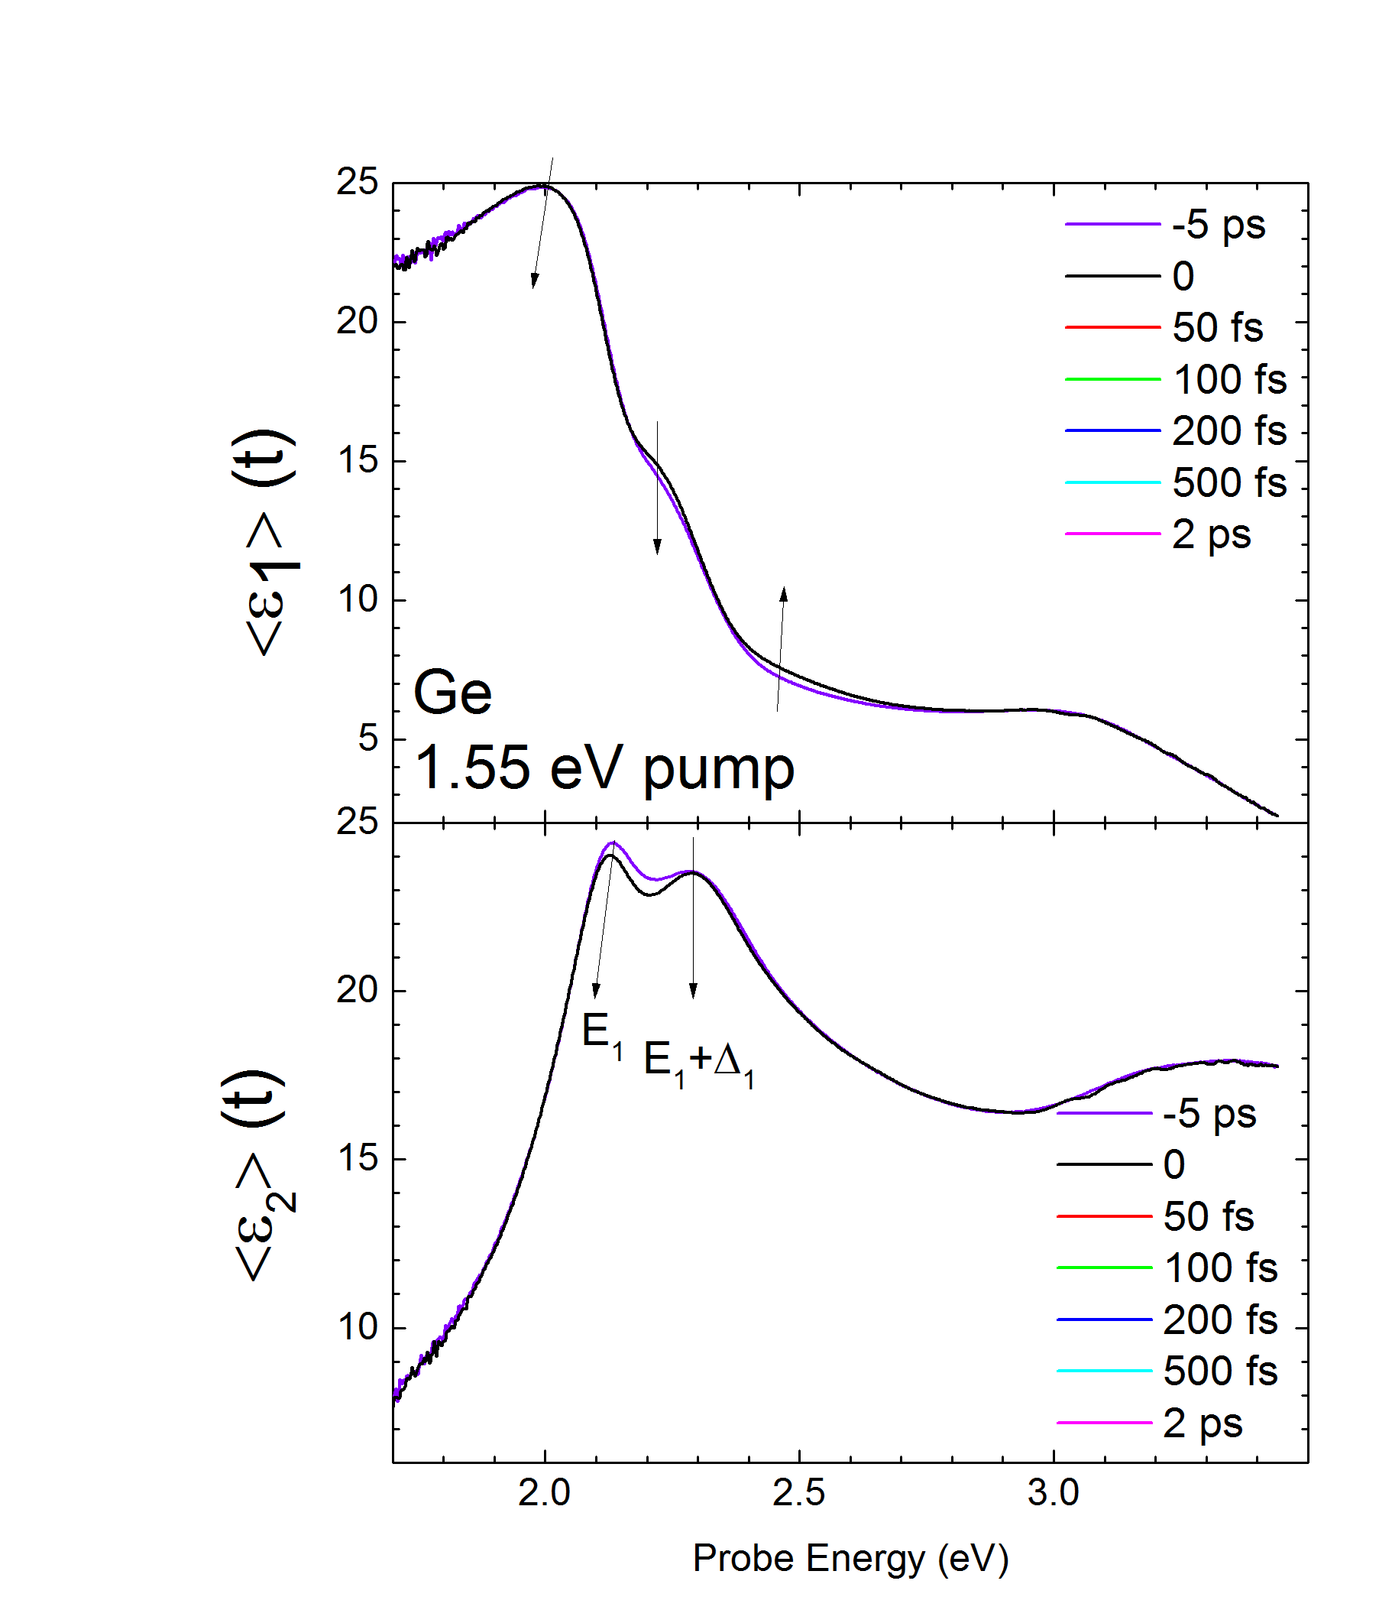
Dynamics of dielectric function of Ge
at 800 nm excitation (1.55 eV)
From 0 to 2ps
Carrier concentration:
10²⁰ cm⁻³
Penetration of pump: 220 nm
(350 um diam.)
Penetration of probe beams:
10 - 60 nm
(200 um diam.)
Appl. Phys. Lett. 115, 052105 (2019)
28.08.2019
19
Notes:
Real (top) and imaginary (bottom) parts of the transient pseudodielectric function of Ge (with 4.5 nm native oxide) versus photon energy during the ﬁrst 2 ps (left) and at later times (right) after photoexcitation of 1020 cm−3 electron-hole pairs with a pump photon energy of 1.55 eV.

Slide 20
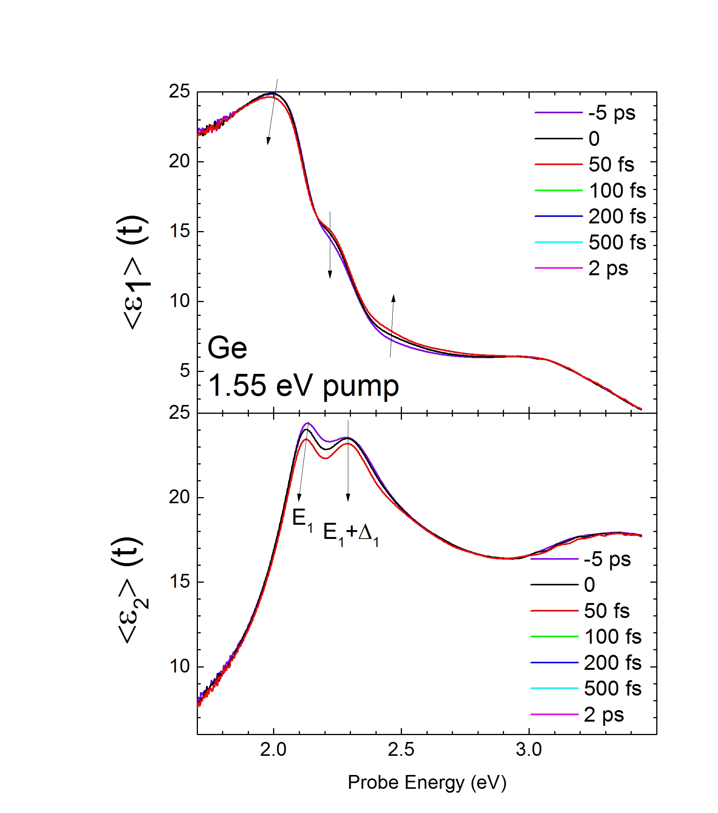
Dynamics of dielectric function of Ge
at 800 nm excitation (1.55 eV)
From 0 to 2ps
Carrier concentration:
10²⁰ cm⁻³
Penetration of pump: 220 nm
(350 um diam.)
Penetration of probe beams:
10 - 60 nm
(200 um diam.)
Appl. Phys. Lett. 115, 052105 (2019)
28.08.2019
20
Notes:
Real (top) and imaginary (bottom) parts of the transient pseudodielectric function of Ge (with 4.5 nm native oxide) versus photon energy during the ﬁrst 2 ps (left) and at later times (right) after photoexcitation of 1020 cm−3 electron-hole pairs with a pump photon energy of 1.55 eV.

Slide 21
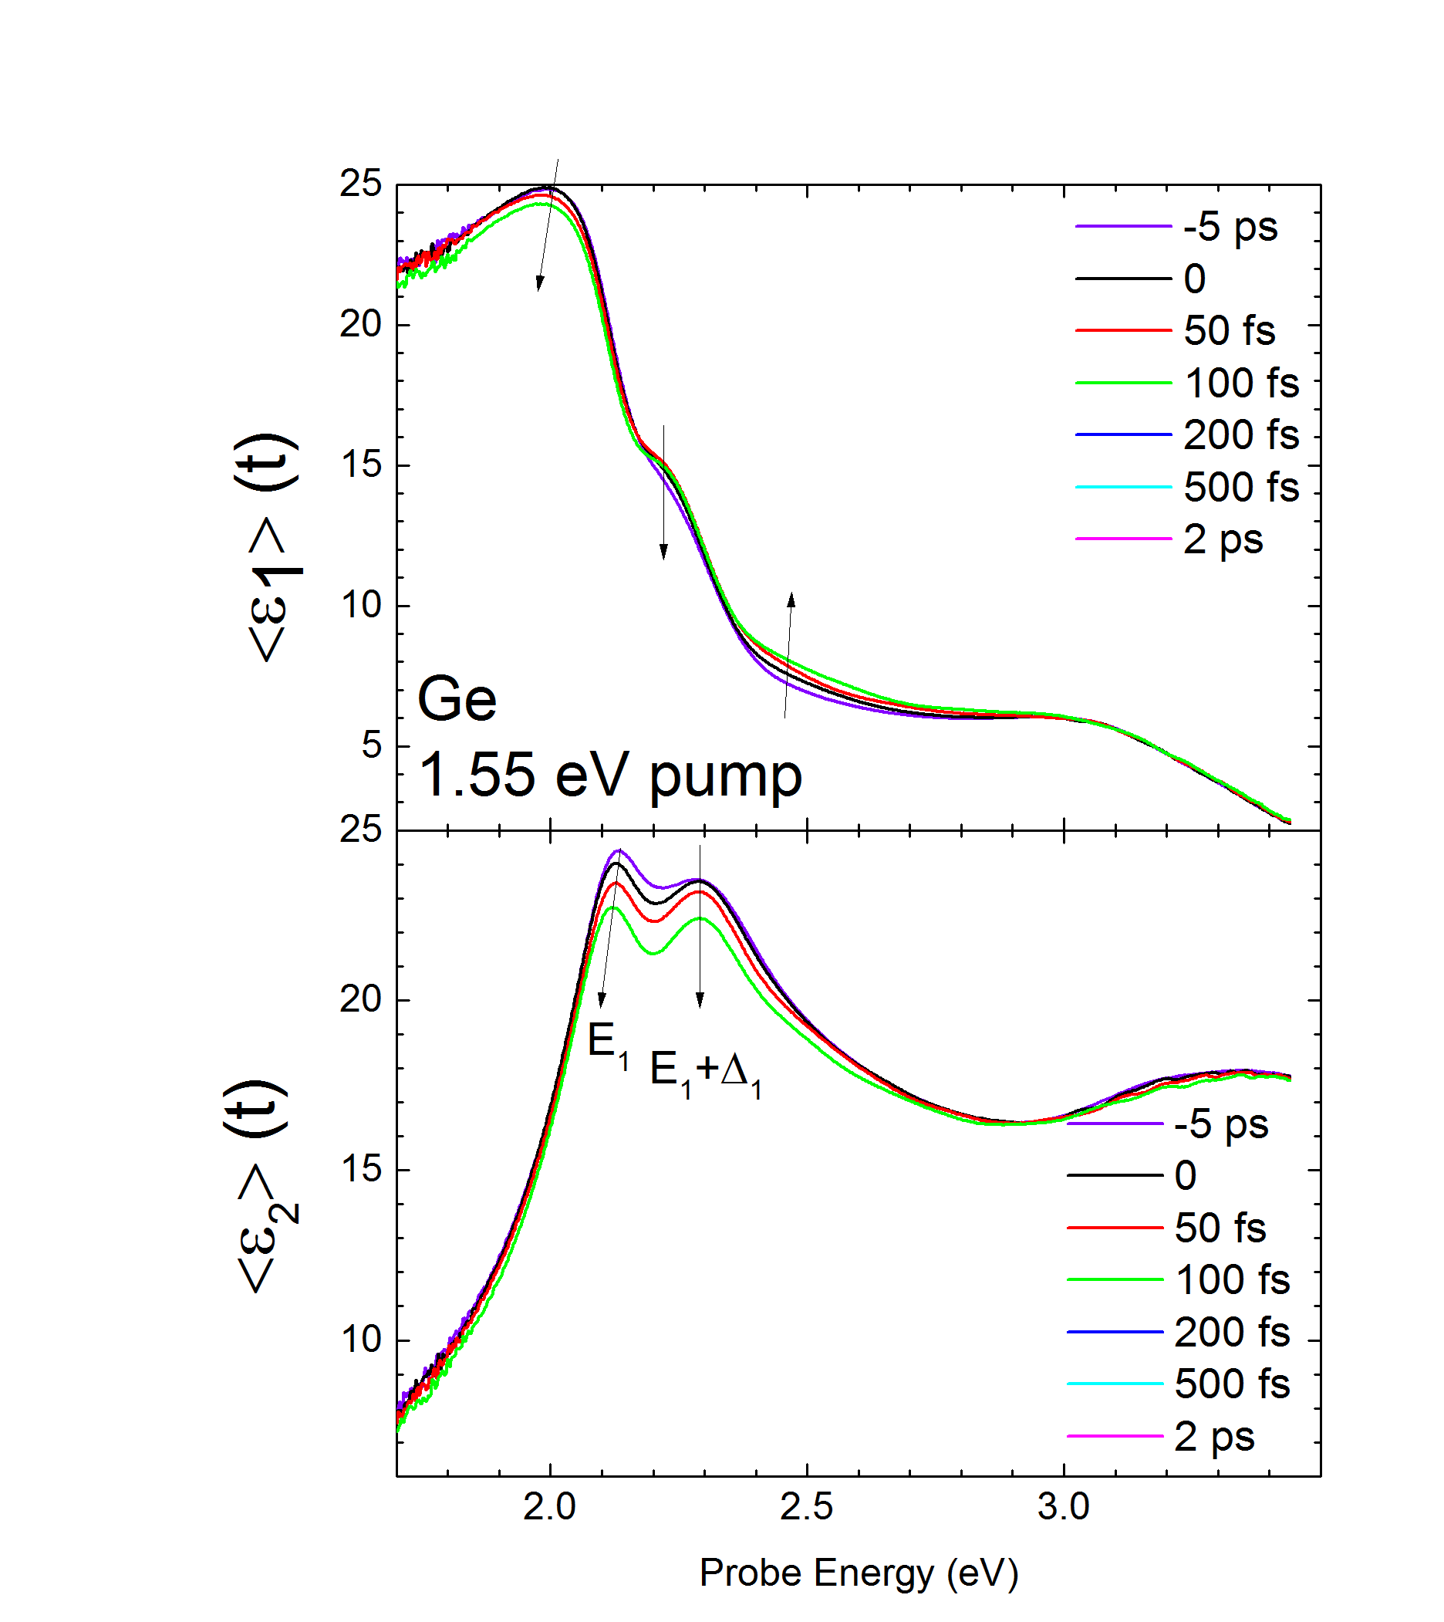
Dynamics of dielectric function of Ge
at 800 nm excitation (1.55 eV)
From 0 to 2ps
Carrier concentration:
10²⁰ cm⁻³
Penetration of pump: 220 nm
(350 um diam.)
Penetration of probe beams:
10 - 60 nm
(200 um diam.)
Appl. Phys. Lett. 115, 052105 (2019)
28.08.2019
21
Notes:
Real (top) and imaginary (bottom) parts of the transient pseudodielectric function of Ge (with 4.5 nm native oxide) versus photon energy during the ﬁrst 2 ps (left) and at later times (right) after photoexcitation of 1020 cm−3 electron-hole pairs with a pump photon energy of 1.55 eV.

Slide 22
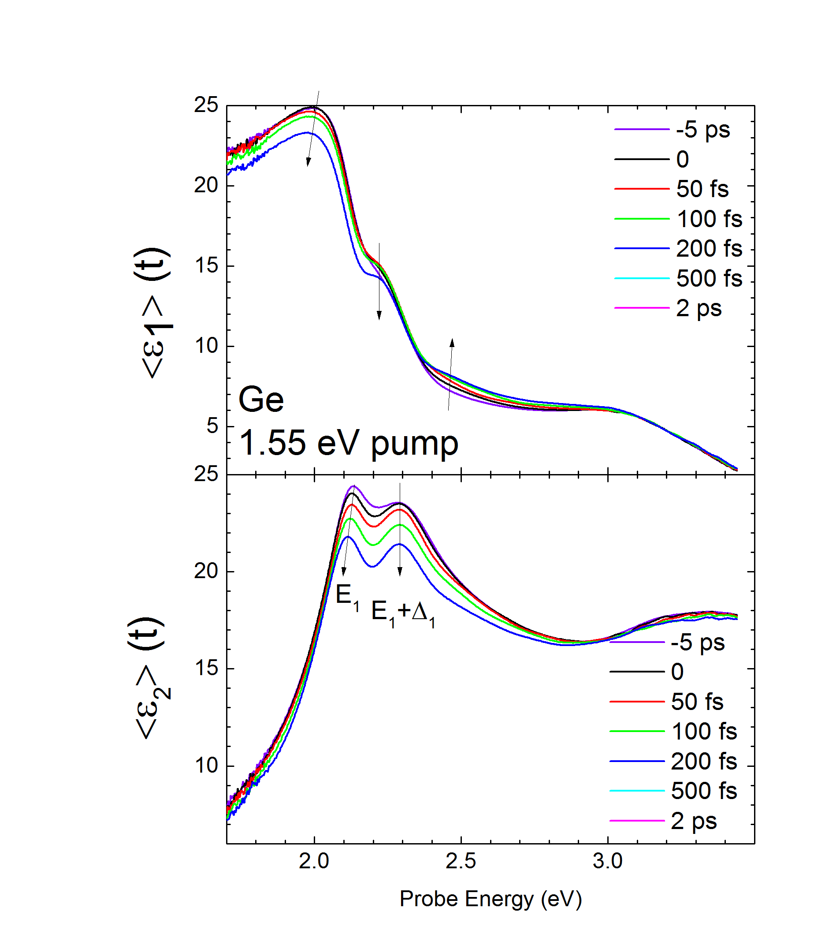
Dynamics of dielectric function of Ge
at 800 nm excitation (1.55 eV)
From 0 to 2ps
Carrier concentration:
10²⁰ cm⁻³
Penetration of pump: 220 nm
(350 um diam.)
Penetration of probe beams:
10 - 60 nm
(200 um diam.)
Appl. Phys. Lett. 115, 052105 (2019)
28.08.2019
22
Notes:
Real (top) and imaginary (bottom) parts of the transient pseudodielectric function of Ge (with 4.5 nm native oxide) versus photon energy during the ﬁrst 2 ps (left) and at later times (right) after photoexcitation of 1020 cm−3 electron-hole pairs with a pump photon energy of 1.55 eV.

Slide 23
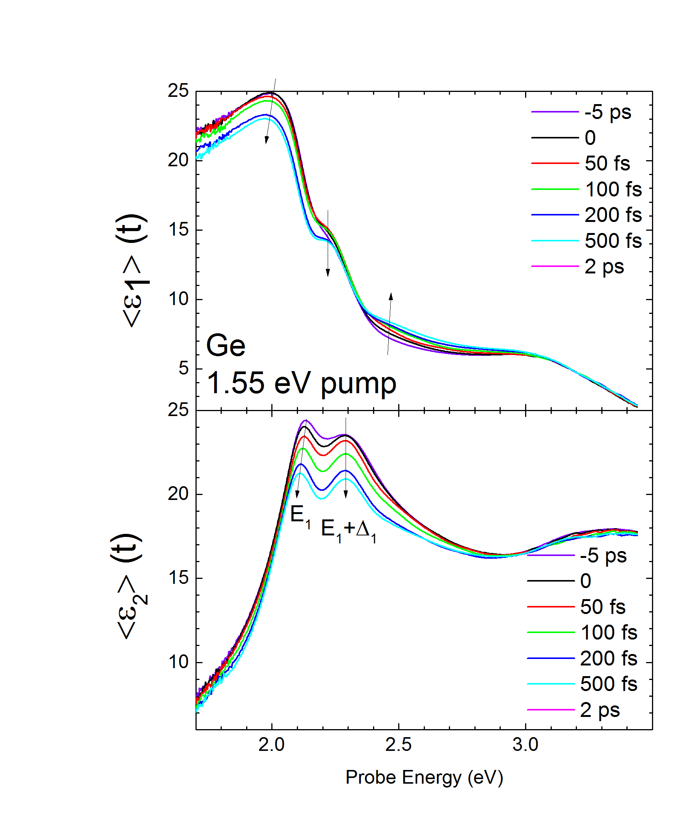
Dynamics of dielectric function of Ge
at 800 nm excitation (1.55 eV)
From 0 to 2ps
Carrier concentration:
10²⁰ cm⁻³
Penetration of pump: 220 nm
(350 um diam.)
Penetration of probe beams:
10 - 60 nm
(200 um diam.)
Appl. Phys. Lett. 115, 052105 (2019)
28.08.2019
23
Notes:
Real (top) and imaginary (bottom) parts of the transient pseudodielectric function of Ge (with 4.5 nm native oxide) versus photon energy during the ﬁrst 2 ps (left) and at later times (right) after photoexcitation of 1020 cm−3 electron-hole pairs with a pump photon energy of 1.55 eV.

Slide 24
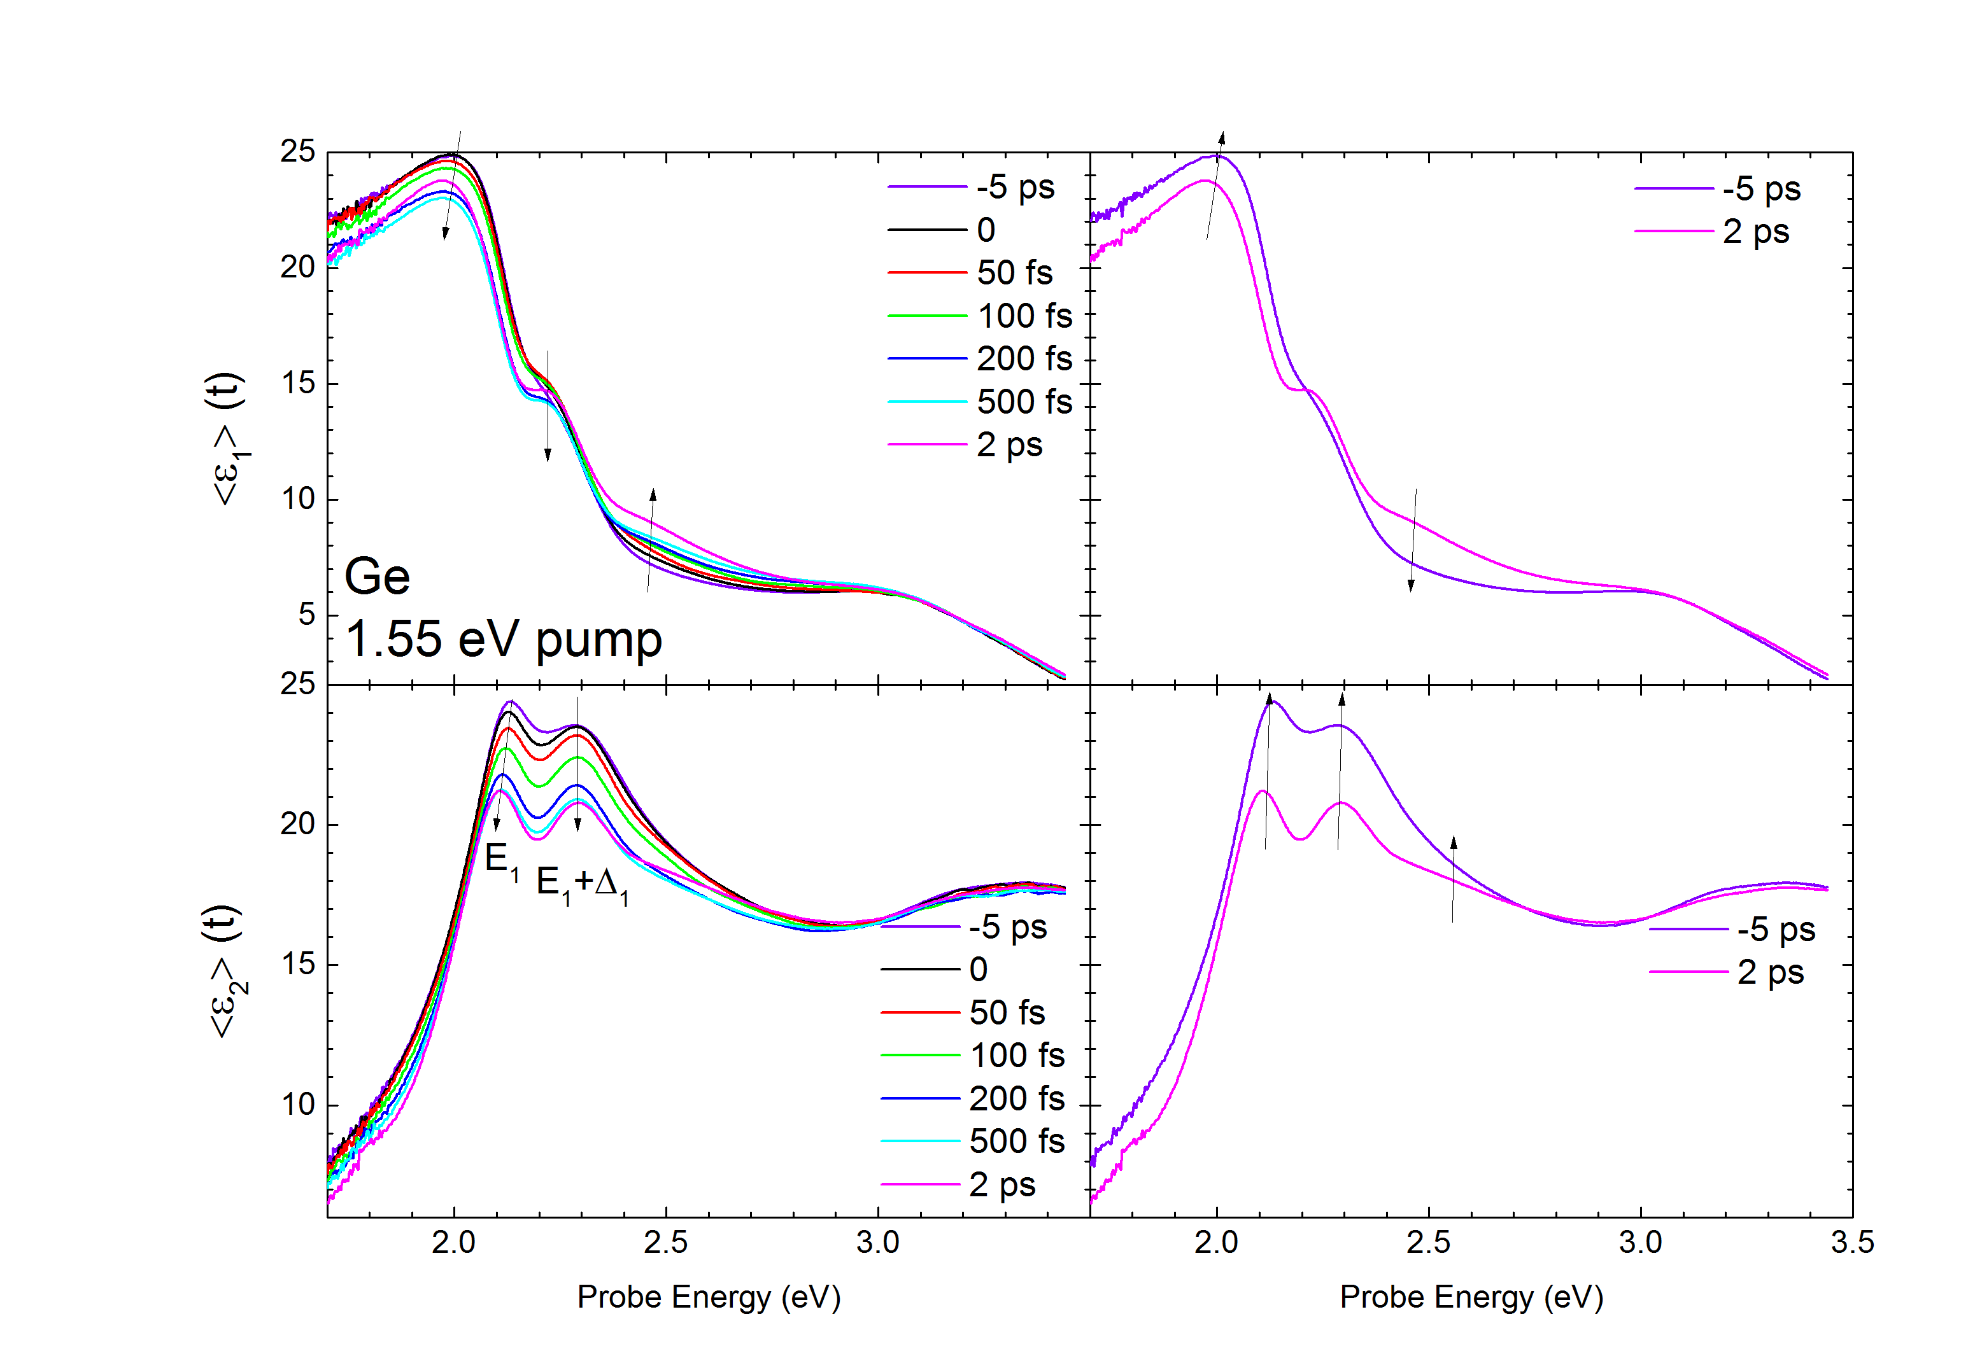
Dynamics of dielectric function of Ge
at 800 nm excitation (1.55 eV)
From 0 to 2 ps
From 2 ps to 500 ps
Carrier concentration:
10²⁰ cm⁻³
Penetration of pump: 220 nm
(350 um diam.)
Penetration of probe beams:
10 - 60 nm
(200 um diam.)
28.08.2019
24
Notes:
Real (top) and imaginary (bottom) parts of the transient pseudodielectric function of Ge (with 4.5 nm native oxide) versus photon energy during the ﬁrst 2 ps (left) and at later times (right) after photoexcitation of 10^20 cm−3 electron-hole pairs with a pump photon energy of 1.55 eV.

Slide 25
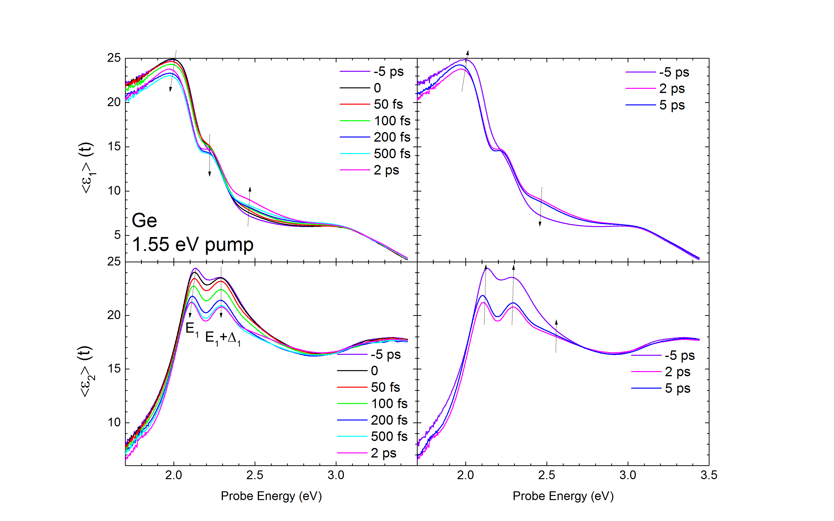
Dynamics of dielectric function of Ge
at 800 nm excitation (1.55 eV)
From 0 to 2 ps
From 2 ps to 500 ps
Carrier concentration:
10²⁰ cm⁻³
Penetration of pump: 220 nm
(350 um diam.)
Penetration of probe beams:
10 - 60 nm
(200 um diam.)
28.08.2019
25
Notes:
Real (top) and imaginary (bottom) parts of the transient pseudodielectric function of Ge (with 4.5 nm native oxide) versus photon energy during the ﬁrst 2 ps (left) and at later times (right) after photoexcitation of 1020 cm−3 electron-hole pairs with a pump photon energy of 1.55 eV.

Slide 26
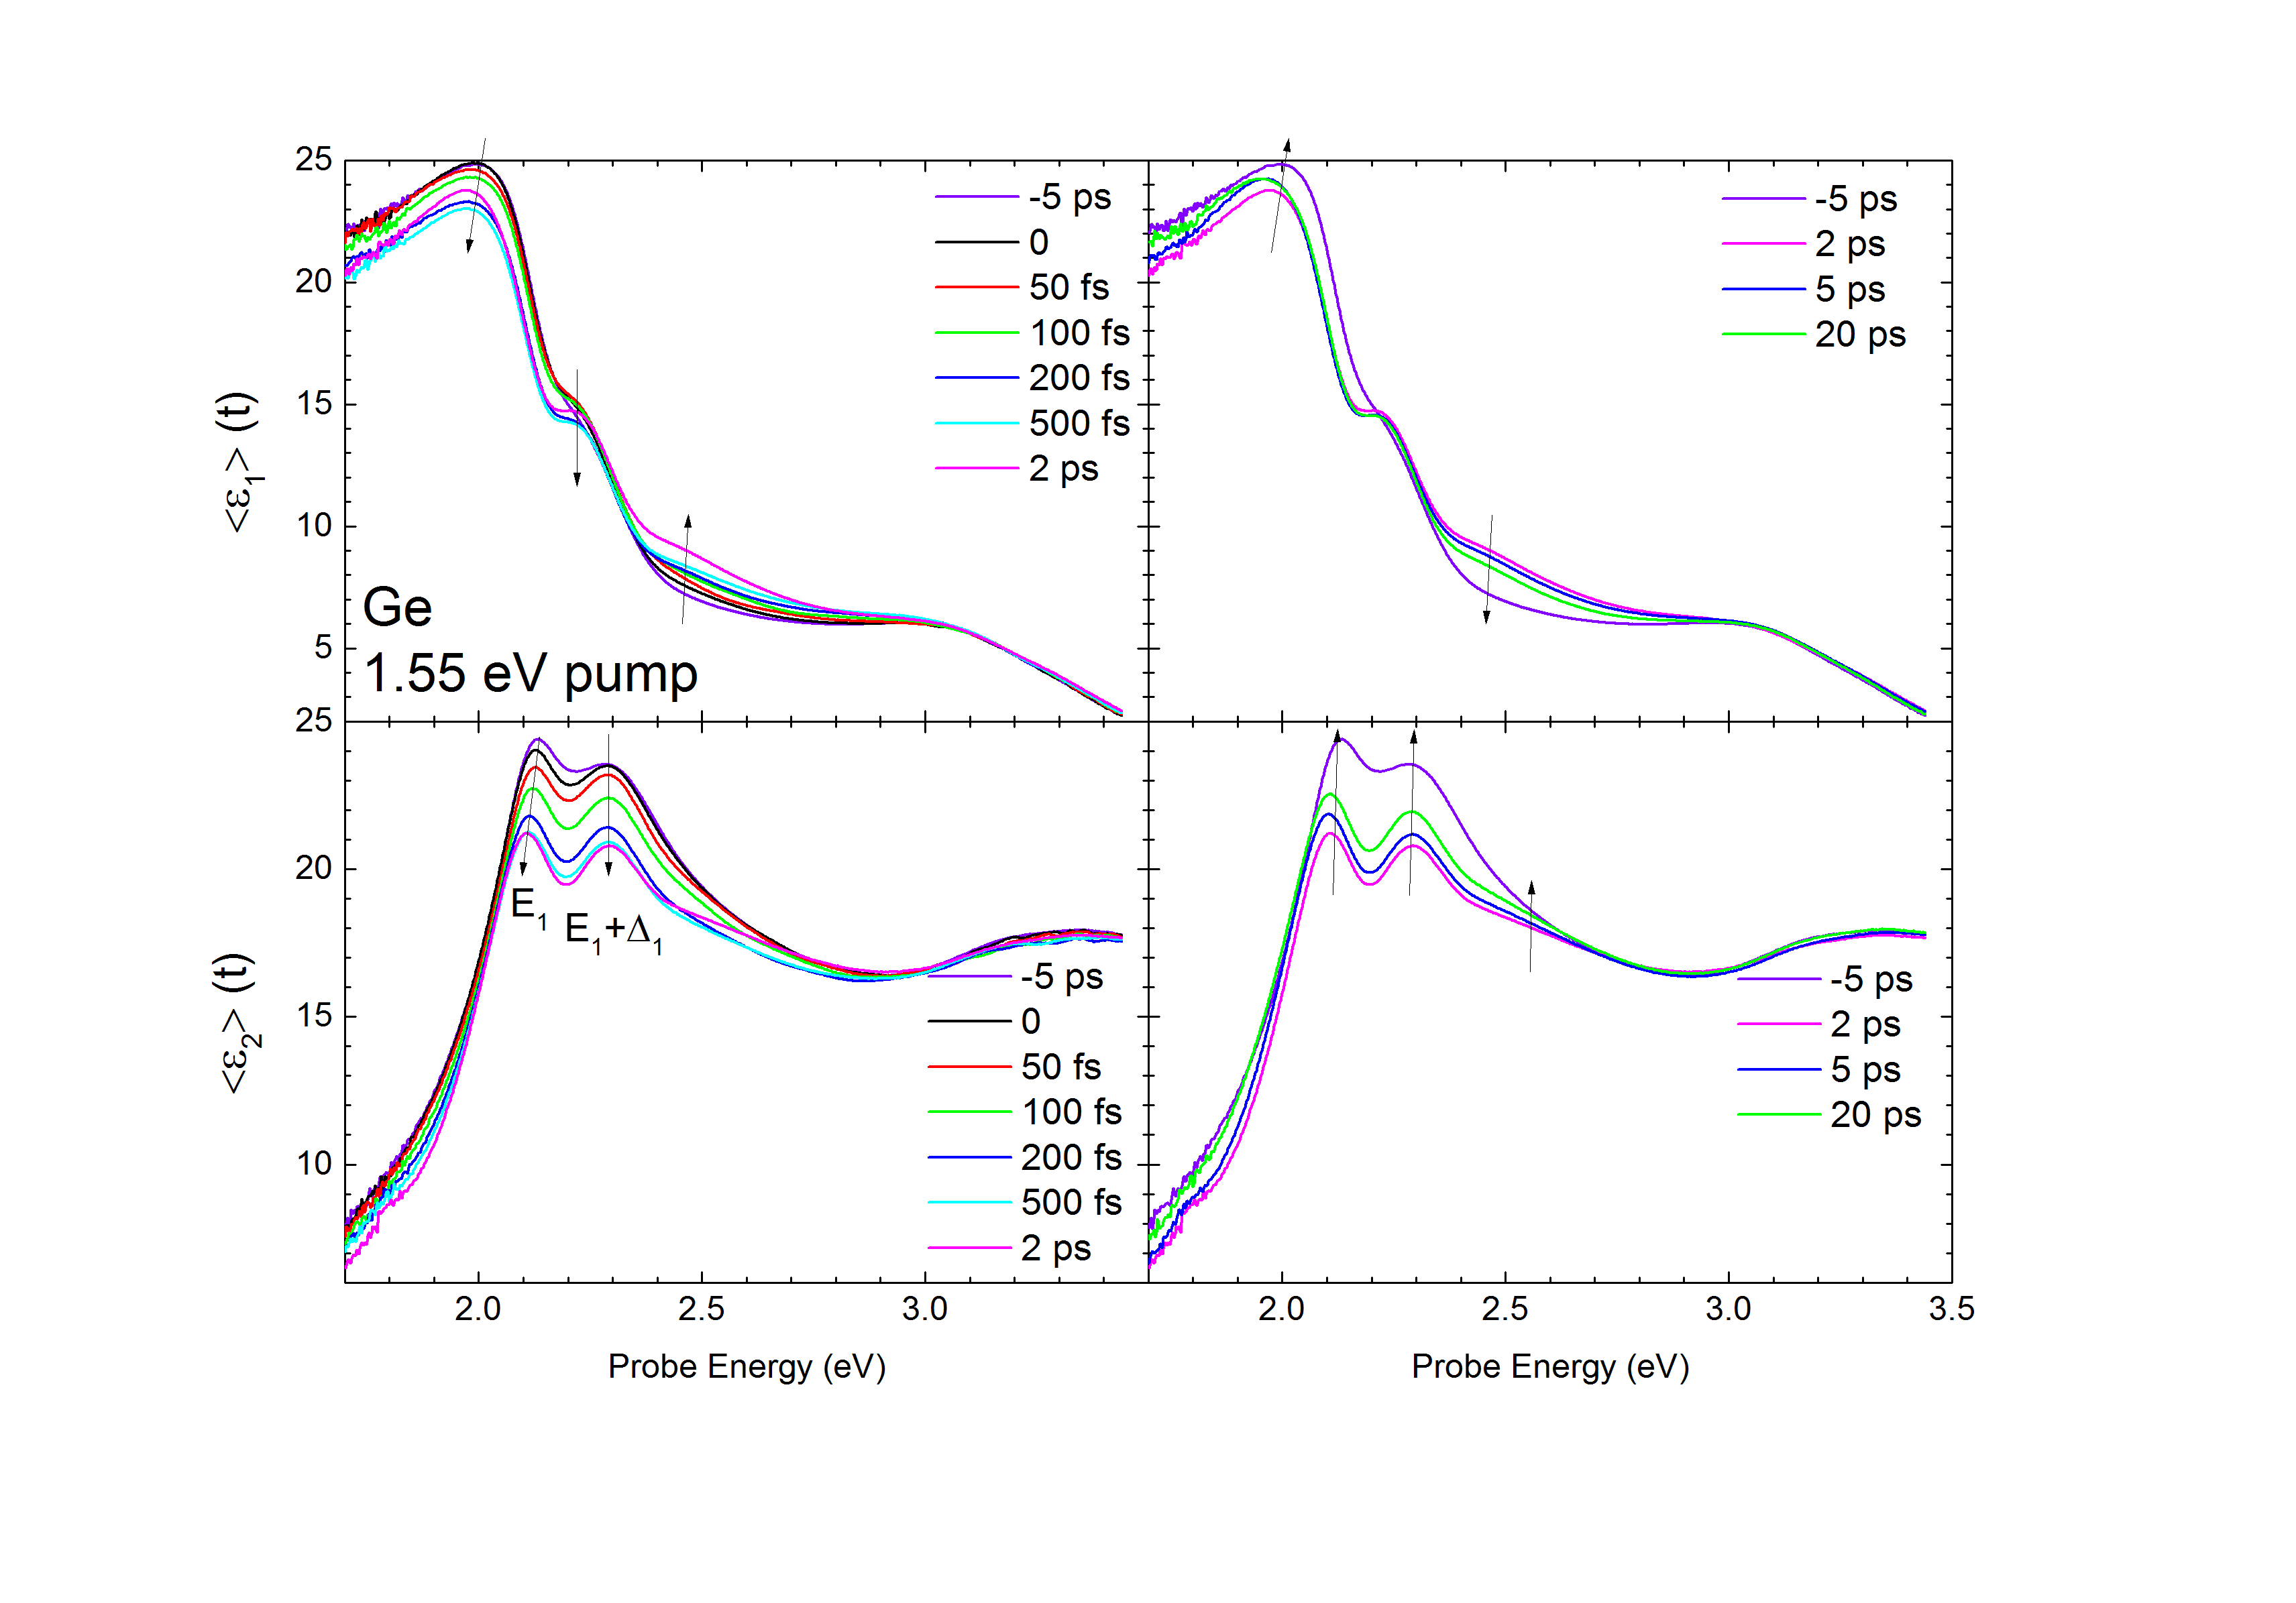
Dynamics of dielectric function of Ge
at 800 nm excitation (1.55 eV)
From 0 to 2 ps
From 2 ps to 500 ps
Carrier concentration:
10²⁰ cm⁻³
Penetration of pump: 220 nm
(350 um diam.)
Penetration of probe beams:
10 - 60 nm
(200 um diam.)
28.08.2019
26
Notes:
Real (top) and imaginary (bottom) parts of the transient pseudodielectric function of Ge (with 4.5 nm native oxide) versus photon energy during the ﬁrst 2 ps (left) and at later times (right) after photoexcitation of 1020 cm−3 electron-hole pairs with a pump photon energy of 1.55 eV.

Slide 27
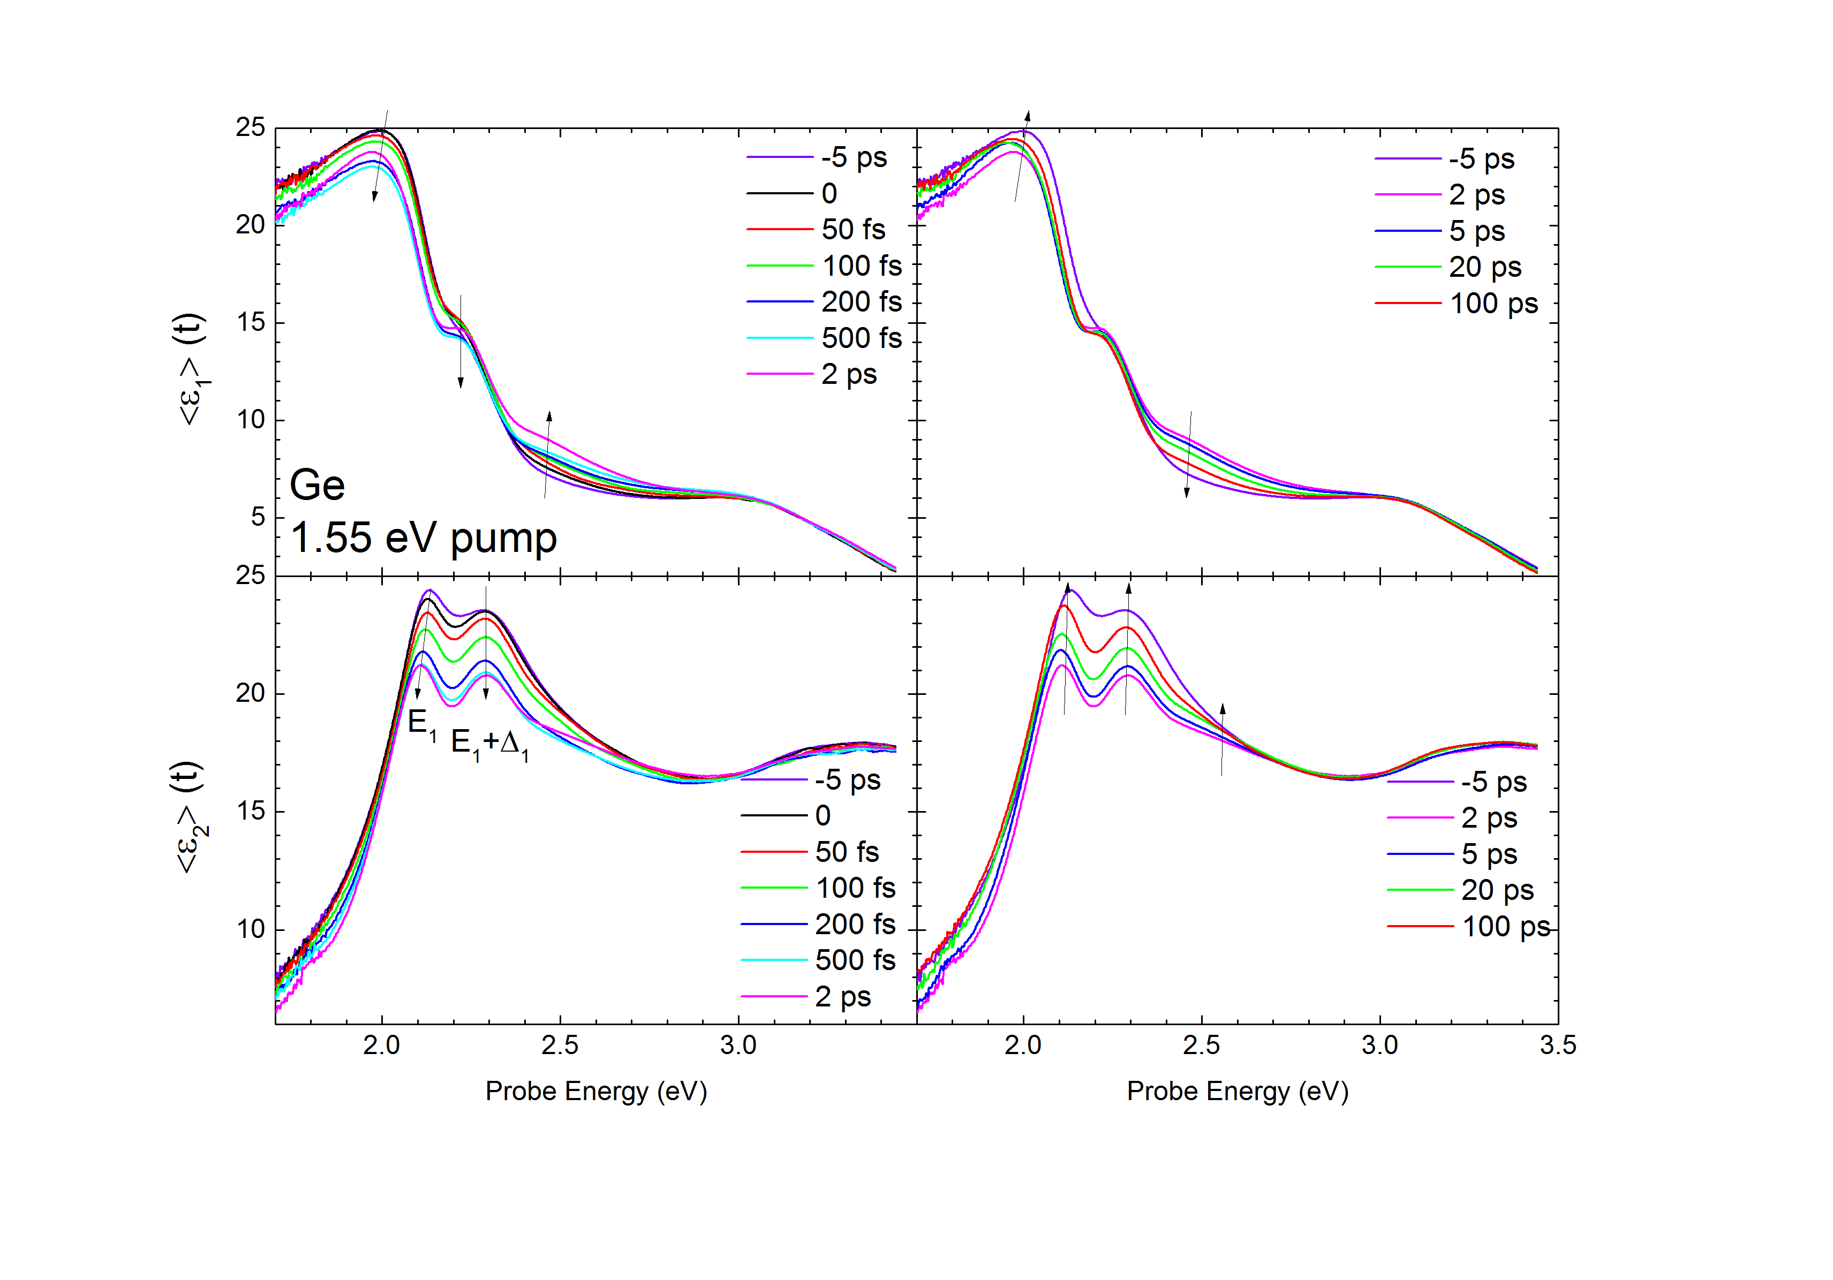
Dynamics of dielectric function of Ge
at 800 nm excitation (1.55 eV)
From 0 to 2 ps
From 2 ps to 500 ps
Carrier concentration:
10²⁰ cm⁻³
Penetration of pump: 220 nm
(350 um diam.)
Penetration of probe beams:
10 - 60 nm
(200 um diam.)
28.08.2019
27
Notes:
Real (top) and imaginary (bottom) parts of the transient pseudodielectric function of Ge (with 4.5 nm native oxide) versus photon energy during the ﬁrst 2 ps (left) and at later times (right) after photoexcitation of 1020 cm−3 electron-hole pairs with a pump photon energy of 1.55 eV.

Slide 28
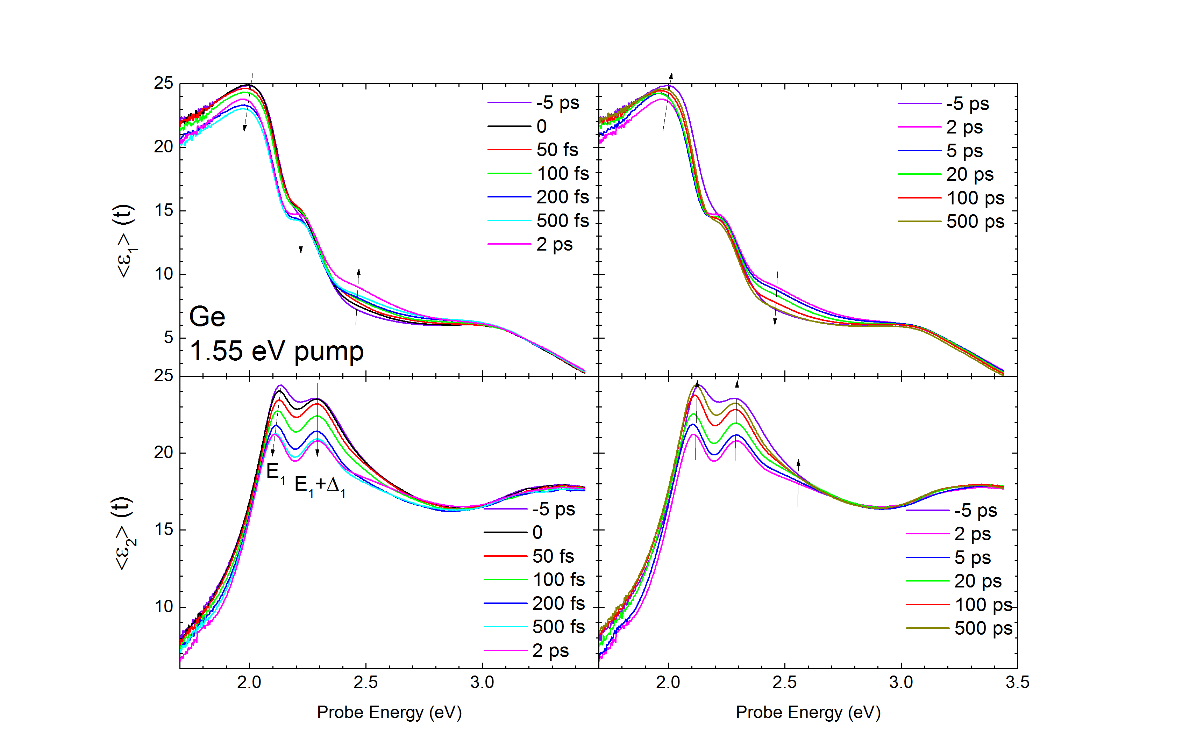
Dynamics of dielectric function of Ge
at 800 nm excitation (1.55 eV)
From 0 to 2 ps
From 2 ps to 500 ps
Carrier concentration:
10²⁰ cm⁻³
Penetration of pump: 220 nm
(350 um diam.)
Penetration of probe beams:
10 - 60 nm
(200 um diam.)
28.08.2019
28
Notes:
Real (top) and imaginary (bottom) parts of the transient pseudodielectric function of Ge (with 4.5 nm native oxide) versus photon energy during the ﬁrst 2 ps (left) and at later times (right) after photoexcitation of 1020 cm−3 electron-hole pairs with a pump photon energy of 1.55 eV.

Slide 29
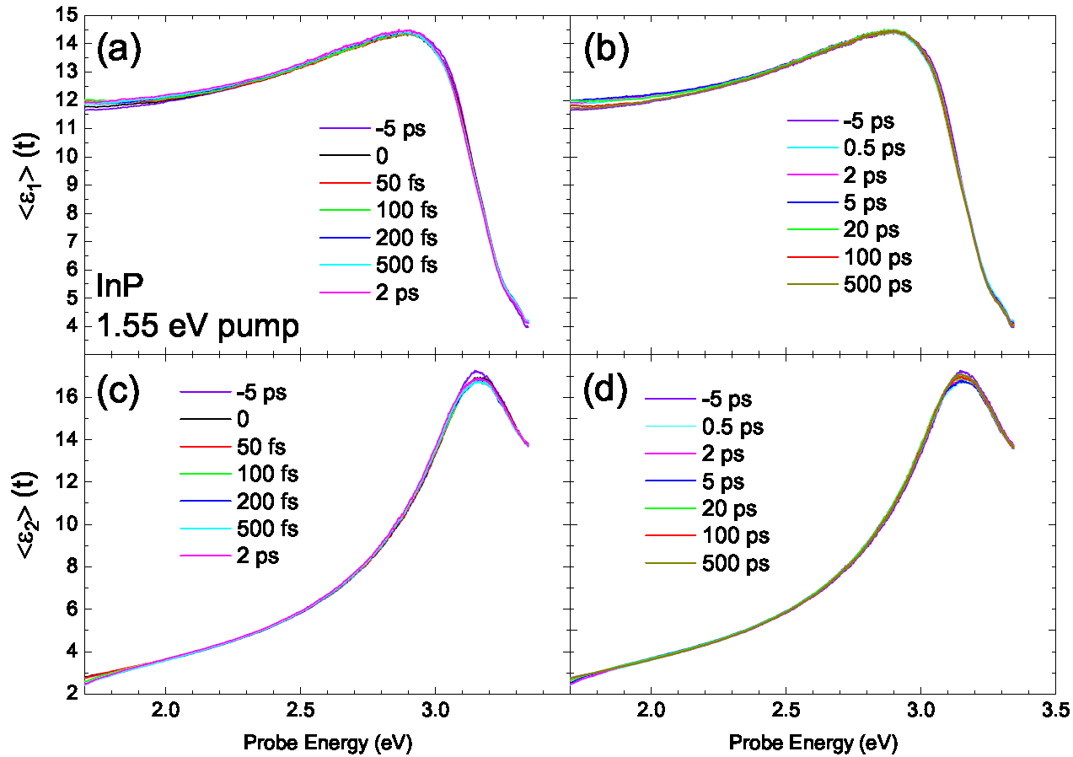
Dynamics of dielectric function of InP
at 800 nm excitation (1.5 eV)
Carrier concentration:
10²⁰ cm⁻³
Penetration of pump: 220 nm
(350 um diam.)
Penetration of probe beams:
10 - 60 nm
(200 um diam.)
28.08.2019
29

Slide 30
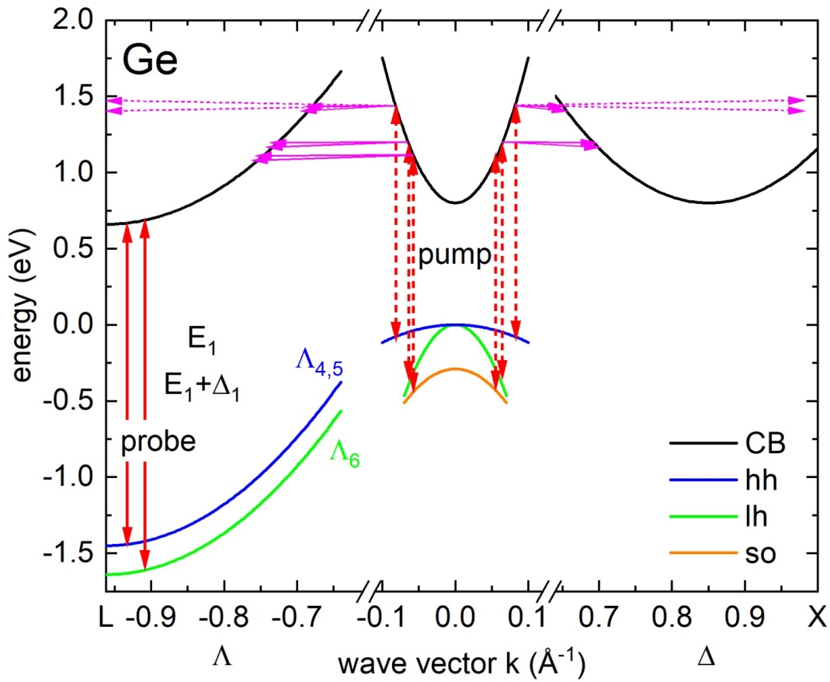
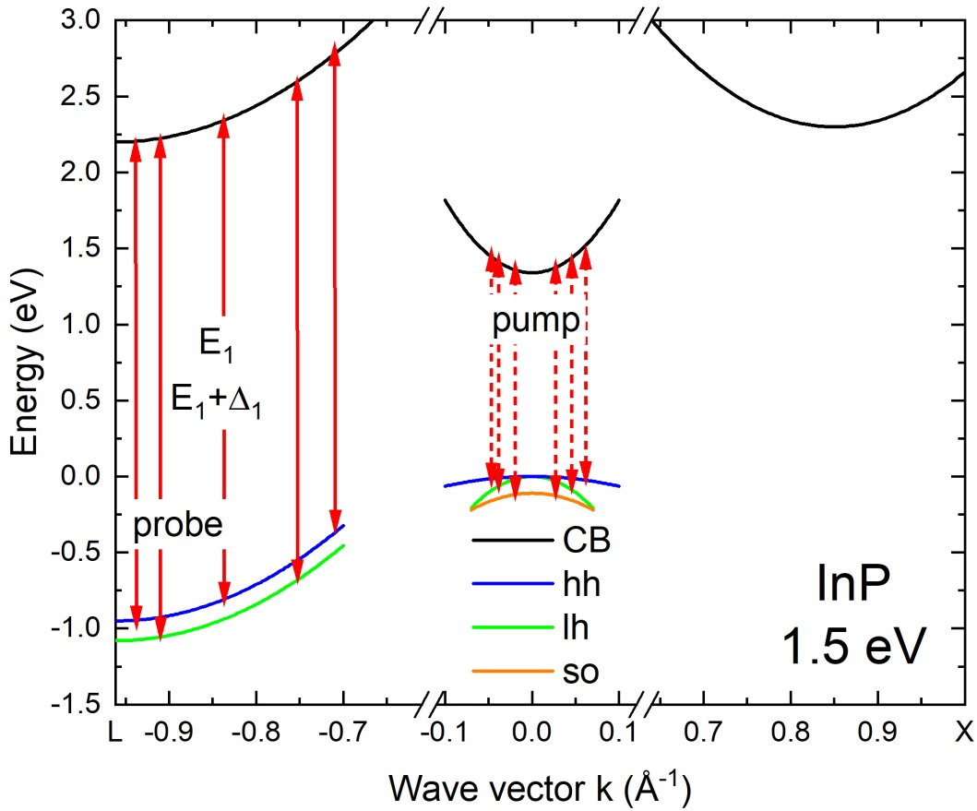
Schematic Band Structure of Ge and InP
Excitation with 1.5 eV Pump Beam
Germanium
Indium Phosphide
27.05.2019
30
Notes:
Schematic band structure of Ge showing optical interband transi-tions (red) from the heavy (hh), light (lh), and split-oﬀ (so) hole bands into the conduction band (CB) with 1.5 eV photoexcitation.
Electron-phonon coupling with multiple phonon modes (magenta) scatters the electrons to the L- and X-valleys, where they relax.
The pump pulse with 1.5 eV photons excites three different electron-hole populations through interband transitions
originating from the heavy, light, and split-o hole bands. The excess energy of these electrons (heavy holes) is up to
0.6 eV (0.1 eV), which corresponds to electron and heavy hole temperatures of 4600 K and 800 K, respectively

Slide 31
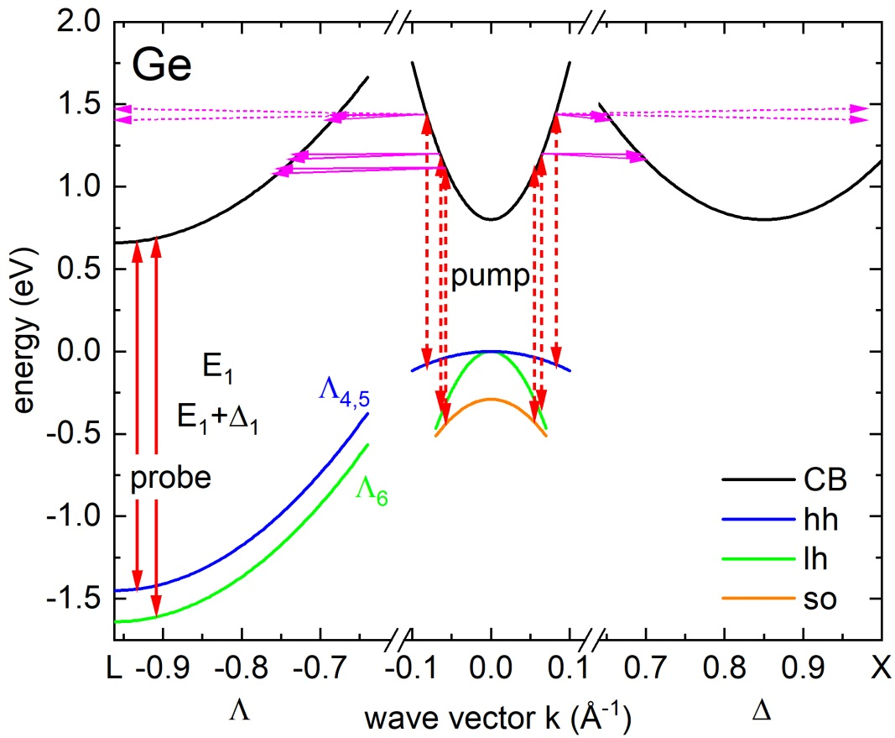
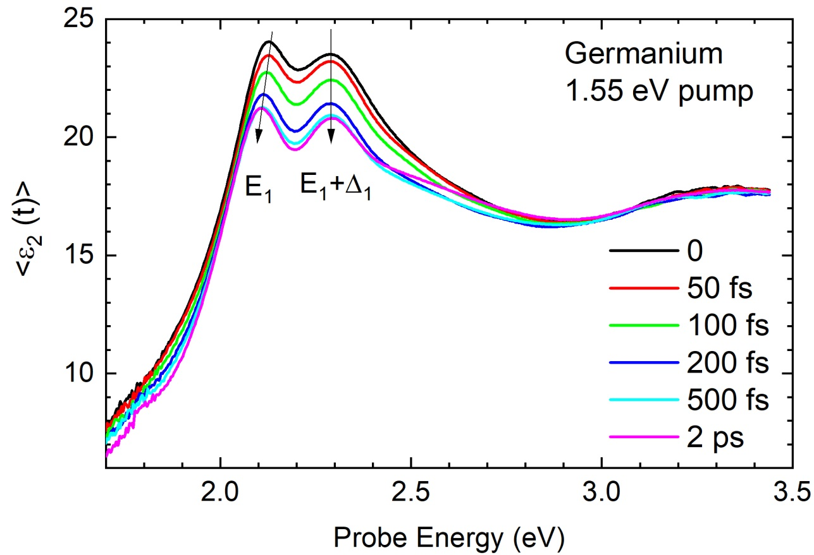
Dynamics of dielectric function of Ge
at 800 nm excitation (1.55 eV)
Excitation in Γ-valley -> Scattering of electrons from Γ to X -> Scattering of electrons from X to L
Reduction of CP amplitudes. Blocking of E₁ transitions. Photoexcited electrons at L reduce the amplitude of E1 transitions. Time: From 0 to 2 ps.
Not much red shift (BGR and thermal increase through lattice heating).
Holes at Γ do not contribute to E₁ transitions (no effect on spectra).
Appl. Phys. Lett. 115, 052105 (2019)
27.05.2019
31
Notes:
The temperature dependence of the E1 energy is about 􀀀0.4 meV/K (see Ref. 12) and therefore we expect an E1 red-shift due to heating of no more than 8 meV. The observed redshift, while dicult to quantify, is about 20 meV. We therefore conclude that lattice heating might be a signicant portion of the observed redshift. Within 500 fs, they scatter from the X-valley to the Lvalley, which is about 0.4 eV lower in energy. The nonequilibrium electron distribution in the L-valley partially blocks the E1 and E1 + 1 transitions (Pauli blocking), thus reducing the amplitude of the E1 and E1+1 peaks in the pseudodielectric function.
Because the electron temperature is still very high after 500 fs, Pauli blocking extends beyond 2.6 eV. At 2 ps, the electrons have cooled down signicantly and therefore the pseudodielectric function at 2.6 eV has recovered its equilibrium value. On the other hand, the carrier density has not changed yet, indicated by the reduced amplitudes of the E1 and E1 + 1 peaks.

Slide 32
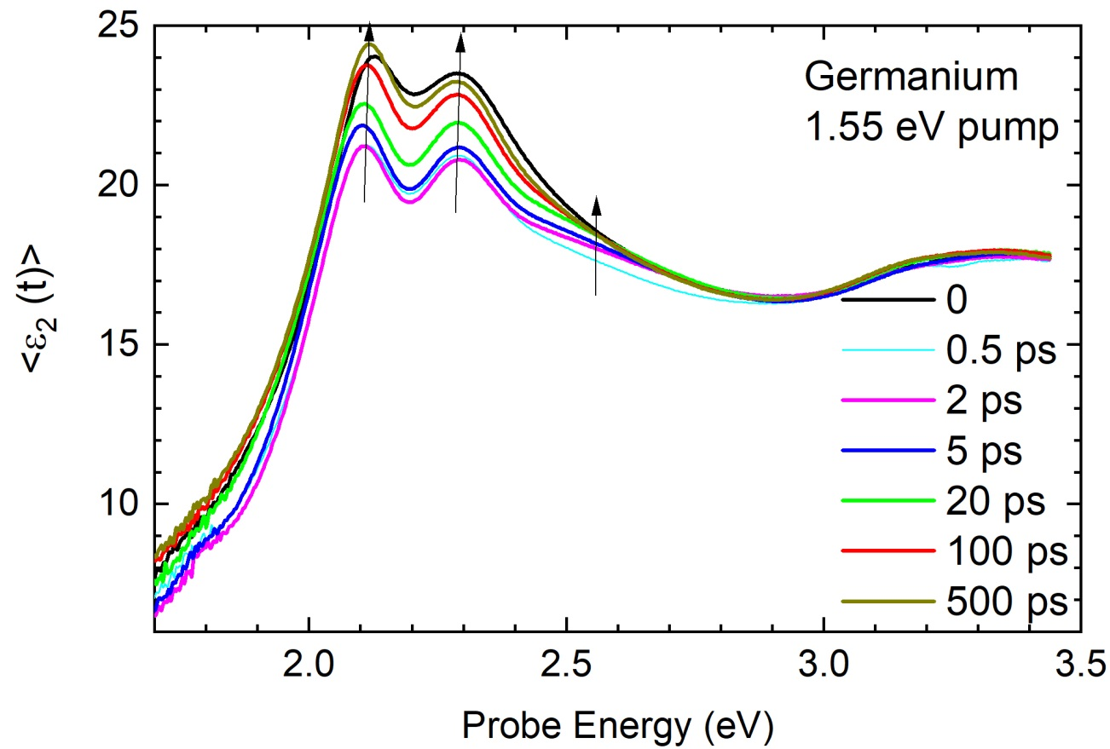
Dynamics of dielectric function of Ge
at 800 nm excitation (1.55 eV)
Full recovery takes about 500 ps
At around 2.6 eV the recovery is much faster
Above 3 eV weak time dependence
Appl. Phys. Lett. 115, 052105 (2019)
27.05.2019
32
Notes:
Between 2 ps and 500 ps, the E1 and E1 + 1 amplitudes recover. This means that the electron concentration falls below the measureable threshold, rst by Auger recombination and later by ambipolar diffusion and electron-hole pair (radiative or non-radiative) recombination.

Slide 33
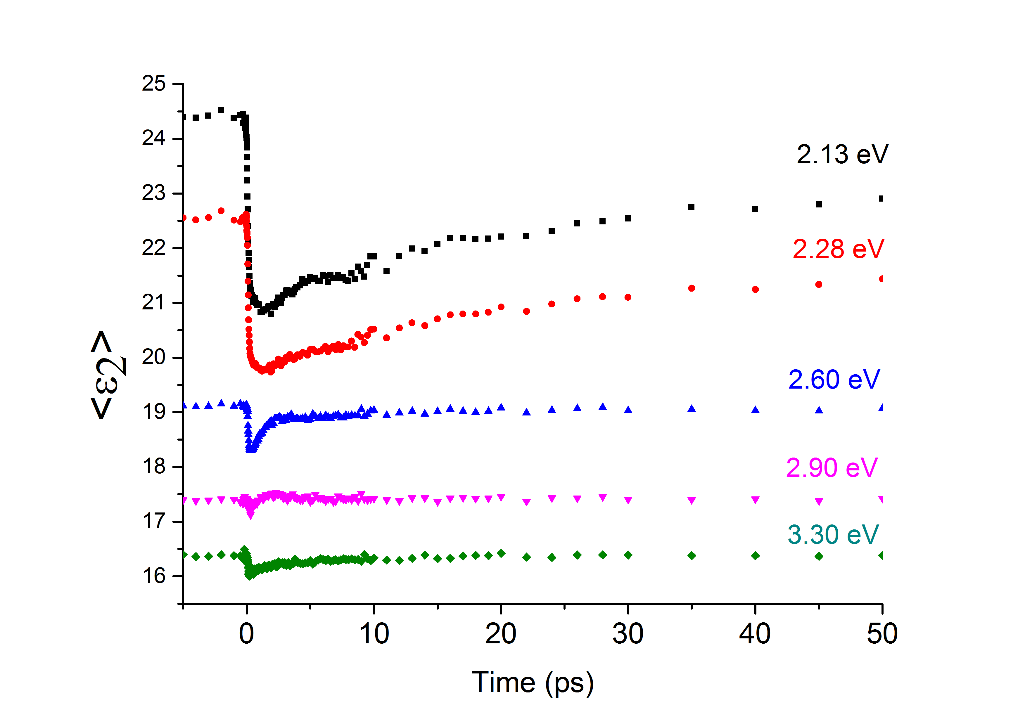
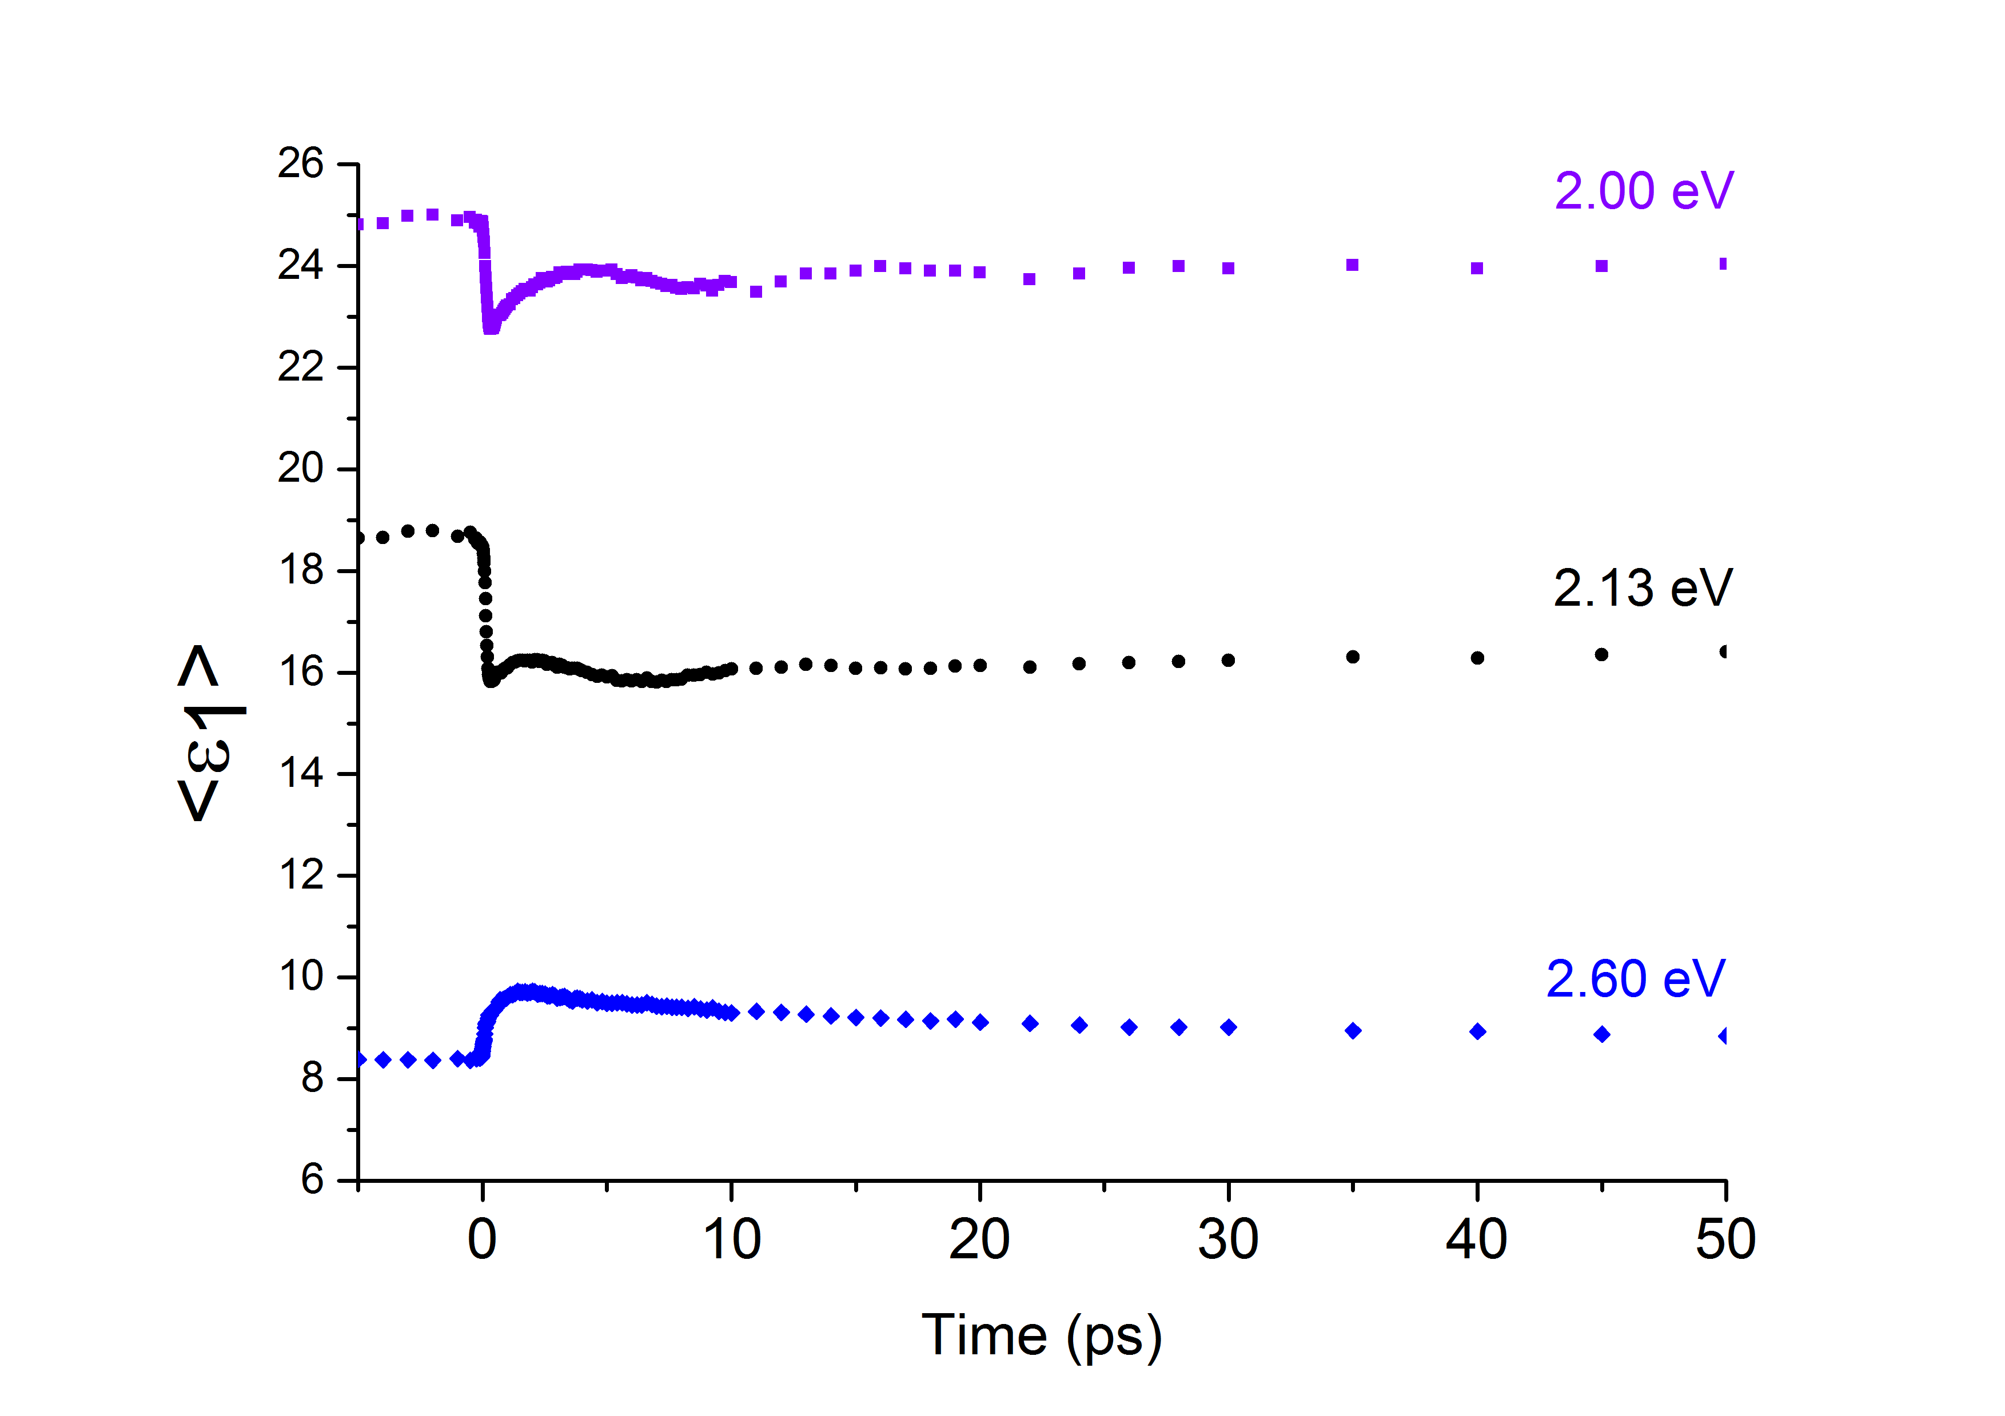
Dynamics of <ε₂> and <ε₁> in Ge
at 800 nm excitation (1.55 eV)
Initial drop: Band filling due to scattering Γ,X->L (observed E₁ transitions)
Recovery: Diffusion and recombination
Oscillation with 10 ps time scale (0.1 THz).
Much too long for Ge optical phonon period (110 fs).
2.55 eV signal: Initial heating and cooling of carriers in L valley
Fermi-level singularity related to band filling (Xu C., et al. Phys. Rev. Lett. 118, 267402, 2017)
27.05.2019
33
Notes:
Change time scales: initial on left, recovery on right, maybe on log scale

Slide 34
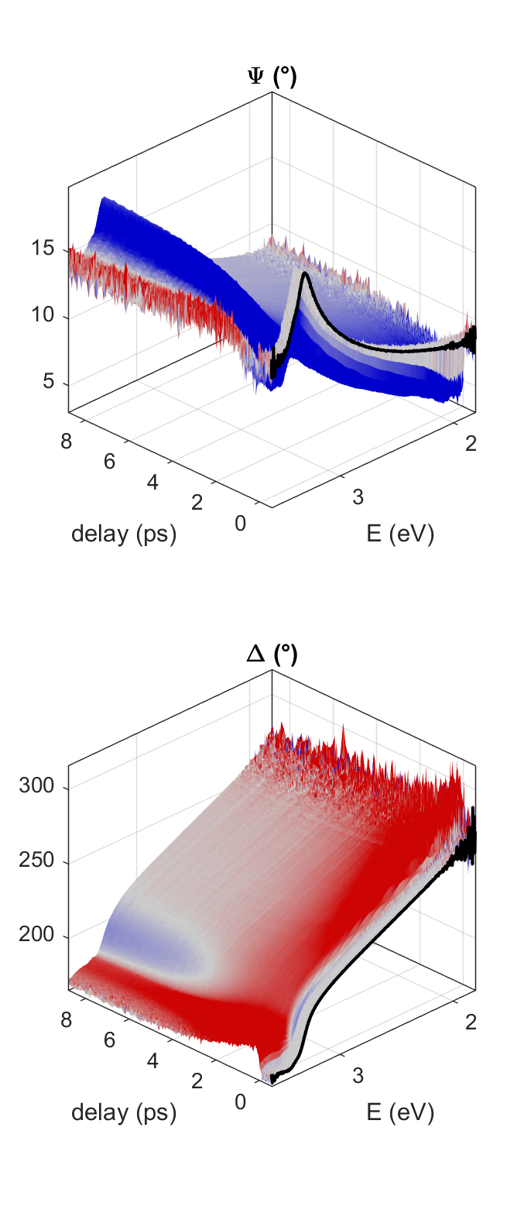
Results: ZnO thin film
Example:
ZnO thin film (30nm on SiO2), hom. pumped by 266nm
“entire film homogeneously pumped” (10²⁰cm⁻³)
arXiv:1902.05832 (2019)

Slide 35
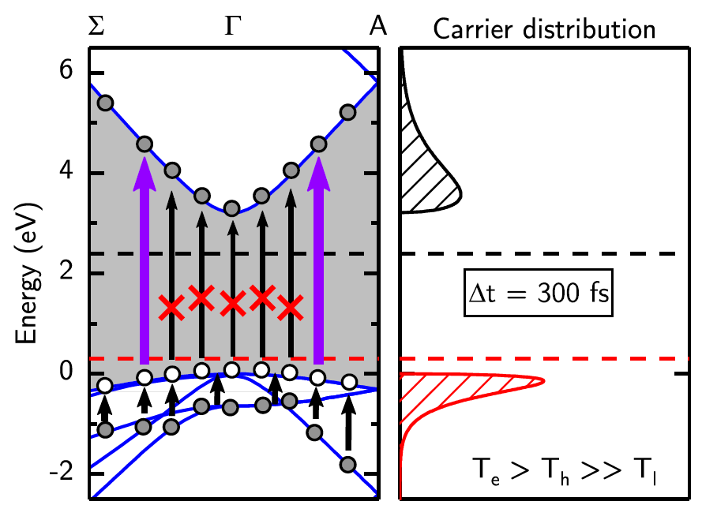
Dynamics of <ε₂> and <ε₁>: ZnO thin film 266 nm excitation (4.66 eV)
Femtosecond timescale:
  immediate bleaching/
  blocking of above-gap
  absorption (excitons)
  mid-gap absorption
  “fine structure”
X
EPC
X - exciton
EPC – exciton-phonon complex
arXiv:1902.05832 (2019)

Slide 36
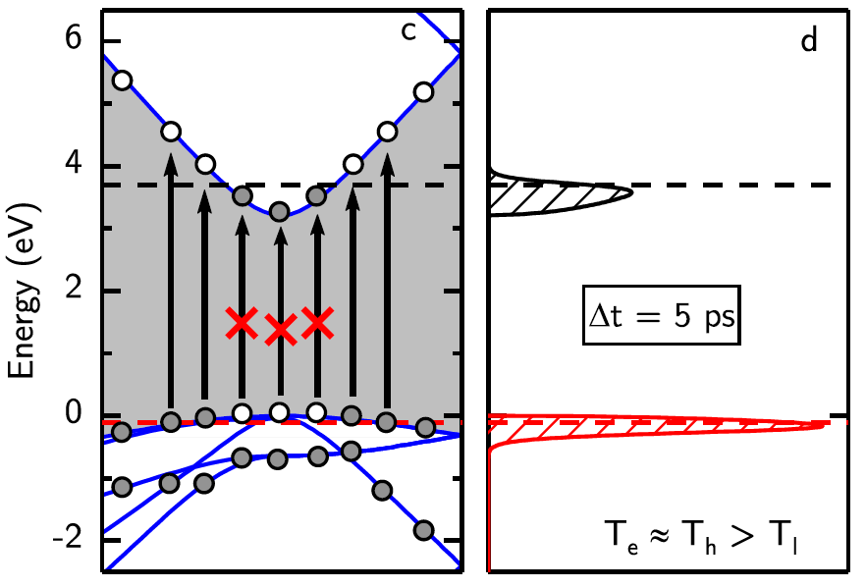
Dynamics of <ε₂> and <ε₁>: ZnO thin film 266 nm excitation (4.66 eV)
Picosecond timescale:
  recovery of above-gap
  absorption
  vanishing mid-gap
  absorption
  vis refractive index
  increasing again
arXiv:1902.05832 (2019)

Slide 37
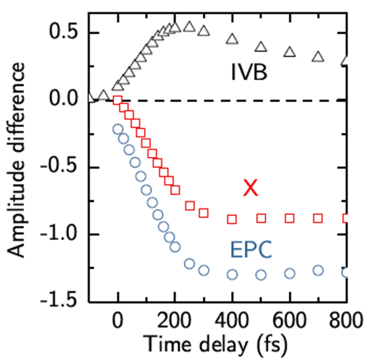
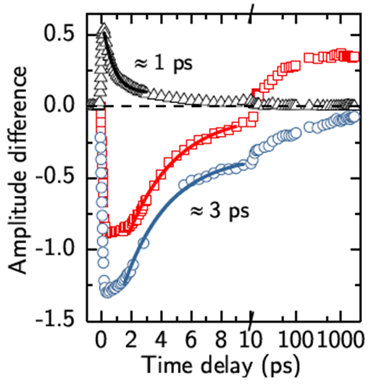
Dynamics of <e₂> and <e₁>: ZnO thin film 266 nm excitation (4.66 eV)
  excitation VB-CB around Г point (electrons and holes carry excess energy)
  electrons and holes cooling by scattering with phonons
  electrons thermalize by carrier-carrier scattering (blocking X and EPC absorption)
  hot phonons slow down electron re-laxation through phonon reabsorption
  reduction of excited carriers (non-radiative Auger recombination and radiative recombination)
  holes scatter to the edges of Brillouin zone (IVB absorption)
arXiv:1902.05832 (2019)

Slide 38
E1 End stations and beam transport for Applications in Molecular, Bio medical and Material science
1: MAC, AMO and Coherent diffractive imaging
2: ELIps, VUV magneto optical ellipsometry
3: and 4: TREX, X-ray diffraction and absorption. PR
5: Optical probes (SRS, TR-absorption, 1 and 2D IR, TR-SE)
L1
L3
HHG
and monochromator
2
1
opt. tables
5
3, 4
38

Slide 39
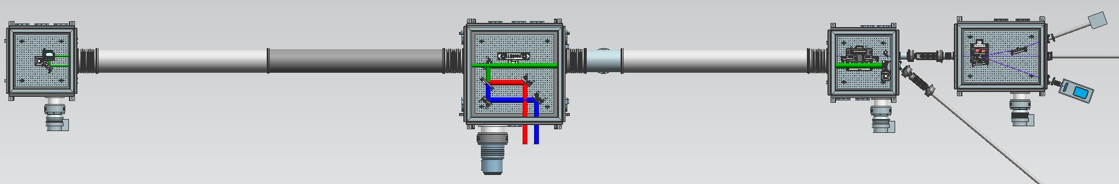
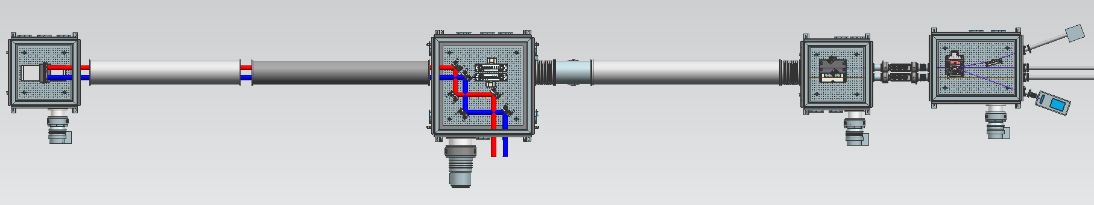
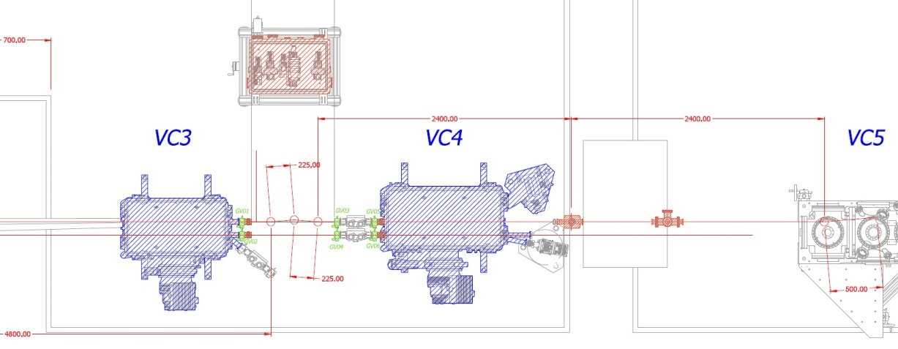
HHG Beamline operating modes
Slide from Jaroslav Nejdl. ELI-BL RP2
ELI Beamlines
1 HHG Beam
2 HHG Beams
Prepared for 2 beam options
2 color drive beam
2 independent HHG sources
Time-preserving VUV monochromatization
Off-plane gratings
Toroidal/ellipsoidal mirrors
39

Slide 40
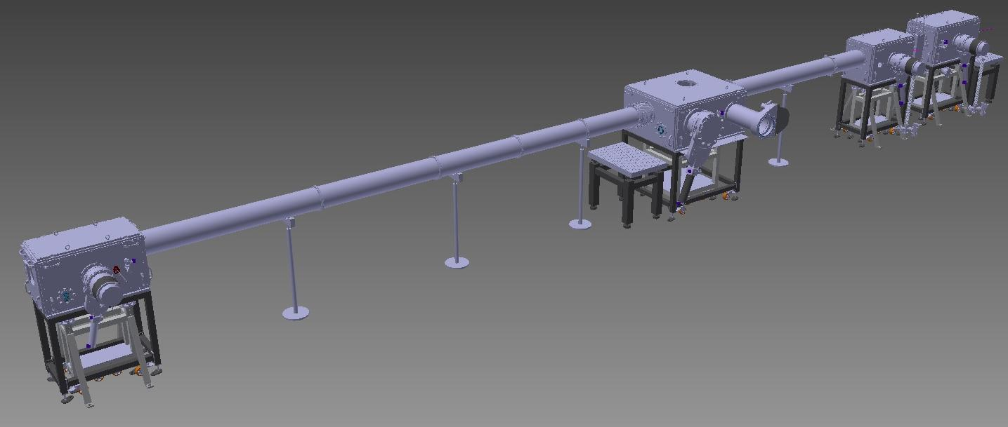
Slide from Jaroslav Nejdl. ELI-BL RP2
HHG Beamline
Interaction chamber
Focusing chamber F- number 40-1000
IR rejection
+ diagnostics
Lasers
1 kHz driver | 6 mJ, 40 fs from 2018 | L1: 100 mJ, <20fs from 2020
Wavelength | 10 -120 nm | 5 -120 nm
Photons/shot | 10⁶ to 10⁹ | few 10⁸ -10¹²
Δλ/λ | 10⁻² | 10⁻²
Divergence | < 1 mrad | < 0.5 mrad
Spatial profile | Gaussian-like | Gaussian-like
Wavefront | λ/10 | λ/10
Duration | < 20fs | < 20fs
Polarization | Linear | Lin./Circ./Eliptical
Versatility / Tunability:
Several focusing geometries
Max. eff. at given wavelength range
40

Slide 41
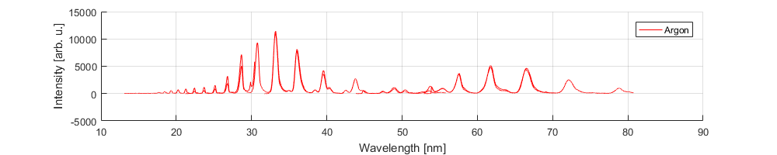

Slide from Jaroslav Nejdl. ELI-BL RP2
HHG Beamline
Argon spectrum:
Neon spectrum
Pulse energy
  Pulse energy in Ar = 0.2 nJ, after 200 nm Al filter
  1e-6 efficiency of generation
41

Slide 42
E1 End stations and beam transport for Applications in Molecular, Bio medical and Material science
1: MAC, AMO and Coherent diffractive imaging
2: ELIps, VUV magneto optical ellipsometry
3: and 4: TREX, X-ray diffraction and absorption. PR
5: Optical probes (SRS, TR-absorption, 1 and 2D IR, TR-SE)
L1
L3
HHG
and monochromator
2
1
opt. tables
5
3, 4
42

Slide 43


VUV ellipsometer (“ELIps”)
Commercial VUV ellipsometers
are currently available up to 140 nm (8.86 eV)6,7. For higher energies, the ellipsometer at MLS uses synchrotron light and has
a documented VUV operational energy range extending up
to 40 eV.
The ELIps instrument at the ELI Beamlines facility is the first user oriented endstation to study transient effects in the materials, in time scales from femtoseconds to picoseconds.
Appl. Surf. Sci. 421, 378. (2017)
43

Slide 44



Time-resolved VUV ellipsometry
The ELIps use the VUV-High Harmonic light generated on
an Argon or Neon gas cell pumped by a 12 mJ, 15 fs, 1 kHz in-house-developed L1 ALLEGRA laser with central wavelength 830 nm.
27.05.2019
44

Slide 45

Time-resolved VUV ellipsometry
The ellipsometer was tested as a rotating analyzer ellipsometer (RAE)
27.05.2019
45

Slide 46


Summary
Time-resolved spectroscopic ellipsometry allows direct observation of carrier excitation and relaxation of L-point electrons on a fs-ns timescale
Both 1.55 eV and 4.65 eV excitations show band-filling at the L-point in Germanium (E₁ and E₁ + Δ₁)
In Indium Phosphide only 4.65 eV pump pulses can excite electrons to the L-valley. The electrons will scatter from L to Γ in less than 250 fs
Results on the VUV ellipsometry were obtained during the first user call
Workshop in Prague on November 11-13th, 2019
A new call for users will be open in Oct.-Nov., 2019
27.05.2019
46

Slide 47



Acknowledgement
New Mexico State
University
Stefan Zollner
Carola Eminger
Universität Leipzig
Oliver Herrfurth
Rüdiger Schmidt-Grund
Università degli Studi di Padova
Fabio Samparisi
Luca Poletto
Fabio Frassetto
ELI RP4 and ELIBIO team
Steffen Richter
Mateusz Rebarz
Jakob Andreasson
Thank you for your attention!
27.05.2019
47

