Slide 1


Relativistic motion in strong laser fields
E.G. Gelfer

Slide 2
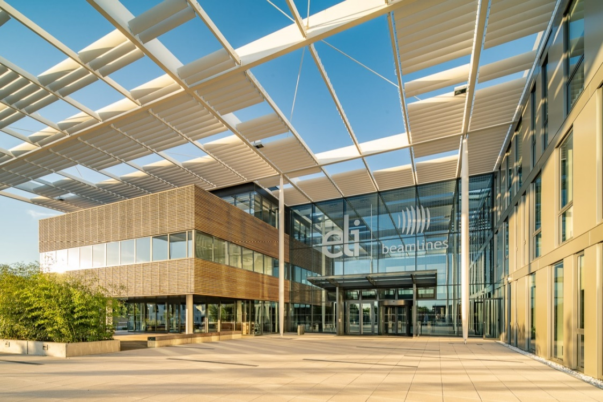
Introduction: high power lasers coming soon
Введение
10 PW: ELI Beamlines (Czech Republic), ELI NP (Romania), Apollon (France), SIOM (China)
100 PW: SULF (China)
200 PW: XCELS (Russia)
Applications
Strong field QED effects: electron-positron pairs, gamma generation, etc.
Particle acceleration (medical applications, e.g. cancer treatment)
etc...

Slide 3
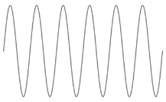
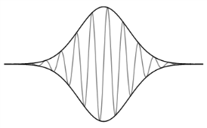
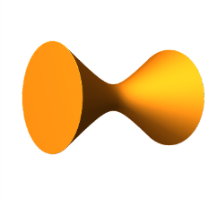
Outline
Введение
Laser field models:
Monochromatic plane wave
Pulsed plane wave
Focused pulse
Radiation and radiation friction
Classical vs quantum descriptions
Radiation induced acceleration
Radiative trapping
Summary

Slide 4
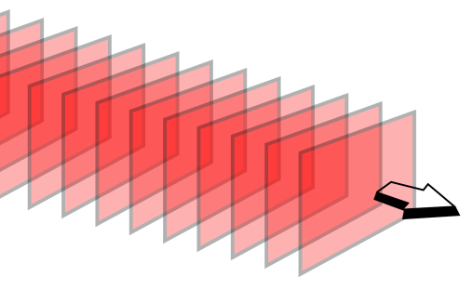
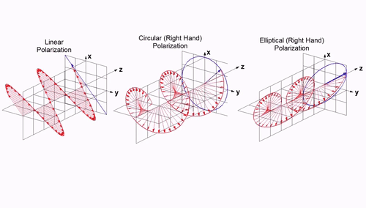
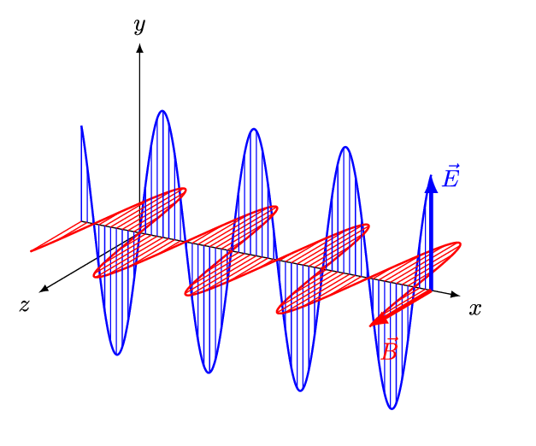



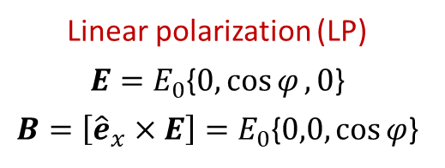

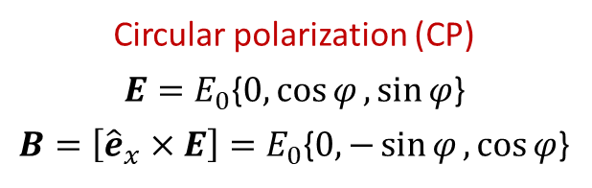
Model for a laser field
Введение
Monochromatic plane wave
$$y$$
$$φ=ω\left(t−\frac{x}{c}\right)$$
$$z$$
$$x$$
Circular polarization (CP)
$E=E_{0}${$0,\cos{φ},\sin{φ}$}
$B=\left[{\hat{e}}_{x}×E\right]=E_{0}${$0,−\sin{φ},\cos{φ}$}
Linear polarization (LP)
$E=E_{0}${$0,\cos{φ},0$}
$B=\left[{\hat{e}}_{x}×E\right]=E_{0}${$0,0,\cos{φ}$}

Slide 5


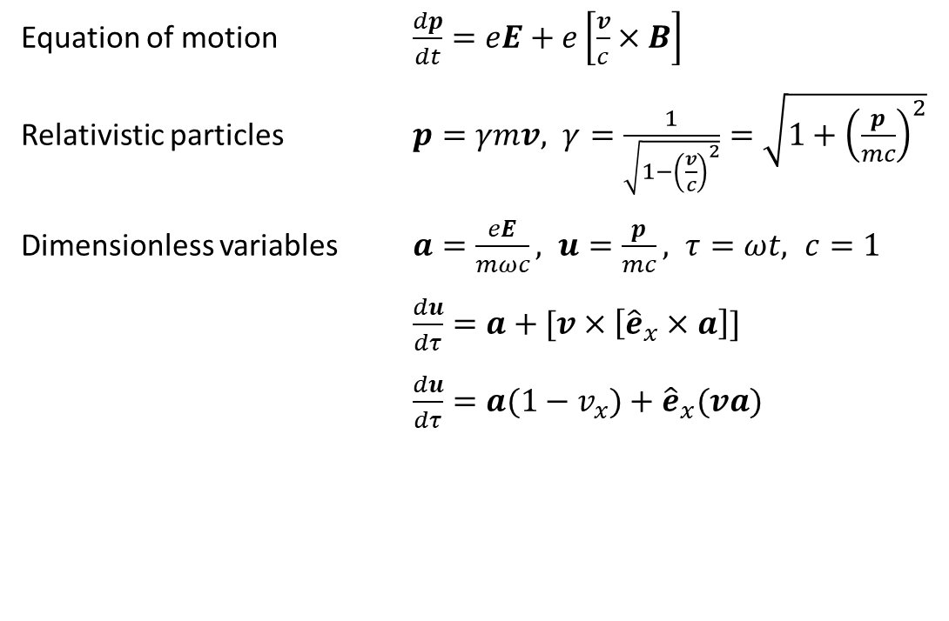
Particle motion in a monochromatic plane wave
Введение
Equation of motion $\frac{dp}{dt}=eE+e\left[\frac{v}{c}×B\right]$
Relativistic particles $p=γmv, γ=\frac{1}{\sqrt{1−{\left(\frac{v}{c}\right)}^{2}}}=\sqrt{1+{\left(\frac{p}{mc}\right)}^{2}}$
Dimensionless variables $a=\frac{eE}{mωc}, u=\frac{p}{mc}, τ=ωt, c=1$
$\frac{du}{dτ}=a+[v×\left[{\hat{e}}_{x}×a\right]]$
$\frac{du}{dτ}=a(1−v_{x})+{\hat{e}}_{x}(va)$
$$dφ=dτ(1−v_{x})$$
transverse
longitudinal
$$\frac{du_{⊥}}{dφ}=a,$$
$$\frac{du_{x}}{dτ}=\frac{1}{2γ}\frac{d}{dφ}u_{⊥}^{2}$$

Slide 6
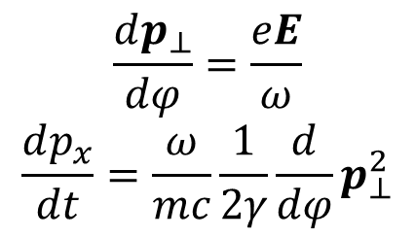
Particle motion in a monochromatic plane wave
Введение
Equation of motion $\frac{dp}{dt}=eE+e\left[\frac{v}{c}×B\right]$
Relativistic particles $p=γmv, γ=\frac{1}{\sqrt{1−{\left(\frac{v}{c}\right)}^{2}}}=\sqrt{1+{\left(\frac{p}{mc}\right)}^{2}}$
Dimensionless variables $a=\frac{eE}{mωc}, u=\frac{p}{mc}, τ=ωt, c=1$
$\frac{du}{dτ}=a+[v×\left[{\hat{e}}_{x}×a\right]]$
$\frac{du}{dτ}=a(1−v_{x})+{\hat{e}}_{x}(va)$
$$dφ=dτ(1−v_{x})$$
transverse
longitudinal
$$\frac{du_{⊥}}{dφ}=a,$$
$$\frac{du_{x}}{dτ}=\frac{1}{2γ}\frac{d}{dφ}u_{⊥}^{2}$$
$$\frac{dp_{⊥}}{dφ}=\frac{eE}{ω}$$
$$\frac{dp_{x}}{dt}=\frac{ω}{mc}\frac{1}{2γ}\frac{d}{dφ}p_{⊥}^{2}$$

Slide 7
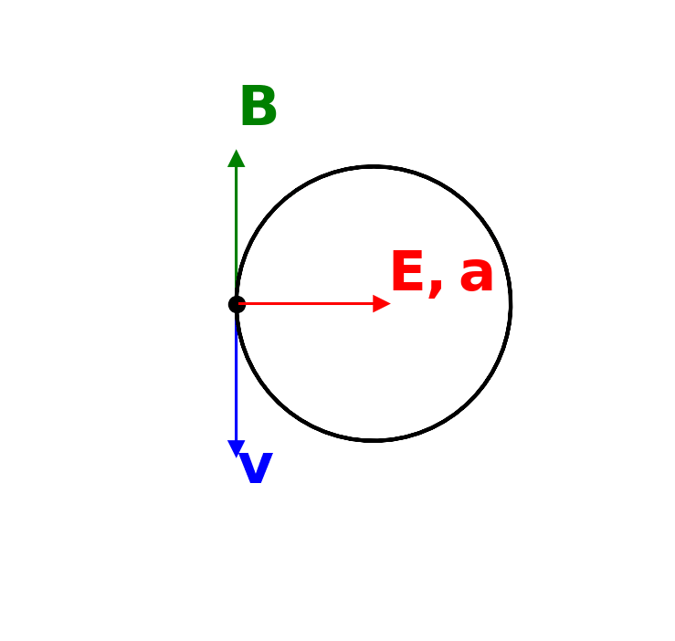
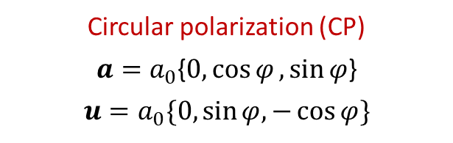
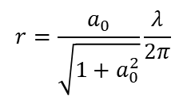
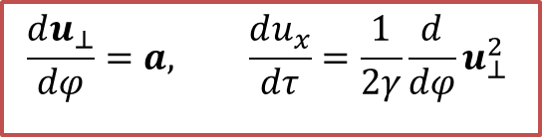


Particle motion in a monochromatic plane wave
Введение
$$\frac{du_{⊥}}{dφ}=a, \frac{du_{x}}{dτ}=\frac{1}{2γ}\frac{d}{dφ}u_{⊥}^{2}$$
Circular polarization (CP)
$a=a_{0}${$0,\cos{φ},\sin{φ}$}
$$u=a_{0}\{0,\sin{φ,−\cos{φ}}\}$$
$$z$$
$$r=\frac{a_{0}}{\sqrt{1+a_{0}^{2}}}\frac{λ}{2π}$$
$$y$$

Slide 8
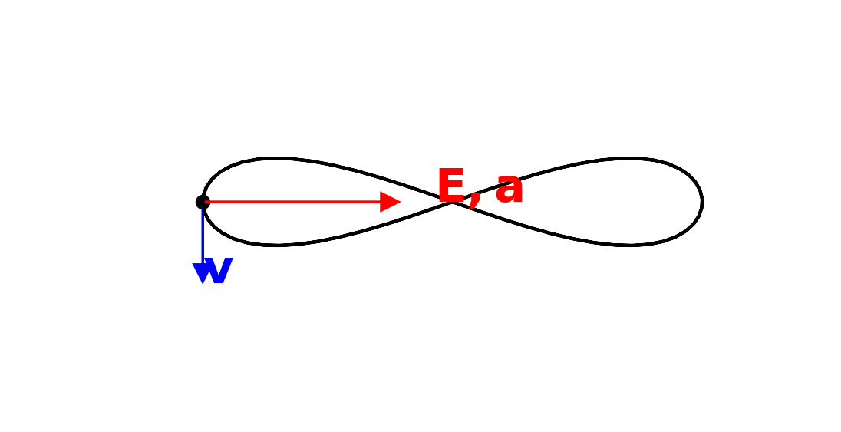
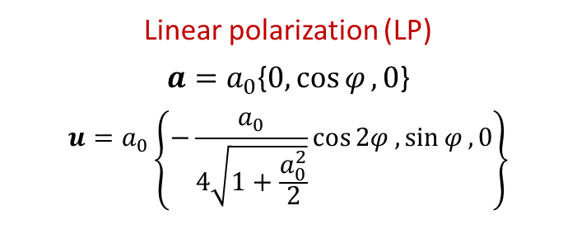



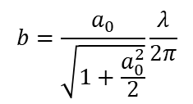
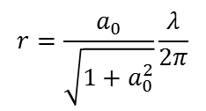

Particle motion in a monochromatic plane wave
Введение
$$\frac{du_{⊥}}{dφ}=a, \frac{du_{x}}{dτ}=\frac{1}{2γ}\frac{d}{dφ}u_{⊥}^{2}$$
Circular polarization (CP)
$a=a_{0}${$0,\cos{φ},\sin{φ}$}
$$u=a_{0}\{0,\sin{φ,−\cos{φ}}\}$$
Linear polarization (LP)
$a=a_{0}${$0,\cos{φ},0$}
$$u=a_{0}\left\{−\frac{a_{0}}{4\sqrt{1+\frac{a_{0}^{2}}{2}}}\cos{2φ},\sin{φ},0\right\}$$
$$z$$
$$r=\frac{a_{0}}{\sqrt{1+a_{0}^{2}}}\frac{λ}{2π}$$
$$b=\frac{a_{0}}{\sqrt{1+\frac{a_{0}^{2}}{2}}}\frac{λ}{2π}$$
$$x$$
$$y$$
$$\frac{b}{4}$$
$$y$$
$$b$$

Slide 9


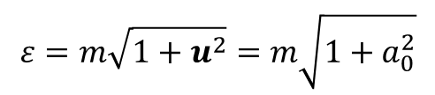
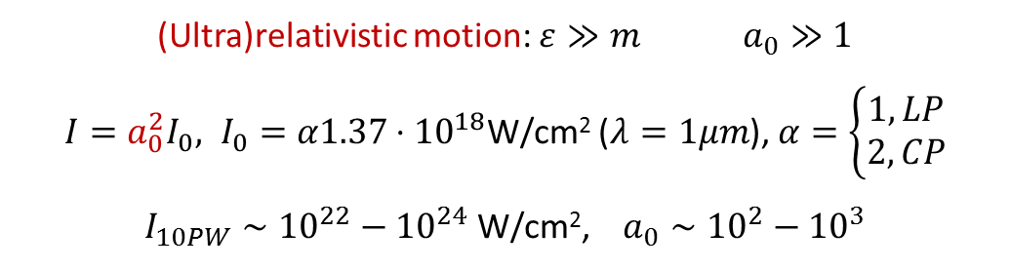


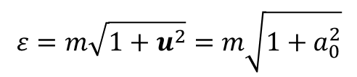

Particle motion in a monochromatic plane wave
Введение
$$\frac{du_{⊥}}{dφ}=a, \frac{du_{x}}{dτ}=\frac{1}{2γ}\frac{d}{dφ}u_{⊥}^{2}$$
Circular polarization (CP)
$a=a_{0}${$0,\cos{φ},\sin{φ}$}
$$u=a_{0}\{0,\sin{φ,−\cos{φ}}\}$$
Linear polarization (LP)
$a=a_{0}${$0,\cos{φ},0$}
$$u=a_{0}\left\{−\frac{a_{0}}{4\sqrt{1+\frac{a_{0}^{2}}{2}}}\cos{2φ},\sin{φ},0\right\}$$
$$z$$
$$r=\frac{a_{0}}{\sqrt{1+a_{0}^{2}}}\frac{λ}{2π}$$
$$b=\frac{a_{0}}{\sqrt{1+\frac{a_{0}^{2}}{2}}}\frac{λ}{2π}$$
$$x$$
$$y$$
$$\frac{b}{4}$$
$$y$$
$$b$$
$$ε=m\left(\sqrt{1+\frac{a_{0}^{2}}{2}}−\frac{a_{0}^{2}\cos{2φ}}{4\sqrt{1+\frac{a_{0}^{2}}{2}}}\right)$$
$$ε=m\sqrt{1+u^{2}}=m\sqrt{1+a_{0}^{2}}$$
(Ultra)relativistic motion: $ε≫m$ $a_{0}≫1$
$I=a_{0}^{2}I_{0}, I_{0}=α1.37⋅{10}^{18}$W/cm² ($λ=1μm$), $α=\left\{\begin{aligned}1, LP \\ 2, CP\end{aligned}\right.$
$I_{10PW}∼{10}^{22}−{10}^{24}$ W/cm², $a_{0}∼{10}^{2}−{10}^{3}$
$$S$$
$$I∼\frac{P}{S}$$

Slide 10
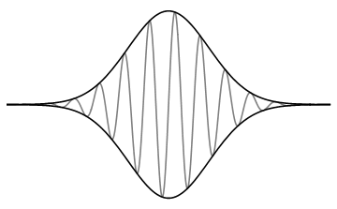

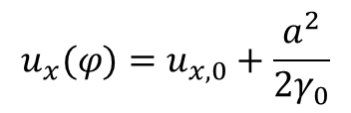

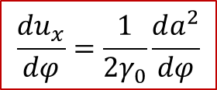
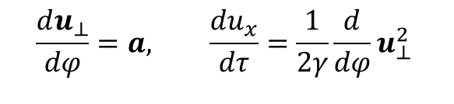
Laser pulse. Ponderomotive force
Введение
$a=a_{0}g\left(\frac{φ}{T}\right)${$0,\cos{φ},\sin{φ}$}
$$\frac{du_{⊥}}{dφ}=a, \frac{du_{x}}{dτ}=\frac{1}{2γ}\frac{d}{dφ}u_{⊥}^{2}$$
Circular polarization
If $T≫1$, then $u_{⊥}≈a_{0}g\left(\frac{φ}{T}\right)\left\{0,\sin{φ},−\cos{φ}\right\}$, $u_{⊥}^{2}≈a^{2}$
$$\frac{du_{x}}{dφ}=\frac{1}{2γ_{0}}\frac{da^{2}}{dφ}$$
$$T$$
$$u_{x}(φ)=u_{x,0}+\frac{a^{2}}{2γ_{0}}$$

Slide 11
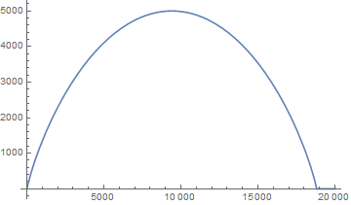



Laser pulse. Ponderomotive force
Введение
$a=a_{0}g\left(\frac{φ}{T}\right)${$0,\cos{φ},\sin{φ}$}
$$\frac{du_{⊥}}{dφ}=a, \frac{du_{x}}{dτ}=\frac{1}{2γ}\frac{d}{dφ}u_{⊥}^{2}$$
Circular polarization
If $T≫1$, then $u_{⊥}≈a_{0}g\left(\frac{φ}{T}\right)\left\{0,\sin{φ},−\cos{φ}\right\}$, $u_{⊥}^{2}≈a^{2}$
$$\frac{du_{x}}{dφ}=\frac{1}{2γ_{0}}\frac{da^{2}}{dφ}$$
$$u_{x}$$
$$T$$
$$a_{0}^{2}/2$$
$$u_{x}(φ)=u_{x,0}+\frac{a^{2}}{2γ_{0}}$$
$$τ$$

Slide 12

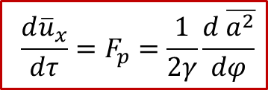
Laser pulse. Ponderomotive force
Введение
$a=a_{0}g\left(\frac{φ}{T}\right)${$0,\cos{φ},\sin{φ}$}
$$\frac{du_{⊥}}{dφ}=a, \frac{du_{x}}{dτ}=\frac{1}{2γ}\frac{d}{dφ}u_{⊥}^{2}$$
Circular polarization
If $T≫1$, then $u_{⊥}≈a_{0}g\left(\frac{φ}{T}\right)\left\{0,\sin{φ},−\cos{φ}\right\}$, $u_{⊥}^{2}≈a^{2}$
$$\frac{du_{x}}{dφ}=\frac{1}{2γ_{0}}\frac{da^{2}}{dφ}$$
$$u_{x}$$
$$T$$
$$a_{0}^{2}/2$$
$$u_{x}(φ)=u_{x,0}+\frac{a^{2}}{2γ_{0}}$$
$$τ$$
Linear polarization: $a=a_{0}g\left(\frac{φ}{T}\right)${$0,\cos{φ},0$}
$$u_{⊥}≈a_{0}g\left(\frac{φ}{T}\right)\left\{0,\sin{φ},0\right\}, \frac{du_{x}}{dφ}=\frac{a_{0}^{2}}{4γ_{0}}\left[\frac{dg^{2}}{dφ}−\frac{dg^{2}}{dφ}\cos{2φ}+2g^{2}\sin{2φ}\right]$$
Motion, averaged over fast laser oscillations, is governed by ponderomotive force
$$\frac{d{\overline{u}}_{x}}{dτ}=F_{p}=\frac{1}{2γ}\frac{d \overline{a^{2}}}{dφ}$$

Slide 13

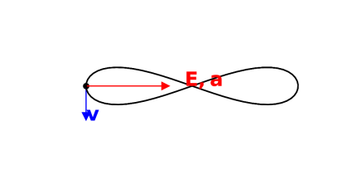

Laser pulse. Ponderomotive force
Введение
$a=a_{0}g\left(\frac{φ}{T}\right)${$0,\cos{φ},\sin{φ}$}
$$\frac{du_{⊥}}{dφ}=a, \frac{du_{x}}{dτ}=\frac{1}{2γ}\frac{d}{dφ}u_{⊥}^{2}$$
Circular polarization
If $T≫1$, then $u_{⊥}≈a_{0}g\left(\frac{φ}{T}\right)\left\{0,\sin{φ},−\cos{φ}\right\}$, $u_{⊥}^{2}≈a^{2}$
$$\frac{du_{x}}{dφ}=\frac{1}{2γ_{0}}\frac{da^{2}}{dφ}$$
$$u_{x}$$
$$T$$
$$a_{0}^{2}/2$$
$$u_{x}(φ)=u_{x,0}+\frac{a^{2}}{2γ_{0}}$$
$$z$$
$$x$$
$$y$$
$$y$$
$$τ$$
Linear polarization: $a=a_{0}g\left(\frac{φ}{T}\right)${$0,\cos{φ},0$}
$$u_{⊥}≈a_{0}g\left(\frac{φ}{T}\right)\left\{0,\sin{φ},0\right\}, \frac{du_{x}}{dφ}=\frac{a_{0}^{2}}{4γ_{0}}\left[\frac{dg^{2}}{dφ}−\frac{dg^{2}}{dφ}\cos{2φ}+2g^{2}\sin{2φ}\right]$$
Motion, averaged over fast laser oscillations, is governed by ponderomotive force
$$\frac{d{\overline{u}}_{x}}{dτ}=F_{p}=\frac{1}{2γ}\frac{d \overline{a^{2}}}{dφ}$$

Slide 14
Laser pulse. Ponderomotive force
Введение
$a=a_{0}g\left(\frac{φ}{T}\right)${$0,\cos{φ},\sin{φ}$}
$$\frac{du_{⊥}}{dφ}=a, \frac{du_{x}}{dτ}=\frac{1}{2γ}\frac{d}{dφ}u_{⊥}^{2}$$
Circular polarization
If $T≫1$, then $u_{⊥}≈a_{0}g\left(\frac{φ}{T}\right)\left\{0,\sin{φ},−\cos{φ}\right\}$, $u_{⊥}^{2}≈a^{2}$
two different time scales allow to separate fast and slow motion
$$\frac{du_{x}}{dφ}=\frac{1}{2γ_{0}}\frac{da^{2}}{dφ}$$
$$u_{x}$$
$$T$$
$$a_{0}^{2}/2$$
$$u_{x}(φ)=u_{x,0}+\frac{a^{2}}{2γ_{0}}$$
$$z$$
$$x$$
$$y$$
$$y$$
$$τ$$
Linear polarization: $a=a_{0}g\left(\frac{φ}{T}\right)${$0,\cos{φ},0$}
$$u_{⊥}≈a_{0}g\left(\frac{φ}{T}\right)\left\{0,\sin{φ},0\right\}, \frac{du_{x}}{dφ}=\frac{a_{0}^{2}}{4γ_{0}}\left[\frac{dg^{2}}{dφ}−\frac{dg^{2}}{dφ}\cos{2φ}+2g^{2}\sin{2φ}\right]$$
Motion, averaged over fast laser oscillations, is governed by ponderomotive force
$$\frac{d{\overline{u}}_{x}}{dτ}=F_{p}=\frac{1}{2γ}\frac{d \overline{a^{2}}}{dφ}$$

Slide 15
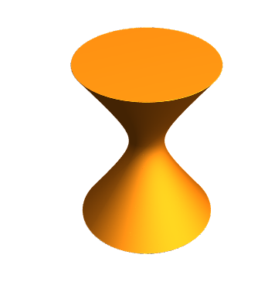


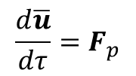





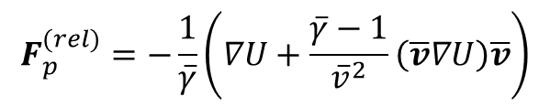


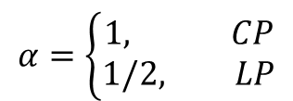






Focused laser. Ponderomotive force
Введение
$$y$$
$$<F>∥−∇a$$
$$x$$
$$v_{2}$$
$$z$$
$$z$$
$$E_{2}$$
$$y$$
$$ω$$
$$E_{1}>E_{2}$$
$$v_{1}$$
$$S=πw^{2}, w≫λ$$
$$\frac{d\overline{u}}{dτ}=F_{p}$$
D. Bauer, P. Mulser, W.-H. Steeb, PRL 75, 4622 (1995)
$$F_{p}^{(nr)}=−∇U$$
$$U=\sqrt{1+αa^{2}}$$
$$F_{p}^{(rel)}=−\frac{1}{\overline{γ}}\left(∇U+\frac{\overline{γ}−1}{{\overline{v}}^{2}}\left(\overline{v}∇U\right)\overline{v}\right)$$
ponderomotive potential
$$α=\left\{\begin{aligned}1, CP \\ 1/2, LP\end{aligned}\right.$$
$\overline{u},\overline{v},\overline{γ}$ – averaged over fast oscillations
Ponderomotive force pushes particle away from a strong field region

Slide 16
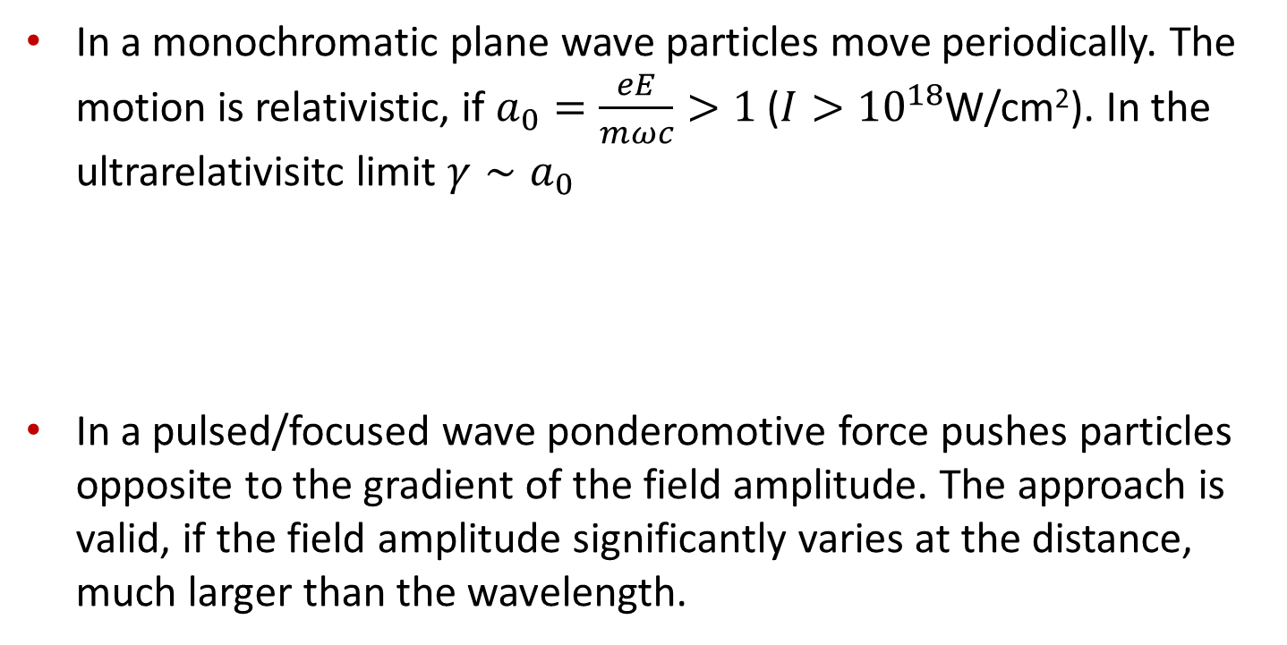
Summary I
In a monochromatic plane wave particles move periodically. The motion is relativistic, if $a_{0}=\frac{eE}{mωc}>1$ ($I>{10}^{18}$W/cm²). In the ultrarelativisitc limit $γ∼a_{0}$
In a pulsed/focused wave ponderomotive force pushes particles opposite to the gradient of the field amplitude. The approach is valid, if the field amplitude significantly varies at the distance, much larger than the wavelength.

Slide 17

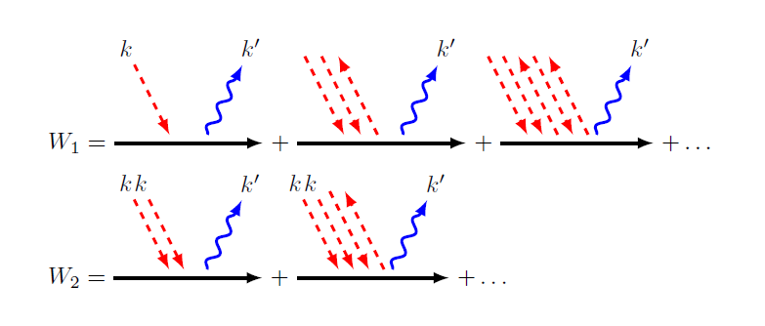







Radiation and radiation friction: quantum and classical approaches
N.B. Narozhny & A.M. Fedotov, Contemporary Physics, 56:3, 249-268, (2015)
$$p+nω→p^{′}+γ′$$
$$ω$$
$$γ^{′}$$
$$γ^{′}$$
$$γ^{′}$$
$ω$ $ω$
$$γ^{′}$$
$ω$ $ω$
$$γ^{′}$$

Slide 18
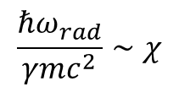
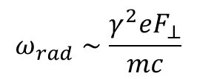
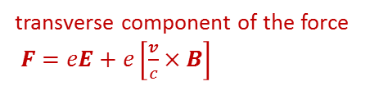
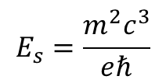

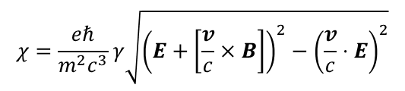
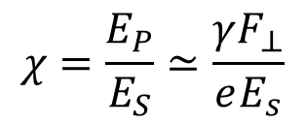
Radiation and radiation friction: quantum and classical approaches
N.B. Narozhny & A.M. Fedotov, Contemporary Physics, 56:3, 249-268, (2015)
$$p+nω→p^{′}+γ′$$
$$ω$$
$$γ^{′}$$
$$γ^{′}$$
$$γ^{′}$$
$ω$ $ω$
$$γ^{′}$$
$ω$ $ω$
$$γ^{′}$$
$$W_{s}=W_{s}(a_{0},χ)$$
$$χ=\frac{eℏ}{m^{2}c^{3}}γ\sqrt{{\left(E+\left[\frac{v}{c}×B\right]\right)}^{2}−{\left(\frac{v}{c}⋅E\right)}^{2}}$$
laser field in the rest frame
transverse component of the force
$F=eE+e\left[\frac{v}{c}×B\right]$
$$χ=\frac{E_{P}}{E_{S}}≃\frac{γF_{⊥}}{eE_{s}}$$
$$E_{s}=\frac{m^{2}c^{3}}{eℏ}$$
QED critical field
$$ω_{rad}∼\frac{γ^{2}eF_{⊥}}{mc}$$
$$\frac{ℏω_{rad}}{γmc^{2}}∼χ$$
is a measure of recoil
radiation frequency (classical)

Slide 19
Radiation and radiation friction: quantum and classical approaches
$χ≳1$ – quantum regime, strong recoil due to single emission event
In a field, more complex than a plane wave, can be treated numerically
quantum radiation
WKB motion along the classical trajectory

Slide 20
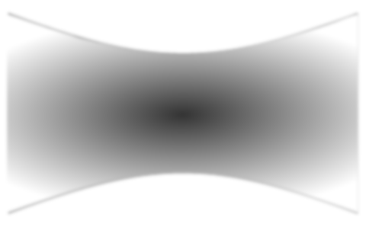
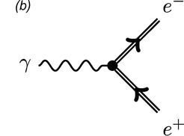






Radiation and radiation friction: quantum and classical approaches
$χ≳1$ – quantum regime, strong recoil due to single emission event
In a field, more complex than a plane wave, can be treated numerically
quantum radiation
WKB motion along the classical trajectory
Breit – Wheeler pair production and QED cascade
$$γ$$
$$e^{−}$$
$$e^{+}$$
$$e^{−}$$
$$e^{−}$$
A. Fedotov, N. Narozhny, G. Mourou, G. KornPRL 105, 080402 (2010)

Slide 21
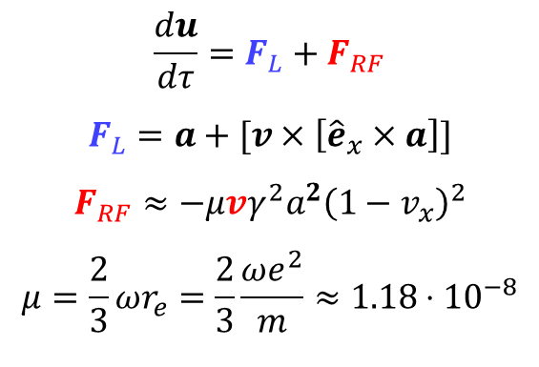
Radiation and radiation friction: quantum and classical approaches
L. D. Landau and E.M. Lifshitz, The Classical Theory of Fields (Pergamon Press, Oxford, 1975)
$χ≪1$ – classical regime, sometimes can be treated analytically
$$\frac{du}{dτ}=F_{L}+F_{RF}$$
$$F_{L}=a+[v×\left[{\hat{e}}_{x}×a\right]]$$
$$F_{RF}≈−μv{γ^{2}a}^{2}{\left(1−v_{x}\right)}^{2}$$
$$μ=\frac{2}{3}ωr_{e}=\frac{2}{3}\frac{ωe^{2}}{m}≈1.18⋅{10}^{−8}$$
Lorentz force
Radiation friction force
(or radiation reaction force)

Slide 22
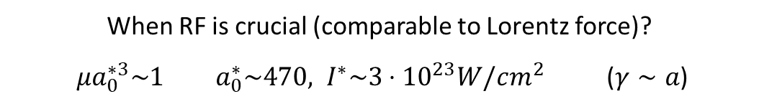
Radiation and radiation friction: quantum and classical approaches
L. D. Landau and E.M. Lifshitz, The Classical Theory of Fields (Pergamon Press, Oxford, 1975)
$χ≪1$ – classical regime, sometimes can be treated analytically
$$\frac{du}{dτ}=F_{L}+F_{RF}$$
$$F_{L}=a+[v×\left[{\hat{e}}_{x}×a\right]]$$
$$F_{RF}≈−μv{γ^{2}a}^{2}{\left(1−v_{x}\right)}^{2}$$
$$μ=\frac{2}{3}ωr_{e}=\frac{2}{3}\frac{ωe^{2}}{m}≈1.18⋅{10}^{−8}$$
Lorentz force
Radiation friction force
(or radiation reaction force)
When RF is crucial (comparable to Lorentz force)?
$μa_{0}^{∗3}\sim 1$ $a_{0}^{∗}\sim 470, I^{∗}\sim 3⋅{10}^{23}W/cm^{2}$ ($γ∼a$)

Slide 23
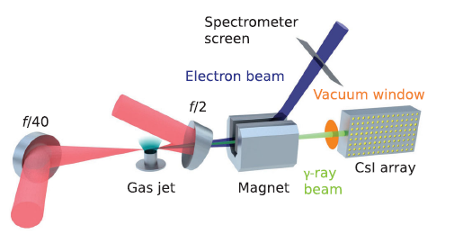

Radiation and radiation friction: quantum and classical approaches
L. D. Landau and E.M. Lifshitz, The Classical Theory of Fields (Pergamon Press, Oxford, 1975)
$χ≪1$ – classical regime, sometimes can be treated analytically
$$\frac{du}{dτ}=F_{L}+F_{RF}$$
$$F_{L}=a+[v×\left[{\hat{e}}_{x}×a\right]]$$
$$F_{RF}≈−μv{γ^{2}a}^{2}{\left(1−v_{x}\right)}^{2}$$
$$μ=\frac{2}{3}ωr_{e}=\frac{2}{3}\frac{ωe^{2}}{m}≈1.18⋅{10}^{−8}$$
Lorentz force
Radiation friction force
(or radiation reaction force)
When RF is crucial (comparable to Lorentz force)?
$μa_{0}^{∗3}\sim 1$ $a_{0}^{∗}\sim 470, I^{∗}\sim 3⋅{10}^{23}W/cm^{2}$ ($γ∼a$)
Experimental observation
J.M. Cole et al. Phys. Rev. X 8, 011020 (2018)
K. Poder et al. Phys. Rev. X 8, 031004 (2018)
$$a≈20, γ≈1000$$

Slide 24
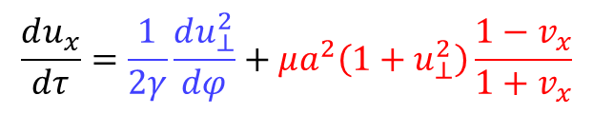
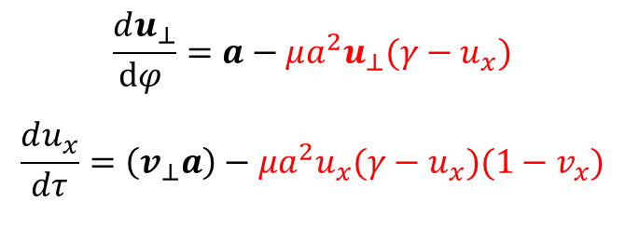
Radiation induced acceleration
$$\frac{du_{⊥}}{dφ }=a−μa^{2}u_{⊥}(γ−u_{x})$$
$$\frac{du_{x}}{dτ}=\left(v_{⊥}a\right)−μa^{2}u_{x}(γ−u_{x})(1−v_{x})$$
$$\frac{du_{x}}{dτ}=\frac{1}{2γ}\frac{du_{⊥}^{2}}{dφ}+μa^{2}\left(1+u_{⊥}^{2}\right)\frac{1−v_{x}}{1+v_{x}}$$
ponderomotive term
RF induced term

Slide 25



Radiation induced acceleration
$$\frac{du_{⊥}}{dφ }=a−μa^{2}u_{⊥}(γ−u_{x})$$
$$\frac{du_{x}}{dτ}=\left(v_{⊥}a\right)−μa^{2}u_{x}(γ−u_{x})(1−v_{x})$$
$$μa^{2}u_{⊥}^{2}\left(1−v_{x}\right)$$
$$\frac{du_{x}}{dτ}=\frac{1}{2γ}\frac{du_{⊥}^{2}}{dφ}+μa^{2}\left(1+u_{⊥}^{2}\right)\frac{1−v_{x}}{1+v_{x}}$$
ponderomotive term
RF induced term
$$−μa^{2}u_{x}(γ−u_{x})(1−v_{x})$$

Slide 26


Radiation induced acceleration
$$\frac{du_{⊥}}{dφ }=a−μa^{2}u_{⊥}(γ−u_{x})$$
$$\frac{du_{x}}{dτ}=\left(v_{⊥}a\right)−μa^{2}u_{x}(γ−u_{x})(1−v_{x})$$
$$μa^{2}u_{⊥}^{2}\left(1−v_{x}\right)$$
$$\frac{du_{x}}{dτ}=\frac{1}{2γ}\frac{du_{⊥}^{2}}{dφ}+μa^{2}\left(1+u_{⊥}^{2}\right)\frac{1−v_{x}}{1+v_{x}}$$
$$z$$
ponderomotive term
RF induced term
$$−μa^{2}u_{x}(γ−u_{x})(1−v_{x})$$
$$y$$
B.S. Voronin, A.A. Kolomenskii, Sov. Phys. JETP 65 1027 (1965)
Y.B. Zeldovich, Sov. Phys.Usp. 18 79 (1975)
D.M. Fradkin, Phys. Rev. Lett. 42 1209 (1975)
Due to modification of transverse motion, RF induces
electron acceleration in longitudinal direction
$$ω$$
Exact solution: A. Di Piazza Lett. Math. Phys. 83 305–313 (2008)
Monochromatic CP plane wave

Slide 27

Radiation induced acceleration
$$\frac{du_{⊥}}{dφ }=a−μa^{2}u_{⊥}(γ−u_{x})$$
$$\frac{du_{x}}{dτ}=\left(v_{⊥}a\right)−μa^{2}u_{x}(γ−u_{x})(1−v_{x})$$
$$μa^{2}u_{⊥}^{2}\left(1−v_{x}\right)$$
$$\frac{du_{x}}{dτ}=\frac{1}{2γ}\frac{du_{⊥}^{2}}{dφ}+μa^{2}\left(1+u_{⊥}^{2}\right)\frac{1−v_{x}}{1+v_{x}}$$
$$z$$
ponderomotive term
RF induced term
$$−μa^{2}u_{x}(γ−u_{x})(1−v_{x})$$
$$y$$
B.S. Voronin, A.A. Kolomenskii, Sov. Phys. JETP 65 1027 (1965)
Y.B. Zeldovich, Sov. Phys.Usp. 18 79 (1975)
D.M. Fradkin, Phys. Rev. Lett. 42 1209 (1975)
Due to modification of transverse motion, RF induces
electron acceleration in longitudinal direction
$$ω$$
Exact solution: A. Di Piazza Lett. Math. Phys. 83 305–313 (2008)
$u_{x}≈{\left(\frac{3}{4}μτ\right)}^{\frac{1}{3}}a_{0}^{2}$ for $μa^{3}τ≫1$
Monochromatic CP plane wave

Slide 28

Radiation friction in plasma: application for ion acceleration
D. Del Sorbo et al 2018 New J. Phys. 20 033014

Slide 29


Ion acceleration by strong lasers
Введение
$$d≲λ$$

Slide 30

Ion acceleration by strong lasers
Введение
Radiation pressure acceleration
S. C. Wilks et al., PRL 69, 1383 (1992)
Light Sail model
T. Esirkepov et.al. PRL 92, 175003 (2004)
...
$$d≲λ$$
opaque target
ions
electrons
$$ε_{i}∼\frac{ε_{L}}{N_{i}}∼m_{e}\frac{a_{0}^{2}T}{σ_{0}}$$
$$T=ωt_{pulse}, { σ}_{0}=\frac{n_{0}}{n_{c}}ωd$$
pulse duration
areal density
charge separation field
$$σ_{0}>σ_{opaque}$$

Slide 31
Ion acceleration by strong lasers
Введение
Radiation pressure acceleration
S. C. Wilks et al., PRL 69, 1383 (1992)
Light Sail model
T. Esirkepov et.al. PRL 92, 175003 (2004)
...
$$d≲λ$$
opaque target
ions
electrons
$$ε_{i}∼\frac{ε_{L}}{N_{i}}∼m_{e}\frac{a_{0}^{2}T}{σ_{0}}$$
$$T=ωt_{pulse}, { σ}_{0}=\frac{n_{0}}{n_{c}}ωd$$
pulse duration
areal density
charge separation field
Opacity threshold
V. Vshivkov et. al., PoP 5, 2727 (1998): $σ_{opaque }∼a_{0}$
E. Gelfer et. al., arXiv:1906.05902 (2019): refined threshold

Slide 32

Ion acceleration by strong lasers
Введение
Radiation pressure acceleration
S. C. Wilks et al., PRL 69, 1383 (1992)
Light Sail model
T. Esirkepov et.al. PRL 92, 175003 (2004)
...
$$d≲λ$$
opaque target
ions
electrons
$$ε_{i}∼\frac{ε_{L}}{N_{i}}∼m_{e}\frac{a_{0}^{2}T}{σ_{0}}$$
$$T=ωt_{pulse}, { σ}_{0}=\frac{n_{0}}{n_{c}}ωd$$
pulse duration
areal density
charge separation field
Opacity threshold
V. Vshivkov et. al., PoP 5, 2727 (1998): $σ_{opaque }∼a_{0}$
E. Gelfer et. al., arXiv:1906.05902 (2019): refined threshold
Radiation friction effect on LS acceleration
M. Tamburini et.al. NJP 12, 123005 (2010)
…

Slide 33

Ion acceleration by strong lasers
Введение
Radiation pressure acceleration
S. C. Wilks et al., PRL 69, 1383 (1992)
Light Sail model
T. Esirkepov et.al. PRL 92, 175003 (2004)
...
$$d≲λ$$
opaque target
ions
electrons
$$ε_{i}∼\frac{ε_{L}}{N_{i}}∼m_{e}\frac{a_{0}^{2}T}{σ_{0}}$$
$$T=ωt_{pulse}, { σ}_{0}=\frac{n_{0}}{n_{c}}ωd$$
pulse duration
areal density
charge separation field
Opacity threshold
transparent target
V. Vshivkov et. al., PoP 5, 2727 (1998): $σ_{opaque }∼a_{0}$
E. Gelfer et. al., arXiv:1906.05902 (2019): refined threshold
Radiation friction effect on LS acceleration
M. Tamburini et.al. NJP 12, 123005 (2010)
…
$I∼{10}^{23}−{10}^{24}$ W/cm²
Radiation friction enhances charge separation
in transparent plasma
E. Gelfer, N. Elkina, A. Fedotov, Sci. Rep. 8, 6478 (2018)
E. Gelfer, A. Fedotov, S. Weber, PPCF 60, 064005 (2018)
$$\frac{dp}{dt}=F_{L}+F_{RF}$$

Slide 34


Radiation friction in plasma: application for ion acceleration
E. Gelfer, N. Elkina, A. Fedotov, Scientific Reports 8, 6478 (2018)
E. Gelfer, A. Fedotov, S. Weber, PPCF 60, 064005 (2018)
E. Gelfer, A. Fedotov, S. Weber, arXiv: 1907.02621 (2019)
PIC simulations: see the lecture by E. Chacon-Golcher
Laser and target parameters :
$I∼4.4⋅{10}^{23}\frac{W}{cm^{2}} (a_{0}=400)$, FWHM pulse duration $t_{p}=30 fs$, CP
$n=0.5n_{c}$ , $d=λ=1 μm$, $H^{+}$ ions
RF ON
RF OFF
Grey – laser field, Blue – longitudinal field,
Red – electron density, Green – ion density

Slide 35







Radiation induced acceleration of ions: electrons motion
RF ON
RF OFF
$$\frac{du_{x}}{dτ}=\frac{1}{2γ}\frac{da^{2}}{dφ}+μa^{4}\frac{1−v_{x}}{1+v_{x}}− σ$$
$$σ\left(τ,x\right)=\int_{x}^{∞}{\frac{n}{n_{c}}ωdx}$$
$$(u_{⊥}^{2}≈a^{2}≫1)$$
ponderomotive term
RF induced term
longitudinal
field
$$n_{c}=\frac{m_{e}ω^{2}}{4πe^{2}}$$
$$\frac{∂σ}{∂τ}+\frac{∂σ}{∂φ}\left(1−v_{x}\right)=0$$
continuity equation

Slide 36
Radiation induced acceleration of ions: electrons motion
RF ON
RF OFF
$$\frac{du_{x}}{dτ}=\frac{1}{2γ}\frac{da^{2}}{dφ}+μa^{4}\frac{1−v_{x}}{1+v_{x}}− σ$$
$$σ\left(τ,x\right)=\int_{x}^{∞}{\frac{n}{n_{c}}ωdx}$$
$$(u_{⊥}^{2}≈a^{2}≫1)$$
ponderomotive term
RF induced term
longitudinal
field
$$n_{c}=\frac{m_{e}ω^{2}}{4πe^{2}}$$
$$\frac{∂σ}{∂τ}+\frac{∂σ}{∂φ}\left(1−v_{x}\right)=0$$
continuity equation
Acceleration mechanisms
Radiation induced acceleration (RIA)
neglect ponderomotive term
Ponderomotive acceleration (PA)
neglect radiation induced term

Slide 37



Radiation induced acceleration of ions: electrons motion
RF ON
RF OFF
$$\frac{du_{x}}{dτ}=\frac{1}{2γ}\frac{da^{2}}{dφ}+μa^{4}\frac{1−v_{x}}{1+v_{x}}− σ$$
$$σ\left(τ,x\right)=\int_{x}^{∞}{\frac{n}{n_{c}}ωdx}$$
$$(u_{⊥}^{2}≈a^{2}≫1)$$
ponderomotive term
RF induced term
longitudinal
field
$$n_{c}=\frac{m_{e}ω^{2}}{4πe^{2}}$$
$$\frac{∂σ}{∂τ}+\frac{∂σ}{∂φ}\left(1−v_{x}\right)=0$$
continuity equation
$$σ_{p}^{(RIA)}\left(τ\right)=σ(τ,φ=T)≈\left\{\begin{aligned}σ_{0}, τ<τ_{bd} \\ \frac{μa_{0}^{4}T}{2τ}, τ>τ_{bd}\end{aligned}\right.$$
$$τ_{bd}=\frac{μa_{0}^{4}T}{2σ_{0}}$$
$$σ_{p}^{(PA)}\left(τ\right)≈\frac{a_{0}}{2\sqrt{Tτ}}$$
charge captured inside the laser pulse
breakdown time

Slide 38











Radiation induced acceleration of ions: ions motion
$$a_{0}=600, t_{pulse}=30fs,$$
$$n=0.5n_{c}, d=λ=1μm$$
LS: $n=190n_{c}$
$$u_{i,max}\left(τ\right)=\frac{m_{e}}{m_{i}}\int_{0}^{τ}{σ_{p}\left(τ^{′}\right)dτ^{′}}, ε_{i,max}=m_{i}\sqrt{1+u_{i,max}^{2}}$$
$$ε_{i,max}^{(RIA)}≈m_{e}\left\{\begin{aligned}σ_{0}τ, τ<τ_{bd} \\ \frac{μa_{0}^{4}T}{2}\left(1+\ln{\frac{τ}{τ_{bd}}}\right), τ>τ_{bd}\end{aligned}\right.$$
$$ε_{i,max}^{(PA)}≈m_{e}\left\{\begin{aligned}a_{0}\sqrt{\frac{τ}{T}}, τ<τ_{acc} \\ a_{0}\sqrt{C}, τ>τ_{acc}\end{aligned}\right.$$
$$τ_{bd}=\frac{μa_{0}^{4}T}{2σ_{0}}$$
$τ_{acc}=CT$, $C≈400$ is defined by the pulse shape
$σ_{0}=\frac{n_{0}}{n_{c}}ωd$ – areal density of the foil
$T=ωt_{pulse}$ – pulse duration
RIA overcomes PA, if $μa_{0}^{3}T≳\sqrt{C}$

Slide 39




Radiation induced acceleration of ions: multidimensional effects
RF ON
RF OFF
$a_{0}=500$, CP,
FWHM 40 fs, $w=6λ$,
$n=15n_{c}$, $d=λ$
Laser diffraction: $a_{0}$ decreases with time
Ponderomotive force expels electrons in transverse direction and reduces $σ_{p}$
Complete charge separation leads to Coulomb explosion in transverse direction

Slide 40


Radiation induced acceleration of ions: multidimensional effects
RF ON
RF OFF
$a_{0}=500$, CP,
FWHM 40 fs, $w=6λ$,
$n=15n_{c}$, $d=λ$
Laser diffraction: $a_{0}$ decreases with time
Ponderomotive force expels electrons in transverse direction and reduces $σ_{p}$
Complete charge separation leads to Coulomb explosion in transverse direction
$$τ_{bd}=\frac{μa_{0}^{4}T}{2σ_{0}}$$
$$ε_{i,max}^{(RIA)}∼σ_{0}τ_{bd}$$
Possible solution: increase $σ_{0}$ to prevent complete charge separation and make $τ_{bd}$ lower than the diffraction time
(but keep $σ_{0}<σ_{opaque}$)

Slide 41




RIA vs LS
$a_{0}=500$ ($I≈7⋅{10}^{23}$W/cm²), CP,
FWHM 15 fs, $w=3λ$,
$n=50n_{c}$, $d=λ$,
$\frac{Z}{A}=\frac{1}{2}$ (deuterium)
LS: $n=160n_{c}$
$a_{0}=700$ ($I≈7⋅{10}^{23}$W/cm²), LP,
FWHM 15 fs, $w=3λ$,
$n=50n_{c}$, $d=λ$,
$\frac{Z}{A}=\frac{1}{2}$ (deuterium)
LS: $n=220n_{c}$

Slide 42























Radiative trapping
A. Fedotov, N. Elkina, E. Gelfer, N. Narozhny, H. Ruhl, PRA, 90, 053847 (2014)
A. Gonoskov et. al. PRL, 113, 014801 (2014)
L. Ji, A. Pukhov, I. Kostyukov, B. Shen, K. Akli, PRL, 112, 145003 (2014)
standing wave
Antinode of CP focused standing wave: $a=a_{0}g\left(αr_{⊥}\right)\left\{0,\cos{τ},\sin{τ}\right\}, B∼−∇g∼O\left(α\right),α≪1$
$$v_{2}$$
$$v_{2}$$
$$α=\frac{λ}{w}$$
$$E_{2}$$
$$a_{0}^{∗}=μ^{−1/3}≈470$$
$$E_{2}$$
$$F_{R,2}$$
$$ω$$
$$ω$$
$$E_{1}>E_{2}$$
$$E_{1}>E_{2}$$
$$z$$
$$v_{1}$$
$$v_{1}$$
$$δ$$
$$y$$
$$F_{R,1}>F_{R,2}$$
$$<F_{R}>⊥∇g$$
$$<F_{L}>∥−∇g$$
$$\frac{\cos{δ}}{\sin^{4}{δ}}={μa}^{3}$$
$$μa^{3}≪1, δ≈\frac{π}{2}$$
$$μa^{3}≫1, δ≈{\left(μa^{3}\right)}^{−1/4}≪1$$

Slide 43









Radiative trapping
$$g=e^{−\frac{α^{2}ω^{2}r^{2}}{2}}$$
A. Fedotov, N. Elkina, E. Gelfer, N. Narozhny, H. Ruhl, PRA, 90, 053847 (2014)
$$z$$
$$a_{0}=800, α=0.02$$
$$z$$
$$a_{0}={10}^{4}, α=0.1$$
drift motion of the guiding center
$$\frac{d\overline{r}}{dt}≈−\frac{α}{2ω}\left(\left[{\hat{e}}_{x}×∇g(\overline{r})\right]+\frac{5}{4}δ∇g(\overline{r})\right)$$
$$δ≪1$$

Slide 44
Summary
The ponderomotive force approach provides the description of particle motion in a general laser field (arbitrary spatial and temporal profiles, but not too short and not too tightly focused)
PF pushes particle away from a strong field region
In a strong field radiation recoil can substantially modify particle motion. From the classical point of view, it can be represented as a radiation friction force, directed oppositely to particle velocity.
However, RF deceleration of transverse motion, induces acceleration in longitudinal direction
Interplay between RF and PF can explain a number of laser – particle/plasma interaction phenomena, such as
Radiation induced acceleration of ions
Radiative trapping

Slide 45
Summary
The ponderomotive force approach provides the description of particle motion in a general laser field (arbitrary spatial and temporal profiles)
PF pushes particle away from a strong field region
In a strong field radiation recoil can substantially modify particle motion. From the classical point of view, it can be represented as a radiation friction force, directed oppositely to particle velocity.
However, RF deceleration of transverse motion, induces acceleration in longitudinal direction
Interplay between RF and PF can explain a number of laser – particle/plasma interaction phenomena, such as
Radiation induced acceleration of ions
Radiative trapping
Thank you for your attention

Slide 46
Scattering

Slide 47




Radiation induced acceleration of ions: multidimensional effects
RF ON
RF ON
$a_{0}=500$, CP,
FWHM 40 fs, $w=6λ$,
$n=15n_{c}$, $d=λ$
$a_{0}=500$, CP,
FWHM 15 fs, $w=3λ$,
$n=50n_{c}$, $d=λ$,
$\frac{Z}{A}=\frac{1}{2}$ (deuterium)
Laser diffraction: $a_{0}$ decreases with time
Ponderomotive force expels electrons in transverse direction and reduces $σ_{p}$
Complete charge separation leads to Coulomb explosion in transverse direction
$$τ_{bd}=\frac{μa_{0}^{4}T}{2σ_{0}}$$
$$ε_{i,max}^{(RIA)}∼σ_{0}τ_{bd}$$
Possible solution: increase $σ_{0}$ to prevent complete charge separation and make $τ_{bd}$ lower than the diffraction time
(but keep $σ_{0}<σ_{opaque}$)

Slide 48


Radiative trapping
A. Fedotov, N. Elkina, E. Gelfer, N. Narozhny, H. Ruhl, PRA, 90, 053847 (2014)
A. Gonoskov et. al. PRL, 113, 014801 (2014)
L. Ji, A. Pukhov, I. Kostyukov, B. Shen, K. Akli, PRL, 112, 145003 (2014)
standing wave
Antinode of CP focused standing wave: $a=a_{0}g\left(αr_{⊥}\right)\left\{0,\cos{τ},\sin{τ}\right\}, B∼−∇g∼O\left(α\right),α≪1$
$$v_{2}$$
$$v_{2}$$
$$E_{2}$$
$$a_{0}^{∗}=μ^{−1/3}≈470$$
$$E_{2}$$
$$F_{R,2}$$
$$ω$$
$$B_{2}$$
$$ω$$
$$E_{1}>E_{2}$$
$$E_{1}>E_{2}$$
$$z$$
$$v_{1}$$
$$v_{1}$$
$$δ$$
$$B_{1}$$
$$y$$
$$F_{R,1}>F_{R,2}$$
$$<F_{R}>⊥∇g$$
$$<F_{L}>∥−∇g$$
$$\frac{\cos{δ}}{\sin^{4}{δ}}={μa}^{3}$$
$$μa^{3}≪1, δ≈\frac{π}{2}$$
$$μa^{3}≫1, δ≈{\left(μa^{3}\right)}^{−1/4}≪1$$

Slide 49
















Laser pulse. Ponderomotive force
Введение
$a=a_{0}g\left(\frac{φ}{T}\right)${$0,\cos{φ},\sin{φ}$}
$$\frac{du_{⊥}}{dφ}=a, \frac{du_{x}}{dτ}=F_{p}=\frac{1}{2γ}\frac{d}{dφ}u_{⊥}^{2}$$
If $T≫1$, then $u_{⊥}≈a_{0}g\left(\frac{φ}{T}\right)\left\{0,\sin{φ},−\cos{φ}\right\}$, $u_{⊥}^{2}≈a^{2}$
$$\frac{du_{x}}{dφ}=\frac{1}{2γ_{0}}\frac{da^{2}}{dφ}, u_{x}(φ)=u_{x,0}+\frac{a^{2}}{2γ_{0}}$$
$$y$$
$$T$$
$$x$$
$$z$$
$$v_{2}$$
$$z$$
Focused laser
$$E_{2}$$
$$y$$
$$ω$$
$$E_{1}>E_{2}$$
D. Bauer, P. Mulser, W.-H. Steeb, PRL 75, 4622 (1995)
$$v_{1}$$
$$\frac{d\overline{u}}{dτ}=F_{p}=−\frac{1}{\overline{γ}}\left(∇U+\frac{\overline{γ}−1}{{\overline{v}}^{2}}\left(\overline{v}∇U\right)\overline{v}\right), U=\sqrt{1+αa^{2}}$$
ponderomotive potential
$\overline{u},\overline{v},\overline{γ}$ – averaged over fast oscillations
$$α=\left\{\begin{aligned}1, CP \\ 1/2, LP\end{aligned}\right.$$
$$F_{p}^{(nr)}=−∇U$$
Ponderomotive force pushes particle away from a strong field region

Slide 50




Radiative trapping
standing wave
A. Fedotov, N. Elkina, E. Gelfer, N. Narozhny, H. Ruhl, PRA, 90, 053847 (2014)
A. Gonoskov et. al. PRL, 113, 014801 (2014)
L. Ji, A. Pukhov, I. Kostyukov, B. Shen, K. Akli, PRL, 112, 145003 (2014)
Antinode of CP focused standing wave: $a=a_{0}g\left(αr_{⊥}\right)\left\{0,\cos{τ},\sin{τ}\right\}, B∼−∇g∼O\left(α\right),α≪1$
$$v_{2}$$
$$v_{2}$$
$$E_{2}$$
$$a_{0}^{∗}=μ^{−1/3}≈470$$
$$E_{2}$$
$$F_{R,2}$$
$$ω$$
$$B_{2}$$
$$ω$$
$$E_{1}>E_{2}$$
$$E_{1}>E_{2}$$
$$z$$
$$v_{1}$$
$$v_{1}$$
$$δ$$
$$B_{1}$$
$$y$$
$$F_{R,1}>F_{R,2}$$
$$<F_{R}>⊥∇g$$
$$<F_{L}>∥−∇g$$
$$\frac{\cos{δ}}{\sin^{4}{δ}}={\left(\frac{a_{0}g}{a_{0}^{∗}}\right)}^{3}$$
$$a_{0}g≫a_{0}^{∗}, δ≈{\left(\frac{a_{0}^{∗}}{a_{0}g}\right)}^{3/4}≪1$$
$$a_{0}g≪a_{0}^{∗}, δ≈\frac{π}{2}$$

Slide 51








Radiation induced acceleration of ions: electrons motion
$$\frac{du_{x}}{dτ}=\frac{1}{2γ}\frac{da^{2}}{dφ}+μa^{4}\frac{1−v_{x}}{1+v_{x}}−a_{∥}$$
one particle equation
$$(u_{⊥}^{2}≈a^{2}≫1)$$
ponderomotive term
RF induced term
longitudinal
field
$$σ\left(τ,x\right)=\int_{x}^{∞}{\tilde{n}ωdx}$$
$$\frac{∂u_{x}}{∂τ}+v_{x}\frac{∂u_{x}}{ω∂x}=\frac{1}{2γ}\frac{da^{2}}{dφ}+μa^{4}\frac{1−v_{x}}{1+v_{x}}−σ$$
hydrodynamic equation
$$\tilde{n}=\frac{n}{n_{c}}, n_{c}=\frac{m_{e}ω^{2}}{4πe^{2}}$$
$$\frac{∂u_{x}}{∂τ}=\frac{∂}{∂φ}\frac{a^{2}}{2γ}+μa^{4}\frac{1−v_{x}}{1+v_{x}}−σ(τ,φ)$$
$$\frac{∂σ}{∂τ}+\frac{∂σ}{∂φ}\left(1−v_{x}\right)=0$$
RF neglected: $\frac{du_{x}}{dτ}≈\frac{1}{2u_{x}}\frac{da^{2}}{dφ}−σ$
$$φ=ω(t−x)$$
$$u_{x}∼a_{0}\sqrt{\frac{τ}{T}}g^{2}\left(\frac{φ}{T}\right)$$

Slide 52

Laser ion acceleration
Radiation pressure acceleration
S. C. Wilks et al., PRL 69, 1383 (1992)
T. Esirkepov et.al. PRL 92, 175003 (2004)
RF effects
M. Tamburini et.al. NJP 12, 123005 (2010)
ions
electrons
opaque target
Radiation induced acceleration
E.G. Gelfer, A.M. Fedotov, S. Weber, arXiv:1907.02621 (2019)
transparent target

Slide 53


Simulations with and without RR
ELI Beamlines laser parameters:
$I∼5⋅{10}^{23}\frac{W}{cm^{2}}$
$$(a_{0}=420)$$
Duration $t_{p}=150 fs$
$$λ=1 μm$$
$$n=0.01n_{c}$$
$$n/n_{c}$$
RF ON
RF OFF
Grey – transverse field
Blue – longitudinal field
Red – electrons density
Green – ions density

Slide 54






Radiation friction in plasma
RF enhances longitudinal waves in plasma
PIC simulations: see the lecture by E. Chacon-Golcher
E. Gelfer, N. Elkina, A. Fedotov, Scientific Reports 8, 6478 (2018)
E.G. Gelfer, A.M. Fedotov, S. Weber, PPCF 60, 064005 (2018)
RF ON
RF ON
Grey – laser field
Blue – (20x)longitudinal field
Red – electron density
Green – ion density (constant)
RF OFF
RF OFF
$$\frac{du_{x}}{dτ}=\frac{1}{2γ}\frac{da^{2}}{dφ}+μa^{4}\frac{1−v_{x}}{1+v_{x}}−a_{∥}$$
$$a_{∥}=\frac{n}{n_{c}}ωx$$
$$(u_{⊥}^{2}≈a^{2}≫1)$$
ponderomotive term
RF induced term
longitudinal
field
$$a_{∥ max}^{(RFM)}≈\sqrt{μ\frac{n}{n_{c}}T}{\left(\frac{I}{I_{0}}\right)}^{2}, a_{∥}^{\left(PM\right)}≈{\left(\frac{n}{n_{c}T}\frac{I}{I_{0}}\right)}^{1/3}$$
ultrarelativistic longitudinal motion: $u_{x}≫u_{⊥}, v_{x}≈1$

Slide 55



Radiative trapping
$$v_{2}$$
$$E_{2}$$
$$B_{2}$$
$$E_{1}>E_{2}$$
$$v_{1}$$
$$B_{1}$$

Slide 56

Summary
We revised the accepted threshold for opaqueness of a thin foil to a strong circularly polarized laser pulse with account to laser absorption.
The opacity threshold depends on laser pulse temporal profile, duration and ions charge to mass ratio. The dependence on laser intensity for Gaussian pulse is weak (logarithmic).
Our findings are is excellent agreement with PIC simulations.
Limitations:
$a_{0}≫\frac{A}{TZμ}$
Only circularly polarized laser pulses.
Rayleigh – Taylor instability in multi dimensions.
Pulse steepening can be used for applications.
E. G. Gelfer, A. M. Fedotov, O. Klimo, S. Weber, arXiv:1906.05902

Slide 57





Radiation
$$γ$$
$$e^{−}$$
$$e^{−}$$
$$e^{−}$$
$$e^{+}$$
QED cascade

Slide 58






Radiation
$$γ$$
$$e^{−}$$
$$e^{−}$$
$$e^{+}$$
$$e^{−}$$
QED cascade

Slide 59



Radiation and radiation friction: quantum and classical approaches
$$p+nω→p^{′}+γ′$$
$$ω$$
$$γ^{′}$$
$$γ^{′}$$
$$γ^{′}$$
$ω$ $ω$
$$γ^{′}$$
$ω$ $ω$
$$γ^{′}$$
Laser field in the rest frame
$$χ=\frac{eℏ}{m^{2}c^{3}}γ\sqrt{{\left(E+\left[\frac{v}{c}×B\right]\right)}^{2}−{\left(\frac{v}{c}⋅E\right)}^{2}}=\frac{E_{P}}{E_{S}}≃\frac{γF_{⊥}}{eE_{s}}, E_{s}=\frac{m^{2}c^{3}}{eℏ}$$
QED critical field

