Slide 1
Laser Electron Acceleration
Gabriele Maria Grittani
Leader of Electron Acceleration Group
27th August 2019, ELI Summer School, Dolni Brezany (Czech Republic)

Slide 2
Outline of the lecture
Why do we need compact accelerators?
Laser Wakefield Acceleration
State of the art
Future Directions
The Electron Acceleration program at ELI-Beamlines
Date:
21.10.2016
Page:
2

Slide 3
Outline of the lecture
Why do we need compact accelerators?
Laser Wakefield Acceleration
State of the art
Future Directions
The Electron Acceleration program at ELI-Beamlines
Date:
21.10.2016
Page:
3

Slide 4

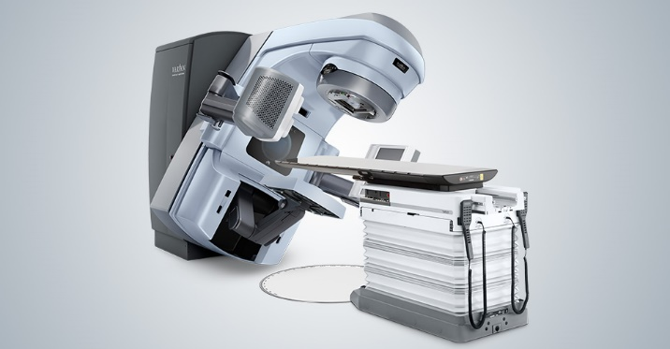
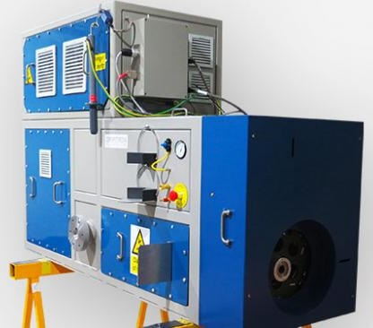
Why do we need compact accelerators?
FUNDAMENTAL SCIENCE
European XFEL, Schenefeld, Germany
17.5 GeV, 1 nC/pulse, 3x10⁴ pulse/s
3.4 km long, 1.25 B€ [1]
3.4 km
MEDICINE & INDUSTRY
30000 accelerators worldwide
MeV energy, 0.01-1 A average current
Market size 500 B€/year [2]
[1] https://www.xfel.eu/facility/overview/facts_amp_figures/index_eng.html
[2] R. Kephart et al., “SRF, COMPACT ACCELERATORS FOR INDUSTRY & SOCIETY”, FRBA03, Proceedings of SRF2015, Whistler, BC, Canada
Date:
21.10.2016
Page:
4

Slide 5
Outline of the lecture
Why do we need compact accelerators?
Laser Wakefield Acceleration
State of the art
Future Directions
The Electron Acceleration program at ELI-Beamlines
Date:
21.10.2016
Page:
5

Slide 6
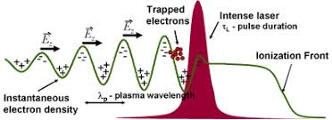

Laser Wakefield Acceleration
The use of plasma as an accelerating medium to avoid breakdown and achieve stronger gradients was already discussed in 50s [1].
In 1979, Tajima and Dawson proposed to accelerate electron beams in the wake of a laser pulse propagating inside a plasma [2]. They predicted GV/cm accelerating gradients by focusing a laser pulse down to 10¹⁸ W/cm² in a 10¹⁸ cm⁻³ plasma.
[1] V. I. Veksler, “Coherent principle of acceleration of charged particles”, Proceedings of the CERN Symposium on High Energy Accelerators and Pion Physics, vol. 1. Geneva, 1956. Pages 80–83
[2] T. Tajima and J. M. Dawson, “Laser Electron Accelerator”, Phys. Rev. Lett. 43, 267 (1979)
Date:
21.10.2016
Page:
6

Slide 7
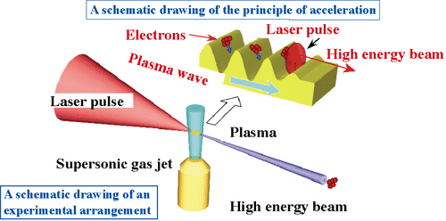
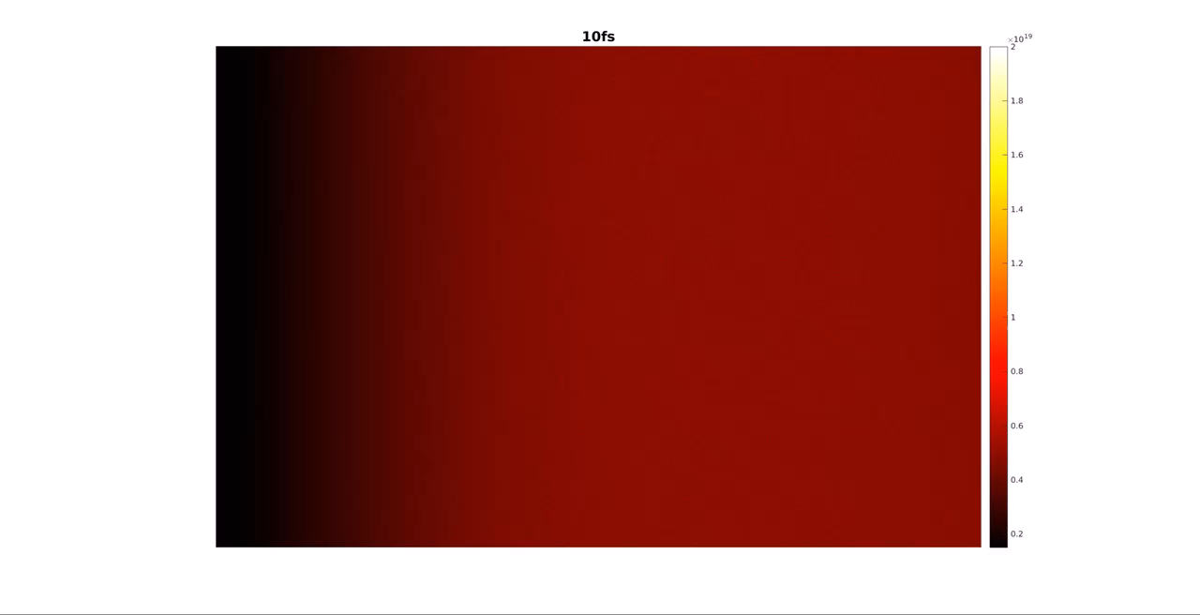
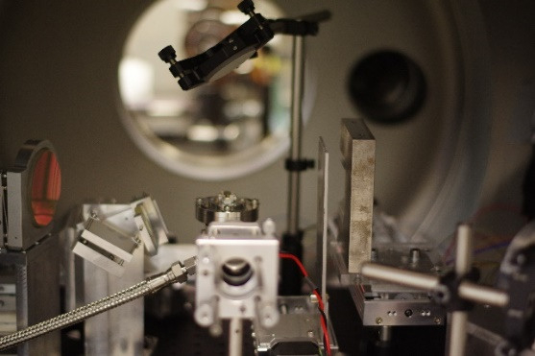
Laser Wakefield Acceleration
The acceleration of quasi-monoenergetic electron beams was demonstrated for the first time by 3 groups independently in 2004 [1-3].
Electron beams with energy exceeding 100 MeV with few % energy spread and hundreds of pC charge have been accelerated by Joule-class ultra-short laser pulses.
[1] S. P. D. Mangles et al., “Monoenergetic beams of relativistic electrons from intense laser–plasma interactions”, Nature 431, 535 (2004)
[2] C. G. R. Geddes, “High-quality electron beams from a laser wakefield accelerator using plasma-channel guiding”, Nature 431, 538 (2004)
[3] J. Faure et al., “A laser–plasma accelerator producing monoenergetic electron beams”, Nature 431, 541 (2004)
Date:
21.10.2016
Page:
7

Slide 8
Laser Wakefield Acceleration
The electron injection in the plasma accelerating cavity plays a crucial role in the quality of the produced beams. It can be controlled by means of overlapping laser pulses [1], ionization of high-Z gases [2], longitudinal density tailoring [3], or a combination of them [4].
Figures from the Ph.D. thesis of E. Guillaume “Control of electron injection and acceleration in Laser-Wakefield Accelerators” Ecole Polytechnique (2015)
[1] J. Faure et al., “Controlled injection and acceleration of electrons in plasma wakefields by colliding laser pulses”, Nature 444, 737 (2006)
[2] A. Pak et al., “Injection and Trapping of Tunnel-Ionized Electrons into Laser-Produced Wakes”, Phys. Rev. Lett. 104, 025003 (2010); C. McGuffey et al., “Ionization Induced Trapping in a Laser Wakefield Accelerator”, Phys. Rev. Lett. 104, 025004 (2010)
[3] S. V. Bulanov et al., “Particle injection into the wave acceleration phase due to nonlinear wake wave breaking”, Phys. Rev. E R5257 (1998); A. J. Gonsalves et al., “Tunable laser plasma accelerator based on longitudinal density tailoring”, Nature Physics 7, 862 (2011)
[4] C. Thaury et al., “Shock assisted ionization injection in laser-plasma accelerators”, Sci. Rep. 5, 16310 (2015)
Date:
21.10.2016
Page:
8

Slide 9
Laser Wakefield Acceleration
Laser wakefield acceleration is limited by different physical processes.
After being focused, the laser diffracts, losing intensity and worsening the plasma cavity. The diffraction length can be estimated by:
This effect can be compensated by self-focusing or external guiding in pre-formed plasma channels. The laser pump depletion happens when the laser driver loses enough energy to not be able anymore to drive the wakefield. It can be estimated by equating the laser energy to the energy left in the wake wave [1]:
Since the electrons travel faster than the plasma wave, after some distance they outrun the accelerating phase of the wave, entering a decelerating phase. This distance is called dephasing length:
Finally, beam loading occurs when the electric field of the injected electrons is strong enough to cancel the accelerating field [2]:
[1] S. V. Bulanov et al., “Nonlinear depletion of ultrashort and relativistically strong laser pulses in an underdense plasma” Phys. Fluids B: Plasma Physics 4(7)1935 (1992); E. Esarey et al., “Nonlinear pump depletion and electron dephasing in laser wakefield accelerators”, Proceedings of the Advanced Accelerator Concept Workshop, 737, 578 (2004)
[2] T. Katsouleas et al., “Beam loading in plasma accelerators”, Part. Accel., 22, 81 (1987)
Date:
21.10.2016
Page:
9

Slide 10
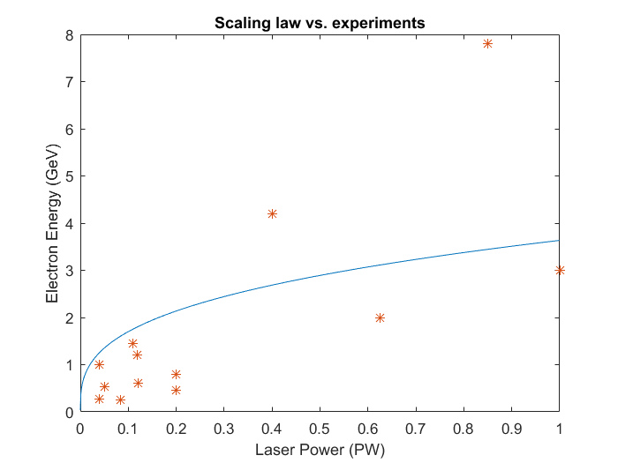
Laser Wakefield Acceleration
Under ideal conditions, the energy and the charge of the electron beam can be estimated by the following expressions [1]:
External guiding
[1] W. Lu et al. “Generating multi-GeV electron bunches using single stage laser wakefield acceleration in a 3D nonlinear regime”, Phys. Rev. ST Accel. Beams, 10, 061301 (2007)
Date:
21.10.2016
Page:
10

Slide 11
Outline of the lecture
Why do we need compact accelerators?
Laser Wakefield Acceleration
State of the art
Future Directions
The Electron Acceleration program at ELI-Beamlines
Date:
21.10.2016
Page:
11

Slide 12
Highest electron energy
The highest electron energy ever achieved is 7.8 GeV by a 0.85 PW laser pulse externally guided [1]:
[1] A. J. Gonsalves et al., “Petawatt Laser Guiding and Electron Beam Acceleration to 8 GeV in a Laser-Heated Capillary Discharge Waveguide”, Phys. Rev. Lett. 122, 084801 (2019)
Date:
21.10.2016
Page:
12

Slide 13
Highest brightness beams
Electron beams with brightness comparable with state-of-the-art LINAC have been produced by a 200 TW laser system by energy chirp control [1]:
[1] W. T. Wang et al., “High-Brightness High-Energy Electron Beams from a Laser Wakefield Accelerator via Energy Chirp Control”, Phys. Rev. Lett. 117, (2016)
Date:
21.10.2016
Page:
13

Slide 14
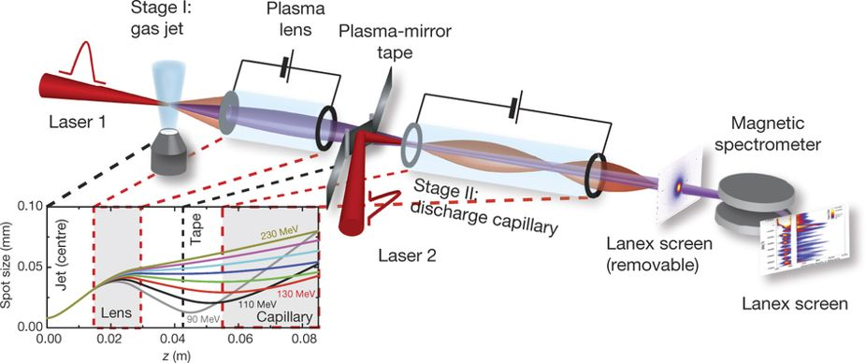
Multi-Stage laser wakefield acceleration
Dual stage electron acceleration has been demonstrated by transporting the beam with an active plasma lens between two gas targets [1]:
[1] S. Steinke et al., “Multistage coupling of independent laser-plasma accelerators”, Nature 530, 190 (2016)
Date:
21.10.2016
Page:
14

Slide 15
Highest Repetition Rate
Laser wakefield acceleration has been demonstrated with kHz laser pulses having 2.1 mJ energy and 3.4 fs time duration [1]:
[1] D. Guenot et al., “Relativistic electron beams driven by kHz single-cycle light pulses”, Nature Photonics 11, 293 (2017); J. Faure et al., “A review of recent progress on laser-plasma acceleration at kHz repetition rate”, Plasma Phys. Control. Fusion 61, 014012 (2019)
Date:
21.10.2016
Page:
15

Slide 16
Outline of the lecture
Why do we need compact accelerators?
Laser Wakefield Acceleration
State of the art
Future Directions
The Electron Acceleration program at ELI-Beamlines
Date:
21.10.2016
Page:
16

Slide 17
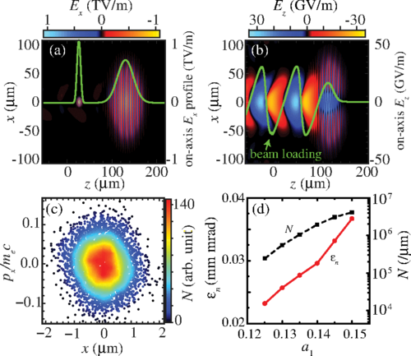
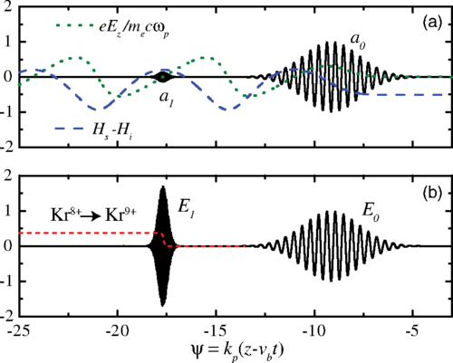
Two-color injection
A new method has been proposed to generate ultra-low emittance electron beams based on the combination of two laser pulses having very different wavelength [1]:
[1] L.-L. Yu et al., “Two-Color Laser-Ionization Injection” Phys. Rev. Lett. 112, 125001 (2014)
Date:
21.10.2016
Page:
17

Slide 18
Laser-based TeV collider
Physical considerations about a possible future TeV electron-positron collider have been done [1]:
[1] W. Leemans and E. Esarey, “Laser-driven plasma-wave electron accelerators”, Physics Today 62, 3, 44 (2009); C. B. Schroeder et al., “Physics considerations for laser-plasma linear colliders”, Phys. Rev. STAB 13, 101301 (2010)
Date:
21.10.2016
Page:
18

Slide 19
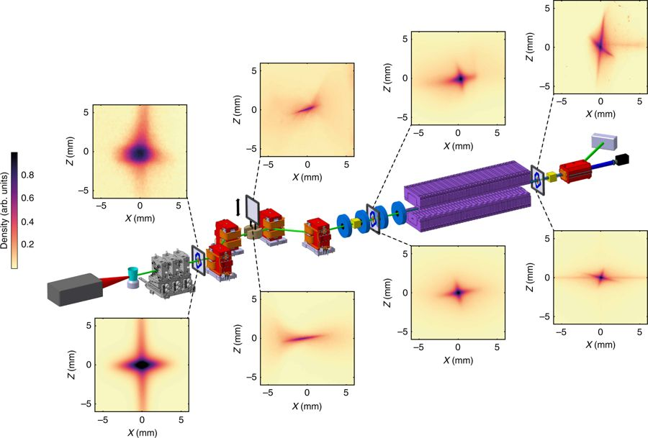
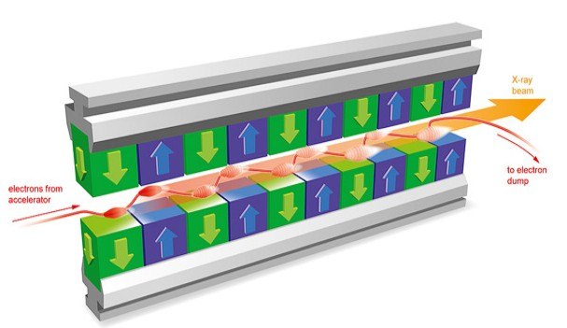
Laser-driven XFEL
Compact Free electron laser might be possible by using laser wakefield acceleration [1]:
[1] A. Maier et al., “Demonstration Scheme for a Laser-Plasma-Driven Free-Electron Laser”, Phys. Rev. X 2, 031019 (2012); T. Andre et al., “Control of laser plasma accelerated electrons for light sources”, Nat. Commun. 9, 1334 (2018)
Date:
21.10.2016
Page:
19

Slide 20
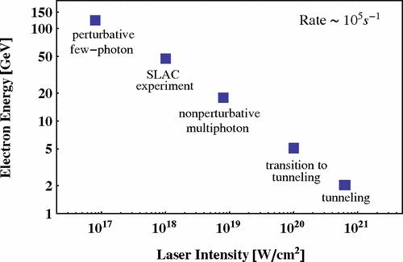

Fundamental Science
Laser wakefield acceleration can be used to study fundamental aspects of the nature [1]. One of the most important predictions of QED is the possibility of transforming light into matter. Shortly after the realization of the laser in 1960, theoreticians started to study possibilities for the creation of e⁺-e⁻ pairs from vacuum by very strong laser fields. Because of constraints from energy-momentum conservation, a single plane-wave laser field cannot create pairs from vacuum, no matter how intense it is. Thus, an additional source of energy is therefore required to trigger the process of pair production in a plane wave. There are essentially three different possibilities:
pair production by a high-energy photon propagating in a strong laser field (multiphoton Breit-Wheeler pair production),
pair production by a Coulomb field in the presence of a strong laser field,
pair production by two counterpropagating strong laser beams forming a standing light wave.
[1] G. A. Mourou, T. Tajima and S. V. Bulanov, “Optics in the relativistic regime”, Rev. Mod. Phys. 78,309 (2006); M. Marklund and P. M. Shukla, “Nonlinear collective effects in photon-photon and photon-plasma interactions”, Rev. Mod. Phys. 78, 591 (2006); A. Di Piazza et al., “Extremely high-intensity laser interactions with fundamental quantum systems”, Rev. Mod. Phys. 84, 1177 (2012)
Date:
21.10.2016
Page:
20

Slide 21
Dense matter inspection
Laser wakefield accelerators are currently studied as a source for inspecting very thick objects (Non Destructive Testing):
Slide from Prof. V. Malka talk at IPAC 2013 at Shanghai (China)
Date:
21.10.2016
Page:
21

Slide 22
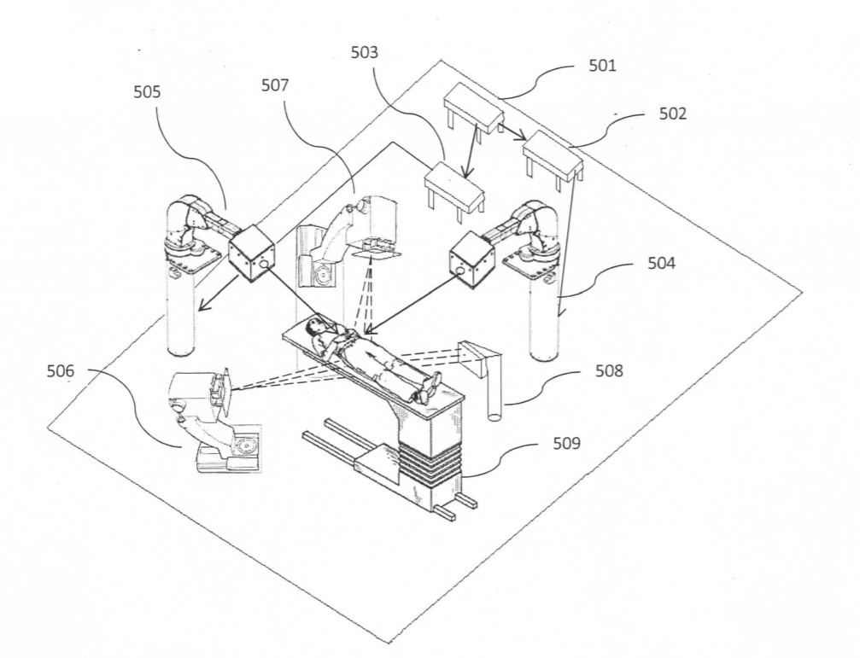
Very high energy electron therapy
Laser wakefield accelerated electron beams are currently studied for being used in VHEE radiotherapy:
Slide from Prof. V. Malka talk at IPAC 2013 at Shanghai (China)
G. Grittani, T. Levato, C. Lazzarini & G. Korn, “Device and method for high dose per pulse radiotherapy with real time imaging”, patent WO2017211331A1
Date:
21.10.2016
Page:
22

Slide 23
Outline of the lecture
Why do we need compact accelerators?
Laser Wakefield Acceleration
State of the art
Future Directions
The Electron Acceleration program at ELI-Beamlines
Date:
21.10.2016
Page:
23

Slide 24
The high energy electron beamline [1]
[1] T. Levato et al., “HELL: High-Energy Electrons by Laser Light, a User-Oriented Experimental Platform at ELI Beamlines”, Appl. Sci. 8, 1565 (2018)
Date:
21.10.2016
Page:
24

Slide 25
First electron beams with L3 laser
Date:
21.10.2016
Page:
25

Slide 26

Thank you for your attention!
Gabrielemaria.Grittani@eli-beams.eu

