Slide 2

Miroslav Kloz
Femtosecond spectroscopy at ELI Beamlines
Probing and Driving (Bio)Molecular Dynamics with Femtosecond Pulses
(wavelengths 200 – 1200 nm, energies below 1 mJ)

Slide 3
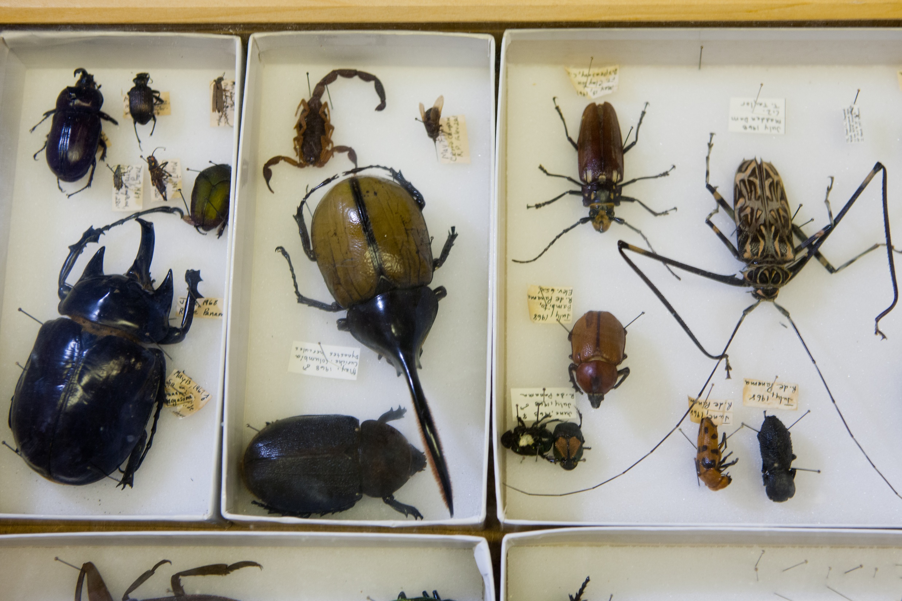
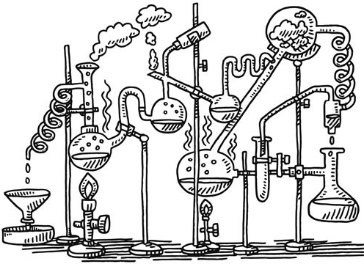
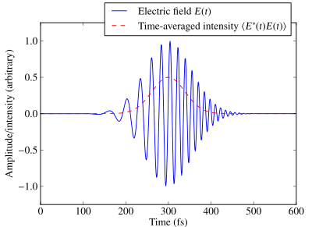
Why femtosecond lasers in chemistry and biology?

Slide 4
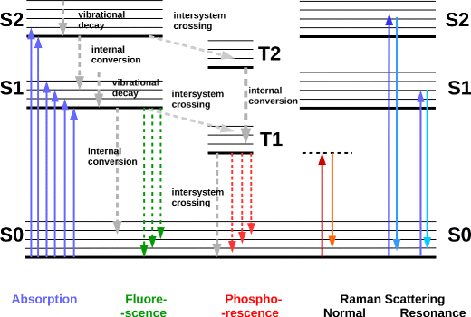
Light matter interaction reflects its quantum structure
ΔE = ħν

Slide 5
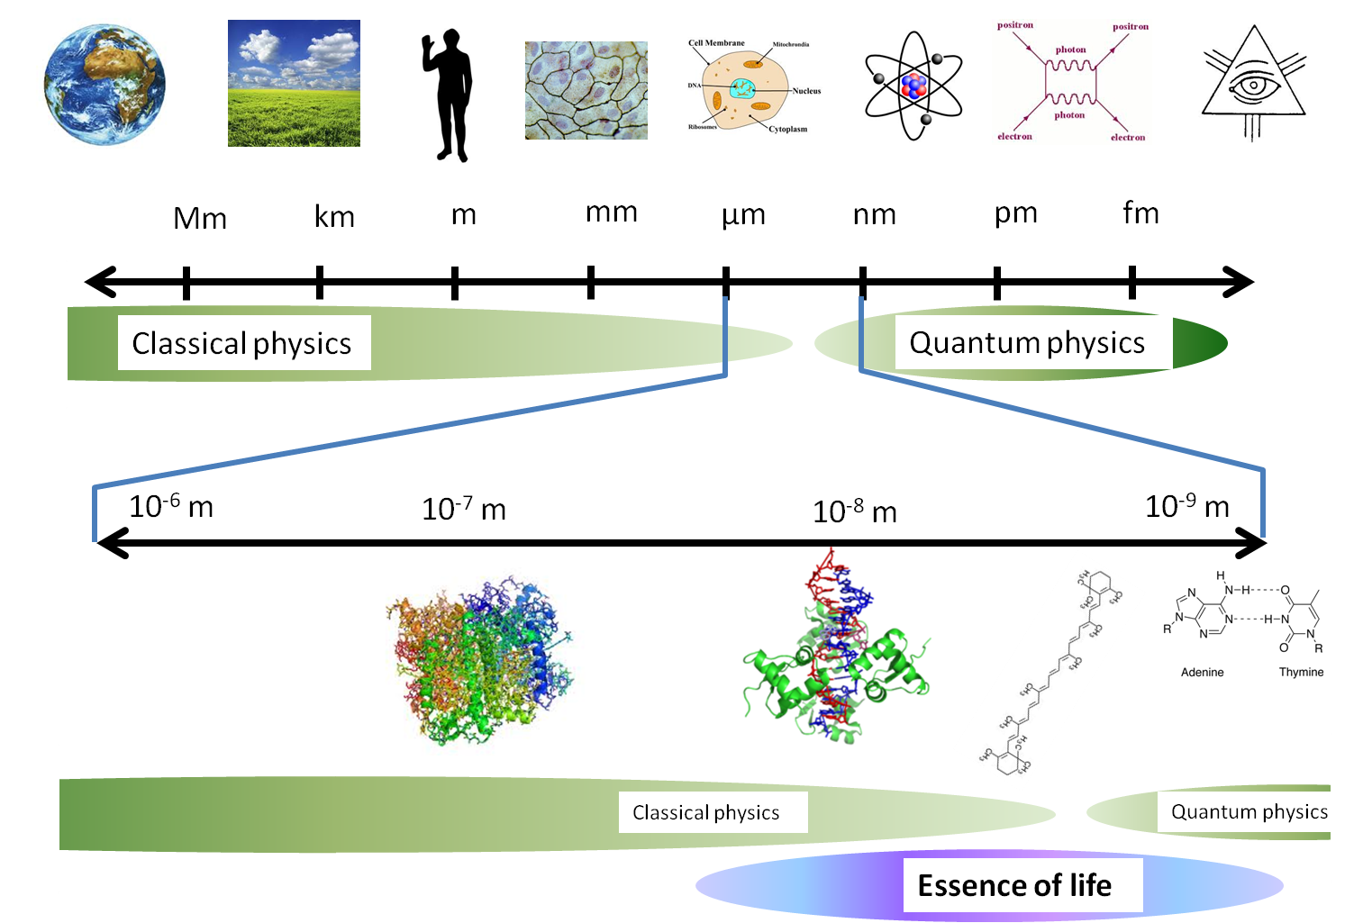
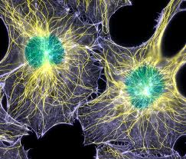

Slide 6
Scales of size and time are closely rerated!
ms
μs
ns
ps
fs
as

Slide 7
X-ray, electron (or other particles) experiments are practically
rarely at natural conditions
Time resolution is just emerging
Expensive, cannot be done at high throughput
Structure does not directly explain function

Slide 8
Optical spectroscopy can explore matter at multiple levels in relatively non-invasive ways in a relatively cost effective manner.

Slide 9
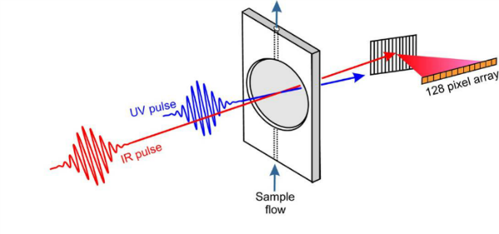
Pump probe experiments

Slide 10
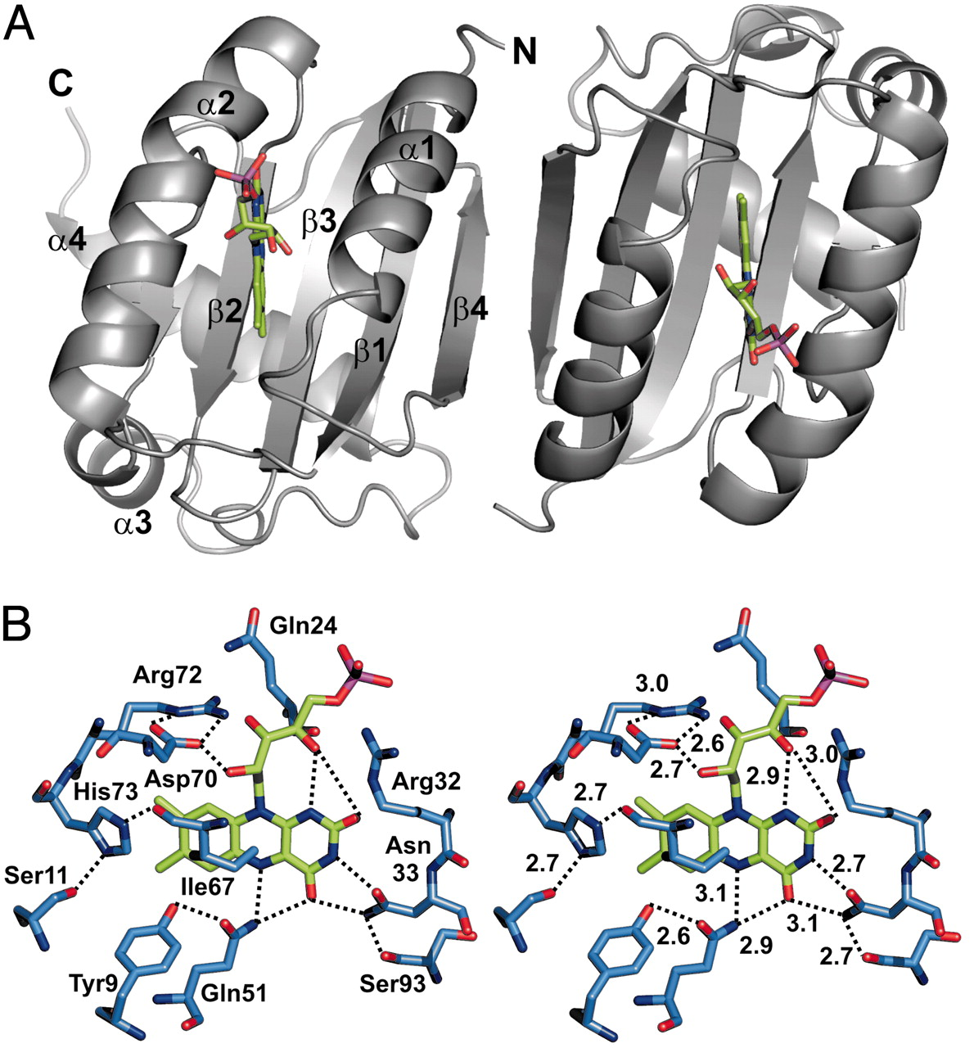
BLUF domain
Biological photo sensor
Using FAD
(Flavin Adenine Dinucleotide)
as cofactor
(biological APD…)

Slide 11
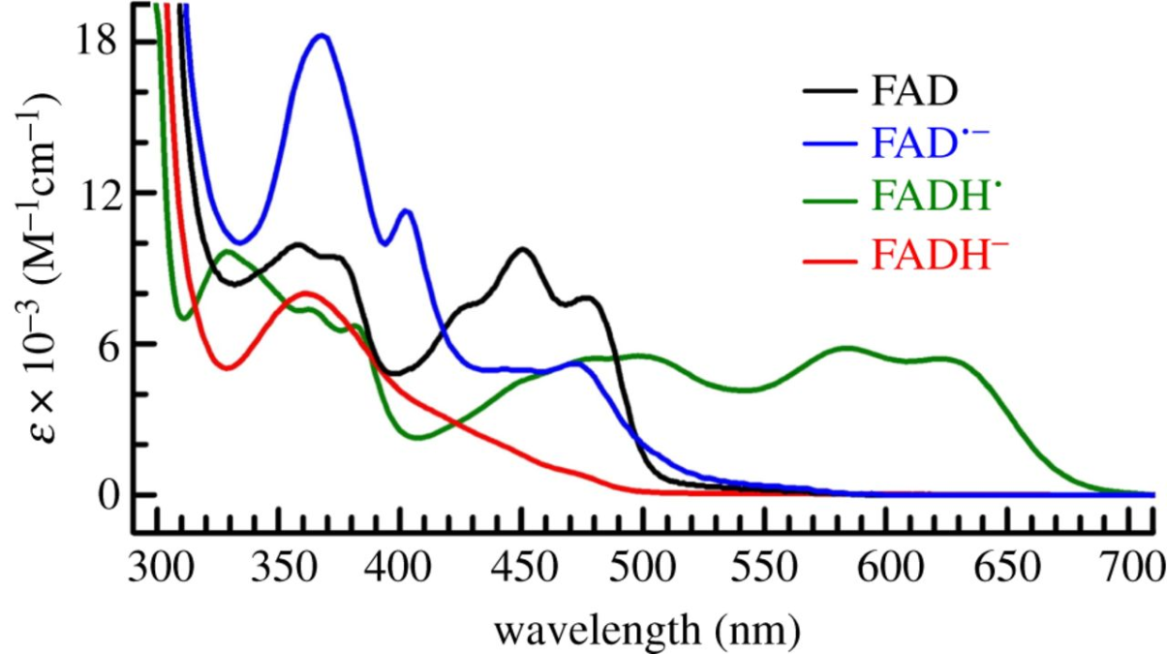
Flavin,
Cofactor operating in visible
Visible
near UV
fs-ns

Slide 12
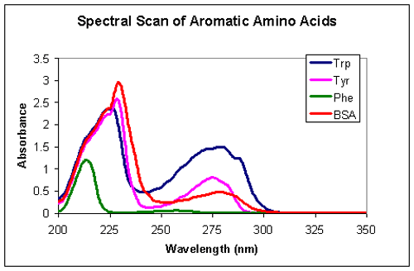
Amino acids
UV
fs-ns

Slide 13
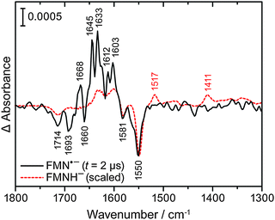
Bond structure (vibration spectroscopy)
Mid IR
fs-μs

Slide 14
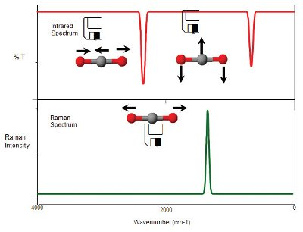
Direct: (E_{photon} = E_{transition}) (Mid Infrared)
ΔE
E
ΔE
Raman: ΔE = E_{transition}

Slide 15
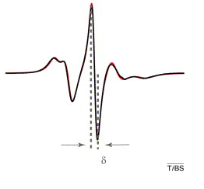
Backbone bulk modes
THz
ps - ms

Slide 16
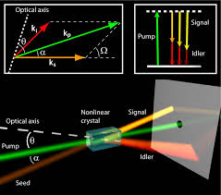
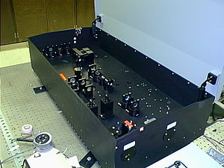
Parametric amplification allows converting pulses into other wavelengths

Slide 17
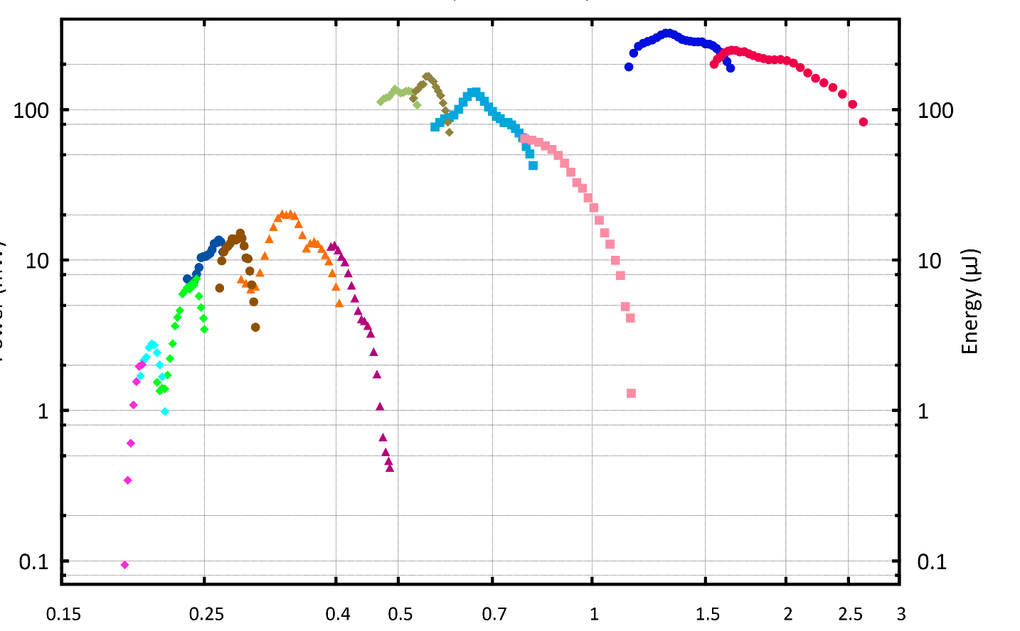
Typical tuning curves

Slide 18
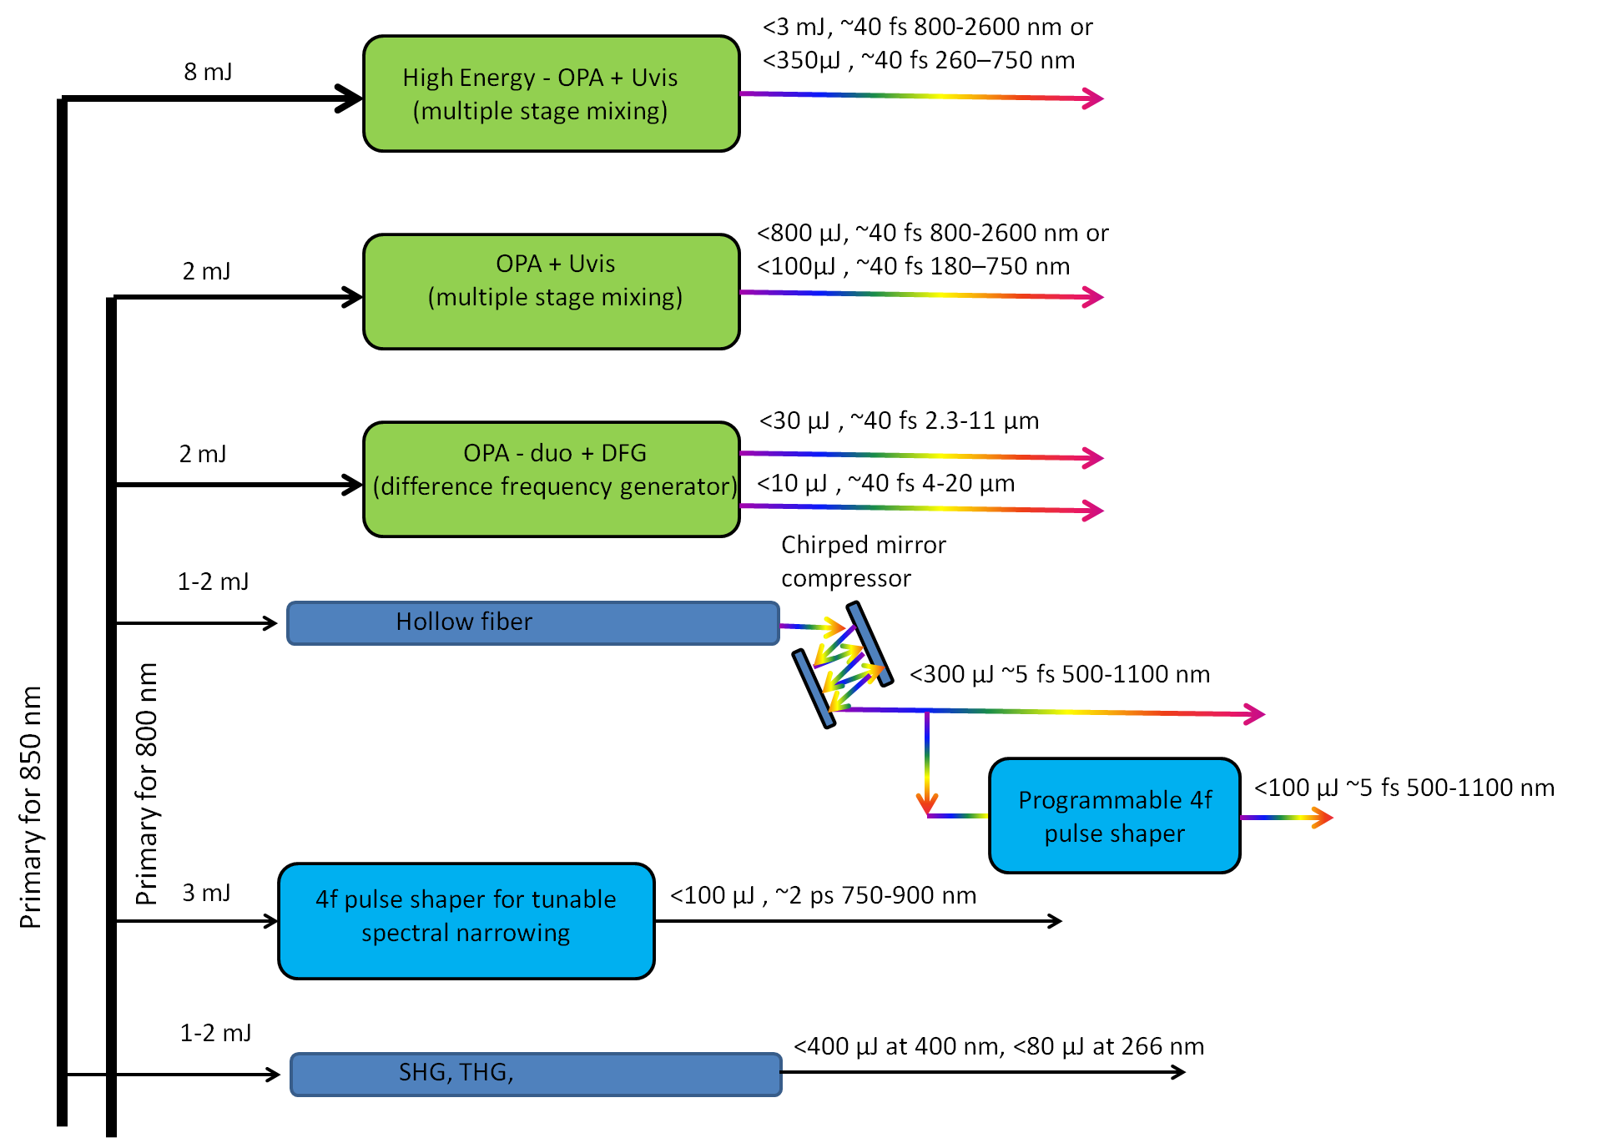
High power VIS + near UV/IR
VIS + UV + IR
MID - IR
Ultrashort
shaped
spectrally narrowed

Slide 19
Time window

Slide 20
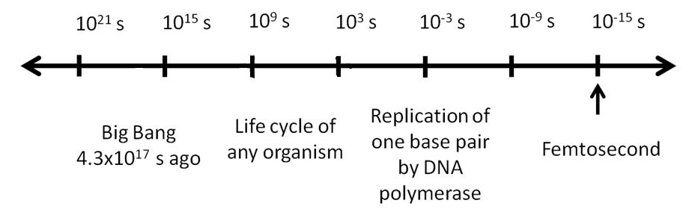
1 fs = 0.000 000 000 000 001 s
~4.3 x 10¹⁷ s since
“Big Bang”
~2.5 x 10⁹ s ~ Life of average men
~0.1 s
fastest process we can perceive by our senses
Femtosecond
Too slow
Common life experience
Too fast

Slide 21
1 kHz Regenerative amplifier 1
82 MHz oscillator seed
gate
1 kHz Regenerative amplifier 2
1 fs < Δt < 1 ms
Modern femtosecond laser technology allows to scan 10 orders of magnitude of dynamic range in a single experiment

Slide 22
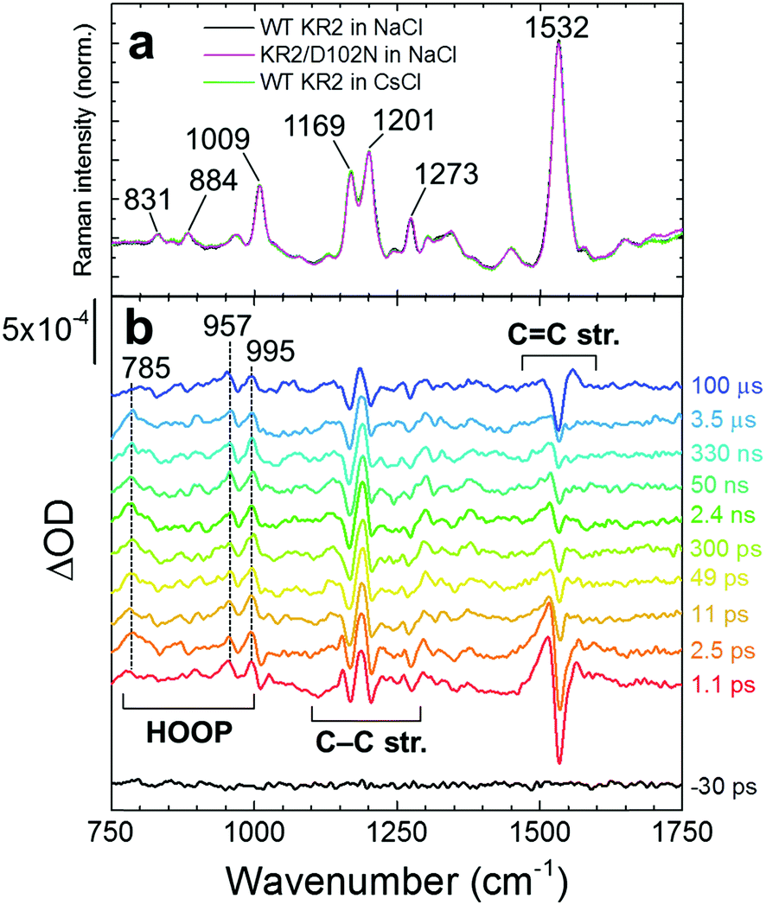
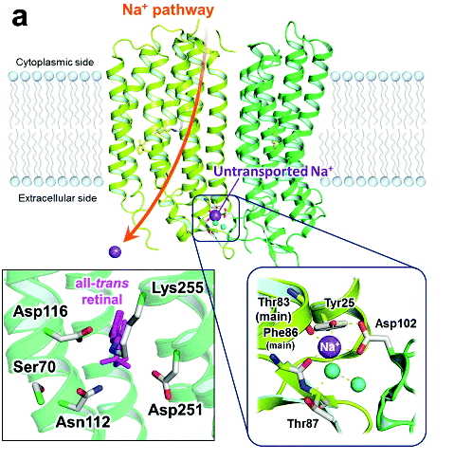
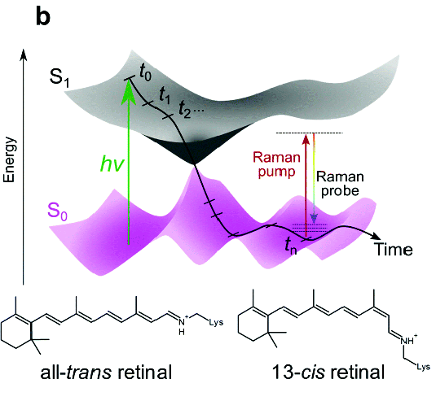

Slide 23
2D spectrocopy

Slide 24
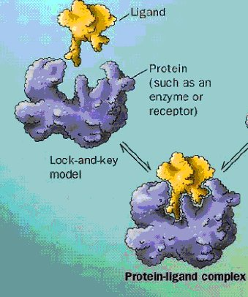
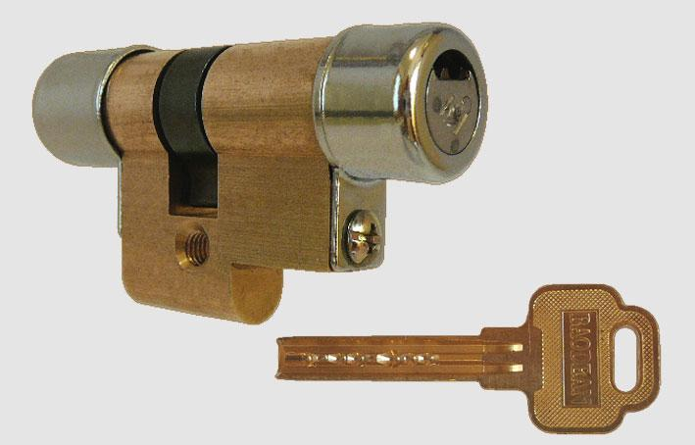
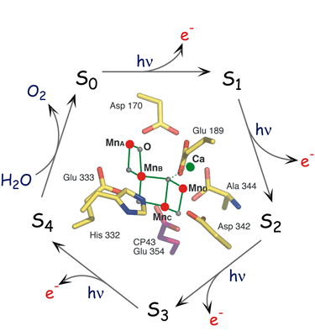
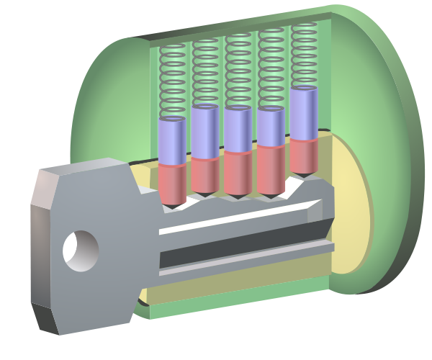
At certain size incomputable…
Too many combinations….

Slide 25
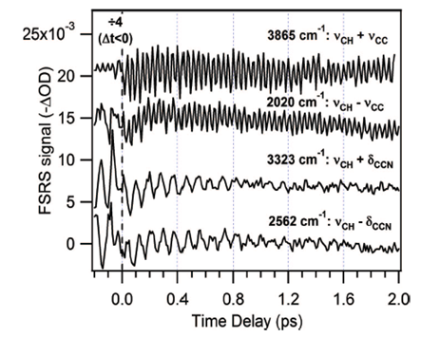
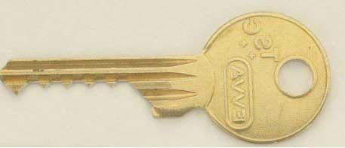
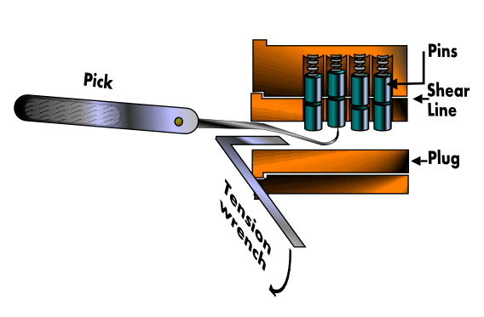
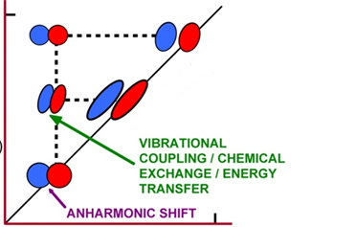
Bump key
Time domain 2D
Lock picking
Frequency domain 2D

Slide 26
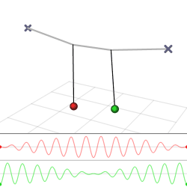
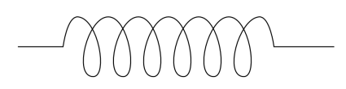
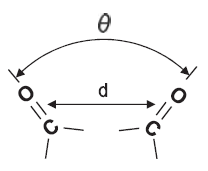
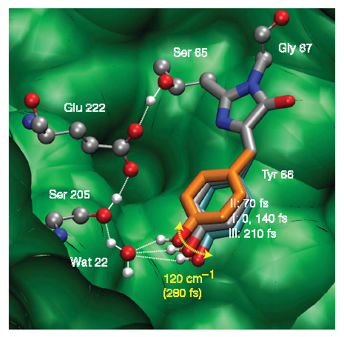
…and observe effect on the other
excite one
vibration…
Mapping GFP structure evolution during proton transfer with femtosecond Raman spectroscopy
Nature (12 November 2009)
Fang,...Mathies
Link to 3D structure is much more direct!

Slide 27
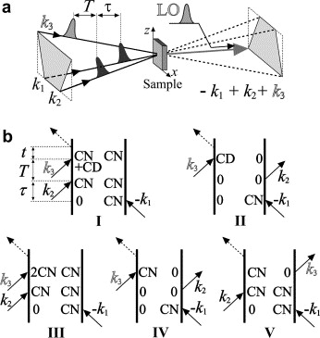

Slide 28
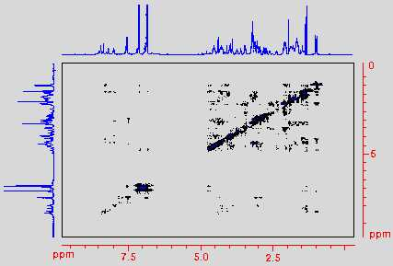
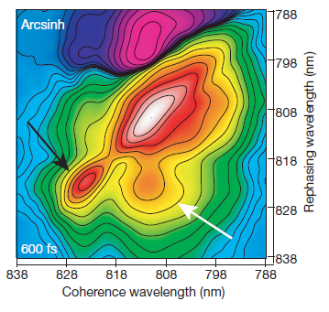
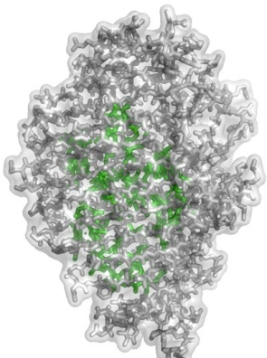
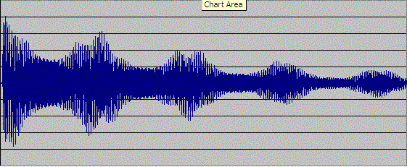
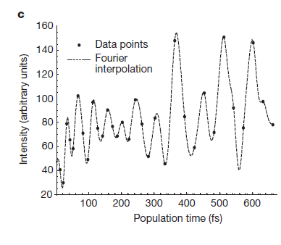
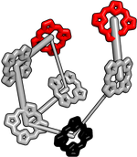
TOCSY spectra of a peptide
NMR
Photon echo of Fenna-Matthews-Olson complex
(Nature, 2007)

Slide 29
Whole series of 2D spectroscopies can be run
In some cases even simultaneously.
fs-mid-IR
ps-Vis
ultrashort ~5fs vis
“Conventional” 2D IR
Mixed
2D IR x Raman
Raman in time domain
2D visible
X-ray Raman resonant with core electrons

Slide 30
Pulse shaping

Slide 31
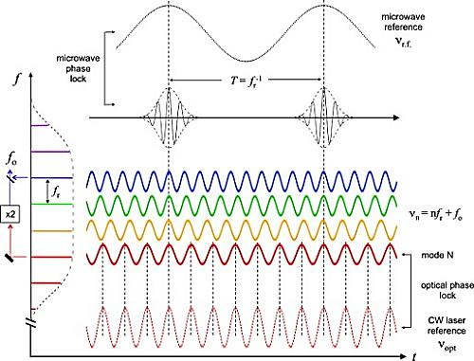
Femtosecond pulse is stabilized superposition of continuous weaves

Slide 32
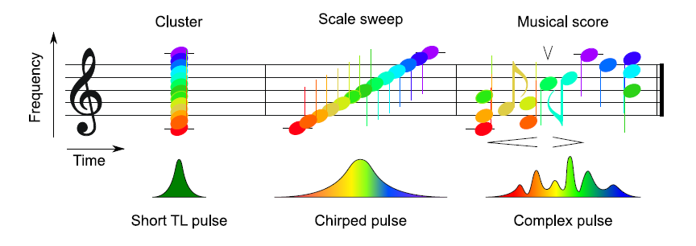
Pulse shaping is like tuning to the exact melody to which the system responses

Slide 33
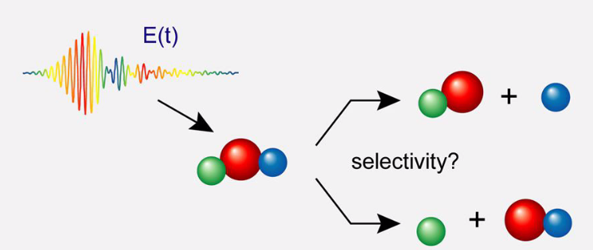
Behavior of the molecule can be selectively affected

Slide 34
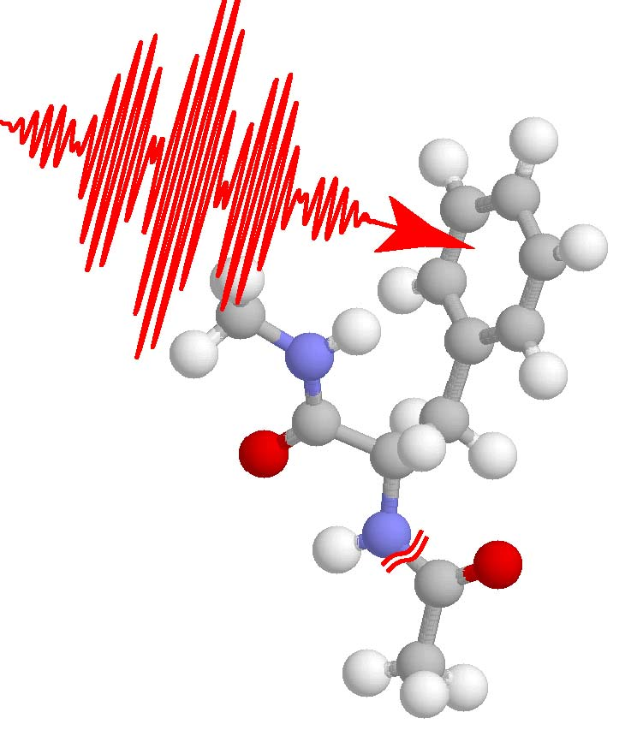

Slide 35
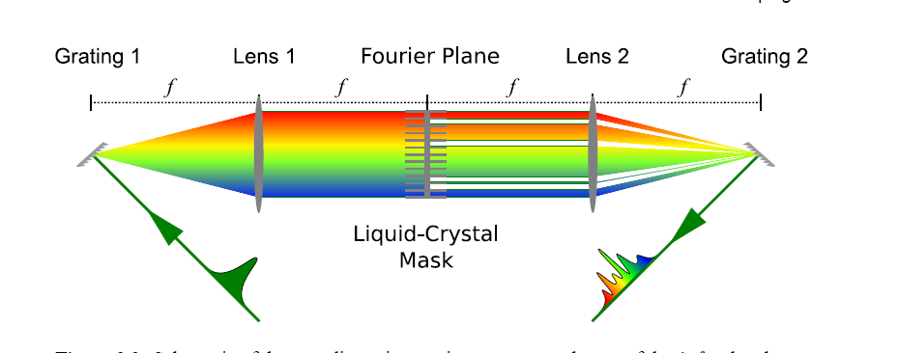
Tvarovač pulzů

Slide 36
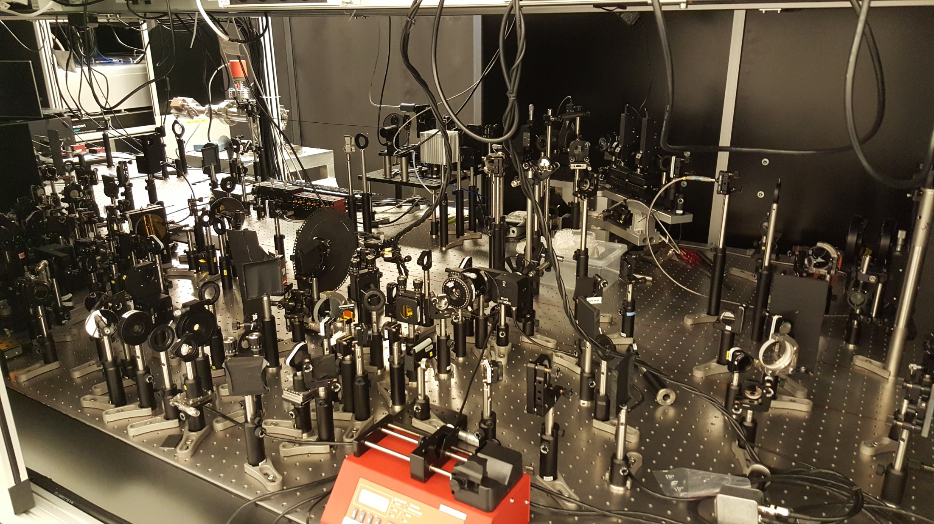
Typical femtosecond set up

Slide 37
