Slide 1
MAC
Scientific end station
for gas phase targets
at the ELI Beamlines
HHG source
ELI Summer School 2019
Dolní Břežany, Czech Republic
August 28th, 2019
Maria Krikunova

Slide 2
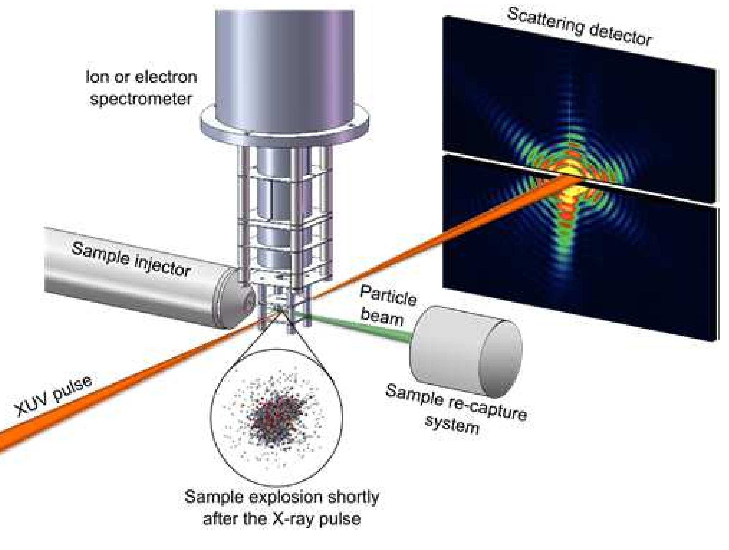
MAC user end-station
MAC - Multi-purpose user end-station
for AMO (atomic, molecular and optical) sciences and CDI coherent diffractive imaging
Main purpose:
Time-resolved experiments with coincident electron/ion spectroscopy and coherent diffractive imaging
to study structure and dynamics of matter
Atomic and molecular systems under intense X-ray radiation,
M. Krikunova, N. Timneanu, J. Andreasson,
ISBN 978-3-319-20172-6
28.08.2019
2

Slide 3
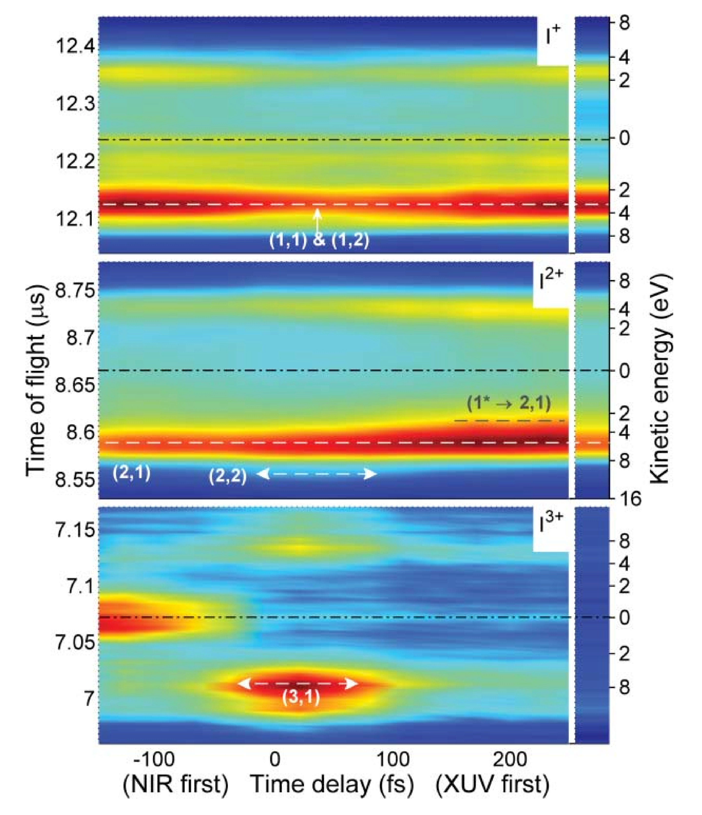
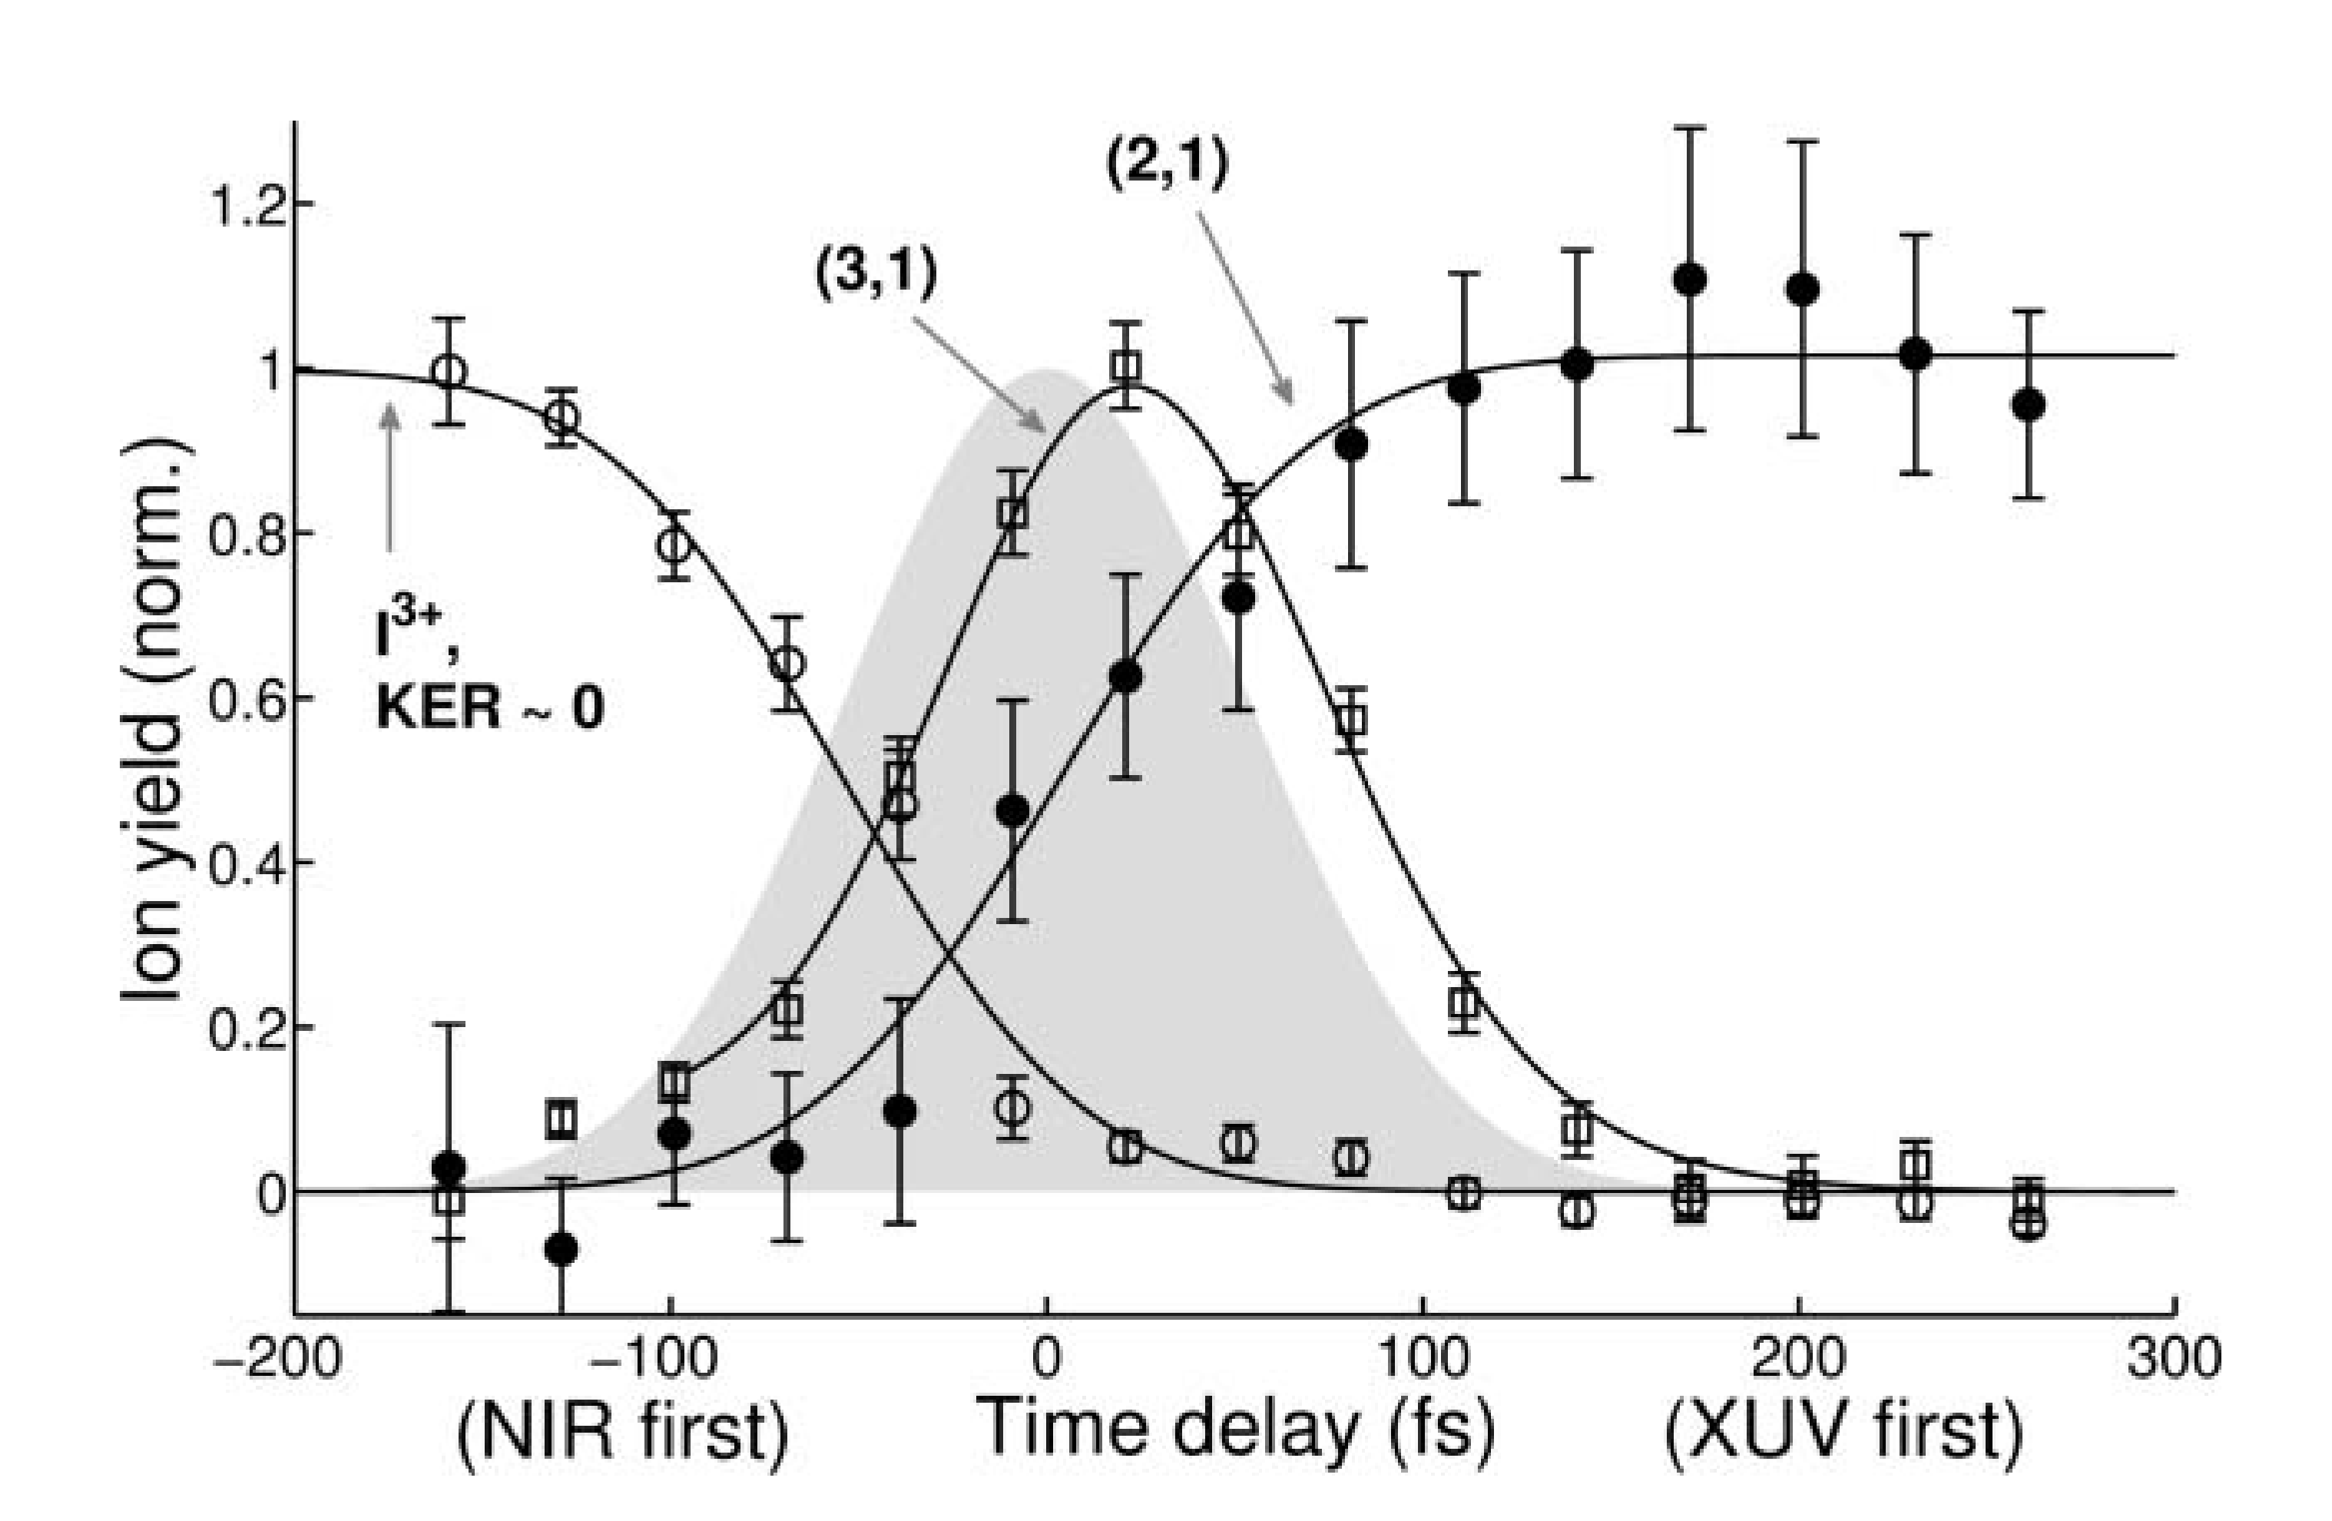
Amazing combination
of VUV/XUV with optical pulses
Femtochemistry –Molecular reactions on a fs time-scale
Time resolved ion spectroscopy on molecular iodine - different reactions channels are studied within one experimental run
M. Krikunova et al, J. Chem. Phys. 134 (2011) 024313
M. Krikunova et al, Phys. Rev. A 86 (2012) 043430
Experiment at Free Electron Laser in Hamburg –
FLASH
28.08.2019
3

Slide 4
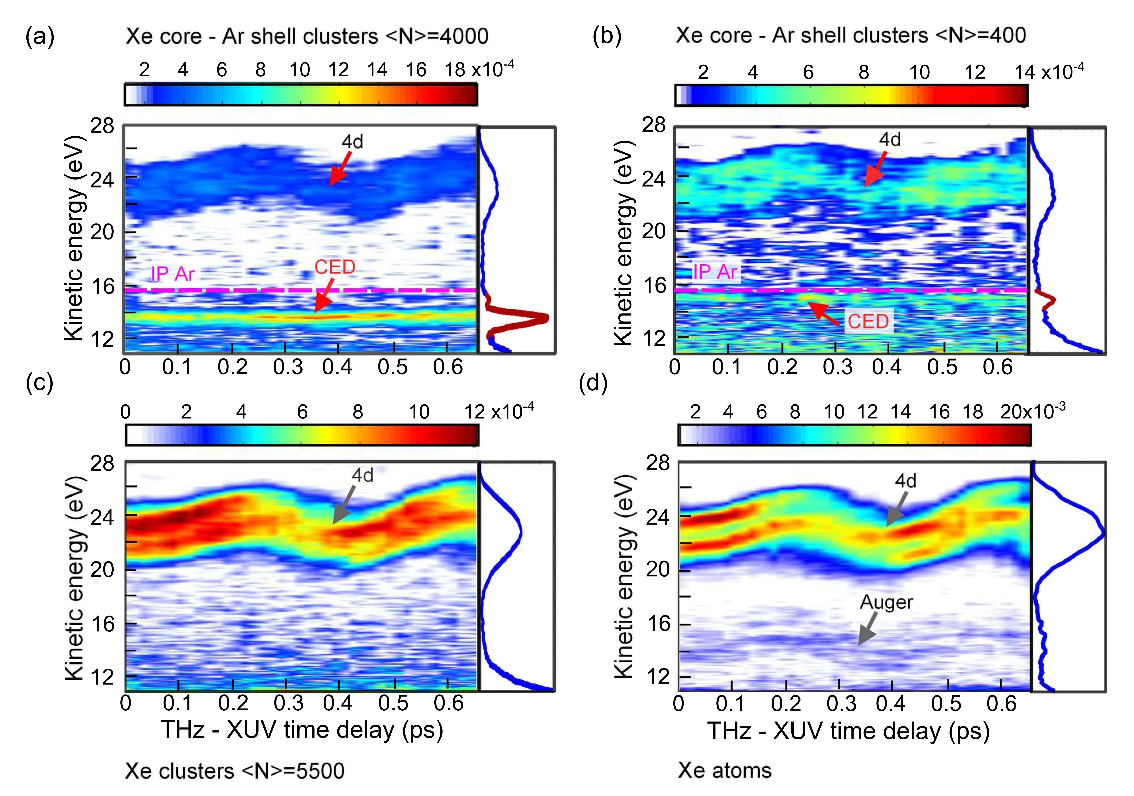
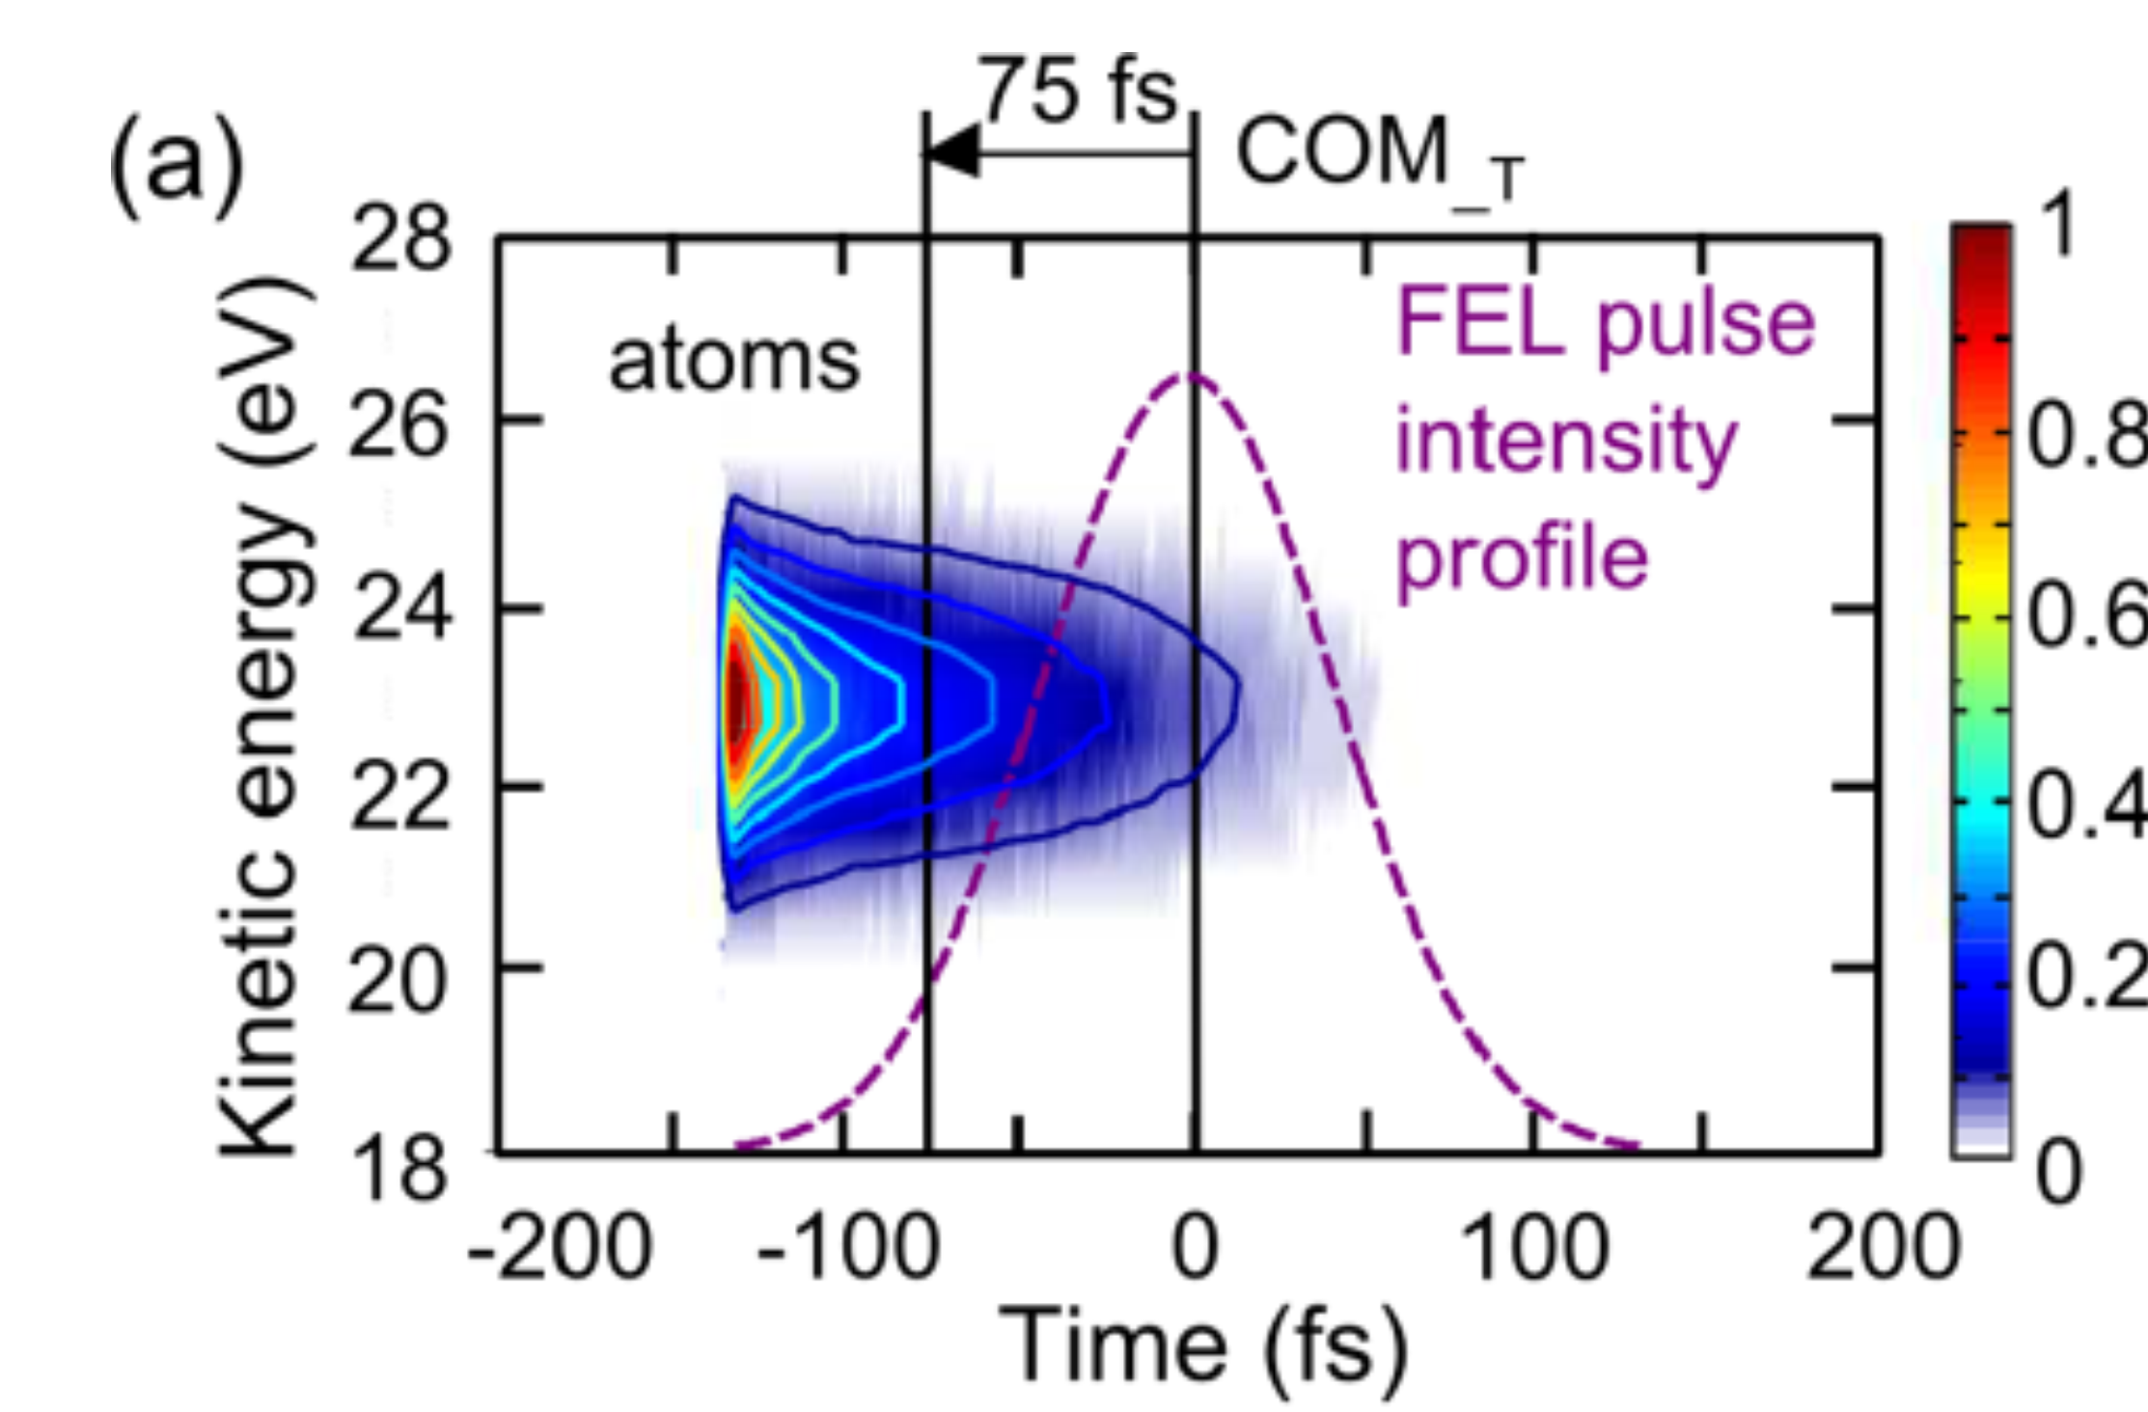
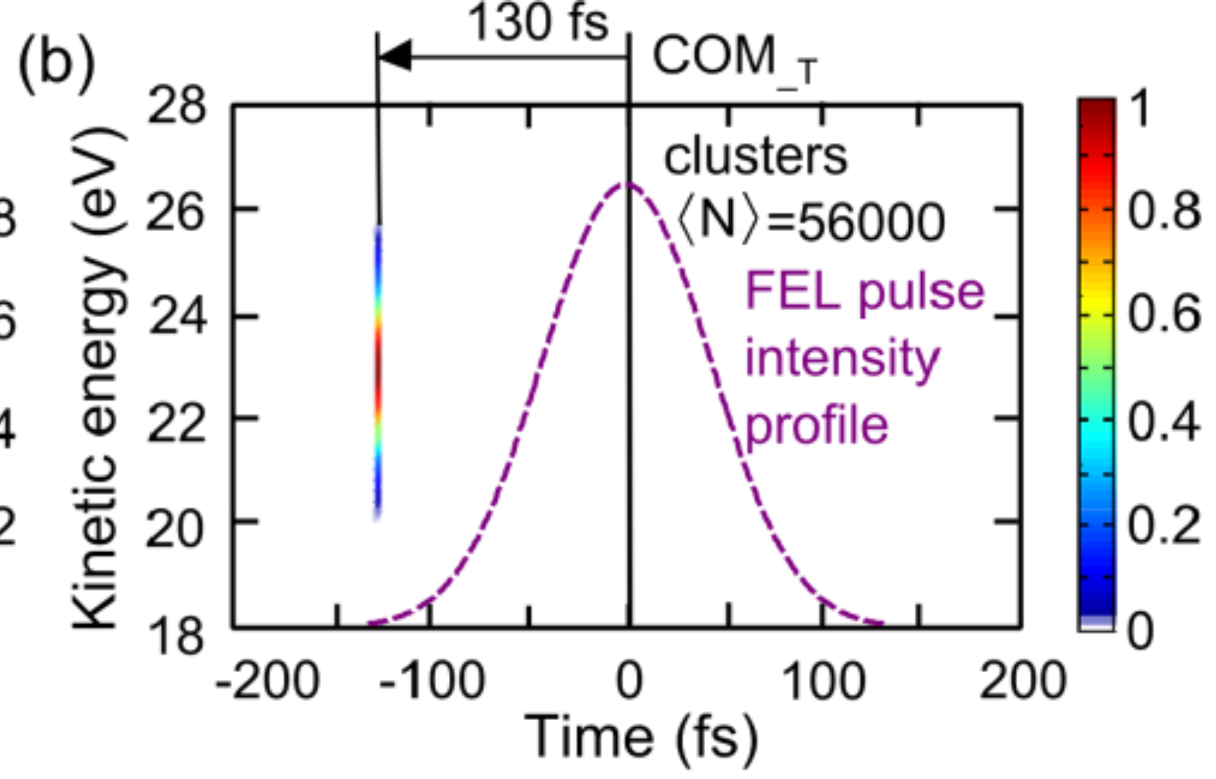
Amazing combination
of VUV/XUV with THz pulses
Time of the electron birth
THz field streaking is sensitive
to the electron birth time
T. Oelze et al, Sci. Rep. 7 (2017) 40736
T. Oelze et al, Phys. Rev. A 99 (2019) 043423
Experiment at FLASH
28.08.2019
4

Slide 5
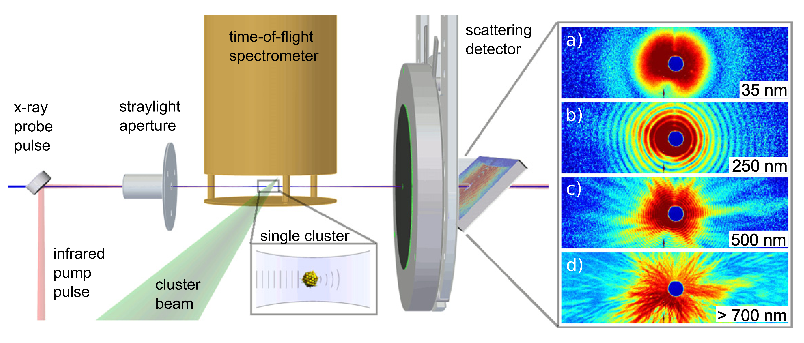
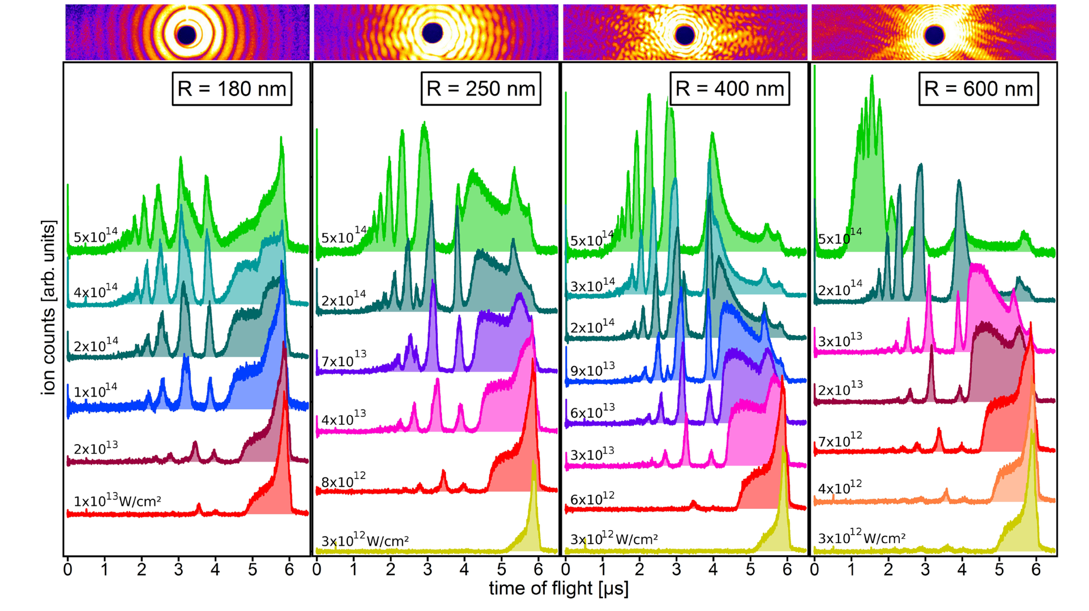
Unique combination of spectroscopy with imaging
Ultrafast dynamics within a single shot
Experiment on single nanoparticles –
possibility to sort experimental data according to irradiation intensity as well as nanoparticle size
D. Rupp et al, Phys. Rev. Lett. 117 (2016) 153401
L. Flückiger et al, New J. Phys. 18 (2016) 043017
Experiment at FLASH
28.08.2019
5

Slide 6
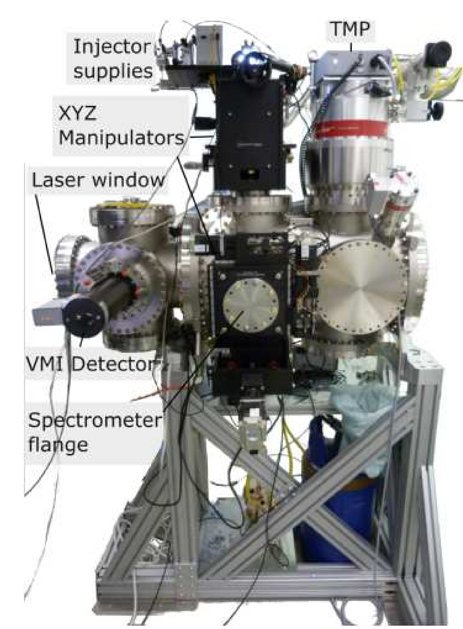
MAC user end-station
Spectrometers:
Time-of-flight electron / ion spectrometers
Velocity Map Imaging (VMI)
Magnetic bottle (under development)
Imaging XUV detectors:
PI-MTE in vacuum for 1eV to 10 keV photons
13.5 x 13.5 μm pixel size
Andor I-Kon flange-mounted for VUV spectroscopy
13.5 x 13.5 μm pixel size
CCD with phosphor screen
Sample delivery systems:
Cluster source based on cryo-cooled Even-Lavie-Valve
Microfluidic gas-dynamic nozzle
Aerosol nano-particle injector
Pump beams:
OPA beam 240 – 2600 nm
Few-cycle beam from hollow fiber compressor
Multi-cycle tunable THz source 4-18 THz
Single-cycle broadband ~1THz source
28.08.2019
6

Slide 7

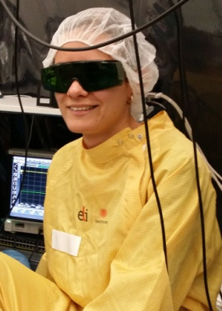
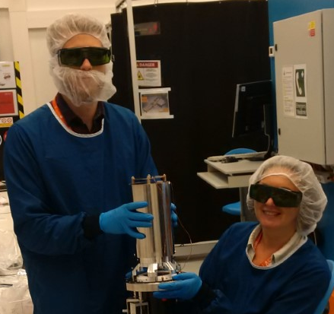
MAC team
Maria Krikunova: Team leader
Eva Klimesova: PostDoc
Andreas Hult Ross: PostDoc (started in July 2019)
Ziaul Md Hoque: PostDoc (supporting the MAC team)
Open position – PostDoc or PhD
Former team members:
Laura Dittrich: M. Sc. Student (finished in July 2018)
Olena Kulyk: PostDoc (finished in June 2019)
This work has been supported by the project
Structural dynamics of biomolecular systems (No. CZ.02.1.01/0.0/0.0/15_003/0000447) from European Regional Development Fund
and by the project Advanced research using high intensity laser produced photons and particles
(No. CZ.02.1.01/0.0/0.0/16_019/0000789) from European Regional Development Fund.
28.08.2019
7

Slide 8
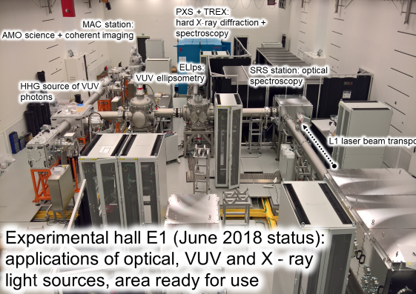
MAC user end-station
E1 experimental hall in January 2019
HHG
28.08.2019
8

Slide 9
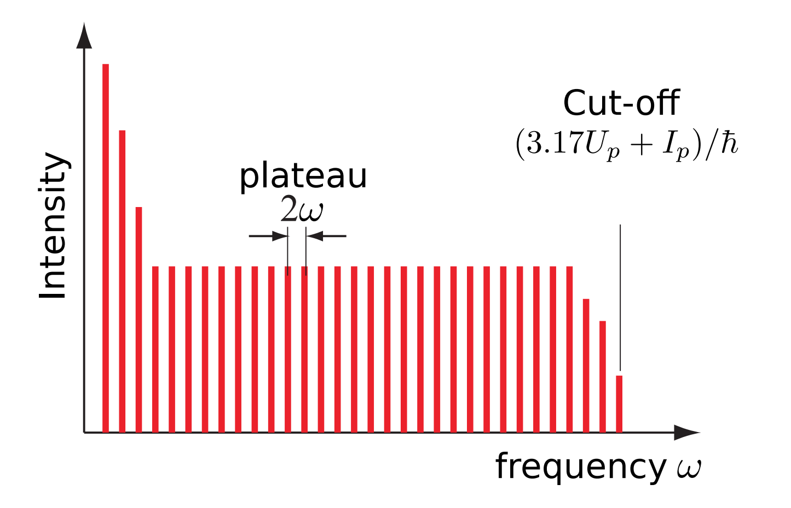
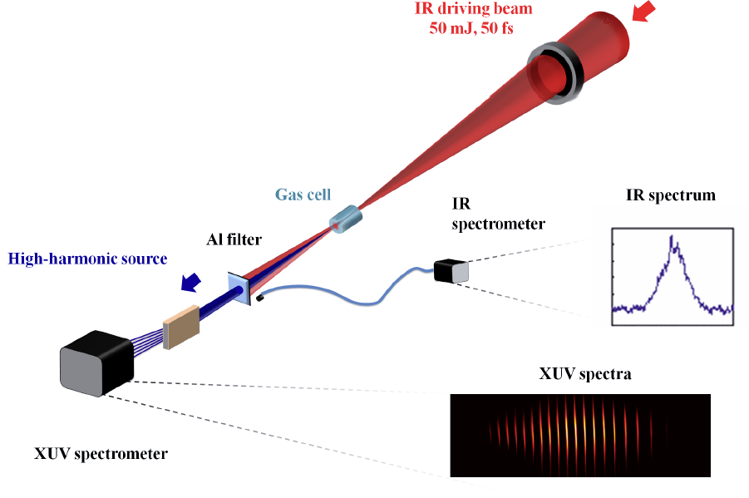
HHG - High Harmonic Generation
I.V. Hertel and C.-P.Schulz. Atome, Moleküle und optische Physik 1, Springer-Verlag Berlin, Heidelberg, 2008
Monochromator -
to select individual harmonics
V. E. Nefedova et al., Phys. Rev. A 98 033414 (2018)
28.08.2019
9

Slide 10
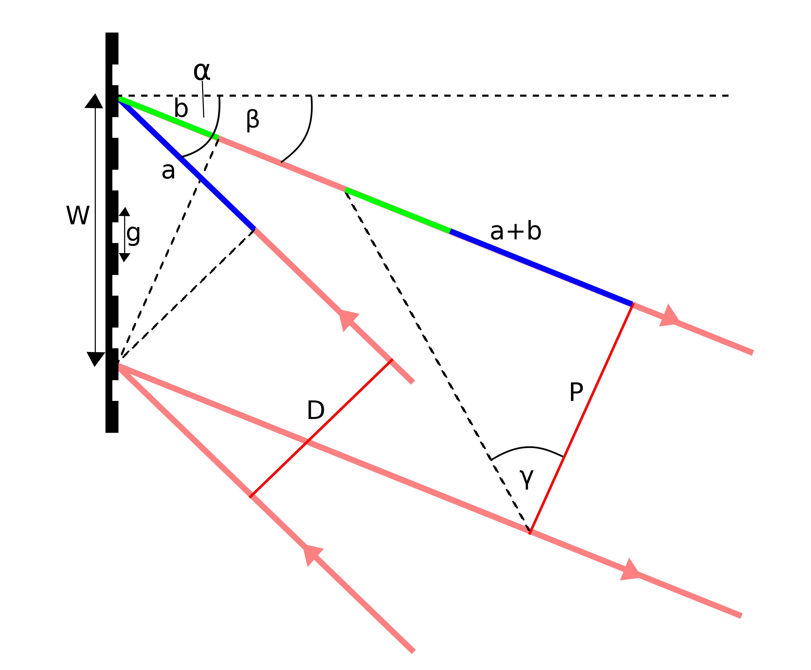
Monochromator –
to select individual harmonics
Pulse front tilt due to the angular dispersion
Pulse-front tilt
Example: 5-mm FWHM beam, λ=30 nm (41 eV), 300 gr/mm grating, normal incidence
⇒ 1500 illuminated grooves
⇒ path-difference ΔOP_{FWHM} = 45 μm, Δt_{FWHM} = 150 fs
The trick to preserve the temporal duration of the XUV pulse is to keep the number of illuminated grooves as close as possible to the resolution λ/Δλ
Collaboration with Luca Poletto
National Research Council
Institute of Photonics and Nanotechnologies
Padova, Italy
28.08.2019
10

Slide 11
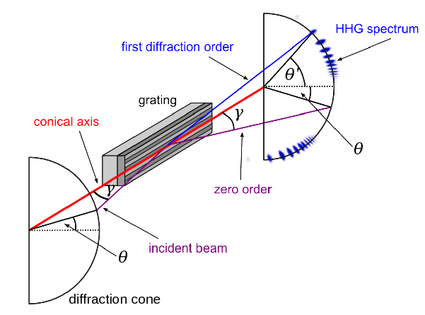
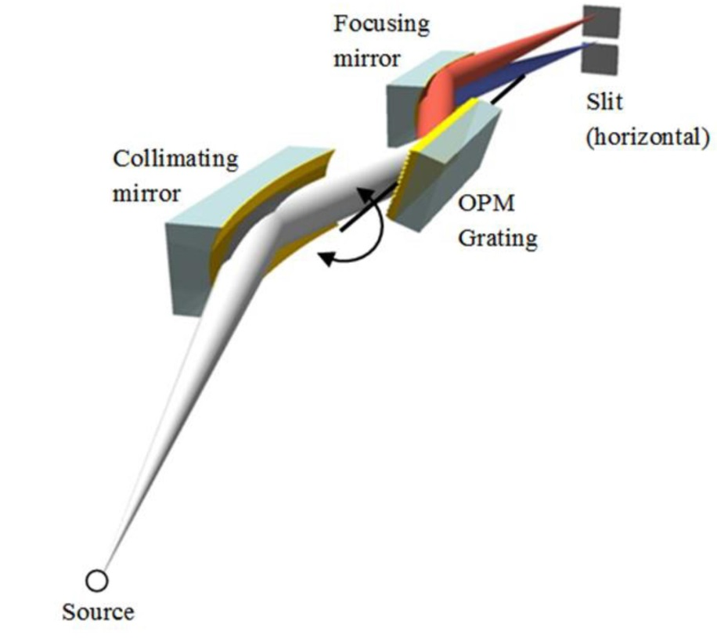

Time preserving monochromator –
to select individual harmonics
OFF-PLANE MOUNT ⇒ the incident and diffracted wave vectors are almost parallel to the grooves
W. Cash, Appl. Opt. 21 710 (1982)
W. Werner & H. Wisser, Appl. Opt. 20 487 (1981)
W. Werner and H. Visser, Appl. Opt. 20, 487 (1981)
28.08.2019
11

Slide 12
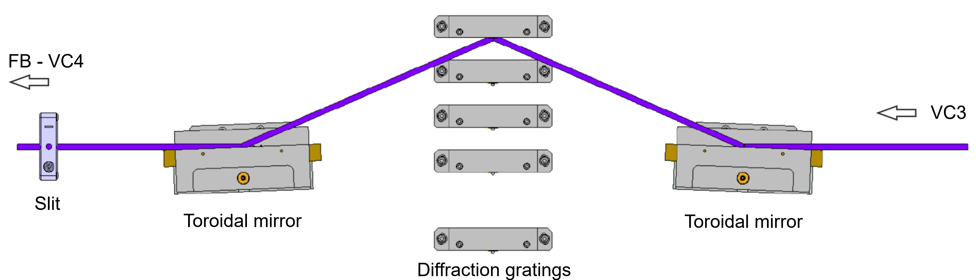
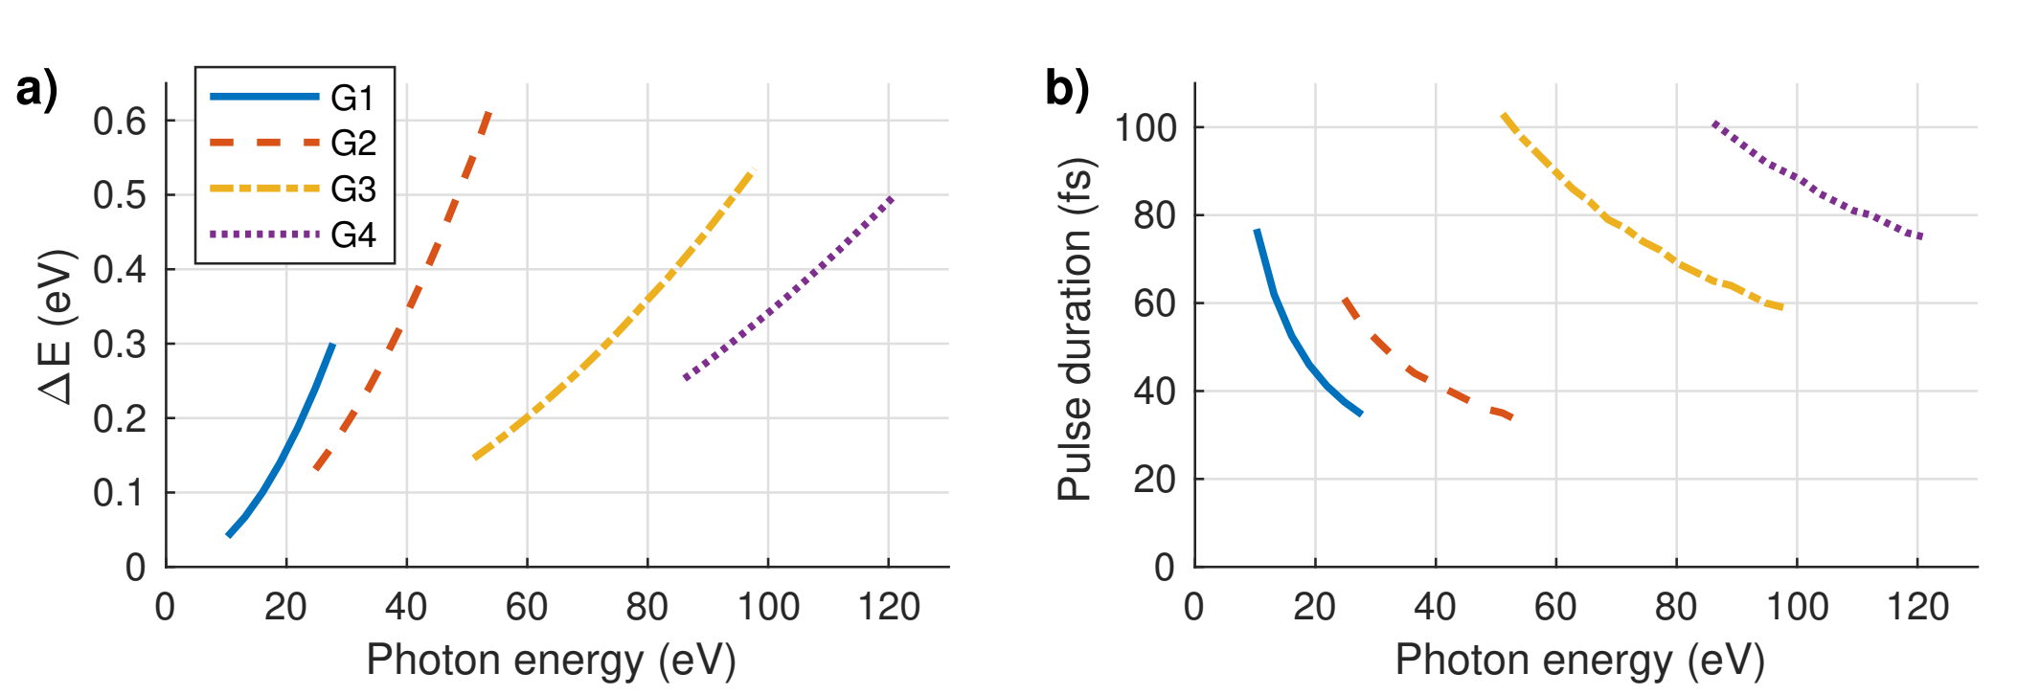
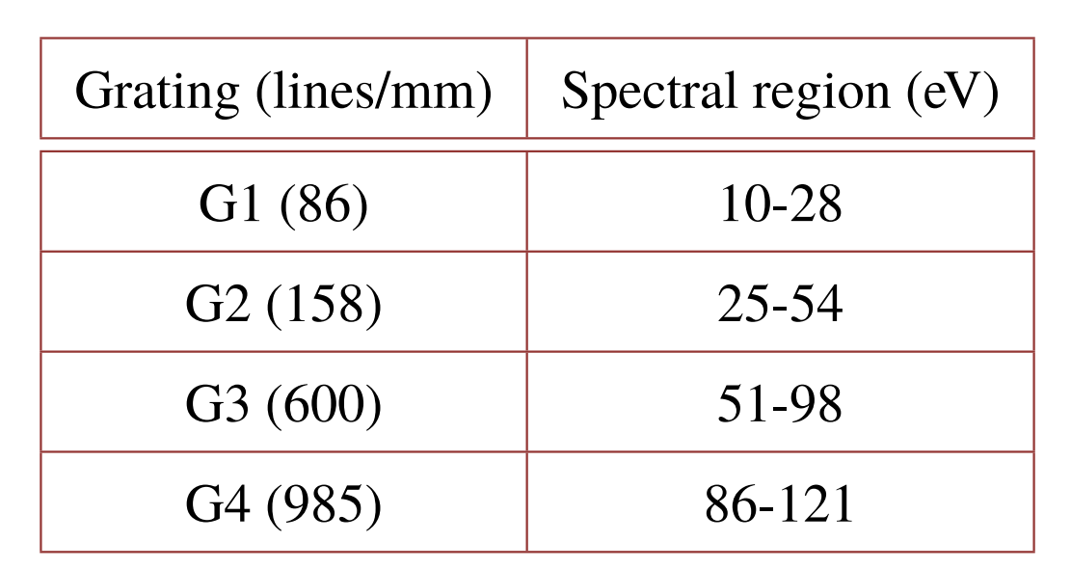
Time preserving monochromator –
to select individual harmonics
Energy resolution
Pulse duration
O. Hort et al, Opt. Express 27 351945 (2019)
Calculated for 100 μm slit and assuming 1 mrad full divergence
28.08.2019
12

Slide 13
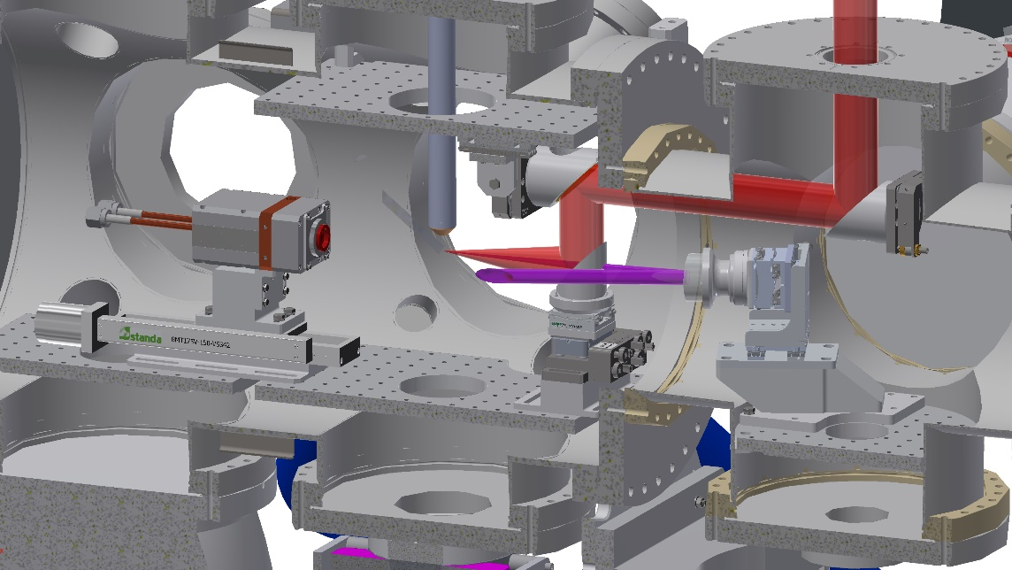
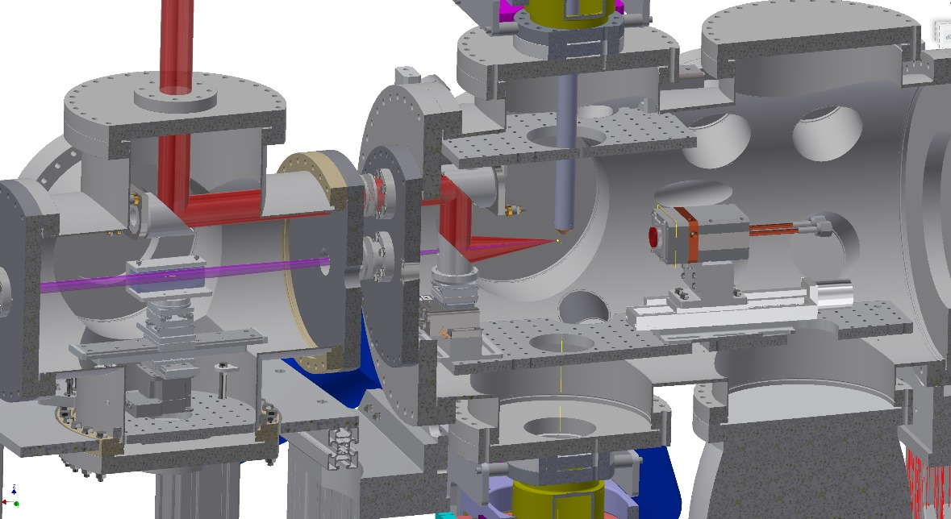
MAC user end-station -
Pump-probe configurations in E1
HHG focusing with multilayer coated off-axis parabola
f=270 mm, angle 21.06°
Current configuration under commissioning -
HHG focusing with ellipsoidal mirror
Ellipsoidal | Imaging ratio 1:4.8
Entrance arm | 2400 mm
Exit arm | 500 mm
Incidence angle | 85°
Clear aperture | 90 mm x 15 mm
28.08.2019
13

Slide 14
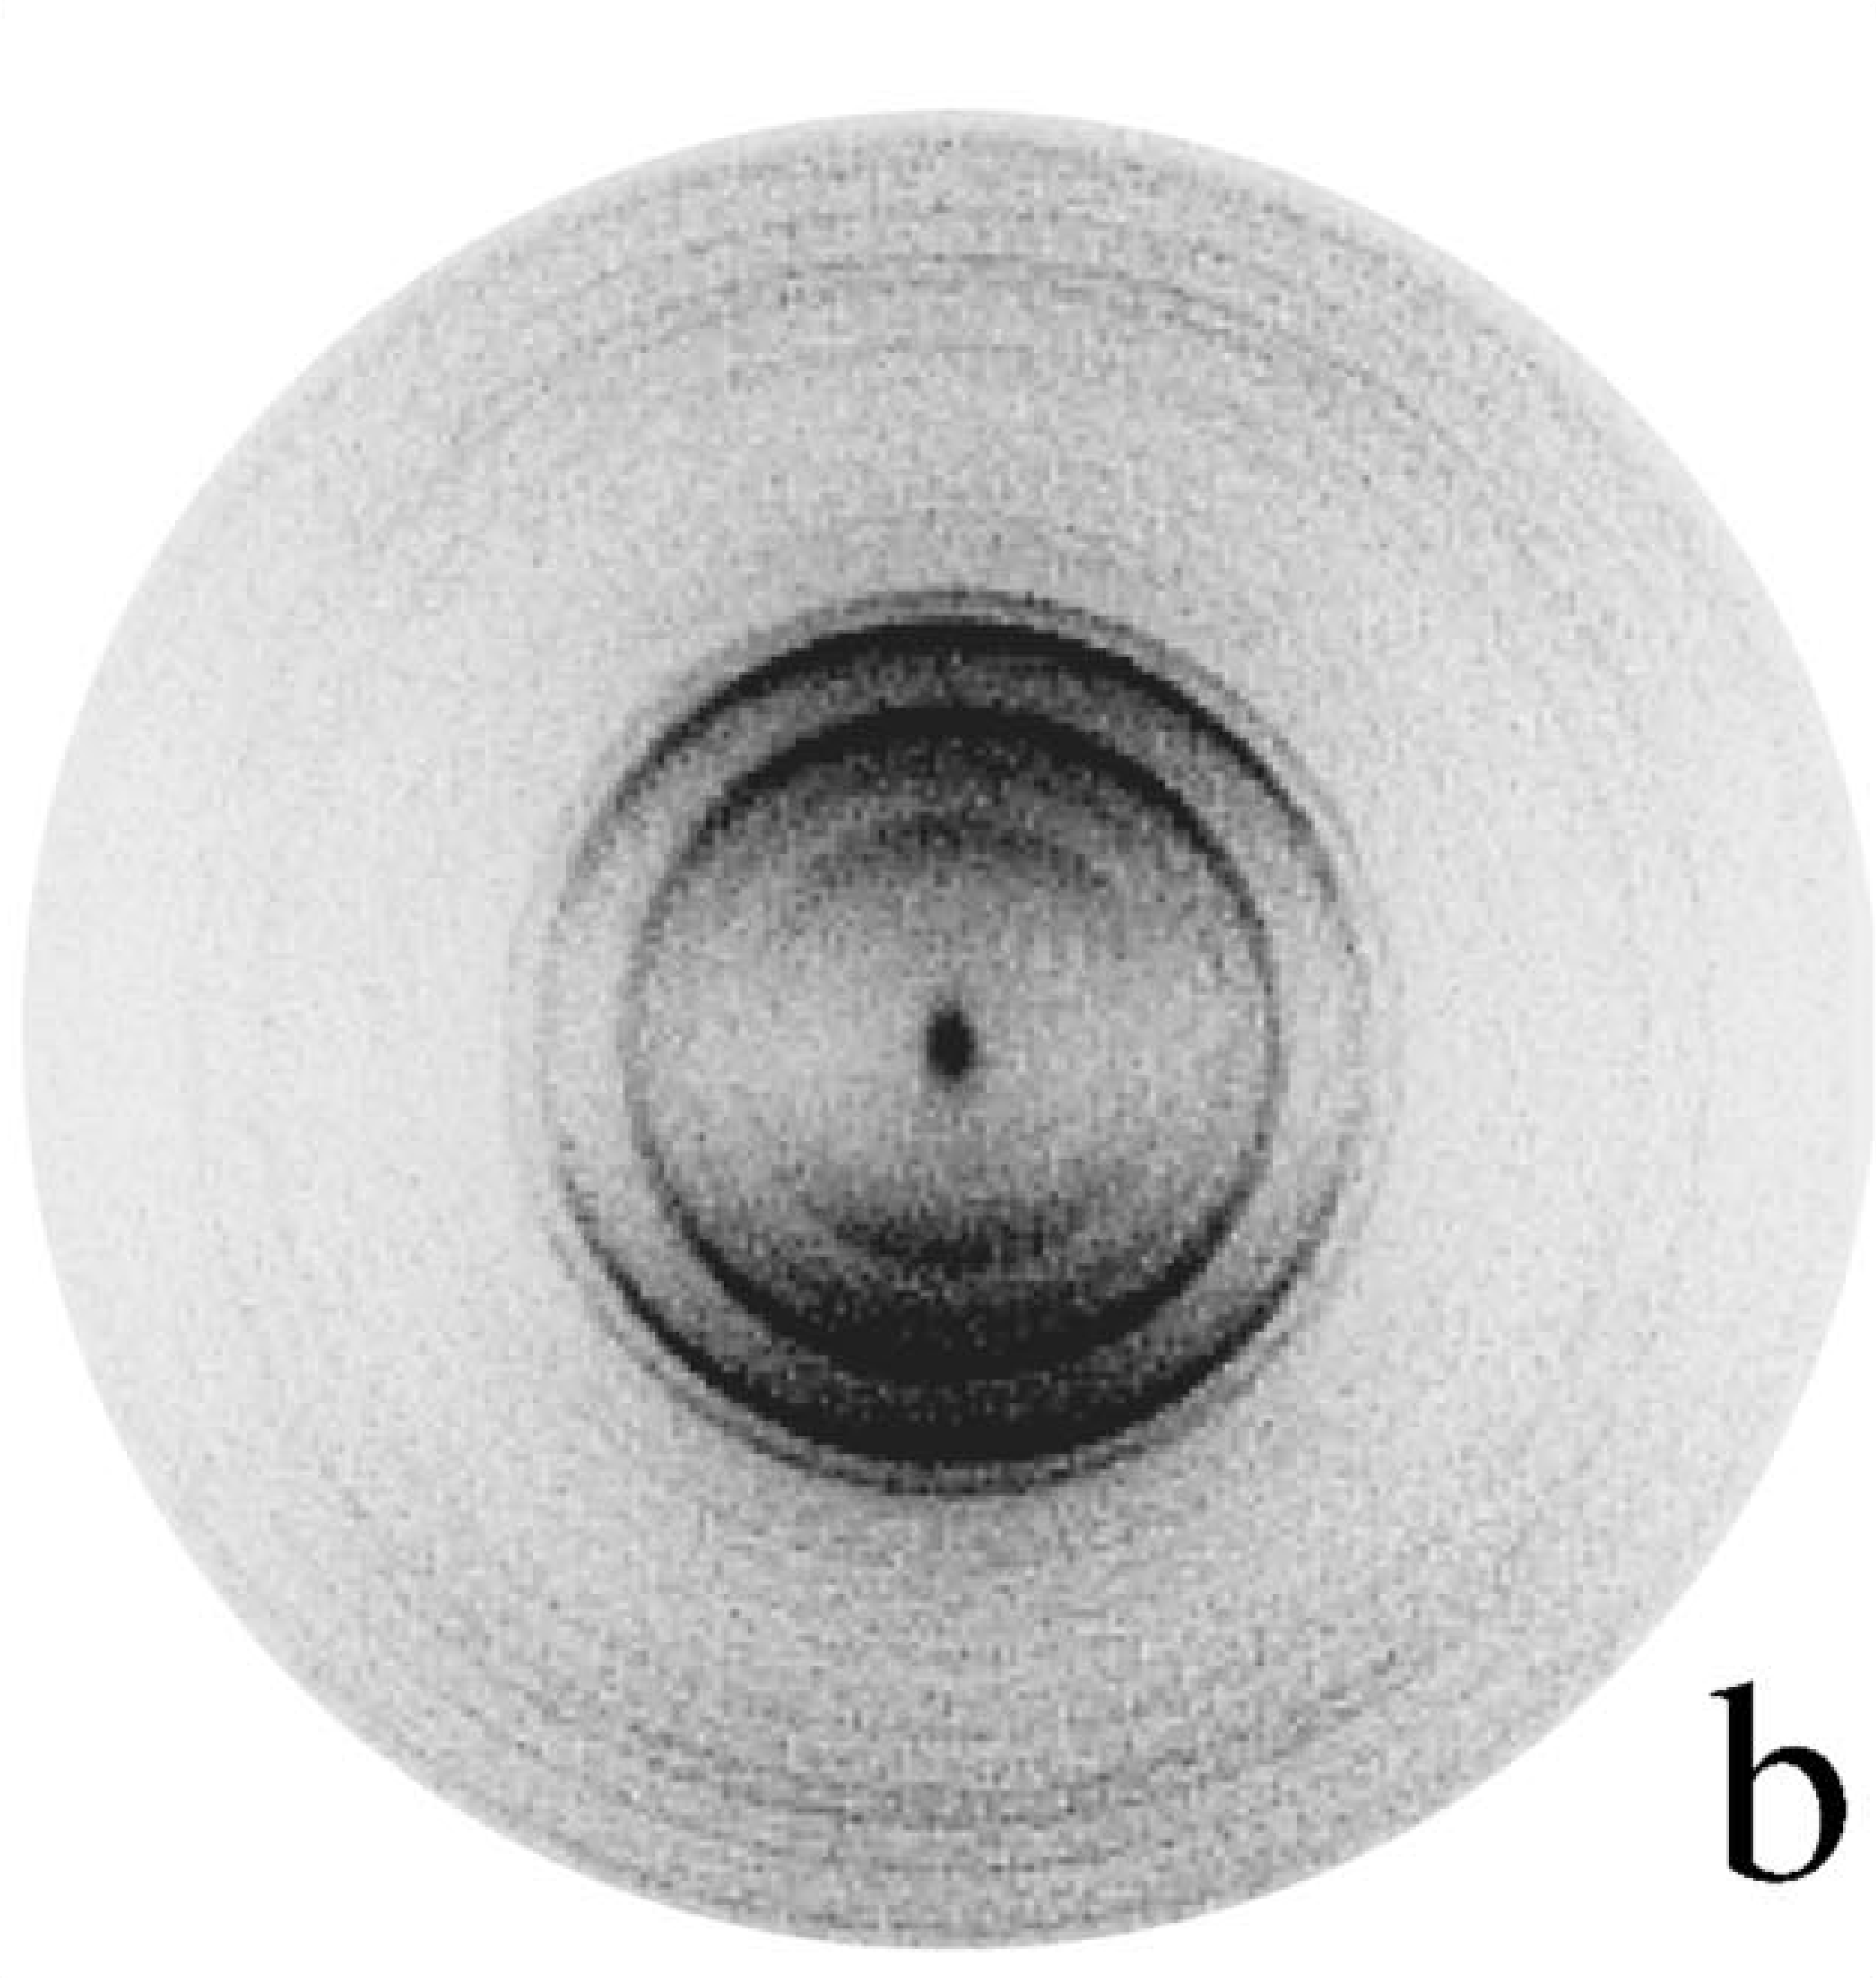
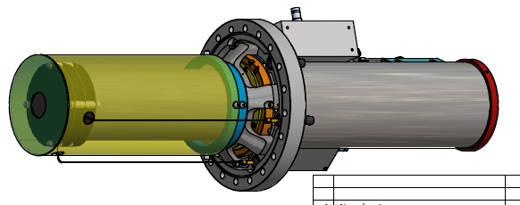

MAC user end-station -
ion and electron spectrometers
VMI – Velocity Map Imaging according to the design of Eppink and Parker
O+ ion image
Produced by
A.T.J. Eppink and Parker, Rev. Sci. Instrum. 68 3477 (1997)
28.08.2019
14

Slide 15
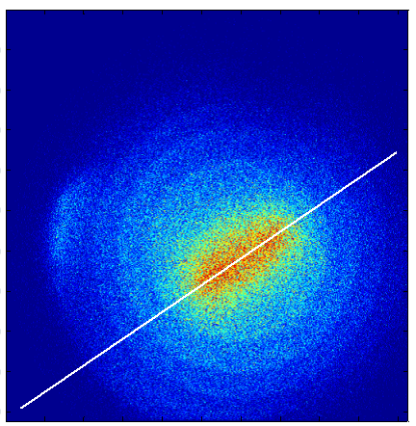
MAC user end-station -
Results from the VMI commissioning in July 2019
Electron image
in velocity mapping mode
Ion image
in velocity mapping mode
Electron image
Spatial resolution mode
Together with our friendly users
Russell Minns and Joanne Woodhouse from University of Southampton, UK
James Thomson and Katharine Reid
from University of Nottingham, UK
Chamber was backfilled with Ar gas. Monochromatized HHG beam with grating G158 in 0th order (~25 - 40 eV estimated, due to the reflection efficiency of the grating)
Running user program
Molecular Frame Photoelectron Angular Distribution as a Probe of Dynamic Structure
28.08.2019
15

Slide 16
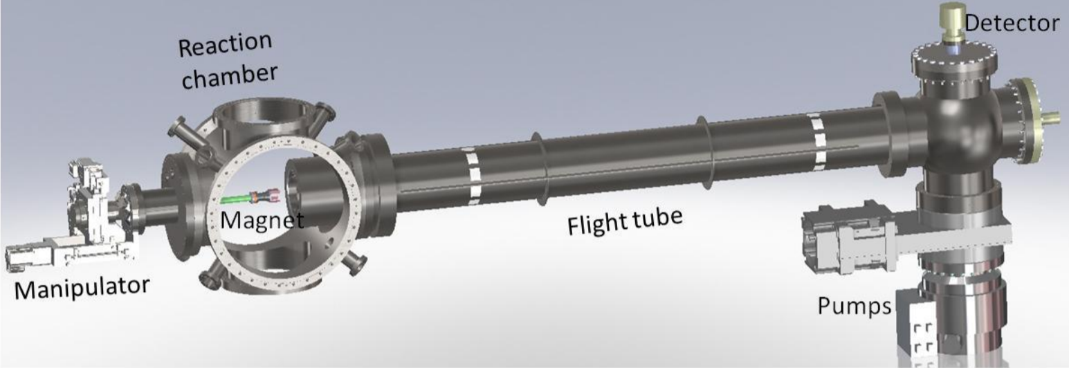
MAC user end-station -
Magnetic bottle electron/ion time-of-flight spectrometer
Initial design for coincident electron and ion coincident mode
Best detection range 0…300 eV, possible tuning to higher energy
2 m flight tube for long arm
Electron mode for long arm or 3 electrode lens for ion high resolution ToF mode
Short arm for ion measurement in coincidence with electrons in long arm
Collaboration with Prof Raimund Feifel, Goteborg Univ., Sweden
28.08.2019
16

Slide 17
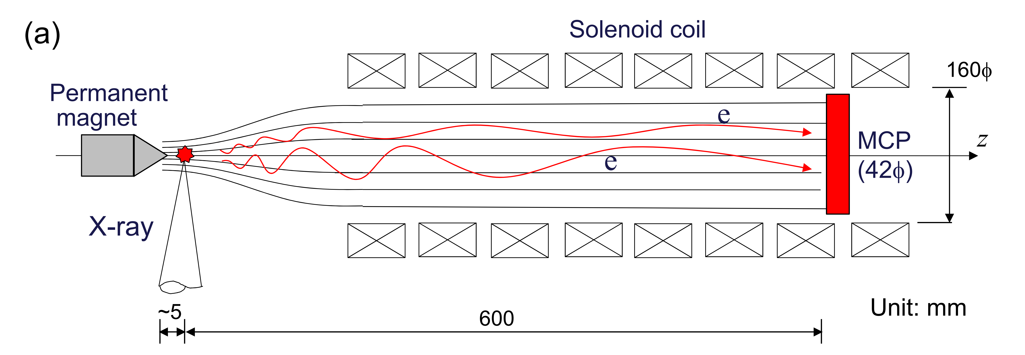
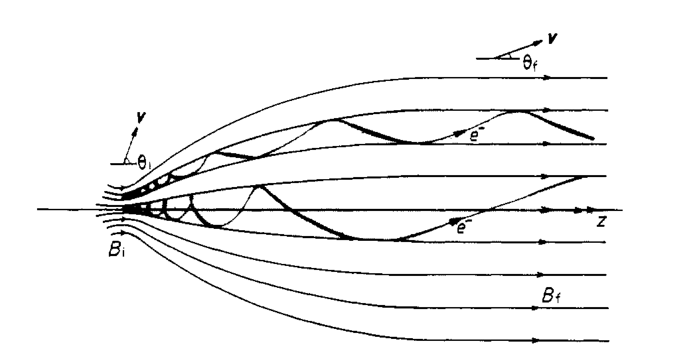
MAC user end-station -
Magnetic bottle working principle
from S.Number et al, AIP Advances 5 117101 (2015)
Schematic diagram showing the helical motion of an electron moving in a magnetic filed
P. Kruit and F.H. Read, J. Phys. E: Rev. Sci. Instrum. 16 313 (1983)
28.08.2019
17

Slide 18
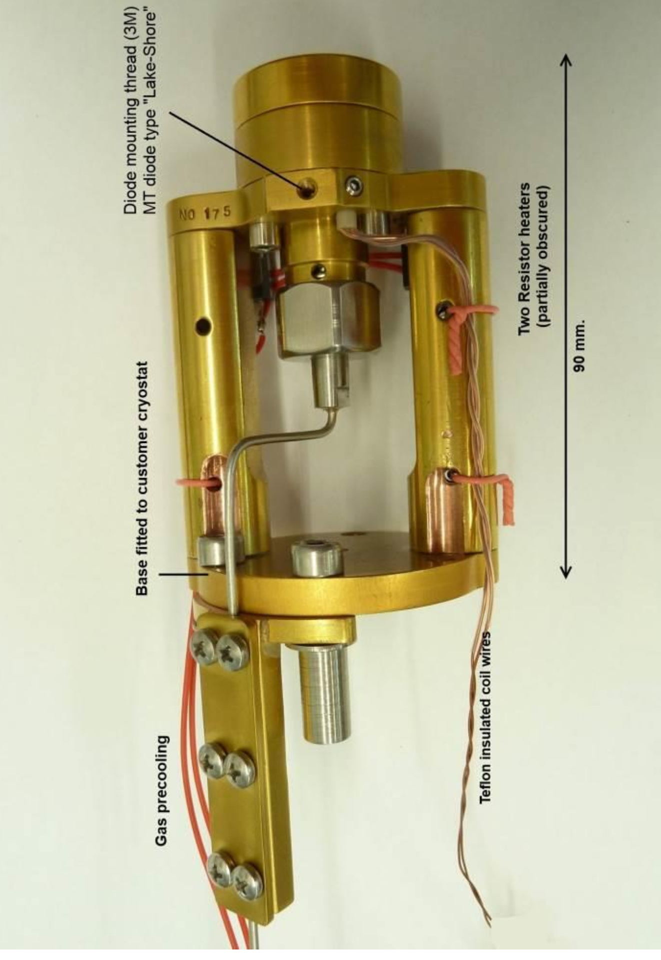
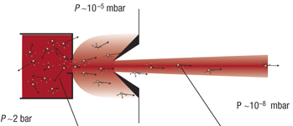
MAC user end-station -
sample delivery systems
Cluster and cold molecular beam source
Adiabatic expansion of rare gases /
molecules
Cluster - size is tuned by temperature and pressure behind the nozzle
Even-Lavie Valve
Cryogenic, temperature controlled pulsed valve
for cryogenic supersonic expansion and Helium droplets experiments
under commissioning
28.08.2019
18

Slide 19
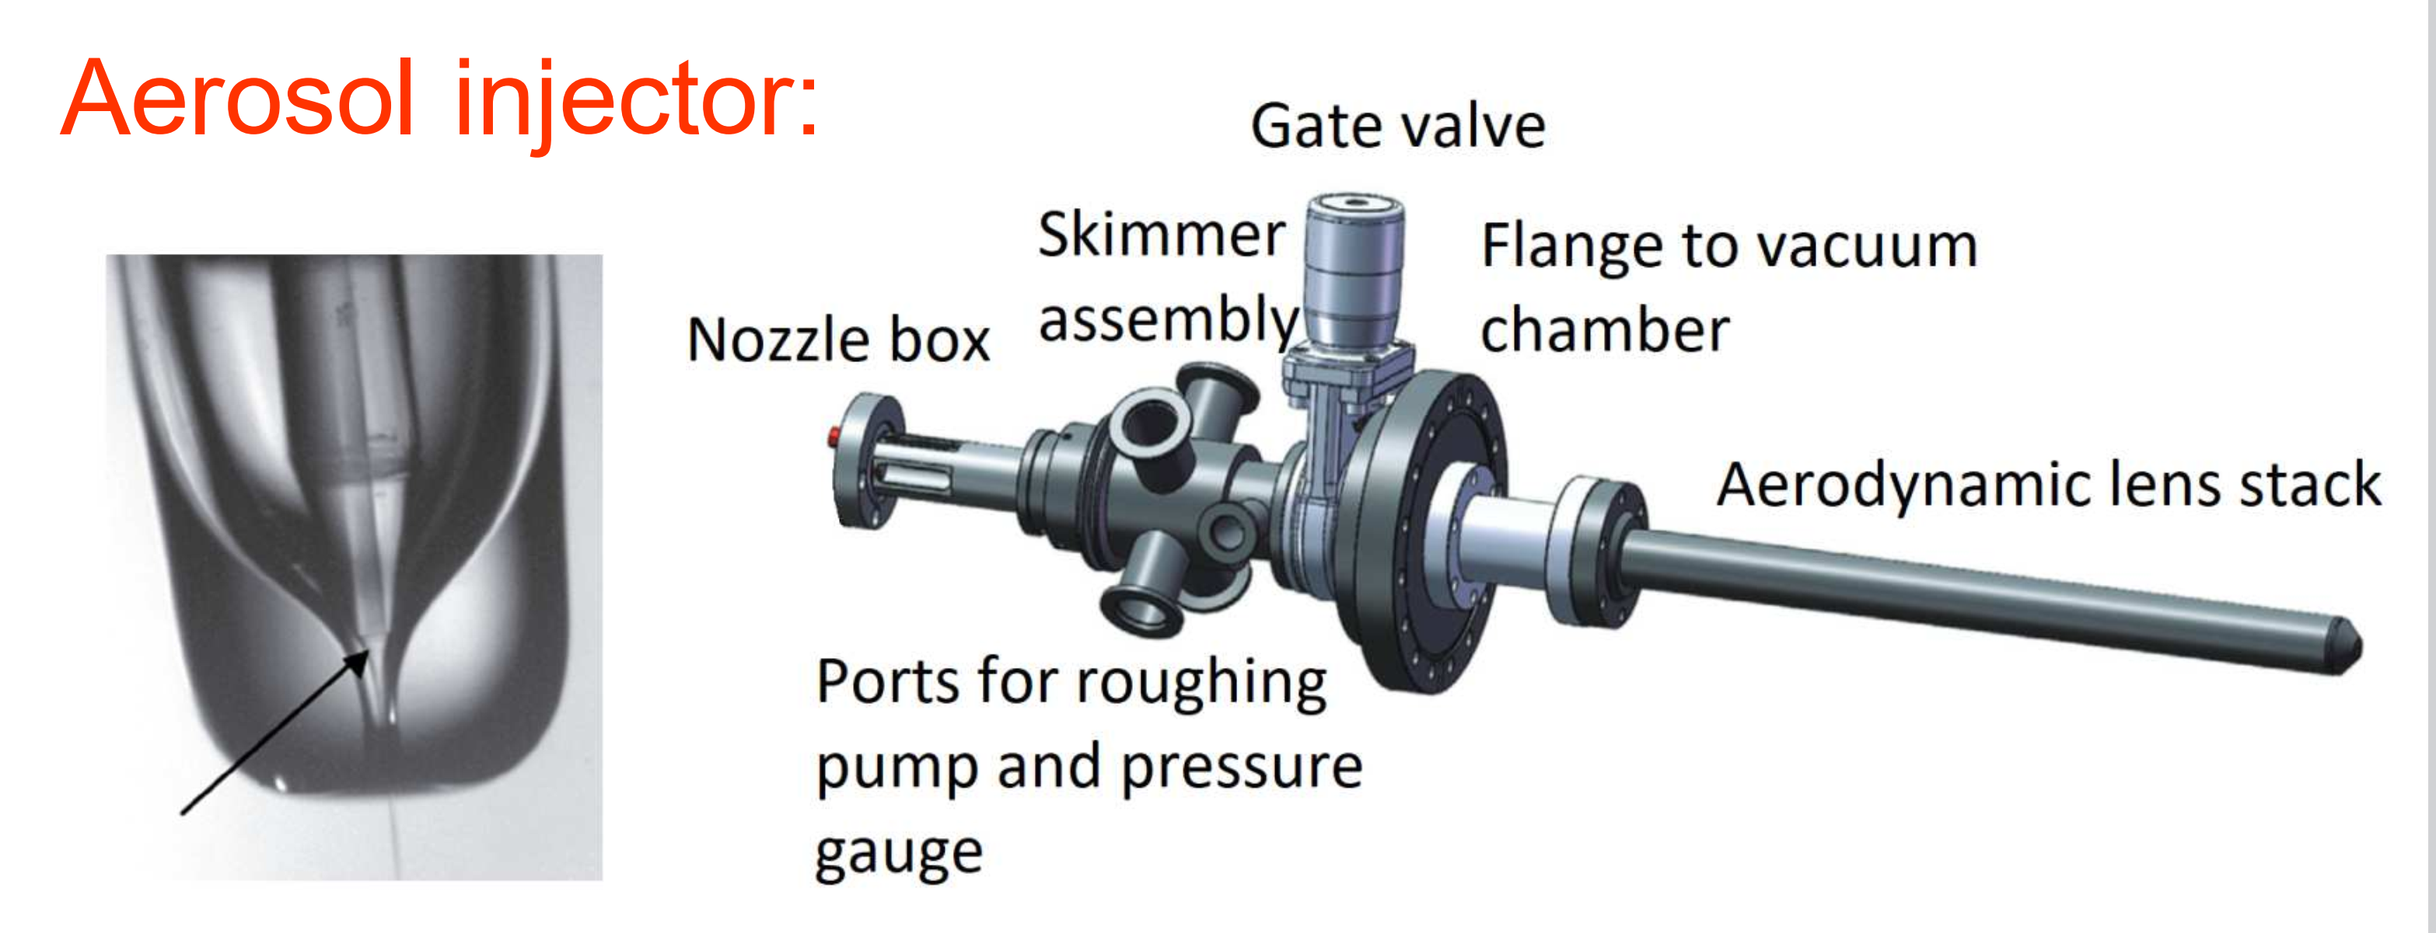
MAC user end-station -
sample delivery systems
Cluster and cold molecular beam source
Aerosol injector
developed in group of Prof. Janos Hajdu at Uppsala University, Sweden
Adiabatic expansion of rare gases / molecules
Cluster - size is tuned by temperature and pressure behind the nozzle
Gas dynamic virtual nozzle to produce microscopic droplet streams
Aerodynamic lens stack to guide and focus nanoparticle beam in vacuum
28.08.2019
19

Slide 20
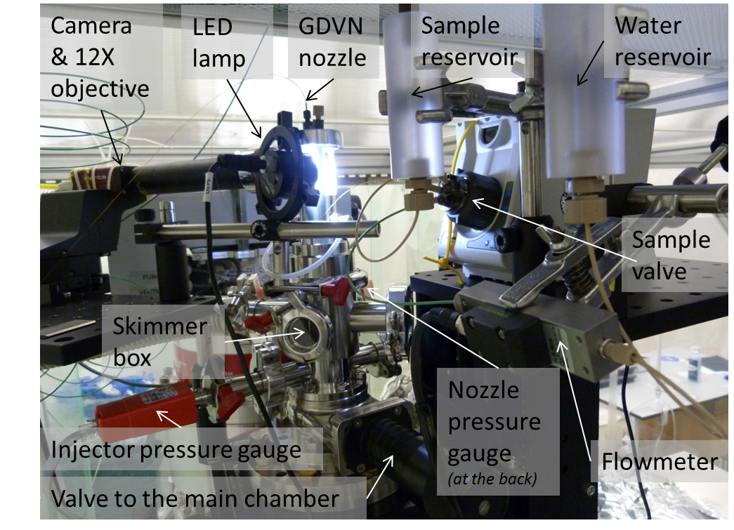
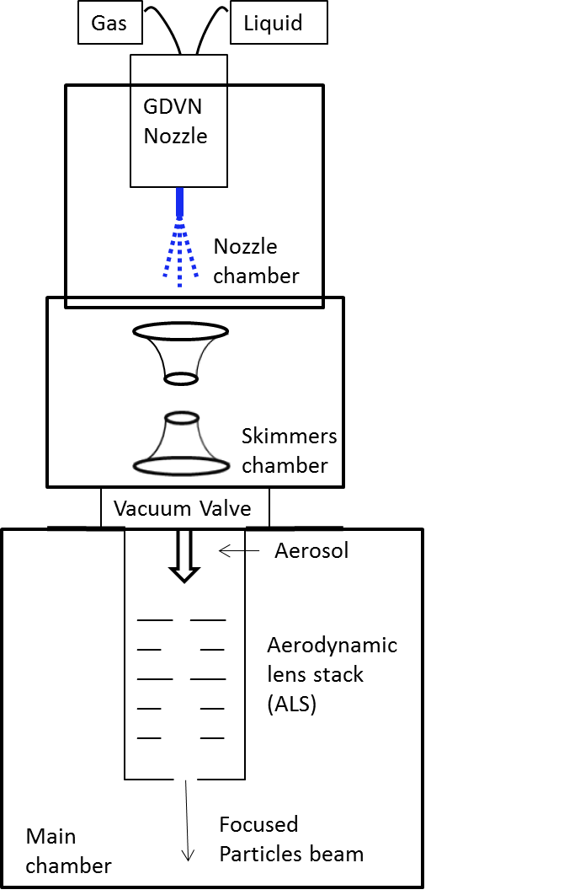
MAC user end-station -
sample delivery systems
The „Uppsala“ injector based on
GVDN (gas dynamic virtual nozzle) and ALS (aerodynamic lens stack)
28.08.2019
20

Slide 21
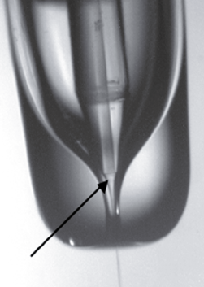
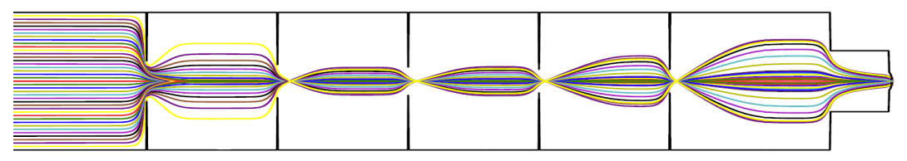
MAC user end-station -
sample delivery systems
GDVN nozzle
ALS
Gas
Liquid
Aerosol
The „Uppsala“ injector based on
GVDN (gas dynamic virtual nozzle) and ALS (aerodynamic lens stack)
28.08.2019
21

Slide 22
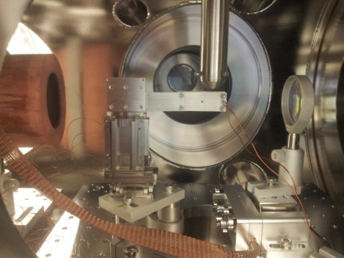
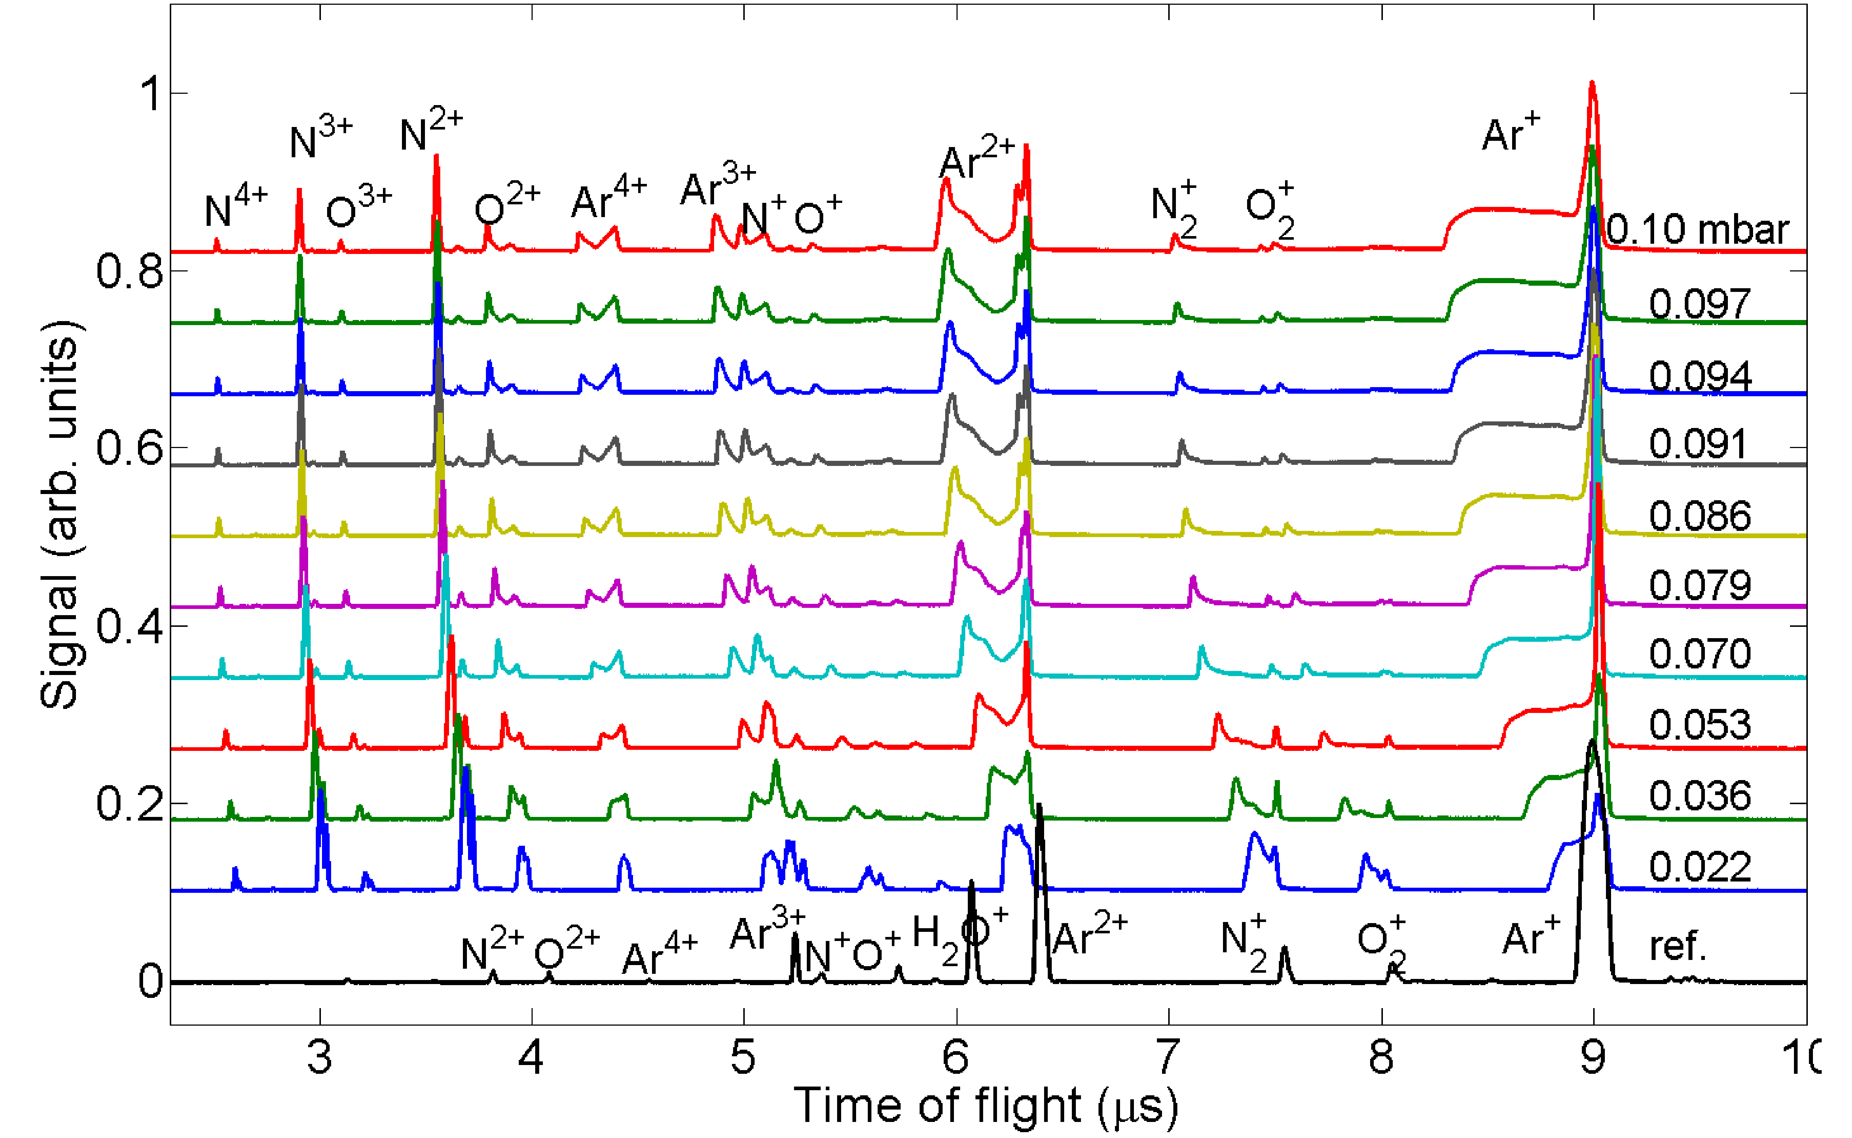
MAC user end-station -
Commissioning experiments in S1
NIR laser: 800 nm, 120 fs, 10¹⁶ W cm⁻²
Ar or He gas through injector
CsCl salt nanoparticles
From first commissioning experiments
to the development of in-house research program
With increasing gas density / irradiation intensity ion peaks become broadened towards shorter TOFs – higher ion kinetic energies
E. Klimešova et al, Sci. Rep. 9 8851 (2019)
28.08.2019
22

Slide 23
Plasma channel formation
in the carrier gas
PIC simulation + analytical calculation
PIC simulation – collaboration with RP6, Yanjun Gu
Plasma channel is formed
Coulomb explosion of positively charged channel
Investigation of carrier gas dynamics
Can be used to estimate gas density
Opens new possibilities to study dynamics in inhomogeneous samples
Or differential pumping might be needed to decrease gas density
E. Klimešova et al, Sci. Rep. 9 8851 (2019)
28.08.2019
23

Slide 24
CsCl nanoparticles in strong NIR fields – ion hits and misses
Single shot misses
Single shot hits
All shots are the same
H⁺, He⁺ and H₂O⁺ ions
He⁺ accelerated to 80 eV
New peaks: Cs⁺, Cl⁺, photons
H₂O⁺ peak disappears
Cl⁺ is accelerated to 100 – 700 eV
He⁺ is accelerated to ~ 1 keV
H⁺ is accelerated to 100 – 200 eV
prepared by E. Klimešova
28.08.2019
24

Slide 25
CsCl nanoparticles in strong NIR fields – electrons
Misses
Only broad electron signal
Energies up to 200 eV
Hits
Same broad electron signal as for misses
Photon peak appears
New: fast signal at 3 – 20 ns,
corresponding energies: 1 – 55 keV
prepared by E. Klimešova
28.08.2019
25

Slide 26
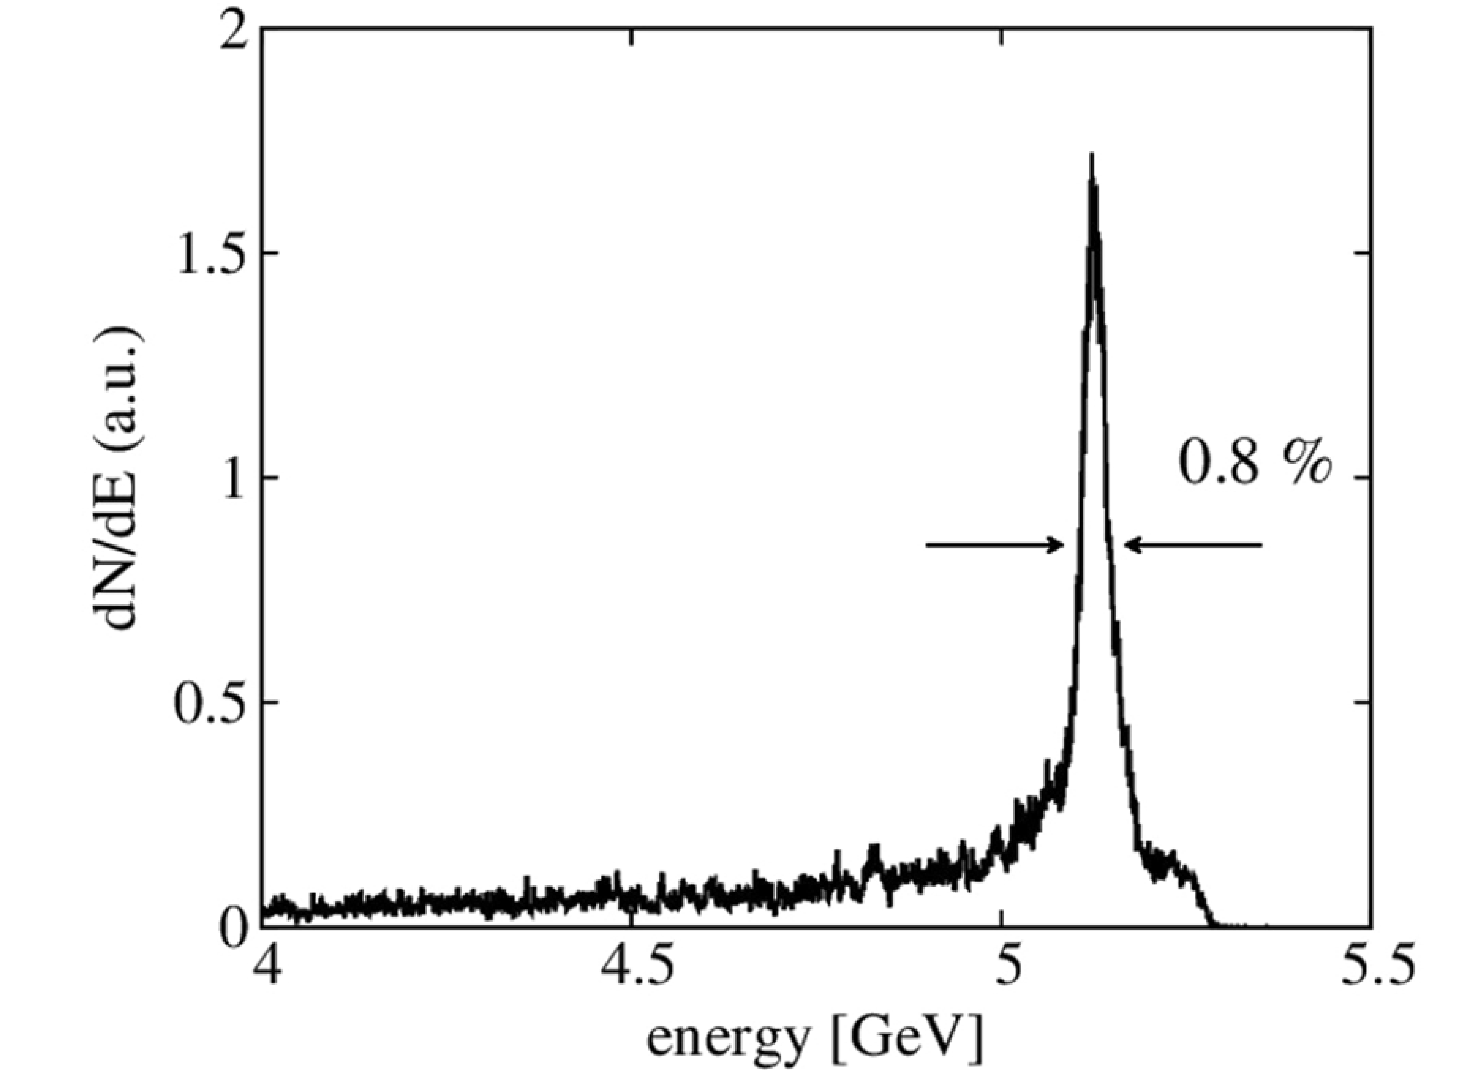
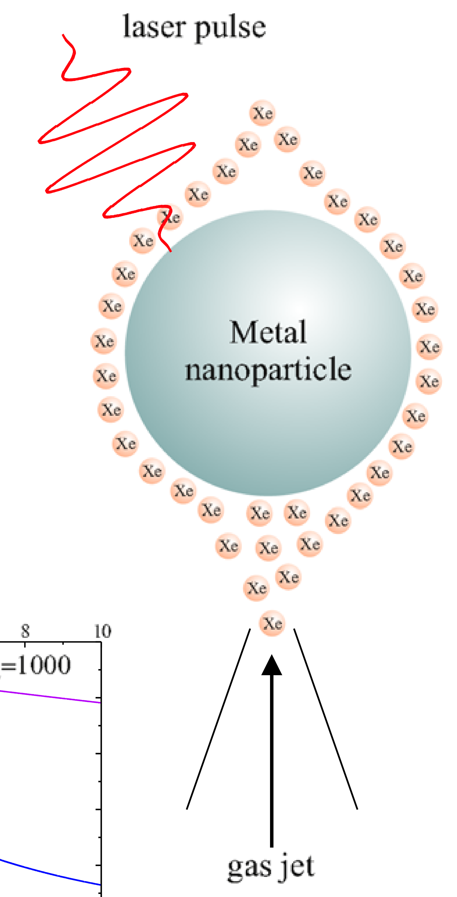
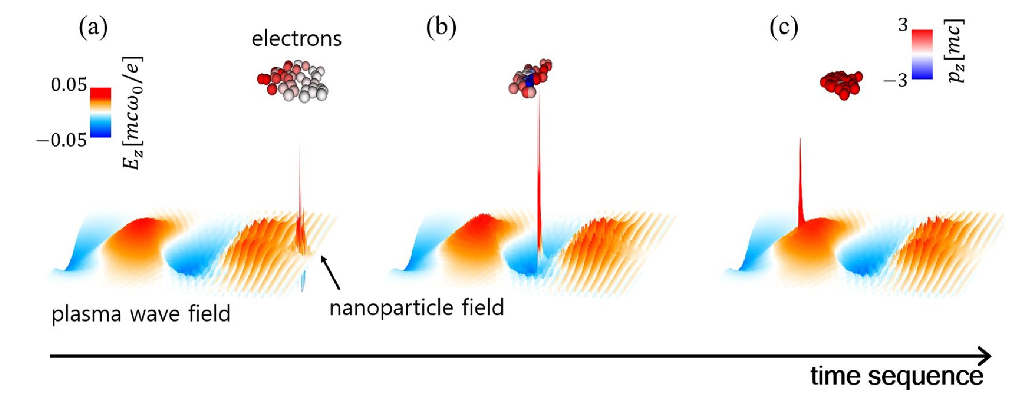
MAC user end-station -
Experiments with aerosol nanoparticle injector
Electron beam with a narrow energy spread
Electron emission in the plasonic
enhanced near-field
ATI (above threshold ionization) at ~10¹³ W/cm²
0.5 PW Laser
Laser wakefield acceleration regime
Nanoparticle inserted into a plasma medium
Controllable and localized electron injection by the nanoparticles
M. F. Ciappina et al,
Laser Phys. Lett. 10 (2013) 105302
M.H. Cho et al, Sci. Rep. 8 16924 (2018)
28.08.2019
26

Slide 27
We are looking forward to
fruitful collaborations and successful user experiments !

