Slide 1




Plasma Physics and Laser-Plasma Interaction C. Riconda LULI, Sorbonne Université, Paris, FRANCE
ELI Summer School, 29.8.2019

Slide 2
Outline of the talk
Plasma in a nutshell
Lasers interacting with plasma/matter
Simulation of laser-plasma interaction (LPI)
Collective effects – parametric instabilities (PI)
Two examples where PI play a role
LPI for Inertial Confinement Fusion (ICF)
Plasma Optics – Plasma Amplification
Conclusion/outlook

Slide 3
Plasma in a nutshell

Slide 4
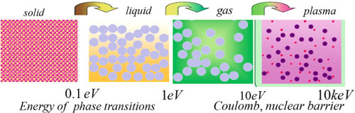
The 4th state of matter
Ionized gas: positive & negative charges are in some sense «free» particles:
cold plasma never really « cold » (1eV = 11605 K)
Πλάσμα (plasma) is the most abundant form of matter in the universe: 99,999%
"In the beginning there was plasma. The other stuff came later.“ (Rogoff, Coalition for Plasma Science)
Introduced by Langmuir & Tonks in 1929.

Slide 5
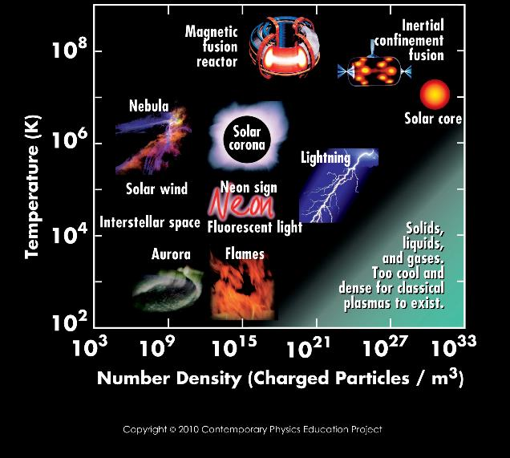
The ubiquitous plasma (The 1st state of matter)

Slide 6
Defining a plasma: some basic parameters
➔ All functions of density n_{e} [in cm⁻³] and temperature T_{e} [in eV] N.B. n_{e}=n_{i ,} m_{i}>>m_{e}
(electron) plasma frequency: ω_{pe} = (4πn_{e}e²/m_{e})^{1/2} = 5.64 x 10⁴ n_{e}^{1/2} [Hz}
(shielding) Debye length: λ_{D} = (kT_{e}/4πne²)^{1/2} = 7.43 x 10²T_{e}^{1/2} n^{−1/2} [cm]
(electron-ion) collision frequency: ν_{e} = 2.91 x 10⁻⁶n_{e} ln Λ T_{e}^{−3/2} [Hz]
(electron) thermal velocity: v_{Te} = (kT_{e}/m_{e})^{1/2} = 4.19 x 10⁷T_{e}^{1/2} [cm/sec]
average distance: d_{o} = n_{e} ^{-1/3}
average potential energy for binary interaction: E_{pot} = e²/d_{o} = e² n_{e}^{1/3}
average (electron) kinetic energy: E_{kin} = m_{e}v_{Te}² = k T_{e}

Slide 7
Some derived parameters to characterize a plasma
one definitely needs for typical scales: L >> λ_{D} & t >> 1/ω_{pe} , 1/ω_{o}
an important parameter is the number of particles in a Debye sphere:
N_{D} ≡ (4π/3) n_{e} λ_{D}³ >>> 1
Freeness: E_{kin} >> E_{pot} → T_{e} >> e²/d_{o}=e²n_{e}^{1/3} → n_{e}^{2/3} T_{e} / e²n_{e} = N_{D}^{2/3}
→ N_{D} >> 1
Collisionlessness: ν_{e} / ω_{pe} ~ 1/N_{D} << 1
A plasma is very often dominated by collective effects !
Definition of a classical plasma: fields due to Coulomb binary interaction ≈ 0 on average, but collective motion and ability to generate macroscopic fields important.
N_{D}>>1 can be satisfied for wide range in n_{e} and T_{e}

Slide 8
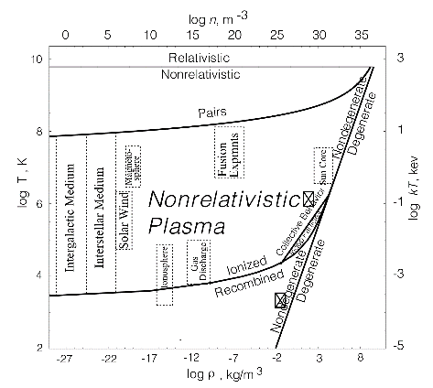
A comment on relativistic and quantum plasmas
relativistic plasmas: T_{e} ~ m_{e}c² ~ 500 keV
quantum effects: very dense, low-temperature plasmas, e.g. WDM studies, or
very intense laser fields, QED effects
uncertitude in spatial coordinate:
δr ~ n_{e}^{-1/3} --> δp n_{e}^{-1/3} ~ ħ/δr = ħ n_{e}^{1/3}
For classic description require:
δp << <p> ~ (m_{e}T_{e})^{1/2} ➔
n_{e} << (m_{e}T_{e})^{3/2}/ħ³ ➔ n_{e} ≪ 10²³T_{e}^{2/3}
with n_{e} [cm⁻³] and T_{e} [eV]

Slide 9
Lasers interacting with plasma/matter

Slide 10
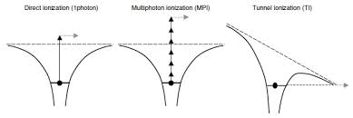
Plasma creation & heating by laser
In a quasi-static field
Initial ionization
H-atom: E_{ion} = 13.6 eV
λ = 1 μm → E_{photon} = 1.2 eV
Electric field E
Keldysh parameter γ = ω_{o} (2m_{e}E_{ion})^{1/2}/eE distinguishes between tunnel (γ << 1)
and multi-photon (γ >> 1) ionization
depends on intensity & wavelength of laser and ionization stage/potential of atom
seed electrons oscillate in the laser field → gain energy → collisional ionization → avalanche process → create a plasma

Slide 11
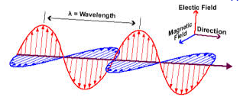

Plasmas interact with laser electromagnetic fields
plasma is ensemble of charged particles which are subject to the oscillating
electromagnetic field of the laser:
Lorentz-force (field-line effect): dp/dt = -e [ E(r,t) + v x B(r,t) ]
because of the mass ratio, ion mouvement can be neglected
First-order approximation → collective quiver velocity of electrons: v_{osc} = eE₀/(m_{e}ω₀) ,
i.e. neglecting v x B = O(v/c)
Coherent motion of the laser induces coherent motion of electrons, enslaved,
e.g. plane wave, linear polarization particles oscillate up and down following E.
Dispersion relation and v_{ph} of the wave modified : only waves with can propagate .
Oscillating electrons collide with ions & lose ordered energy (inverse Bremsstrahlung)
→ wavse absorption and plasma heating
v_{osc} II E
ω_{o} >ω_{pe}
N.B. Relativistic effects, O(v²/c²), → drift parallel to propagation + figure 8 motion for intensities above ~10¹⁸ W/cm²

Slide 12
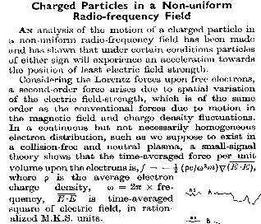
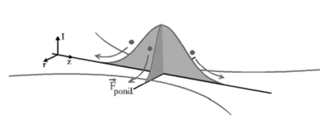
The ponderomotive force
Discovered in 1957 by Boot & Harvie in radio-frequency context (Nature 180, 1187 (1957))
Existence of a non-zero time-averaged force in non-uniform fields (Landau, Mechanics 1940)
F_{Pond} = − (e²/4m_{e}ω_{o}²) ∇E²
Ponderomotive force is an envelope effect*, related to the light pressure, which exists in:
1) tranverse direction: kicks away electrons from high intensity zones resulting in channeling,
density perturbations, focusing, sideway shocks (long-pulse)
2) propagation direction: particle acceleration (short-pulse), e.g. wakefield
*quadratic in E, need somewhat high intensity

Slide 13
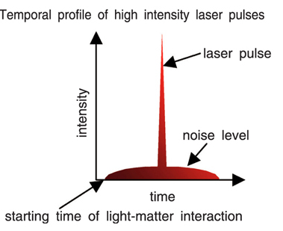
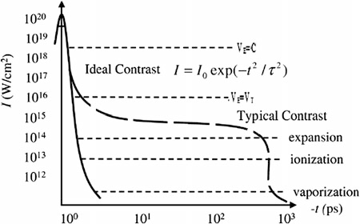
A real-life laser pulse
➔ A laser pulse is not a Heaviside function in time (not even a Gaussian)
➔ There is almost always already a plasma when „your“ pulse arrives
➔ Consequences also for simulation: can not always consider the complete pulse

Slide 14
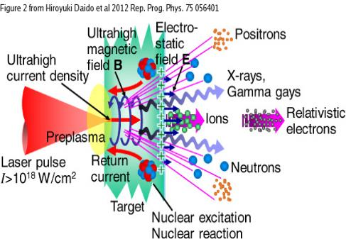
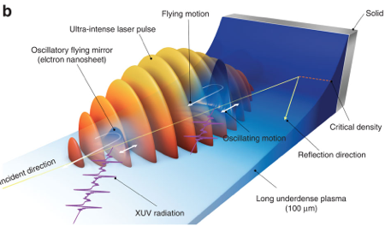
High-intensity laser interacting with plasma/matter
‘Underdense’ Plasma : ω₀ > ω_{pe}
Laser propagates inside the plasma,
volume interaction.
‘Overdense’ Plasma : ω₀ < ω_{pe}
Relativistic laser
Mainly surface interaction
Laser pulse
Next we‘ll consider collective effects of weakly or non-relativistic Laser-Plasma-Interaction,
i.e. many particles interacting in a coherent way in an underdense plasma‚ ‘long‘ pulse

Slide 15
Simulation of laser-plasma interaction (LPI)

Slide 16
A hierarchy of models available
➔ Why simulation at all ? Things are strongly nonlinear and multi-dimensional;
quantitative aspects require simulation.
Approach depends on the kind of physics and characteristic scales to be simulated
E.g.: particle motion, multi-fluid models, 1 fluid model (MHD), kinetic models
Laser-plasma interaction as we consider requires relativistic kinetic approach:
VLASOV equation for each species
∂f_{s}/∂t + (p/m_{s}) •∂f_{s}/∂x + q_{s} (E + (p/m_{s}γ) × B)•∂f_{s}/∂p = 0
➔ Equation describes the evolution of the particles distribution function
Equation can be integrated directly or solved using a statistical approach (numerically)
Very well suited for high field, relativistic domain

Slide 17
Particle-in-cell approach
➔ Idea: initial condition is a large number of particles with a given temperature distribution
- they then evolve according to the following equations (Maxwell + Newton)
Electromagnetic field
∇× E + ∂B/∂t = 0
∇× B − (1/c²) ∂E/∂t = μ₀ J
∇•E = ρ/ε₀
∇•B = 0
Characteristics of Vlasov-eqn.
dx_{p}/dt = u_{p}/γ_{p}
du_{p}/dt = q_{p} (E_{p} + u_{p} × B_{p}/γ_{p})
γ_{p} = (1 + p²/(mc)²)^{1/2}
Reality versus simulation
L >> λ_{D,} N_{D} = O(10²...10⁶)
➔ millions of billions of particle impossible !
BUT: simulation same for 10 and 10.000
since collective motion, particles ‘enslaved‘
Constituent relations for each cell
ρ = Σ q_{p}
J = Σ q_{p} u_{p}/γ_{p}

Slide 18
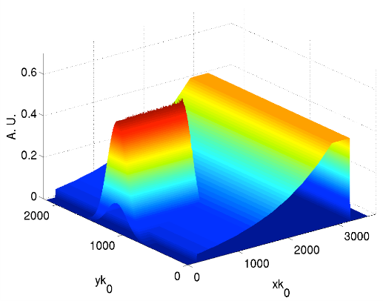
Computational aspects: a case study from ICF
Need to resolve: 1/ω_{pe} , 1/ω_{o} & 1/k_{o}
Particular case:
10 ps laser propagating in the plasma
for some 100 microns
(Δx = Δy = 0.18 k_{o}⁻¹ , Δt = 0.18 ω_{o}⁻¹ ; CFL: c Δx ≤ Δt)
2.4 x 10⁸ computational cells
1.4 x 10⁵ time steps
10^{8...9} macro-particles
(a small fraction of the real number!)
Order of 500‘000 CPU-hours !! (~1 month running on 600 cores-57 yrs on 1 core)
Producing hundreds of GB data
Multidimensional kinetic equations require VERY BIG computers !!!

Slide 19
Collective effects parametric instabilities

Slide 20
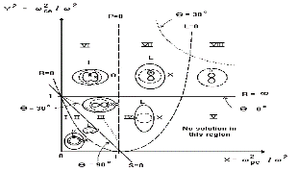
From wave propagation to dispersion relation
A plasma supports BOTH transverse electromagnetic waves (e.g. Laser propagating inside the plasma) and longitudinal compression waves (electrons or ions). How to characterize these waves ?
Procedure:
Choose governing equations, e.g. fluid eqns or kinetic eqn.
Choose background (0th-order) (cold or hot, at rest or in mouvement, magnetized or not)
Study response of the plasma to small electric or electromagnetic perturbations
of the form exp{i(k•r – ωt)}
Determine dispersion relation, D(ω,k) = 0, and solve for ω = ω(k) to get possible
combinations of frequency ω and wave vector k
Find which waves are supported by the plasma, i.e. natural oscillation modes of the plasma*
Plasma waves ‘Zoo‘
*analogous to propagation of electromagnetic waves in dielectrics ω = kc√ε or study of acoustic waves in gaz ω = kc_{s}: natural mode of the considered medium.

Slide 21
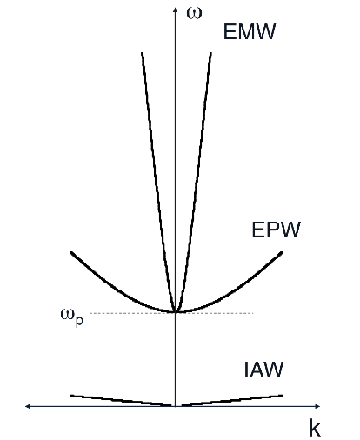
Natural oscillation modes in a non-magnetized plasma
Only three
Electromagnetic wave (EMW)
ω² = ω_{p}² + k² c² → limiting frequency ω >= ω_{p}
Electron plasma wave (Langmuir wave, EPW)
ω²_{epw} ≈ ω²_{p} + 3 k²_{epw} v²_{Te} ≈ ω²_{p} (1 + 3 k²_{epw} λ²_{D})
Ion-acoustic wave (IAW)
ω_{iaw} ≈ c_{s} k_{iaw} c_{s}<<v_{Te}
ω_{p} = (4πn_{e} e²/m_{e})^{1/2} ; v_{Te} = (k_{B}T_{e}/m_{e})^{1/2} ;
λ_{D} = v_{e}/ω_{p} ; c_{s} = (k_{B}T_{e}/m_{i})^{1/2}
➔ „Un“-natural modes are of great interest in LPI (see later) !

Slide 22
Wave coupling in a plasma
Waves in a plasma can couple:
intensity of one or two waves can grow
at the expense of the intensity of another
pre-existing wave if a resonance condition
is fulfilled:
ω₀ = ω₁ + ω₂ (energy)
k₀ = k₁ + k₂ (momentum)
Plasma
Laser, E&M
EP wave
~~~~~~
Backward, E&M
IA wave
~~~~~~
Decay or
Backscattering
EPW₁
Laser, E&M
~~~~~~
EPW₂
~~~~~~
3-wave coupling due to
conservation of energy and
momentum
Plasma
Two plasmon decay
A classic exemple of Laser-Plasma Interaction (LPI):
Parametric Instabilities (PI)
Laser loosing its energy in favor of other waves

Slide 23
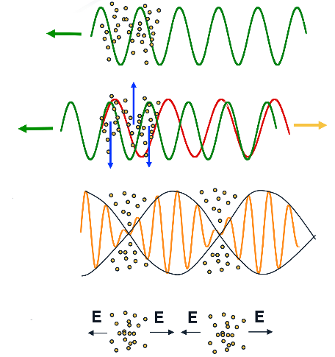
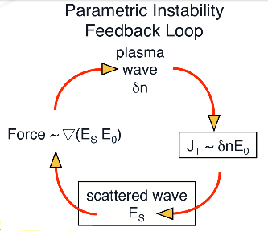
Parametric Instability growth: from noise to coherent motion
Laser into plasma
Plasma oscillations
radiate scattered
light
Beating of 2 em. Waves
→ponderomotive force
→particles into troughs
⬇
⬇
⬇
⬇
Backscattering :
from noise to coherent motion
Bunching matches
electrostatic mode
3 waves resonant
growth of instability :
generates stronger scattered radiation

Slide 24
Two examples where PI play a role: “from detrimental to beneficial"

Slide 25
LPI for Inertial Confinement Fusion (ICF)
1. Example

Slide 26
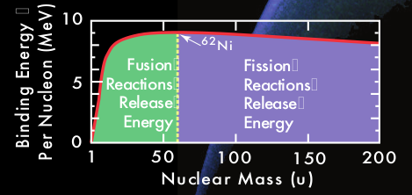
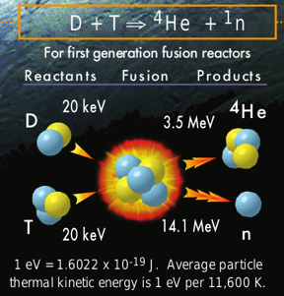
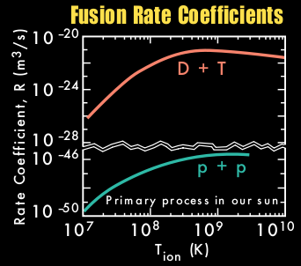
Need of a dense and HOT plasma to have fusion
➔ Nuclear reaction energy: ΔE = (m_{i} – m_{f}) c²

Slide 27
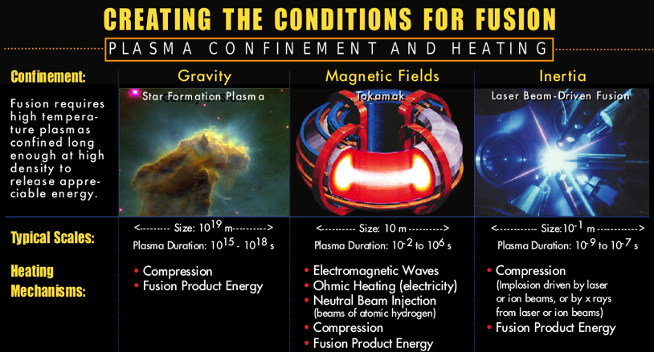
And how to get there ?
➔ more than one way to confine particles (plasma): n τ T > 3 x 10¹⁸ eV cm⁻³ s

Slide 28
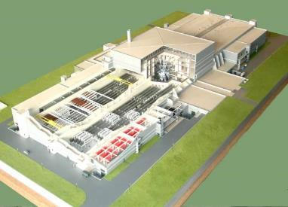
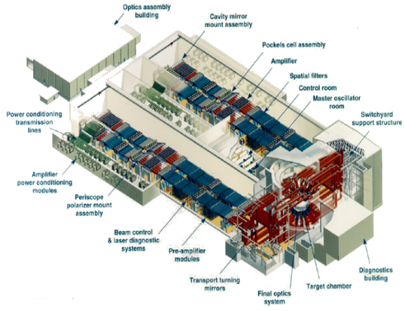
Large-scale projects related to achieving fusion
LMJ
Starting now, only part of total energy
NIF
operating
➔ Also active projects in China, Japan and Russia

Slide 29
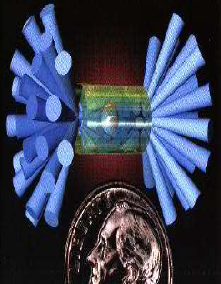
Inertial confinement fusion
Laser
Laser
Laser
To heat and compress
efficiently the target (plasma)
many intense pulses need to be
absorbed in the corona
for a ‘long’ time ns.
Laser
Laser
Laser
How intense can the laser pulses be?

Slide 30
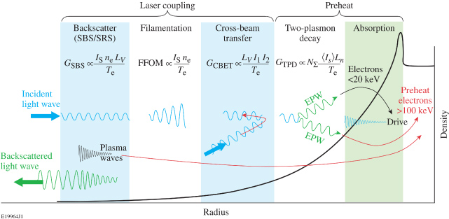
Problem: parametric instability activity in the plasma corona
➔GOAL : absorbe the laser in the ‚absorption zone‘.
Limitations are given by laser propagation in the long-scale underdense plasma
Froula et al. PPCF 54 124016 (2012)
To avoid all this keep intensity `low` I_{o}λ_{o}² ≈ 10¹³⁻¹⁴ Wμm²/cm²

Slide 31
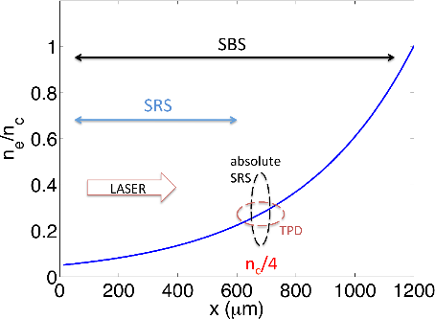
Parametric Instabilities for high laser intensity
➔ Of interest for a new fusion scheme called ‚shock ignition‘
High laser intensities but only for some 10s ps:
I_{o}λ_{o}² ≈ 10^{15...16} Wμm²/cm²
long underdense plasmas: mm-scale
high temperatures: few keV
→ strongly nonlinear processes (kinetics !)
an intricate interplay of parametric instabilities
SRS, SBS, LDI, TPD, filamentation & cavitation
a big issue: hot electrons creation

Slide 32
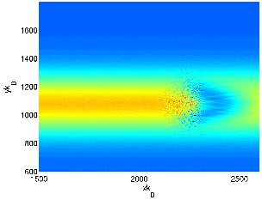
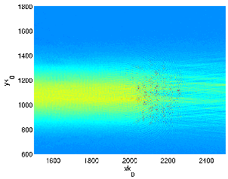
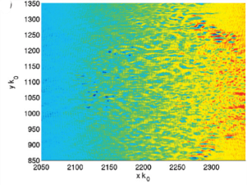
A big kinetic simulation for Laser Plasma Interaction
Propagation of the laser strongly affected because of parametric instabilities
Depending on T_{e} different instabilities run the show, strong backscattering
Good choice of parameters: creation of hot, not too hot eIectron, efficent laser absorption
Laser intensity
Laser intensity
Density
laser
Laser depletion
Initially, backscattered
Randon Phase Plate
effect, better transmission
Cavitation
Significant absorption and hot electrons creation BEFORE the absorption zone
CONCLUSION: PI are very important for ICF/SI,
need a very good understanding

Slide 33
Plasma Optics – Plasma Amplification
2. Example

Slide 34
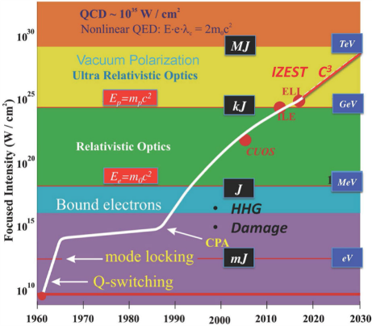
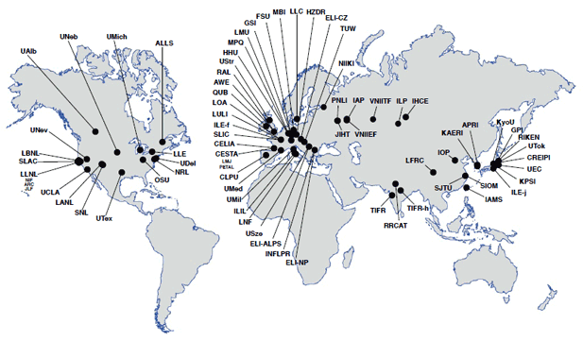
High-intensity laser in time and space
⬅ since invention of laser:
constant push towards
increasing focused intensity
of the light pulses
UHI light infrastructures in the world ➔
from ICUIL 2011

Slide 35
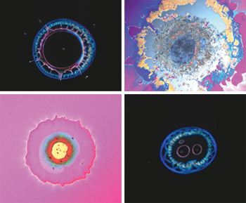
The problem of damage threshold for optical materials
Chirped pulse amplification
D. Strickland, G. Mourou, Optics Comm. 55, 219 (1985)
G.A. Mourou et al., Phys. Today 51, 22 (1998)
⇒ ionisation intensity-limit: I ≤ 10¹² W/cm²
⇒ damage threshold of gratings: ≤ 1 J/cm²
⇒ 1 EW & 10 fs → 10 kJ
→surface areas of order 10⁴ cm² = 1m x 1m
⇒ difficult to produce and very expensive
Laser-induced damage of optical coatings
⬇
PLASMA OPTICS
-> focus on plasma based laser amplification
Notes:
Use plasma as an optical medium

Slide 36
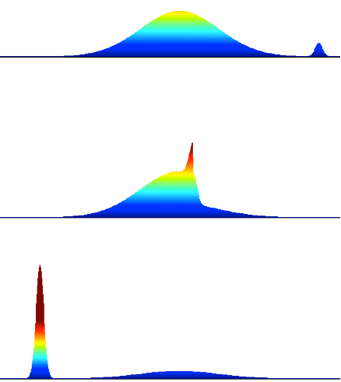
The basic principle of plasma amplification
”NO” damage threshold in plasmas
high-energy long pump
⬆⬇
low-intensity short seed
Standard parametric instabilities :
3 wave coupling where the
plasma response is taken up by
• electron plasma wave −→ Raman
• ion-acoustic wave −→ Brillouin
conservation equations
• ω_{pump} = ω_{seed} + ω_{plasma}
• k_{pump} = k_{seed} + k_{plasma}
time scales
• Brillouin τ_{s} ≥ ω_{cs}⁻¹ ∼ 1 − 10 ps
• Raman τ_{s} ≥ ω_{pe}⁻¹ ∼ 5 − 10 fs
pump ➔
⬅ seed
interaction
⬅ amplified seed
depleted pump ➔
Raman allows higher intensity since contraction to shorter scales

Slide 37
Brillouin in the strong-coupling regime (sc-SBS)
in contrast to before: sc-SBS is a non-resonant mode (not an eigen-mode)
When the laser intensity is above a treshold that depends on the plasma temperature, transition from eigen-mode regime → quasi-mode regime characterized by:
ω_{sc} = (1 + i √3) 3.6 x 10⁻² (I₁₄ λ²_{o} )^{1/3} (Zm_{e}/m_{i})^{1/3} (n_{e}/n_{c})^{1/3}
i.e. pump wave (laser) determines the properties of the electrostatic wave !
instability growth rate: γ_{sc} = Im(ω_{sc})
New characteristic time scale for IAW: ~ 1/γ_{sc} → can be a few 10s of fs !!
More compression = higher intensity, and some advantages with respect to Raman

Slide 38
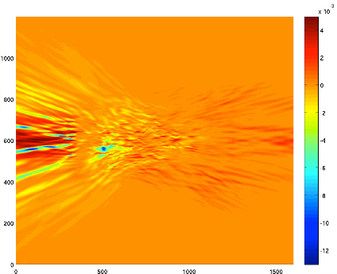
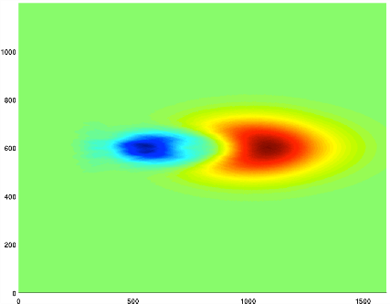
Competing instabilities
amplification process has to be optimised in concurrence with other plasma instabilities !
1) avoid filamentation for pump and seed: τ_{p,s}/(1/γ_{fil}) < 1 with γ_{fil}/ω_{o} ≈ 10⁻⁵ I₁₄ λ²[μm](n_{e}/n_{c})
→ upper limit for τ_{p} & plasma amplifier length;
τ_{pump} = O(10ps) too long for the given density
τ_{pump} = 300 fs ok for instability
But not much energy transfert

Slide 39
Competing instabilities cont’d
2) avoid SRS if possible: τ_{p}/(1/γ_{srs}) < 1 with γ_{srs}/ω_{o} ≈ 4.3 x 10⁻³ √(I₁₄ λ²[μm]) (ne/nc)^{1/4}
→ 1/γ_{srs} ≈ 25 fs !!
BUT can be controlled by plasma profile and temperature, associated energy losses small
Other limit related to efficency of energy transfer: (1/γ_{sc} ) ∼ τ_{wb} → a_{max} = v_{osc/}c ≈ √(m_{i}/Zm_{e}) (n_{e}/n_{c})
→ for n_{e} = 0.05 n_{c} get I_{max} ≈ 10¹⁸W/cm²
From these consideration one obtains a parameter space of operation
Optimization is required wrt to plasma profile, seed duration, pump intensities
Requires extensive 2D kinetic simulation work

Slide 40
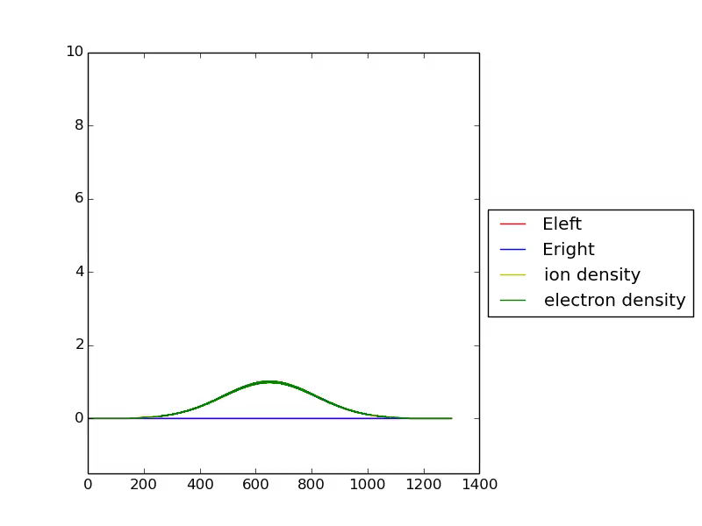
Video on 1D* plasma amplification using a PIC code
* 1D simulation fully reliable, once transverse filamentation instability is controlled

Slide 41
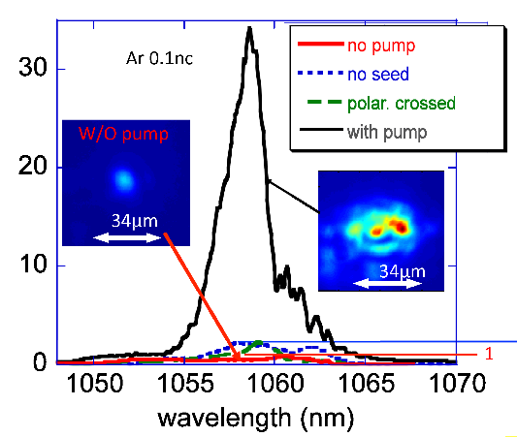
Experimental proof
E_{p} = 2 J, I_{p} = 6.5 x 10¹⁶W/cm²
τ_{p} = 3.5 ps
E_{s} = 15mJ, I_{s} = 5 x 10¹⁵W/cm²
τ_{s} = 400 fs
pump & seed cross under angle
interaction length: ≈ 100 μm
energy uptake of seed 45 mJ
amplification factor of 35
(Is/Is0) achieved
pump depletion achieved !
(100% on trajectory)
crossed polarization ⇒ NO
amplification
➔ L. Lancia et al. PRL (2010, 2016)

Slide 42
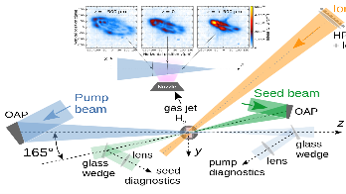
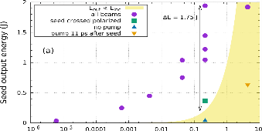
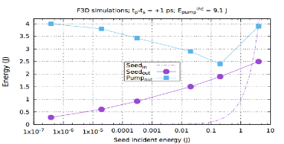
Record energy transfer by scan in seed intensity
Experiment confirmed by theory and 3D simulations : optimum intensity I_{s} ~ few % I_{p}
System enters more quickly into efficient self-similar regime
Favors pump depletion form the beginning : 2 J energy exchange and highest intensity gain.
➔ J.R. Marquès et al. PRX (2019)

Slide 43
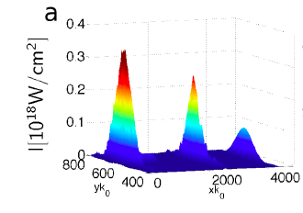
2D PIC simulation of amplification over a large focal spot
Possibility of quasi-relativistic intensity over large focal spot ( ~100 microns)!

Slide 44
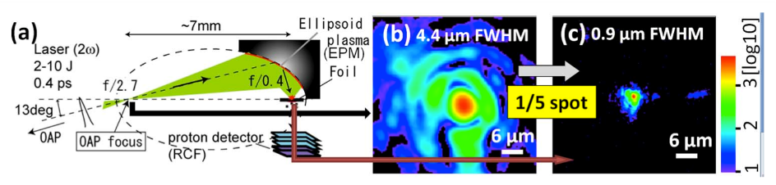
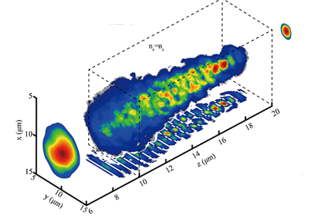
Plasma focusing mirror – plasma lens
To focus the amplified pulse plasma optics
focusing plasma mirror
Nakatsutsumi 2010
plasma lens based on relativistic self-focusing:
another controlled instability usage
10PW focusing:
combining conventional mirror
plasma mirror in 2-stage process
Bin 2014

Slide 45
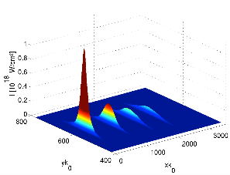

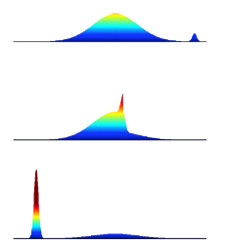
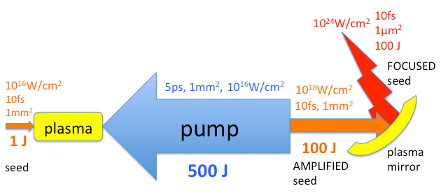
Plasma amplification: a longterm perspective
➔
➔



➔ The future of UHI light pulse generation ?!

Slide 46
Conclusion/outlook

Slide 47
Conclusions
Plasma physics and LPI : many open questions/problems,
they are anything but simple research !
There is a multitude of research topics in the field; only two were presented. Important also macroscopic effects e.g. nonlocal transport, which is big chapter of laser-plasma interaction.
LPI for high intensities also far from understood
Experiment and theory/simulation will have to go hand in hand !!

Slide 48
Thanks/Díky

Slide 49
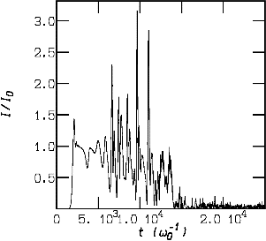
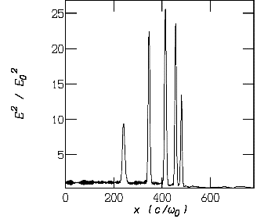
Relation to ICF
analysis of single hot-spot for standard ICF conditions
in sc-regime reflectivity can exhibit large oscillations (pulsation regime), which can
be related to cavitation and soliton formation
➔ backscattered Brillouin pulses are strongly amplified in an uncontrolled way
➔ Idea: make the transition from random processes to controlled environment

Slide 50
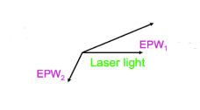
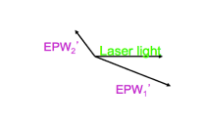
Many possible coupling processes
➔ 3-wave resonant decay processes in laser-plasma interaction
emw → emw + epw (stimulated Raman scattering, SRS)
emw → emw + iaw (stimulated Brillouin scattering, SBS)
emw → epw + epw (two-plasmon decay instability, TPD)
epw → epw + iaw (Langmuir decay instability, LDI)
emw → epw + iaw (parametric decay instability)
epw → emw + iaw (electromagnetic decay instability)
iaw → iaw + iaw (two ion wave decay)
TPD
other nonlinear processes: filamentation, self-focusing, modulational instability etc. etc.

Slide 51
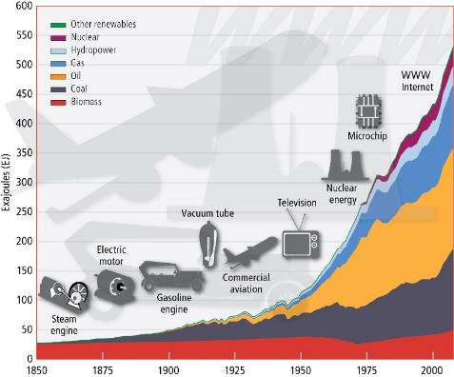

Why fusion ?
To avoid the last step, if possible! ➔

