Slide 1
Laser Safety Training A3
Required training for all Class 3B & Class 4
Laser Users at ELI Beamlines
Viktor Andrle - Laser Safety Officer
Dávid Horváth - Deputy LSO
Jaroslav Kašpar - Deputy LSO
Kenneth Barat - Laser Safety Advisor
Jaroslav Nejdl - Chairman of the Laser Safety Committee

Slide 2
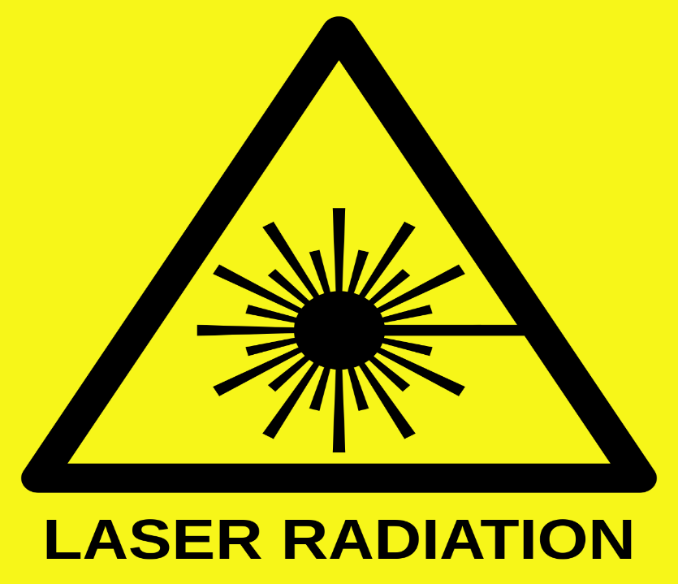
Table of Contents
7. Regulations & Standards - ELI User
Good work practics
9. The bad practices
10. Emergency situations
Why the concern?
Laser terminology
Classification
Biological effects - Eye
- Skin
PPE
Non-beam hazards

Slide 3
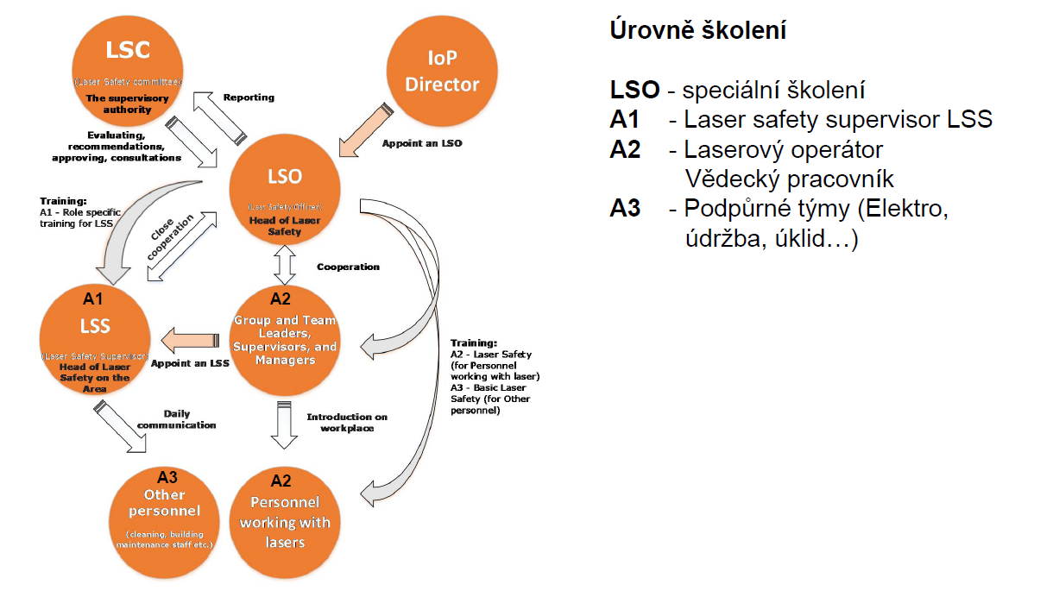
Levels of training:
LSO – Special trainings
A1 – Laser safety supervisor - LSS
A2 – Laser operator
A3 – Other personnel
ELI ERIC
Director

Slide 4
With all the hazards one faces each day why be concerned about lasers?
Why the concern?
Why should lasers receive special attention?
I hope the next two slide helps answer that question

Slide 5
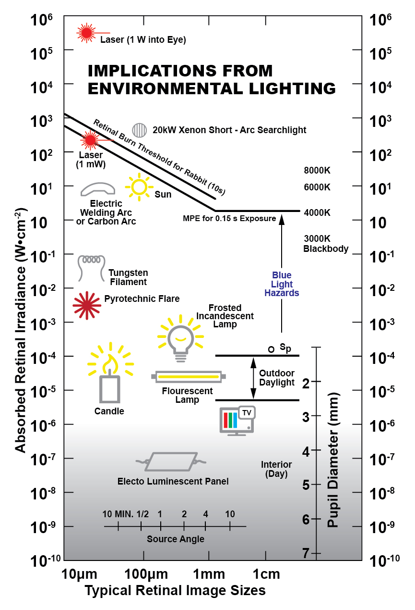
Why the concern?

Slide 6
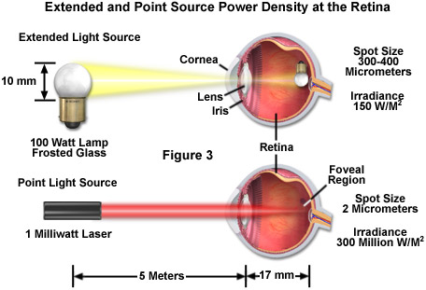
Why the concern?

Slide 7
2. Laser terminology
It is good to know the language of Laser Safety
There are a number of terms used concerning Laser safety worth your knowing

Slide 8
MPE
Maximum Permissible Exposure - (in W/cm² or J/cm²)
Easiest way to think of it is as the exposure speed limit. the level of laser radiation to which a person can be exposed under normal circumstances without the exposure leaving him with adverse consequences
The maximum permissible exposure (MPE) is the highest power or energy density of a light source that is considered safe.
2. Laser terminology

Slide 9
NOHD
Nominal Ocular Hazard Distance nominal distance with the risk of visual impairment
This is the distance from the source at which the intensity or the energy per surface unit becomes lower than the Maximum Permissible Exposure (MPE) on the cornea and on the skin. The laser beam can thus be considered as dangerous if the operator is closer from the source than the NOHD.
2. Laser terminology

Slide 10
NOHA
Nominal Ocular Hazard Area nominal area with a risk of visual damage - 3D space around the laser with a radius of NOHD
Inside this area, the intensity or the energy per surface unit is higher than the M.P.E. on the cornea. The size of this area is defined by the N.O.H.D.
However, it is very difficult to define this area as it depends on the environment (dusty or not,...) and on the objects than can be on the beam trajectory – in other words, one has to take into account the specular reflections.
2. Laser terminology

Slide 11
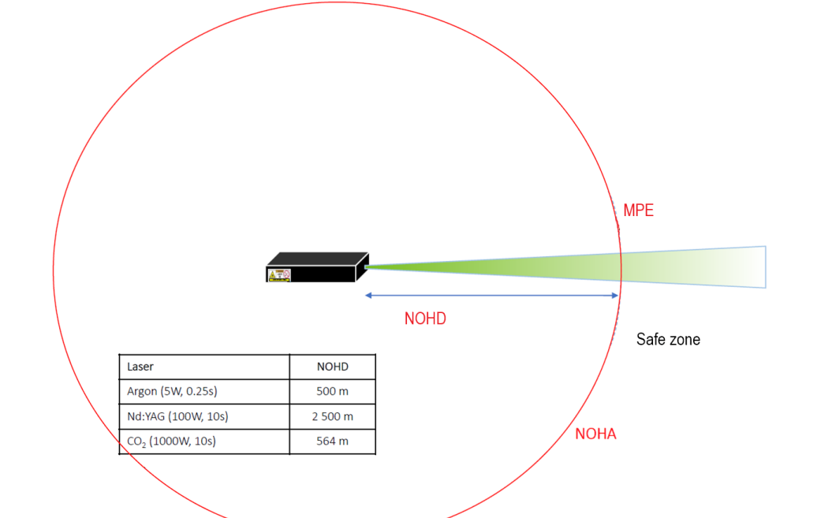
2. Laser terminology

Slide 12
2. Laser terminology
SPECULAR REFLECTIONS
Specular or mirror-like reflections can
occur when the size of surface irregularities
or roughness is less than the wavelength
of the incident radiation.
Angle of incidence = angle of reflection
Example: A good mirror.
Remember flat black can be specular !

Slide 13
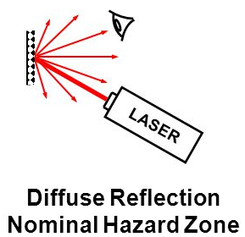
2. Laser terminology
DIFFUSE REFLECTIONS
Diffuse reflection occurs when the surface
irregularities are randomly orientated
and are much greater than the wavelength
of the incident radiation.
Examples: light reflected from a road surface or a projection screen

Slide 14

2. Laser terminology
LASER COTROLLED AREA
a space in which the time of stay and work of the staff is monitored and controlled for the reason of protection against the danger of radiation
It is critical to your safety and ELI operations that you respect exclusion areas
At ELI Beamlines there will be time when NO ONE is allowed in laser labs or experimental halls.
This is generally due to the production of ionizing radiation as part of experimental work
This may include periods after experimental shots to allow for the decay of induced radiation
Once again you must not violate exclusion area boundaries
Laser controlled area

Slide 15
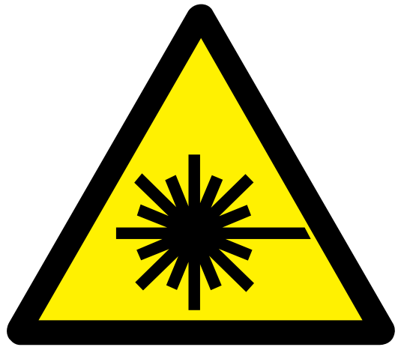
3. Laser Hazard Classification
A common question laser users hear is “What class laser do you have?”
The purpose of laser hazard classification # is to understand the potential hazard of the laser system just by the classification without detailed knowledge of the laser
In many ways similar to the international system for chemical hazard identification
A means of Hazard Communication
Most laser users never quite know
the hazard classification of their lasers
or what it means

Slide 16
3. Laser Hazard Classification
Class 1
  No eye or skin hazard
Class 1M
  Expanded beam, invisible
Class 1C
Direct contact with target
Class 2
  1 mW, aversion reflex
Class 2M
  Expanded beam, visible
Class 3R
  1-5mW, safe for momentary exposure
Class 3B
  5-500 mW- CW
  Cannot produce 125mJ
  in less than .25 seconds
Class 4
  >500 mW- CW
  125.J/pulse in less than 0.25 seconds

Slide 17
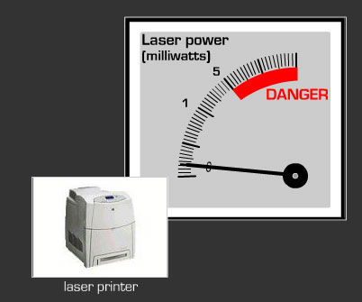
3. Laser Hazard Classification
CLASS 1 LASER
Power output is too low to cause eye or skin injury
Examples:
power = few microwatts
high-powered expanded beam

Slide 18
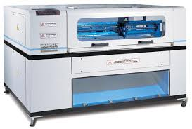
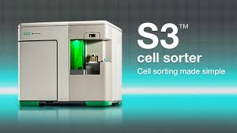
3. Laser Hazard Classification
CLASS 1 PRODUCT
aka Embedded Laser
A product that completely contains a laser
During normal operation there is no potential for exposure to the laser beam
Therefore a Kilowatt laser can be turned into a Class 1 product
No laser safety training or laser protective eyewear is needed by operator or those around the class 1 product
Much of ELI will be in this configuration during normal operation are Class 1 Products

Slide 19
3. Laser Hazard Classification
Class 1 Product Concern
As stated during operation of a class 1 product there is no laser hazard, no operator training, no eyewear no signage is required
All that changes when these systems are opened up for service
If a potential for exposure exists then it must be dealt with
We will need to set up procedures and controls for such times that limit their effect to the rest of the laser halls

Slide 20
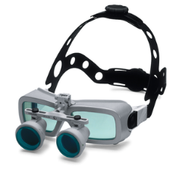
3. Laser Hazard Classification
Class 1M Invisible wavelengths
Incapable of producing damaging radiation levels during operation
Unless the beam is viewed with an optical instrument
Eye-loupe or telescope
Exempt from any control measure other than to prevent potentially hazardous optically aided viewing

Slide 21
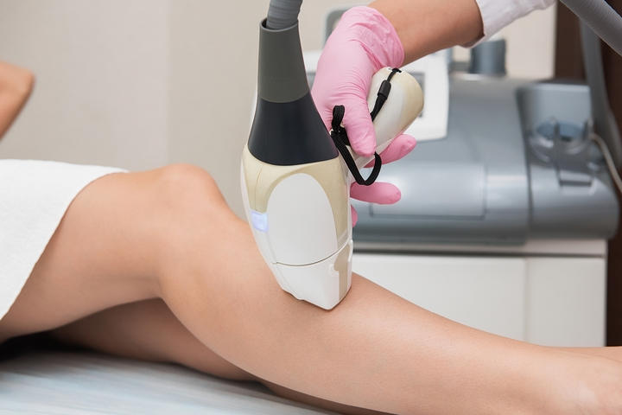
3. Laser Hazard Classification
CLASS 1C
New category
Medical or Dermatological devices
High power but requires direct contact with target. Emission of radiation can’t exceed the level of class 1.
Only requirement is to read the manual.
Examples:
Hair and tattoo removal
Acne treatment

Slide 22

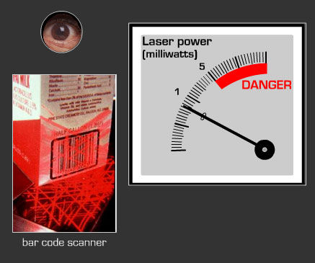
3. Laser Hazard Classification
CLASS 2
Power output is too low to cause eye or skin injury
Class 2 (Low power)
  Visible (400-700 nm)
  CW upper limit is 1 mW
Counts on aversion reflex of 0.25 seconds to prevent eye damage
Can be a hazard if the aversion response is over-ridden or slowed
Examples
  Supermarket or barcode scanners
  Some laser pointers

Slide 23
3. Laser Hazard Classification
CLASS 2M
Class 2M
  visible (400-700 nm)
  eye protection is aversion response for unaided viewing
Potentially hazardous when viewed with optical aid
  CW upper limit is 1 mW
Examples
  Leveling instruments and some construction industry lasers, interferometers

Slide 24
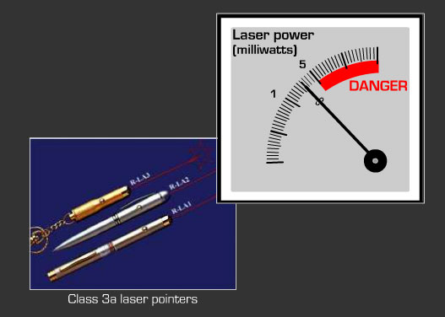
3. Laser Hazard Classification
CLASS 3R
Safe for momentary viewing
As a commercial product can only be Visible
Between 1-5 mW
Can be a hazard if viewed through optics
Majority of legal laser pointers are 3R
Some alignment lasers
R stands for Reduced Requirements

Slide 25
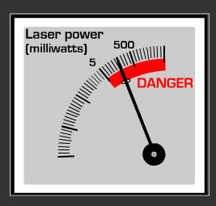
3. Laser Hazard Classification
CLASS 3B
Can be Visible or invisible
Intrabeam viewing hazard
Specular reflection hazard
CW output between 5-500 mW
Starting point for required laser safety program

Slide 26
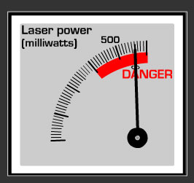
3. Laser Hazard Classification
CLASS 4
Output higher than Class 3B
Poses greatest danger
Fire hazard
Skin hazard
Intrabeam viewing hazard
Specular reflection hazard
Possible Diffuse reflection hazard
Can produce more than 125mJ in less that 0.25 seconds
Over 500 mW CW

Slide 27
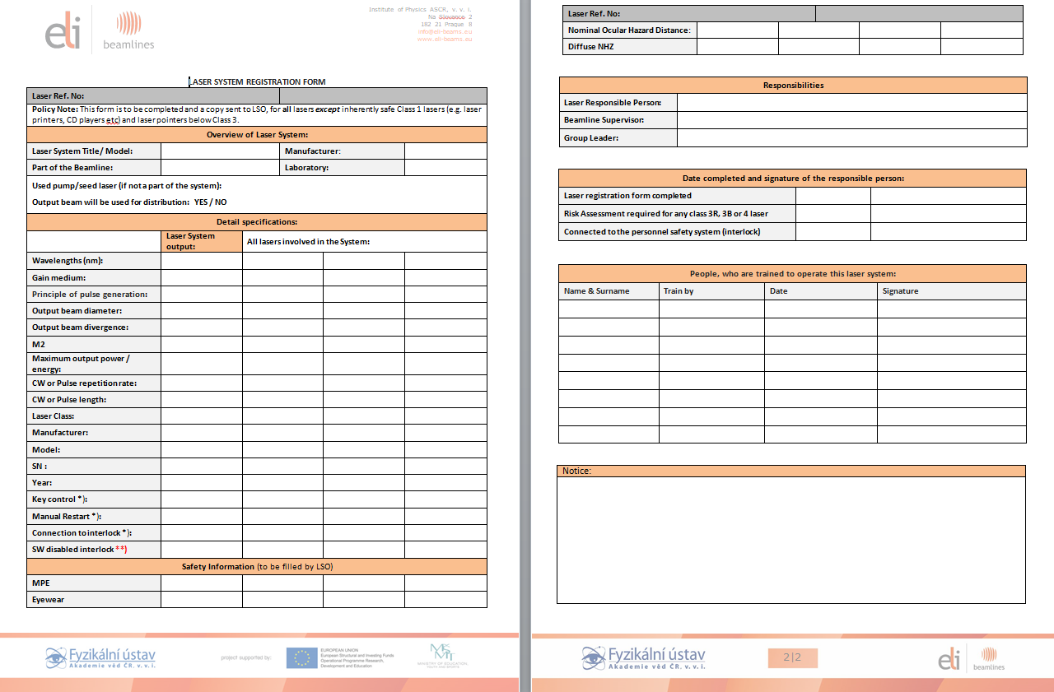
LASER SYSTEM REGISTRATION FORM

Slide 28
3. Laser Hazard Classification
Why is classification so important?
Your entire laser safety program even if you have only one laser system is all based on what class lasers your facility has
Control measures can take a graded approach, but the requirement for a program is straight forward
Potential access to class 4 laser, must have a laser safety program

Slide 29
3. Laser Hazard Classification
Requirements by Laser Classification
Class | Procedural & Administrative Controls | Training | Medical check up | LSO
1 | Not Required | Not Required | Not Required | Not Required
1M | Required | Application Dependent | Not Required | Application Dependent
1C | Not Required | Manual | Not required | Not required
2 | Not Required | Not Required | Not Required | Not Required
2M | Required | Application Dependent | Not Required | Application Dependent
3R | Not Required | Not Required | Not Required | Not Required
3B | Required | Required | Required | Required
4 | Required | Required | Required | Required

Slide 30
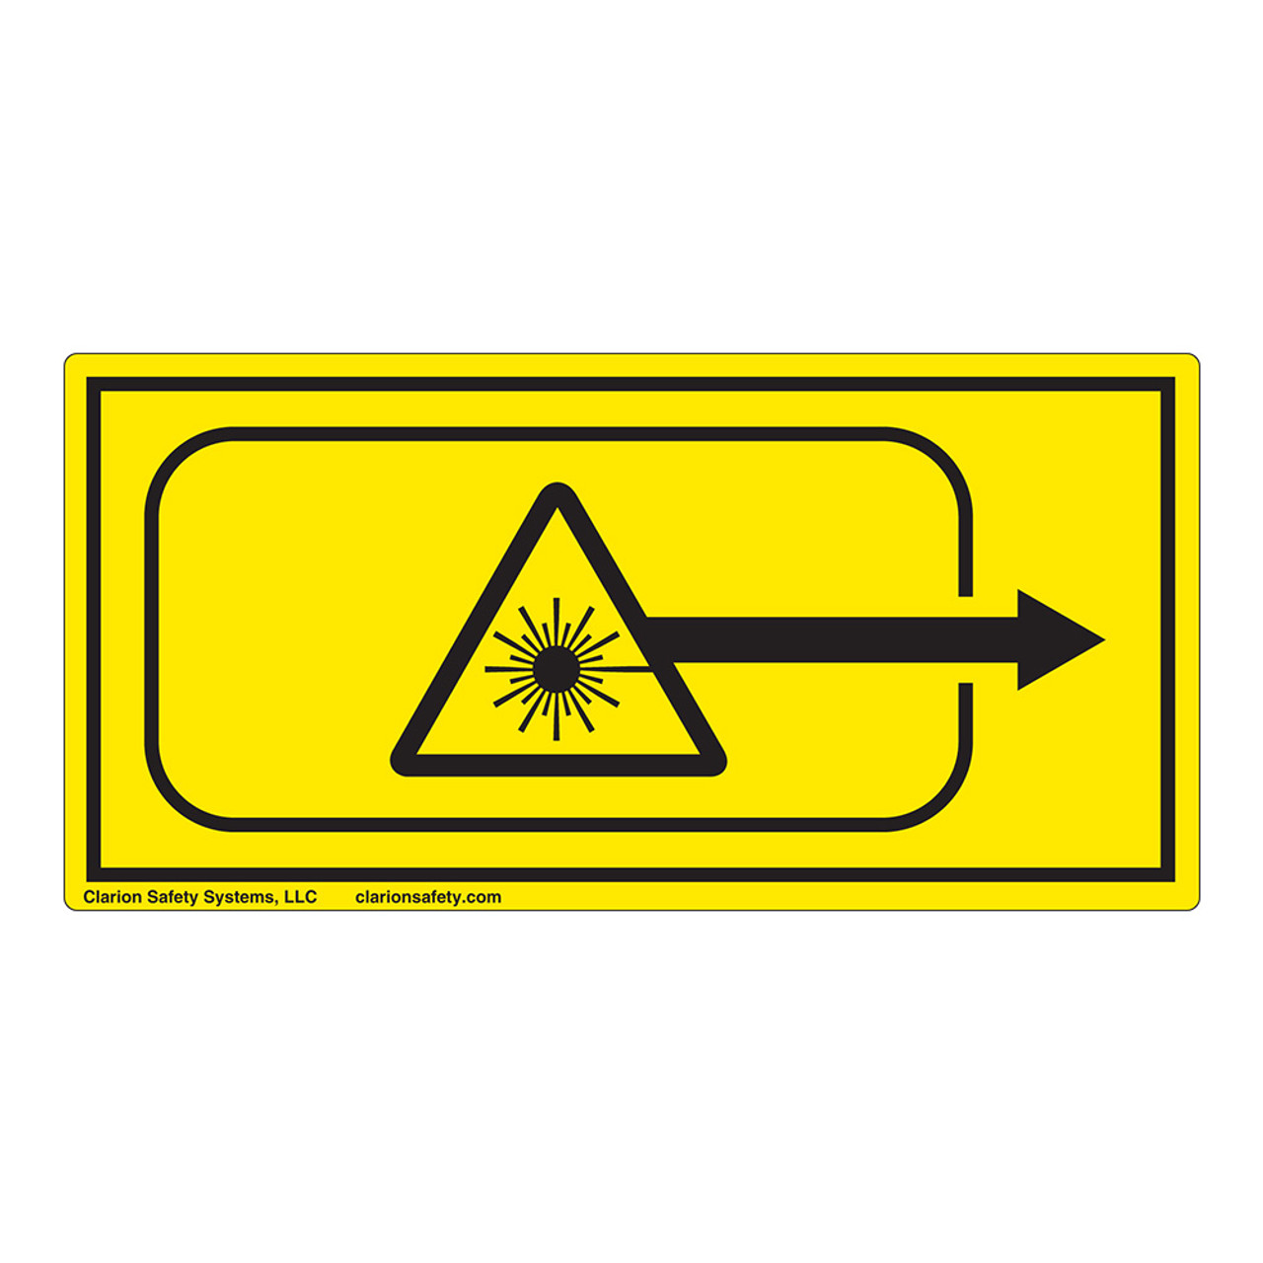
Increasing risk
Class
Range of wavelengths | 180 nm – 1nm 1M:302.5 – 4000nm | 400 – 700nm | 180 nm – 1 mm | 180 nm – 1 mm | 180 nm – 1 mm
Maximum output | ˂ 0.4 mW @ 632 nm | ˂ 1 mW | ˂ 5 mW | ˂ 500 mW | no limit
Risk | Safe for eye | Safe for eye for < 0.25s | Unsafe for eye | Unsafe for eye Safe for skin | Unsafe for eye Unsafe for skin Fire hazard
Control measure |  | Blinking effect | Avoid direct eye exposure | Laser safety eyewear | Laser safety eyewear
Sign
1
2
1M
2M
3R
3B
4
1C
CAUTION
WARNING
DANGER

Slide 31
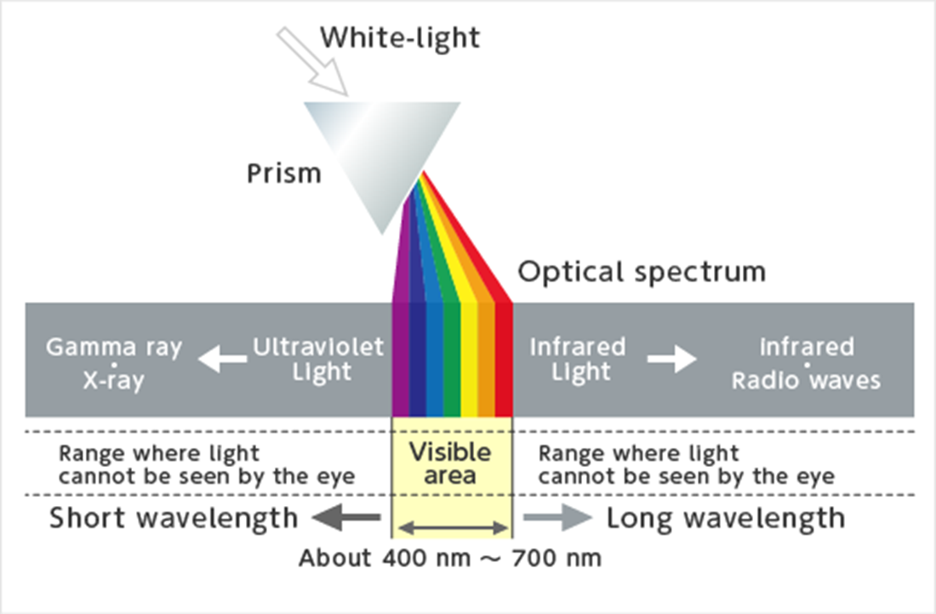
4. Bio Effects
Wavelengths of the electromagnetic spectrum have varying penetrations and exposure properties for eyes and skin

Slide 32
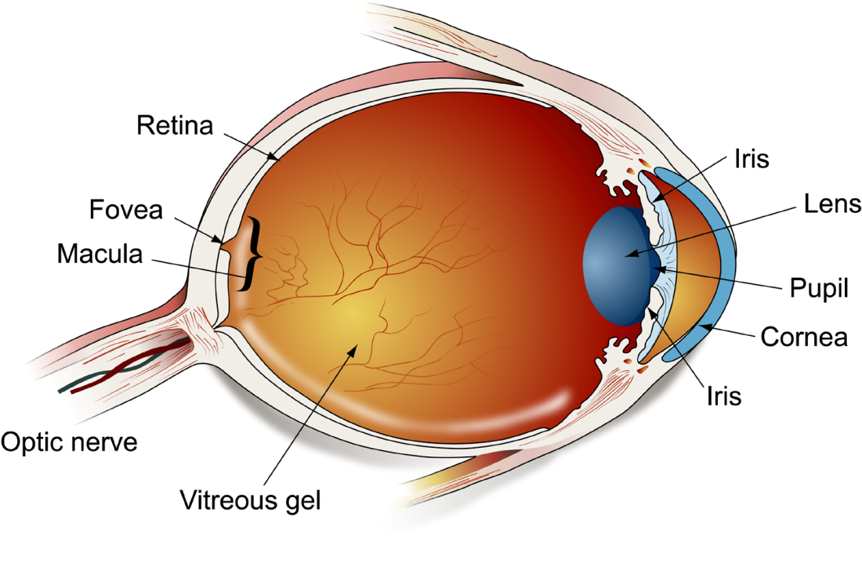
4. Bio Effects
Your eye

Slide 33
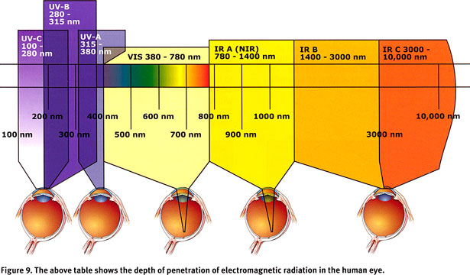
4. Bio Effects
Penetration per wavelength

Slide 34
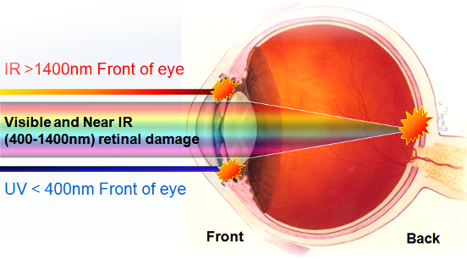

Slide 35
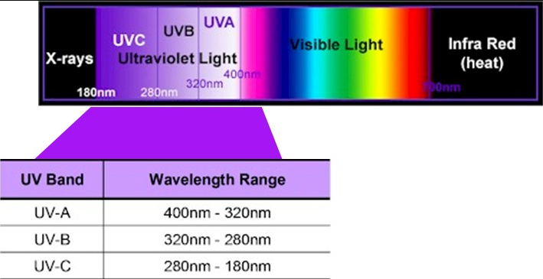
4. Bio Effects
Ultra Violet (180-400nm)
UV exposure
  Invisible
  Delayed effect
  Photosensitive agents
  UV sources
    Laser radiation
    Xeon flash lamps
    Solar lamps
    Plasmas
    UV incidents can occur
      Eye
      Skin

Slide 36
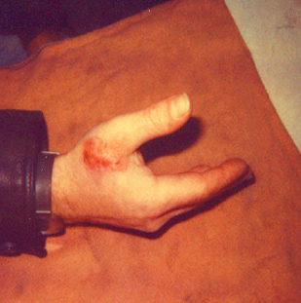
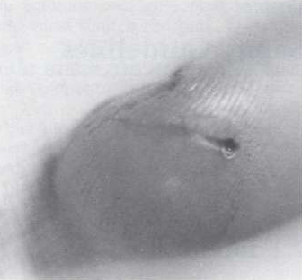
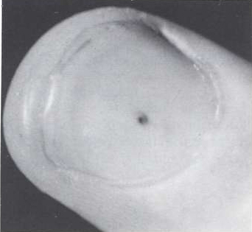
4. Bio Effects
Laser Accidents:
Skin Injury
CO₂ & YAG laser – most often implicated
Most notable injuries
  Holes through fingers
  3rd degree burns
In general, non-debilitating
Entry point
Exit point

Slide 37
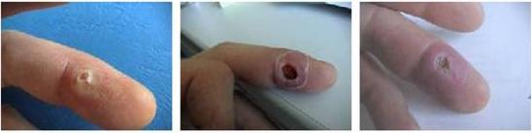
Nd:YAG Laser
4. Bio Effects
Laser Accidents:
Skin Injury
Unfocused, 1600-W, 1030-nm laser
Immediately after accident
10 days after accident
21 days after accident
Photos courtesy of Laser Zentrum Hannover

Slide 38
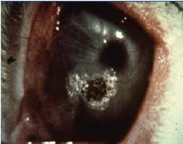
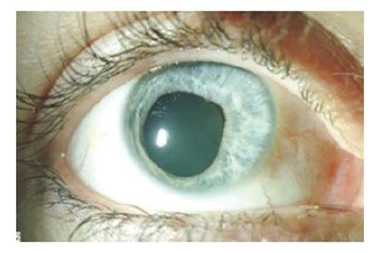
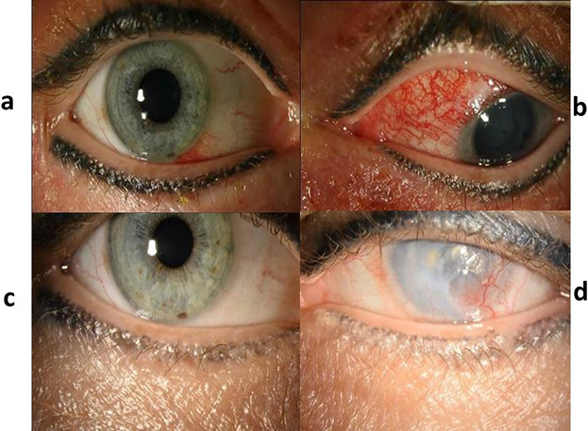
Laser Accidents:
Eye Injury

Slide 39
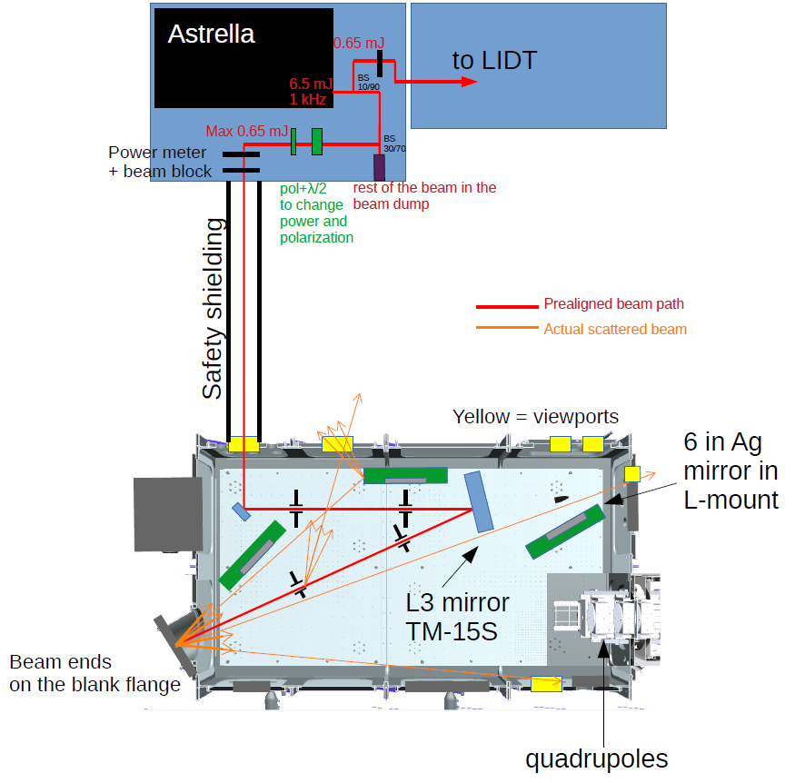
4. Bio Effects

Slide 40
5. PPE, Eyewear
Laser goggles are required for class 3B and 4 lasers
After Bioeffects it makes sense to follow with laser protective eyewear
When one says laser protection, 90 % of the time users think eyewear
In fact beam containment is the best option
Beam containment can take away the need for laser eyewear

Slide 41
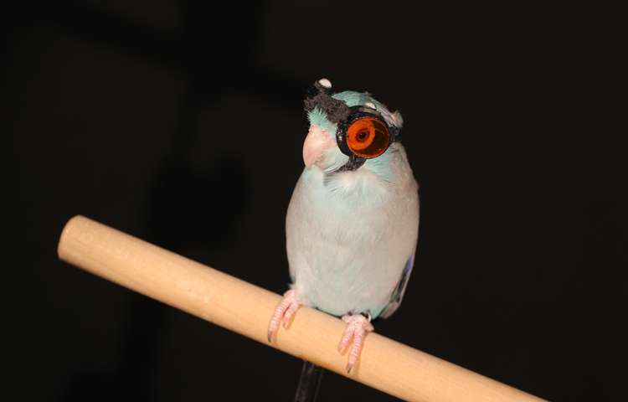
5. PPE, Eyewear
Eyewear selection
Several elements go into eyewear selection
Eyewear Filter must be
  For wavelength (s) in use
  Meet the minimum (LB number)
Give highest possible visible light transmission (VLT)
Must fit well
Have high visual acuity

Slide 42
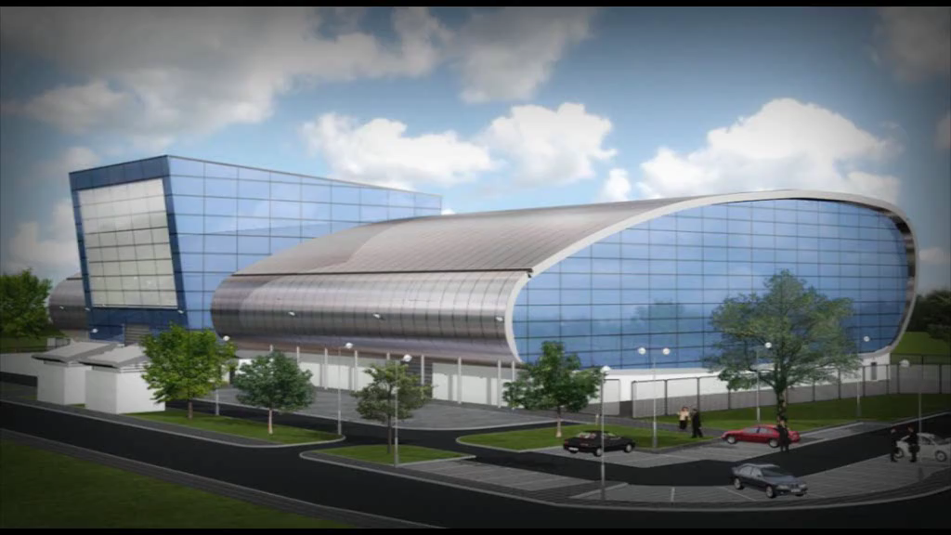

Slide 43
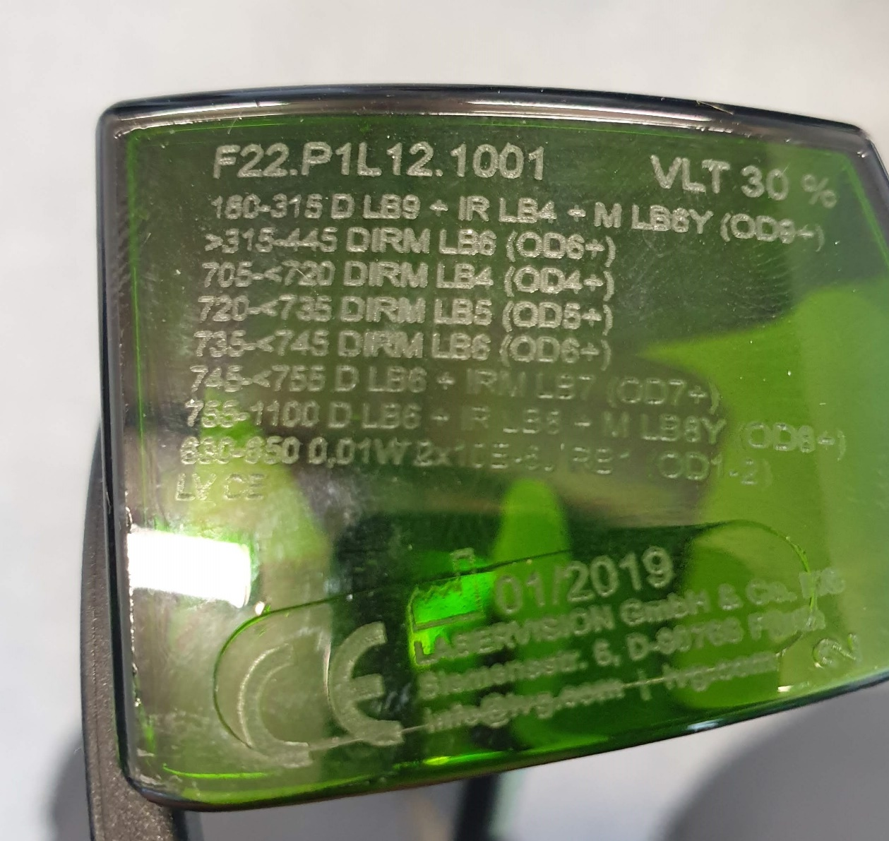
5. PPE, Eyewear
Labeling
IEC Stantands requires laser protective eyewear to be labeled with information to assure the user they have the correct eyewear for their potential laser exposure
The laser eyewear manufacturer will imprint on the eyewear the most common range of wavelengths and protection level for a particular pair.

Slide 44
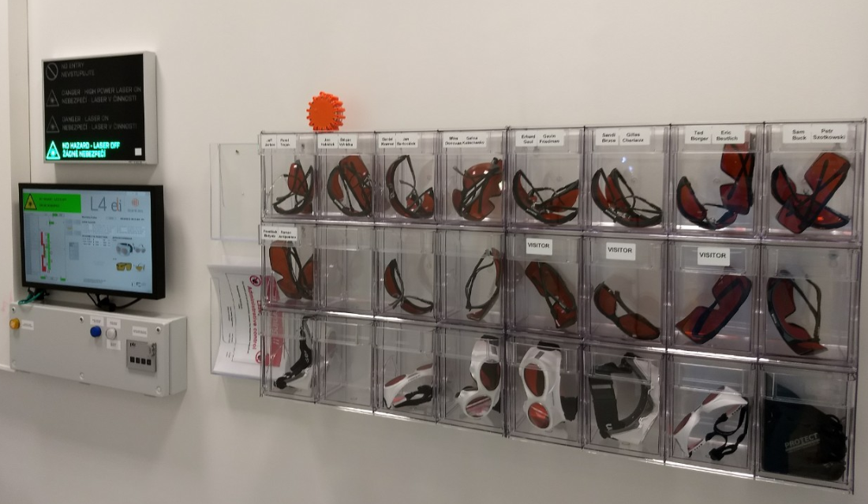
Proper Storage will prolong the life of ones eyewear
5. PPE, Eyewear
It is there to protect you
Take care of it!

Slide 45
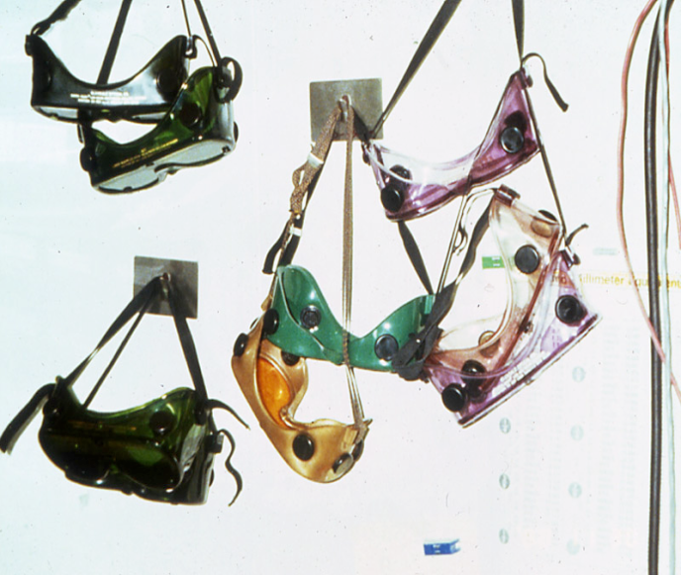
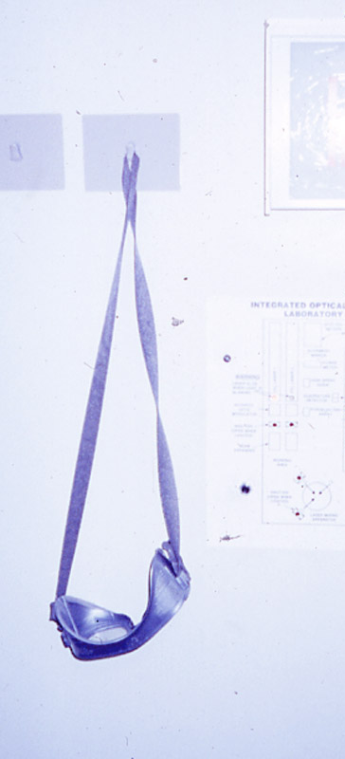
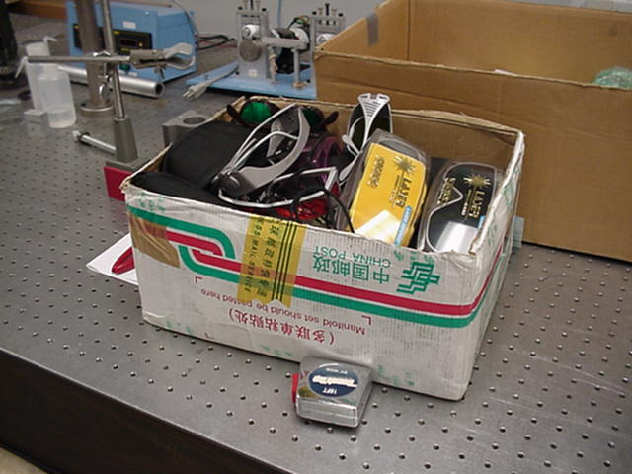
Improper care of eyewear
5. PPE, Eyewear
One can stretch out elastic head bands to the point of being unuseable
Poor storage can scratch eyewear
Dielectric or reflective coatings can be starched off, removing protection to the user

Slide 46

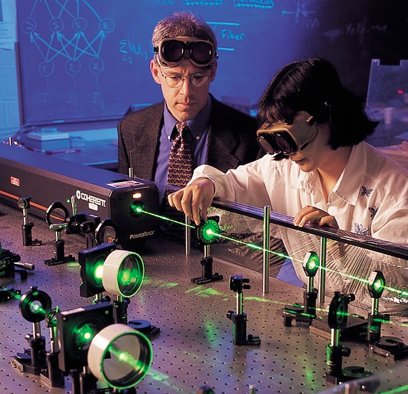
Most of all = WEAR YOUR EYEWEAR !!!
5. PPE, Eyewear

Slide 47
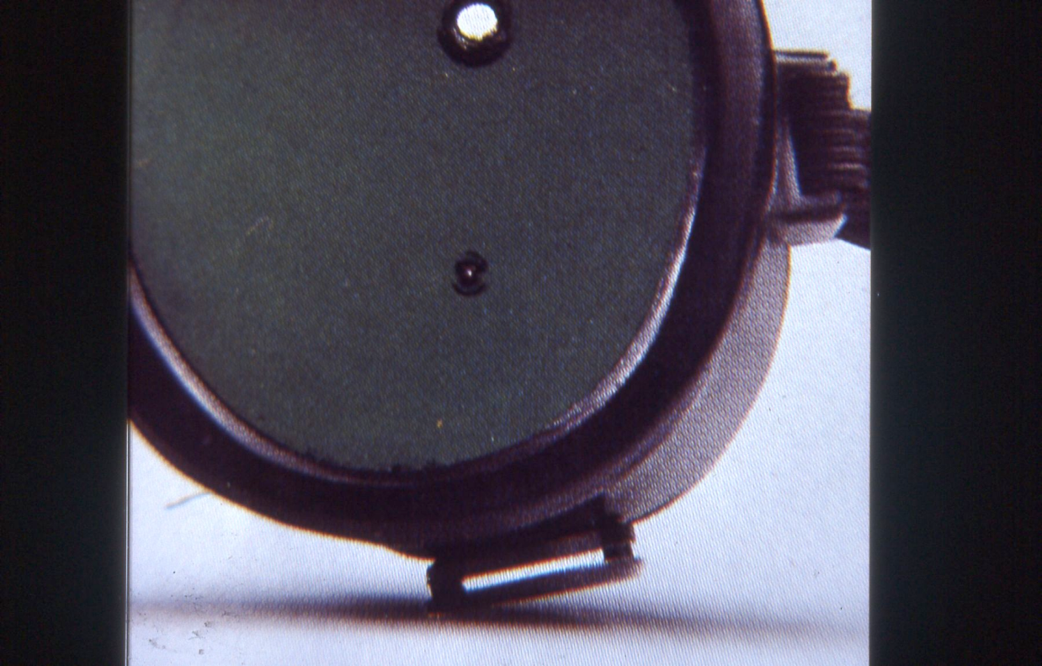
LASER EYEWEAR IS NOT IMPREGNABLE
5. PPE, Eyewear
Laser safety eyewear is tested for 5s or min. 50pulse

Slide 48
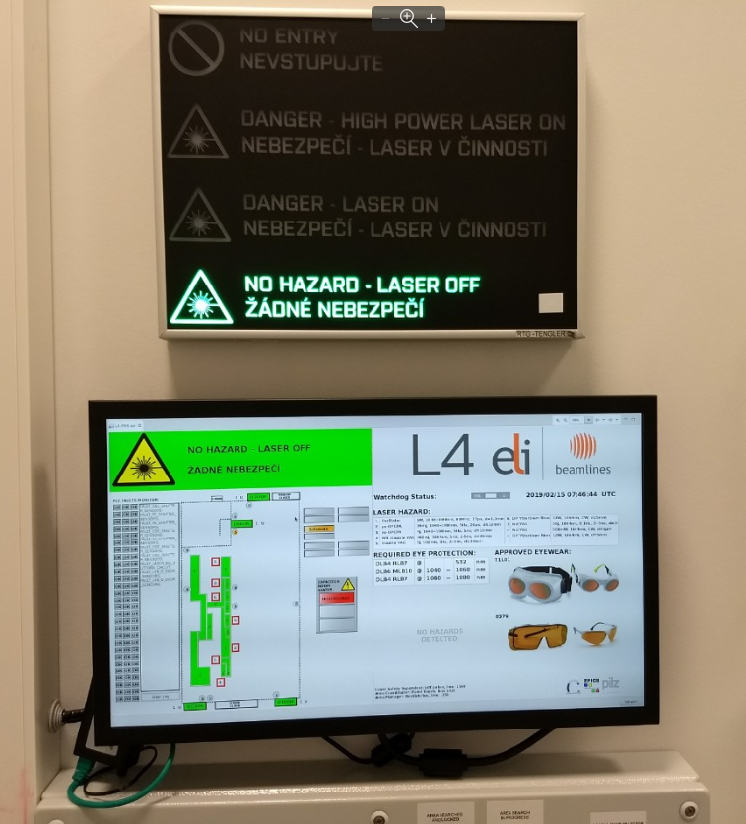
5. PPE, Eyewear
Labeling option
Poster near eyewear
Shows what it looks like
Has Wavelength
Shows associated LB number
Has simple tag on each pair to ID
LB / OD & wavelength wearing off
from not a problem

Slide 49
EYEWEAR INSPECTION
5. PPE, Eyewear
All of the following applicable criteria listed below are required to be checked before documenting "yes" on the 'Passed Inspection?" section on a the Laser Eyewear Audit and:
Verify the eyewear is appropriate for the wavelengths used.
Verify that the eyewear is appropriate for the power output.
Verify that there is adequate eyewear available for all users.
Check that the eyewear is not dirty, dusty or has broken temples.
Inspect the eyewear for scratches that would render them unsafe to use.
Inspect the eyewear for burn marks. Burn marks are a good indicator of poor beam management, intra-beam viewing or accidents.
If applicable, check integrity of elastic bands and replace if needed.

Slide 50
5. PPE, Eyewear
EN 207 code
Timescale
D Continuous wave
(‘Dauerstrich’) 10 s
I Normal pulse
(‘Impuls’) ~ ms
R Q-switched
(‘Riesenpuls’) ~ μs
M Mode-locked < ns

Slide 51
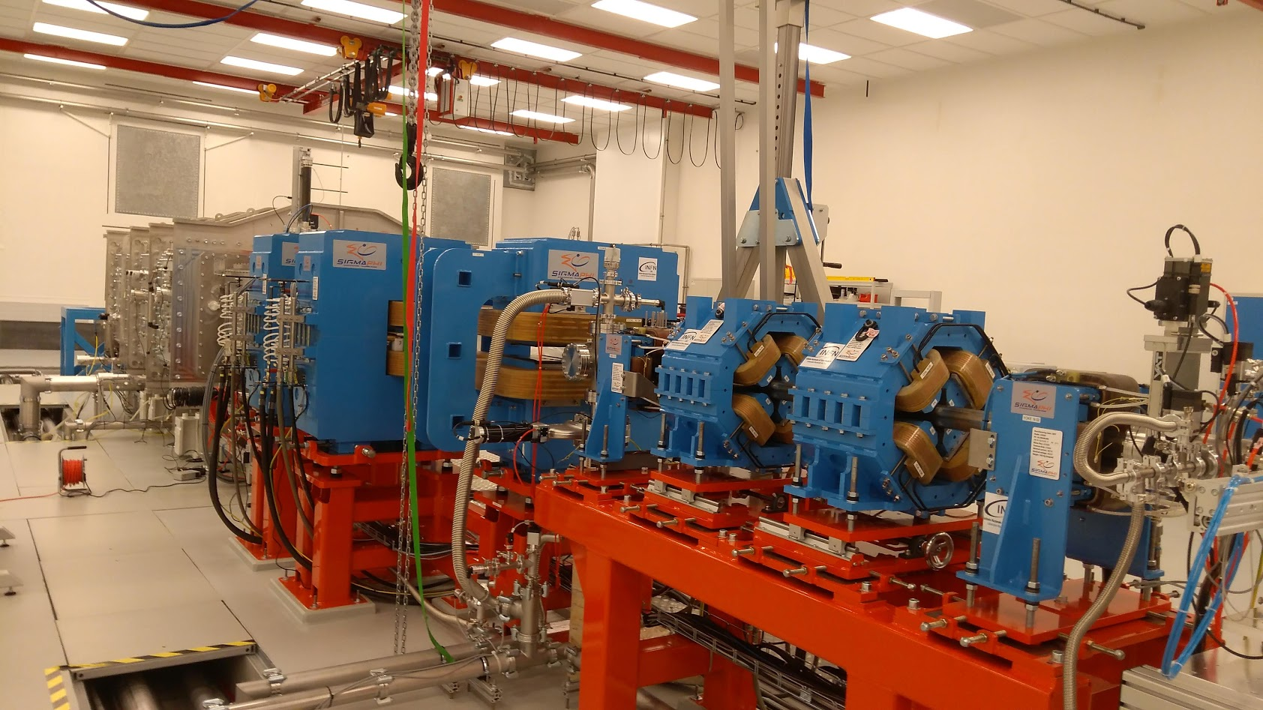

Slide 52
6. Non Beam Hazards
DO NOT develop tunnel vision
Laser Safety is not only eye & skin hazards
Eyewear does one no good if one is electrocuted
All laser non-medical deaths have come from Non-Beam Hazards
  Electrocution or fire
The list of non-beam or associated hazards is long, an example
Electrical
Chemical
Ergonomic
Mechanical
Vacuum systems
Many more

Slide 53
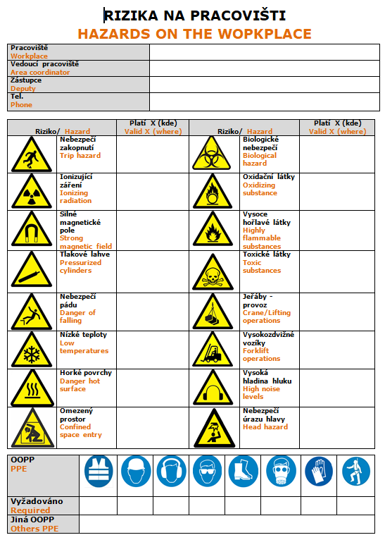
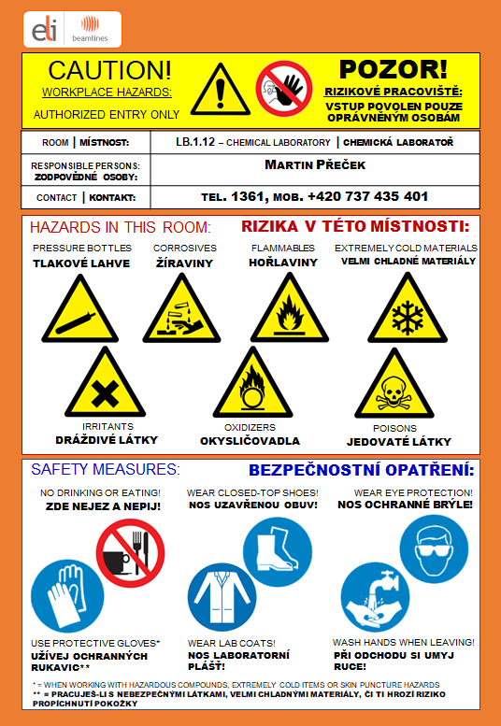

Slide 54

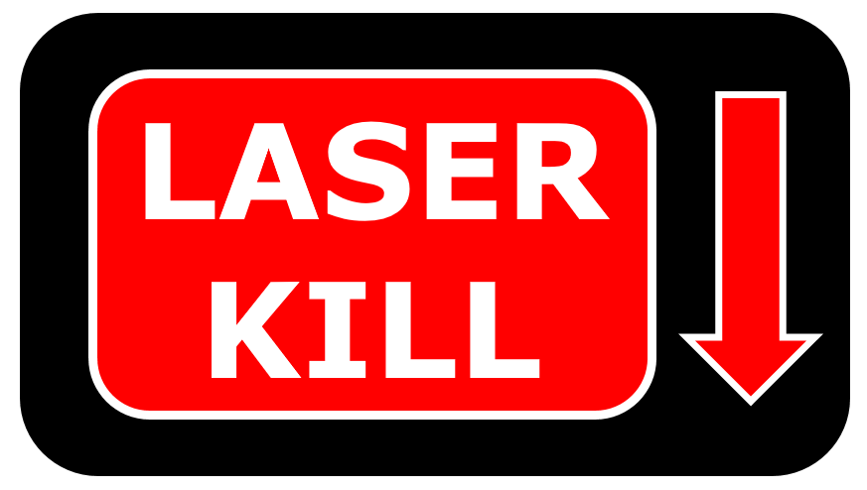


Slide 55
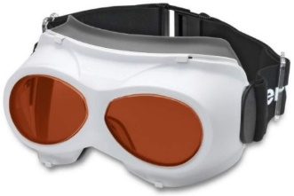
When to access from CR and from corridor ?
Always check the hall status on the information panel
Alignment Mode
Clear Mode
Free to access without googles
CR door unlocked
SD unlocked
CR door locked, unlock button active from inside and outside hall
Access to hall only with googles
SD locked
E-stop Mode
All doors are unlocked
Safe to access except if the E-stop happened during High Power or Post Exp mode – radiation hazard possible
All SGVs, local laser shutters are closed, no laser hazard
Search Mode
High power or Post experimental Mode
Do not enter unless doing the search, no googles needed
CR door locked, unlock button active from inside and outside hall
SD locked
No access from CR, except RO
CR door locked, can open from inside hall
SD locked, unlock from inside in emergency

Slide 56
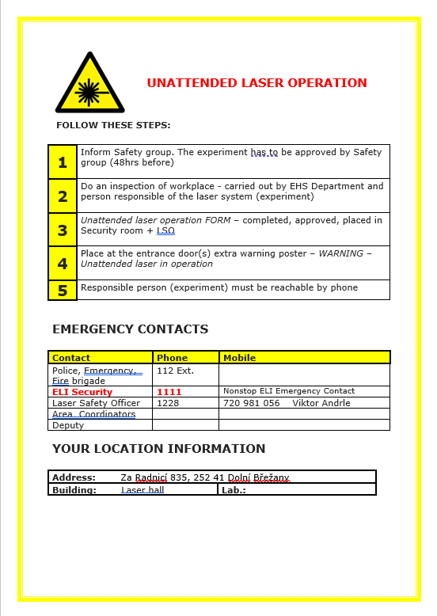
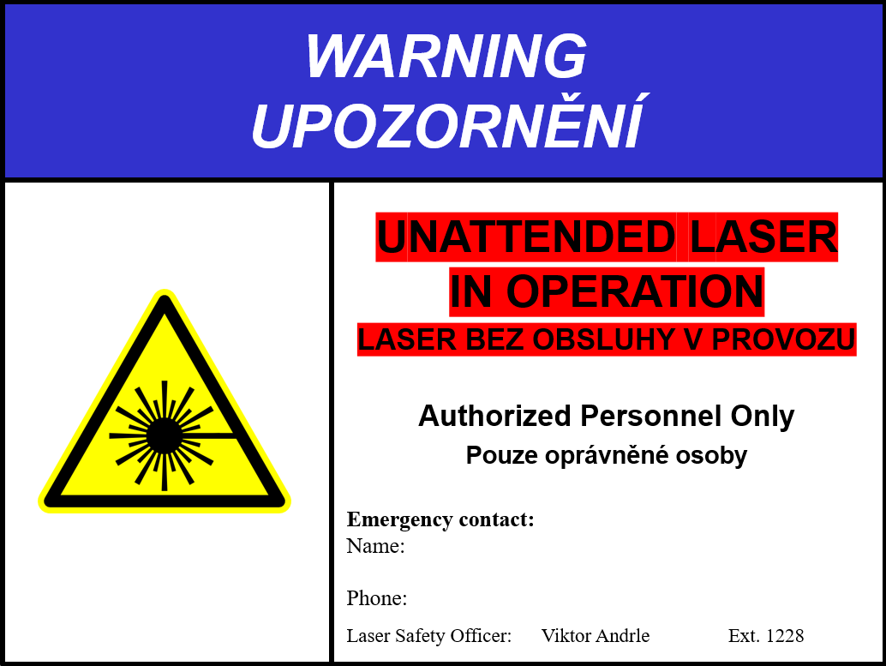
Unattended laser operation

Slide 57
7. Regulations & Standards
Laser User must comply with a number of laser regulations
Czech Republic Regulations
  Law no. 258/2000 Sb. about public health protection
    rules - classification of lasers
  Law no.291/2015 Sb.
    defines non-ionizing radiation - protection
    Law no. 390/2021 Sb.
    . PPE
European Norms
  ČSN EN 60825 - Safety of laser products
  ČSN EN 207, 208 - Protective glasses against laser
  ELI – BEAMS Regulations:
  Laser Safety Manual

Slide 58
7. Regulations & Standards
Who can work with lasers at
ELI Beamlines?
Only mentally and physically capable, qualified and operation instructed persons
What do you need?
1. Medical examination – include Eye examination
2. Qualification, set by institution
3. Safety training course – EHS, Laser safety
4. Knowledge of operation code – Standart Operation Procedures

Slide 59

8. Good Work Practices
Good Work Practices
Always wear laser safety glasses for specific wavelength
NEVER look directly into the laser beam
Avoid placing laser (beam) in the level of eyes
Watches and other jewelry that might enter the optical plane should not be allowed in the laboratory

Slide 60

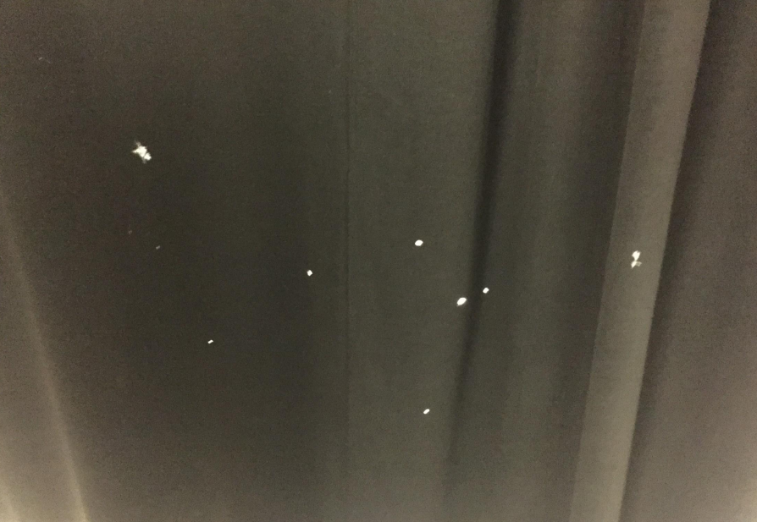
9. The Bad Practices

Slide 61
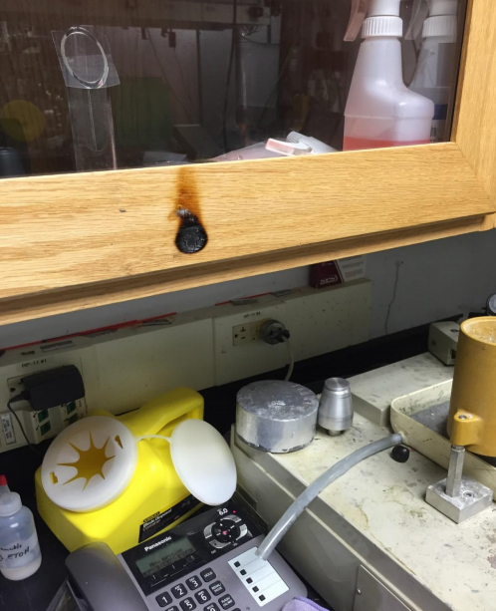

Slide 62


Slide 63


Slide 64


Slide 65


Slide 66


Slide 67

10. Emergency situation

Slide 68


Slide 69


Slide 70


Fire alarm

Slide 71

Thank you
for your attention!
Laser Safety Training
Trainer: Viktor Andrle - LSO
https://youtu.be/el0-Vb8XwCU
https://youtu.be/lV6s7NoFsSU

